Slide 1

From Clicks to Keys. Using Facebook & Google ads to sell more homes

Slide 2







Trove Team
John Connolly
CEO & Co-Founder
James Connolly
President & Co-Founder
Mike Pollack
Head of Sales

Slide 3
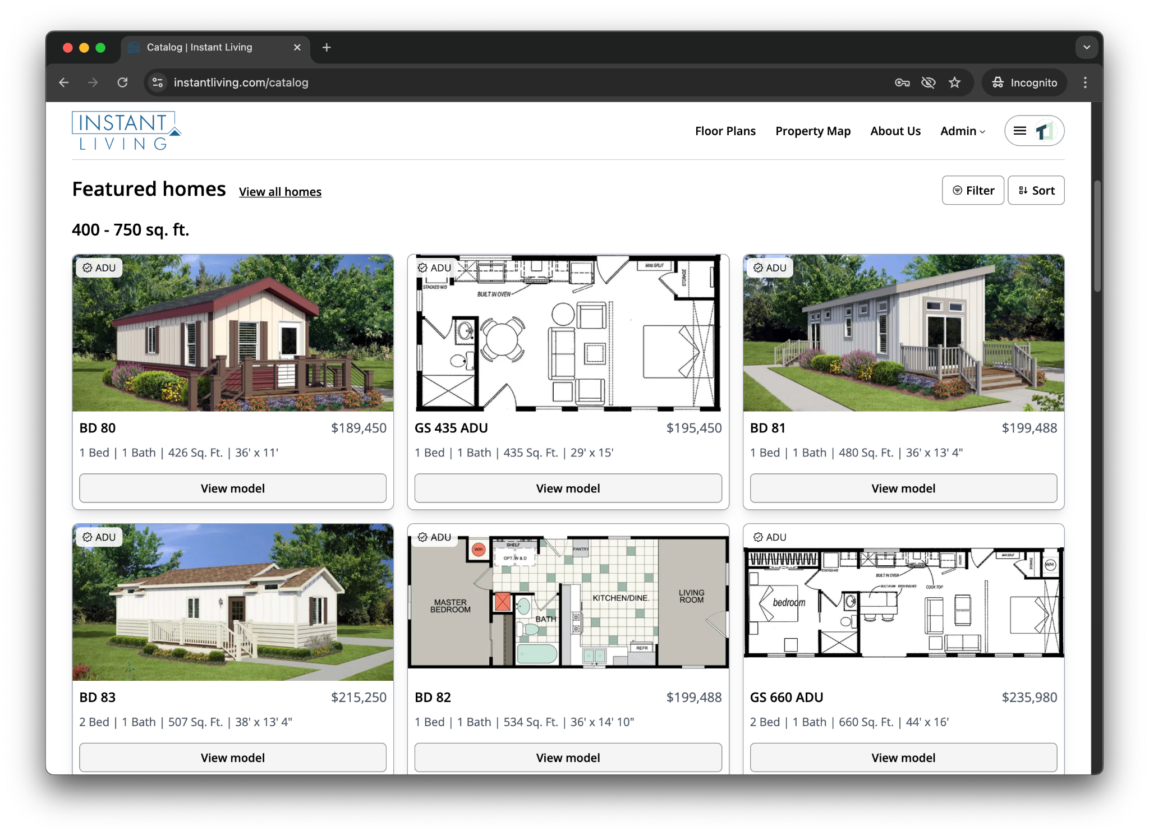
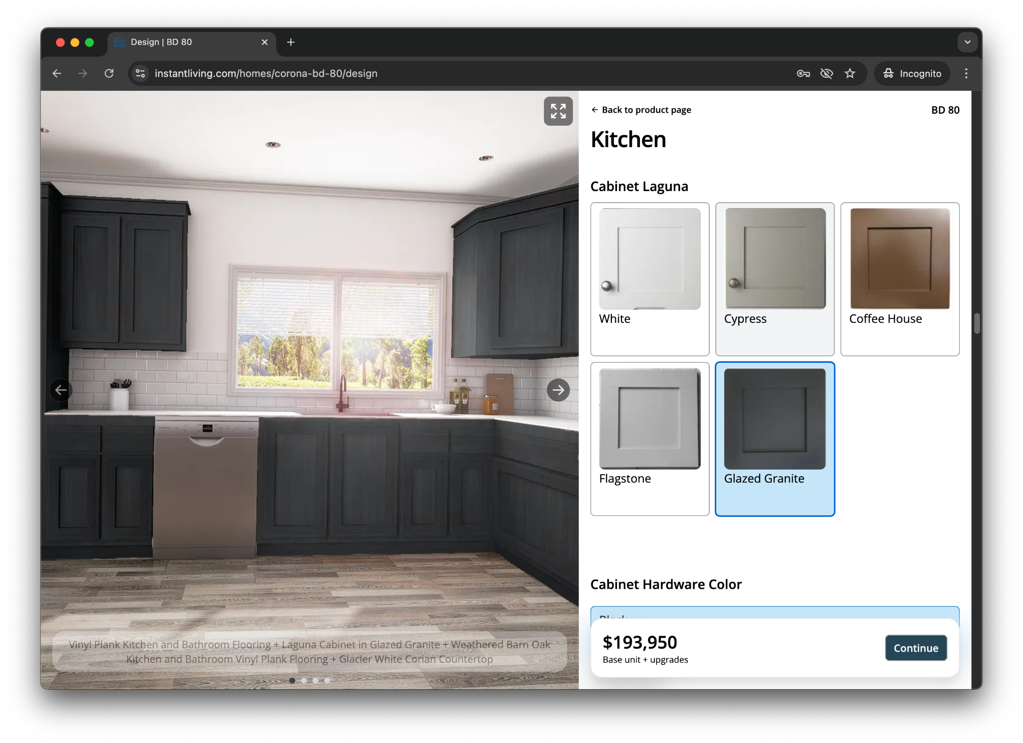
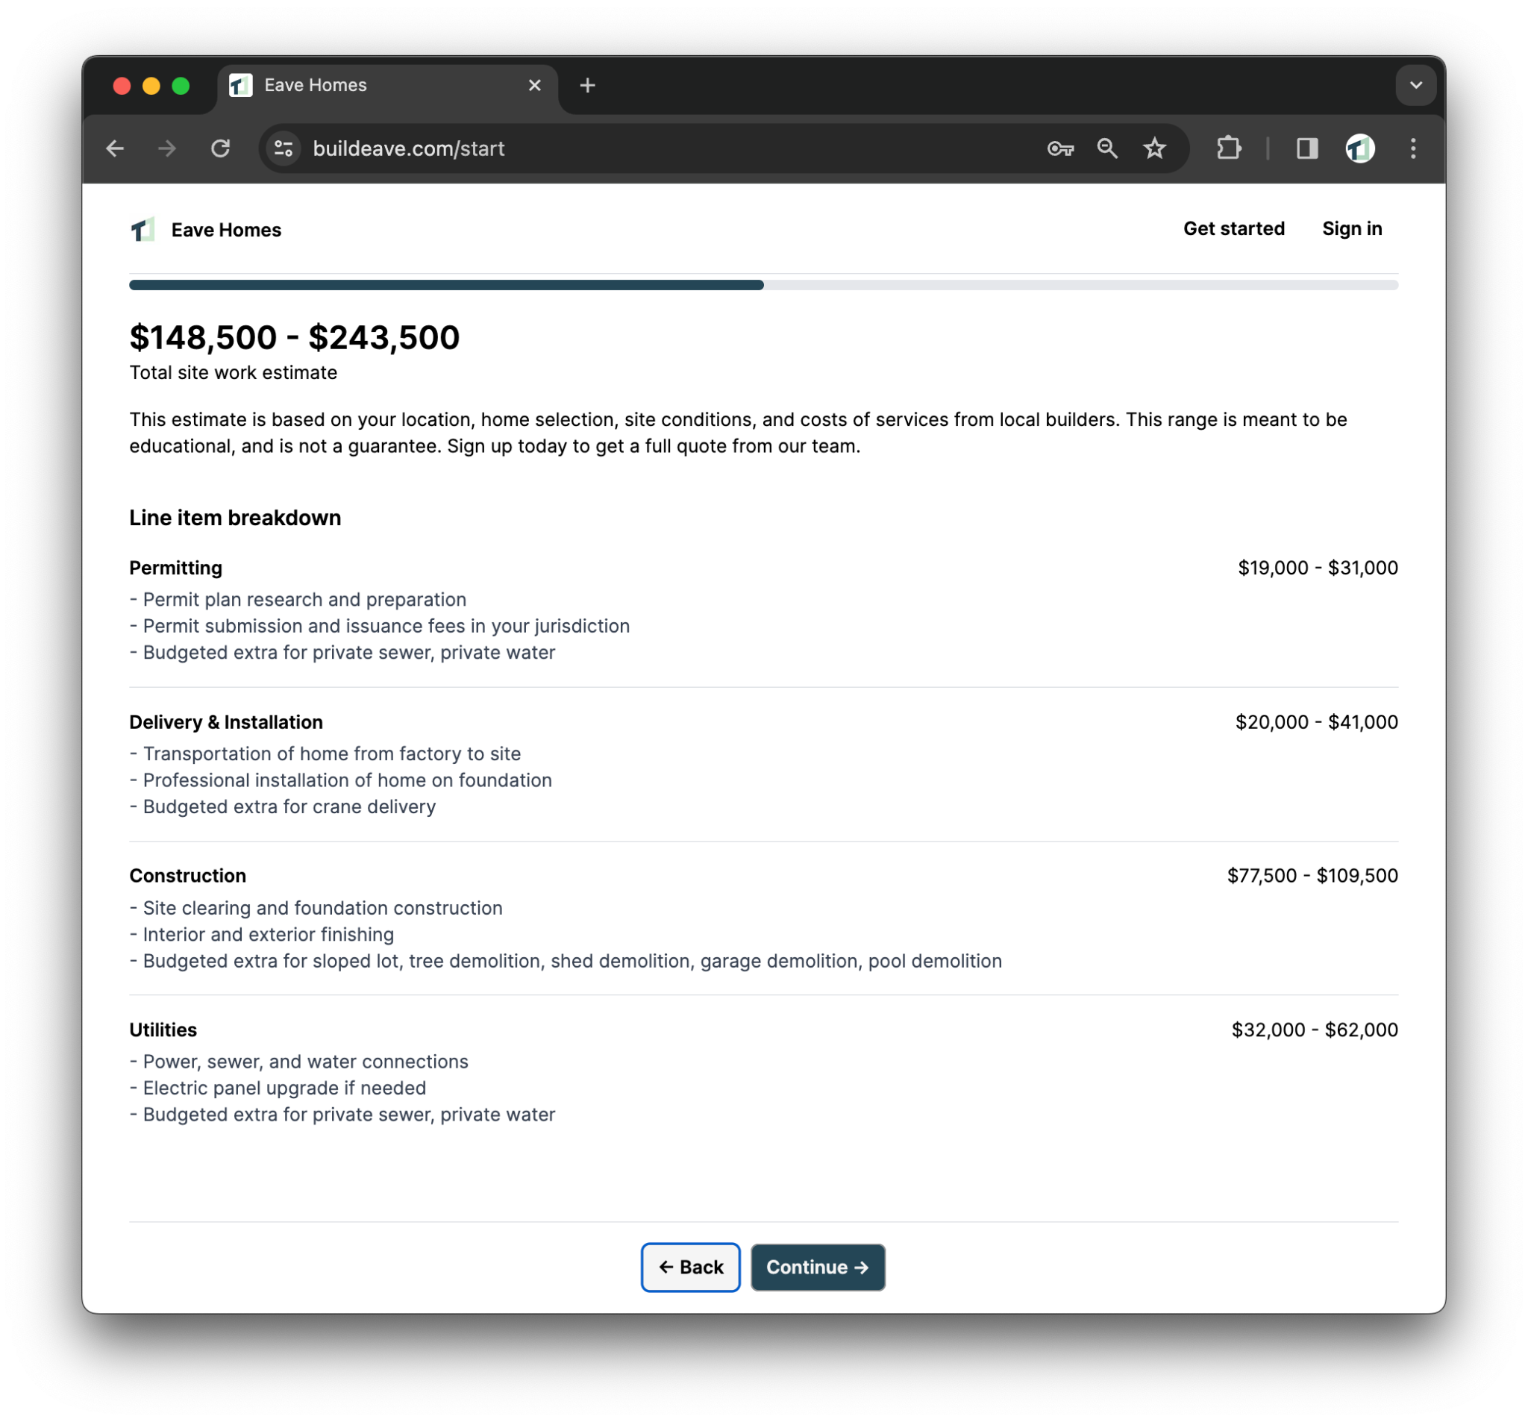
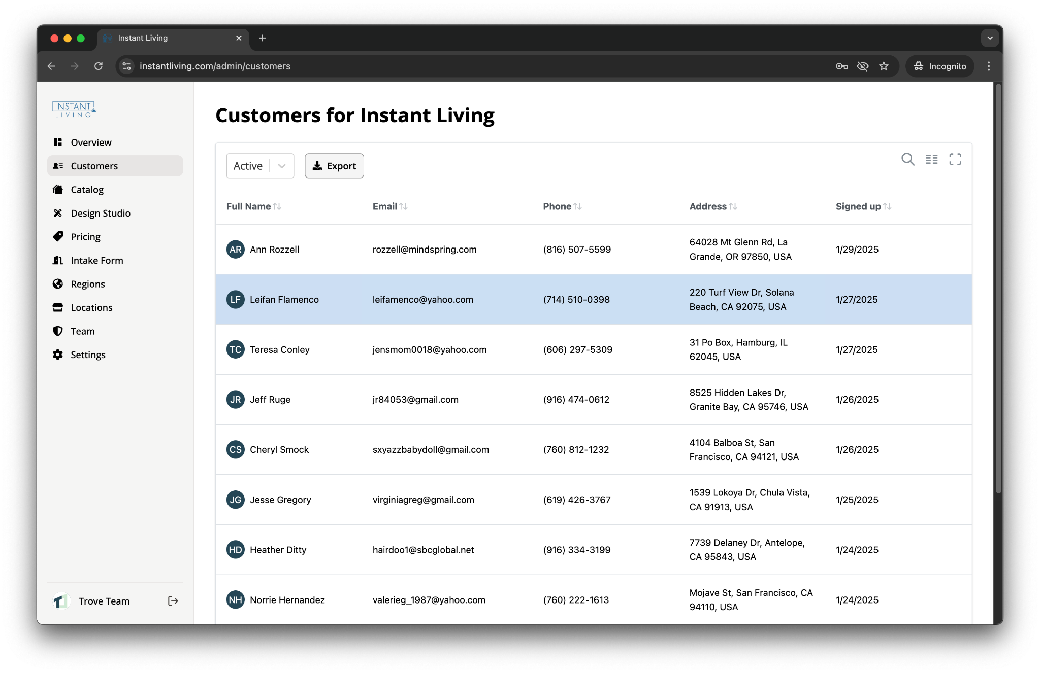
Trove: End-to-End Platform for Manufactured Home Dealers
Attract Buyers
Educate
Qualify
Close
Online Marketing To Generate More Leads | Automate Factory Updates & Manage Inventory | Design Homes & Generate Instant Quotes | CRM: Track & Win More Deals

Slide 4
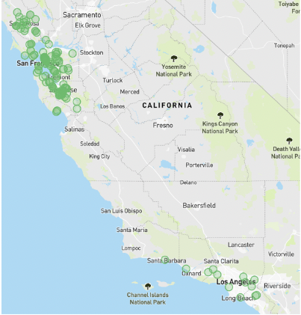
Before Trove: Manufactured Homes Sales through Digital Marketing
Map of Installed Homes
Highlights
First 4 yrs After Founding
Generated >50k Online Leads from Facebook and Google
Sold 600+ HUD Homes
Sold 30+ Homes in a
Single Month
Total of Just 3 Lot Models
James Connolly
CEO & Founder
Nation’s Largest Turnkey HUD ADU Retailer
2020-2024
Mike Pollack
CRO & Founder

Slide 5
Why Does Digital
Marketing Matter?

Slide 6
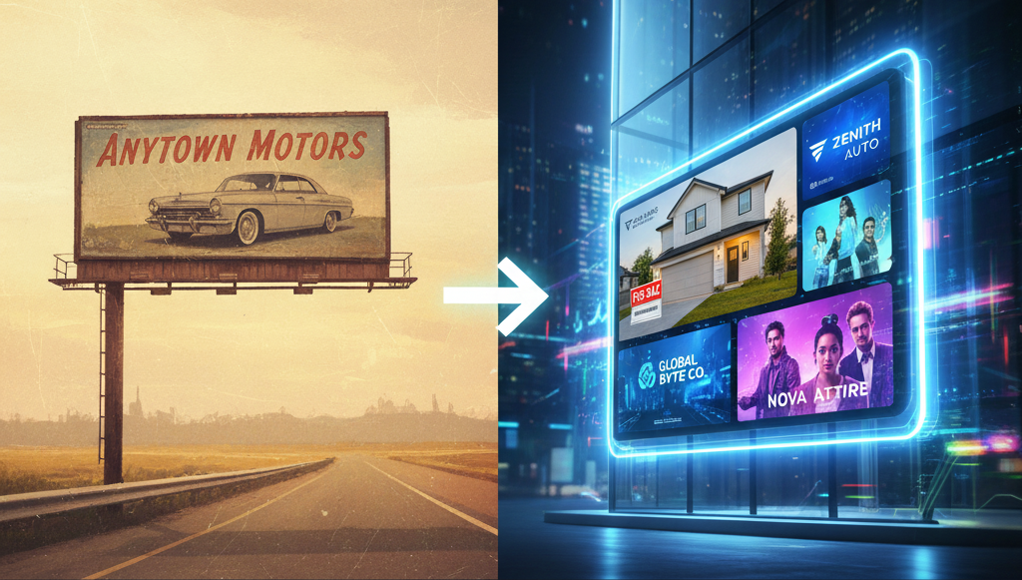
It is the billboard of the future

Slide 7
Why Do I Care?
38%
National Association of Realtors (NAR) "2024 Home Buyers and Sellers Generational Trends" report confirms that millennials were the
largest generation of homebuyers at 38% of all homes bought
Takeaway: Millenials have become the largest home buying generation

Slide 8
Why Do I Care?
>80%
Over 80% of millennials research products online before making a purchase
Takeaway: Millennials shop online first before coming to your store

Slide 9
Why Do I Care?
88%
A staggering 88% of online shoppers say they wouldn't return to a website after having a bad user experience.
Takeaway: Online shopper’s expectations have never been higher

Slide 10
What is Digital Marketing, Exactly?

Slide 11
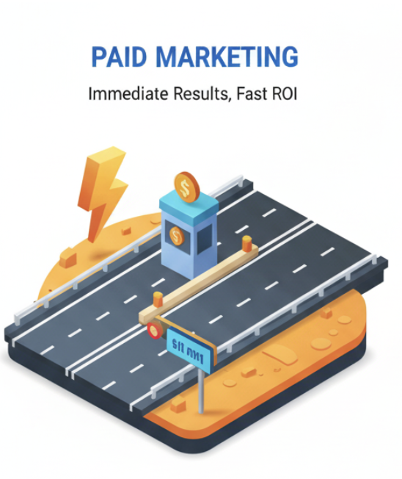
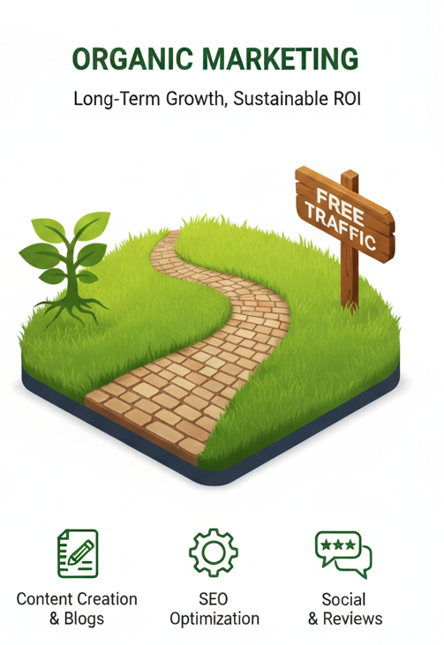

Digital Marketing Channels: Paid vs. Organic

Slide 12
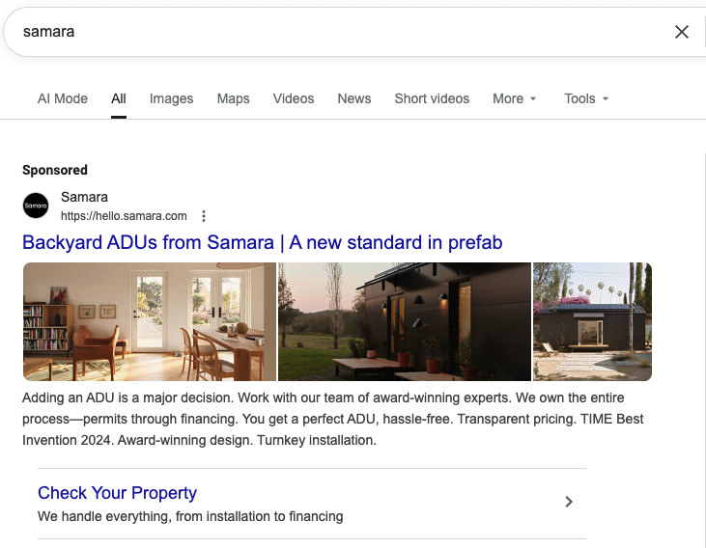
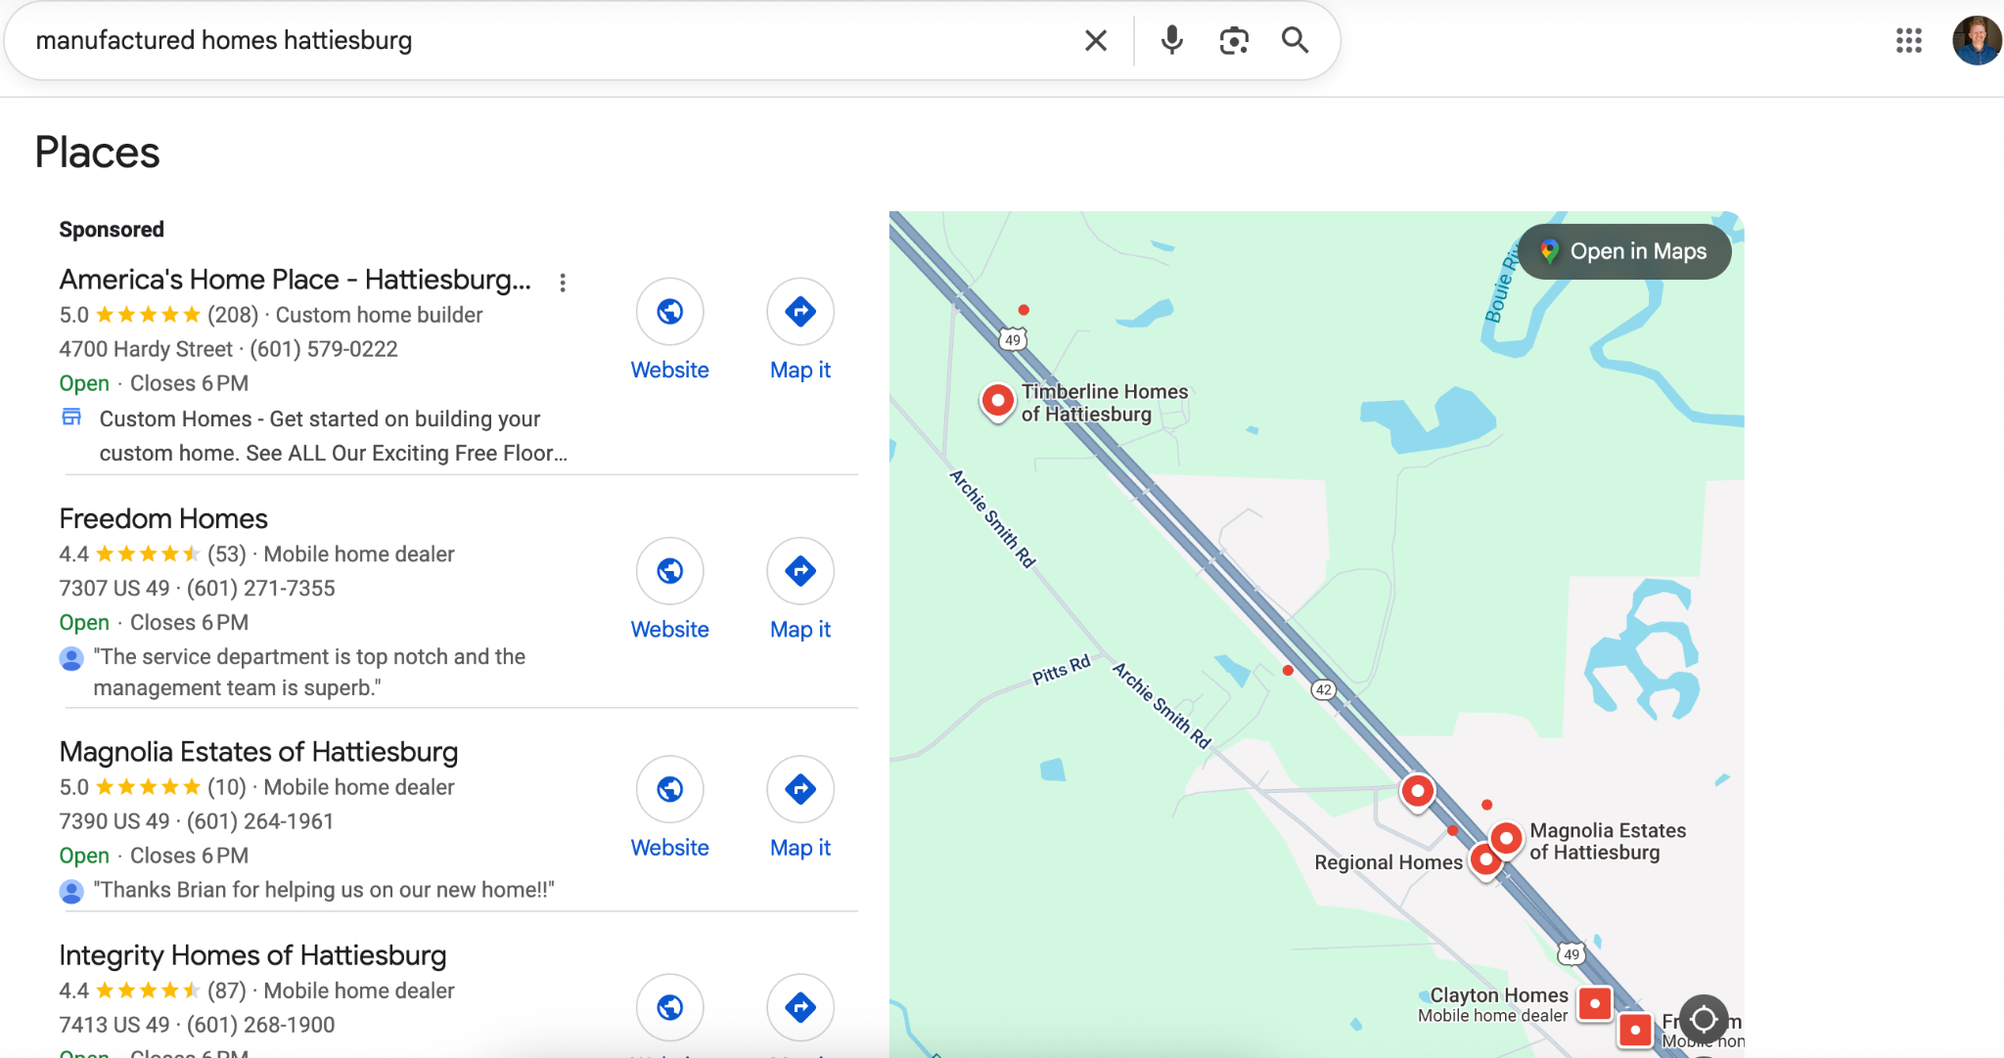
Example Paid Ads: Paid Search & Google Maps
Search
Google Maps

Slide 13
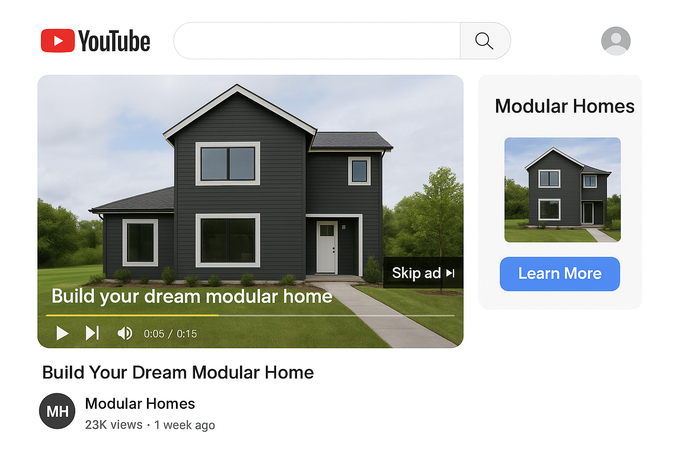
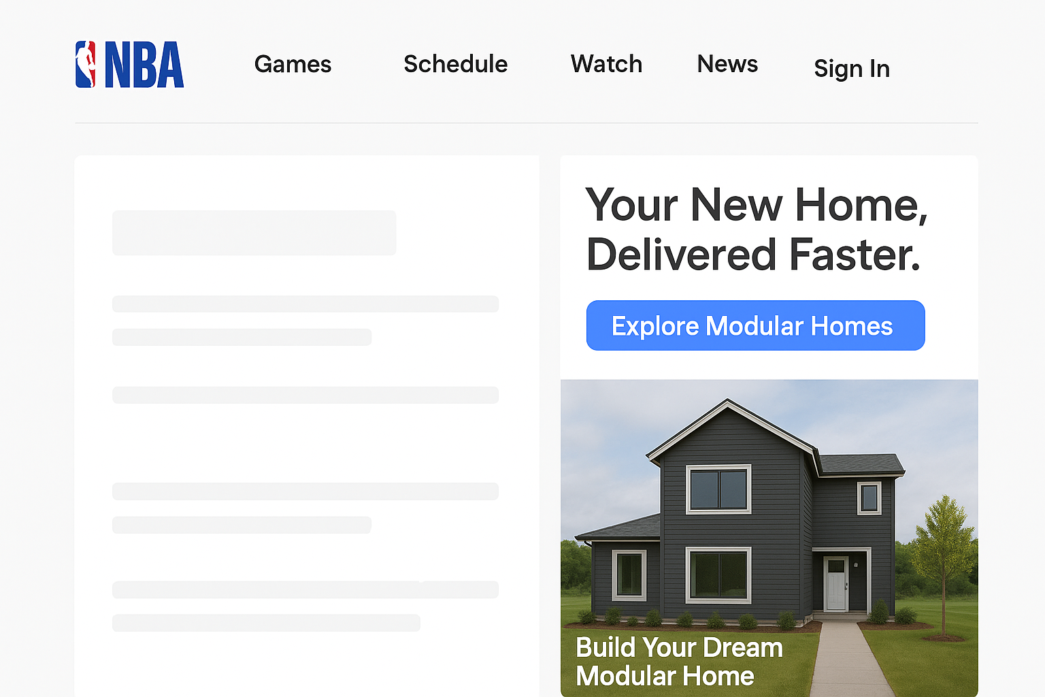
Example Paid Ads: PMAX Ads
Youtube
Display

Slide 14
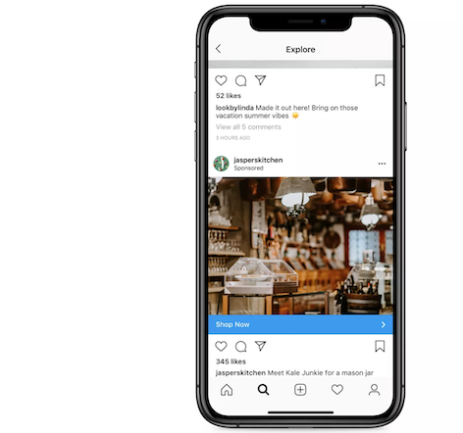




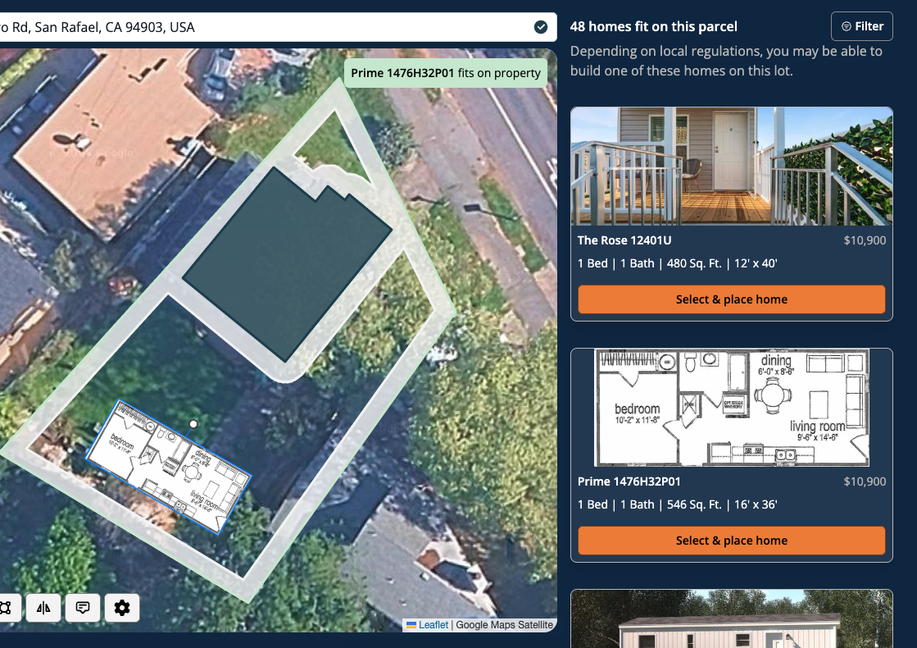
Example Paid Facebook & Instagram Ads

Slide 15
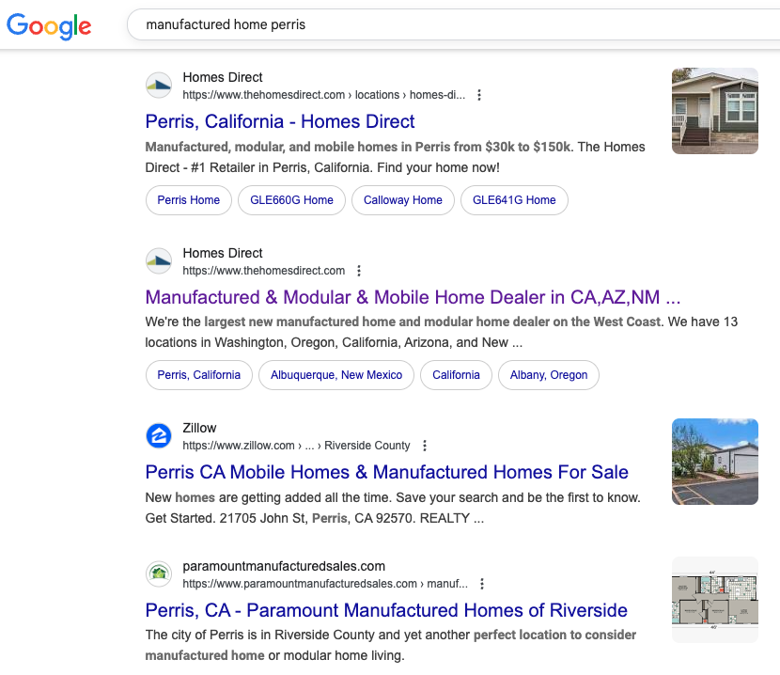
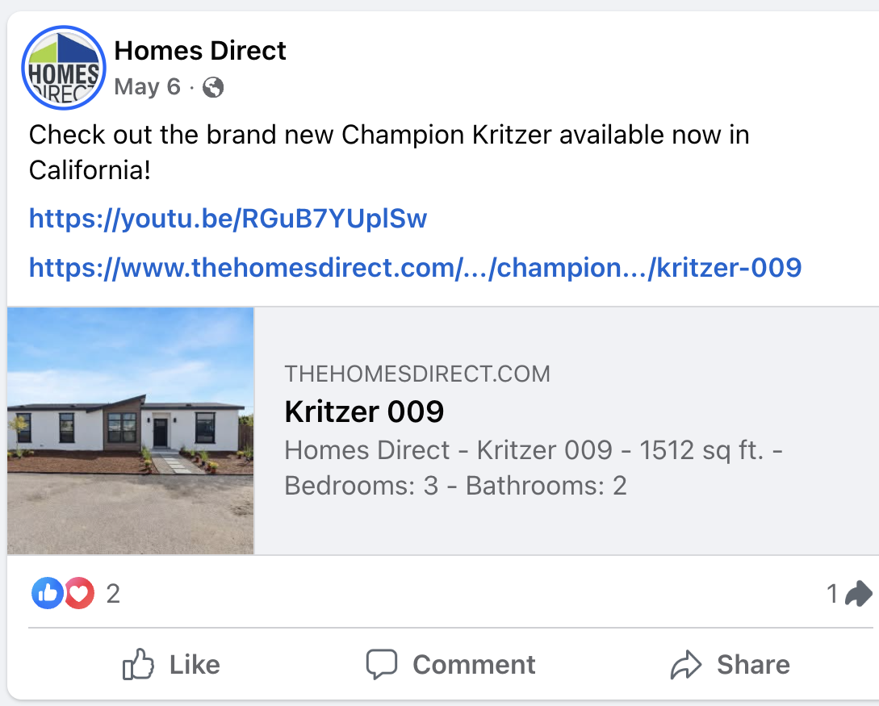
Example Organic Ads
Google: Non-Sponsored Searches
Facebook/Instagram: Posting

Slide 16
What is SEO? Boosts your organic search engine ranking
Keyword Research & Strategy – Identify the best search terms to target for your industry and audience.
On-Page Optimization – Improve titles, meta descriptions, headings, and content for better search rankings.
Technical SEO Fixes – Ensure your site is mobile-friendly, loads fast, and is easily crawlable by search engines.
Content Optimization – Refine existing pages to better match user intent and boost relevance.
Image & Media Optimization – Compress images, add alt text, and improve media SEO.
Internal Linking Structure – Improve navigation and help search engines understand your site’s hierarchy.
Local SEO Setup – Optimize for Google Business Profile and location-based searches (if applicable).
Analytics & Tracking Setup – Install and configure tools like Google Analytics & Google Search Console to monitor results.
Monthly Performance Reports – Track keyword rankings, traffic growth, and SEO improvements over time.
Goal: Rank High on Google

Slide 17
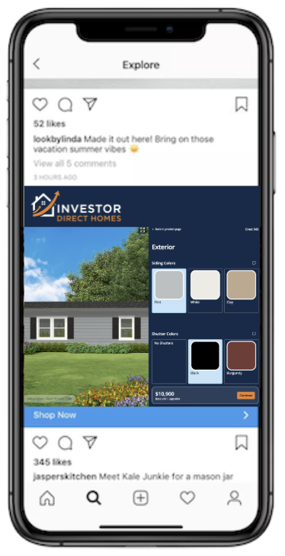
The Power of Paid: Get Noticed Instantly
Immediate Impact: Drive traffic to your website or business tomorrow.
Faster ROI: More expensive, but provides an immediate return on investment.
Google: High-intent, concentrated & more expensive leads
Facebook: Low-intent, broad & least expensive leads

Slide 18
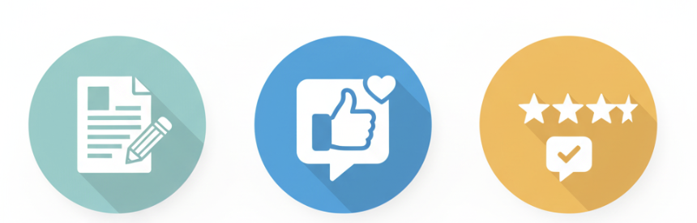
Organic: Building a Sustainable Future
Long-Term Strategy: Organic marketing is a long-term play.
High ROI (Long-Term): Difficult to attribute in the short term, but offers a high return on investment over time.
Key Organic Activities
Search Engine Optimization (SEO): The process of making sure you rank high on Google for relevant search terms.
Content: Posting blogs, posts and videos.
Reputation Management: Generating reviews and managing your Google My Business (GMB) profile.

Slide 19

The Ultimate Strategy: A Hybrid Approach
Paid and Organic are not mutually exclusive!
Paid Marketing: Provides the immediate traffic and leads you need to get started and sustain growth.
Organic Marketing: Builds the long-term authority, trust, and free traffic that ensures your business thrives for years to come.
Key Takeaway: A successful digital marketing strategy combines the immediate impact of paid channels with the sustainable growth of organic efforts.

Slide 20
Enough Already,
Show Me the Money!

Slide 21
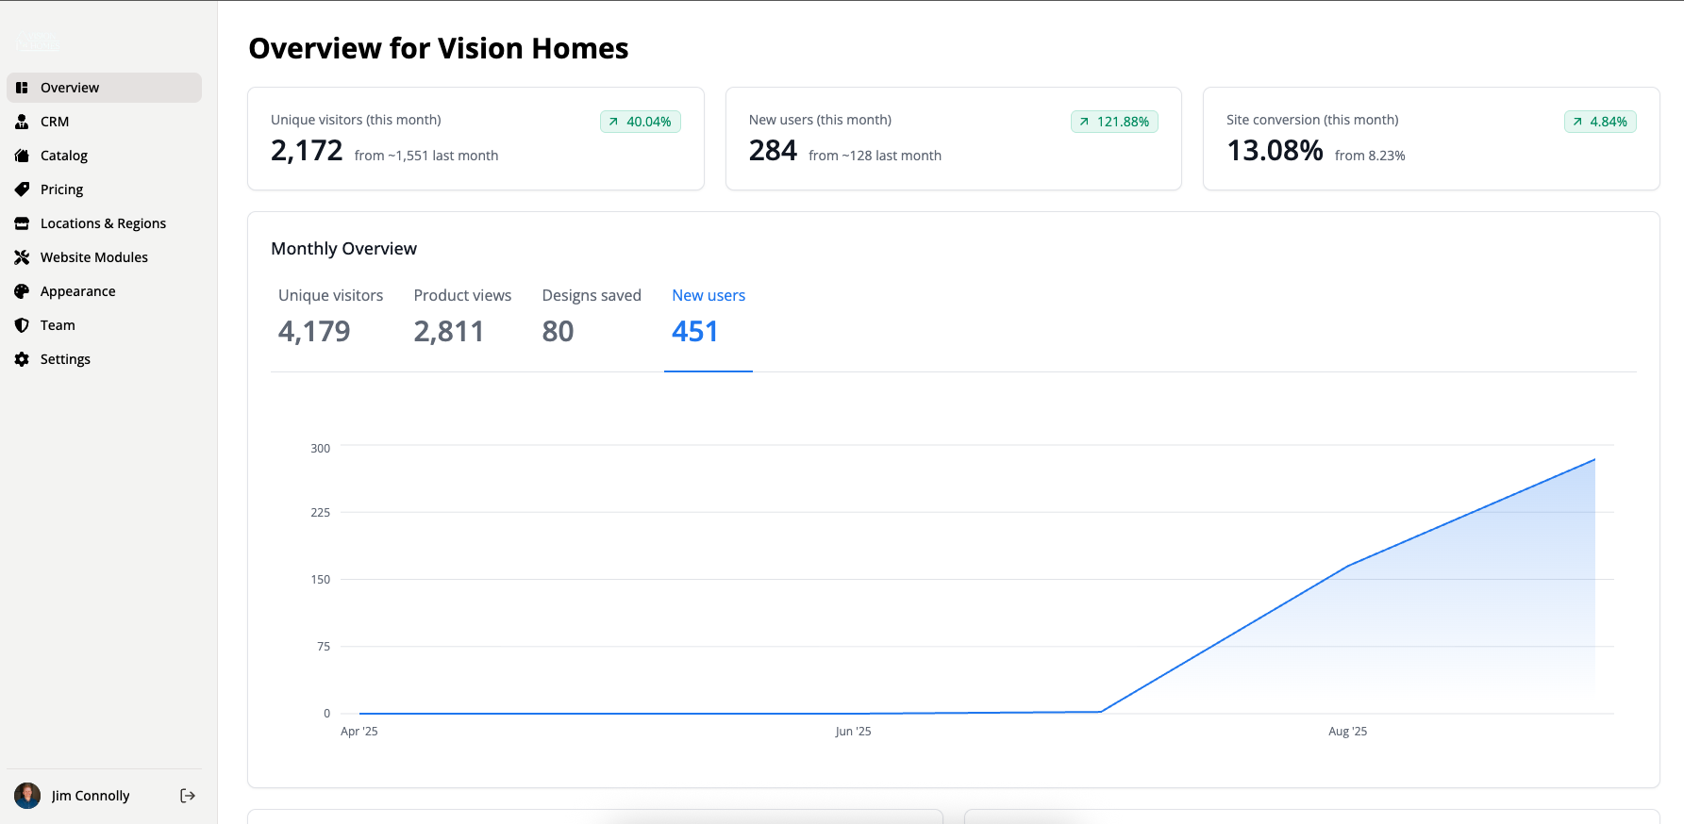
What metrics matter?
Traffic x

Slide 22
What metrics matter?
Traffic x
Conversion Rate =

Slide 23
What metrics matter?
Traffic x
New Leads!
Conversion Rate =

Slide 24
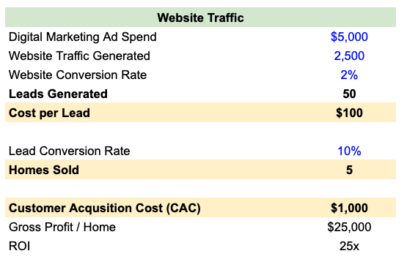
How to think about your metrics in terms of $$$

Slide 25
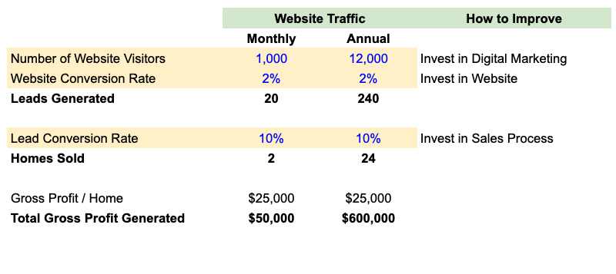
Okay, so what can I actually control?

Slide 26

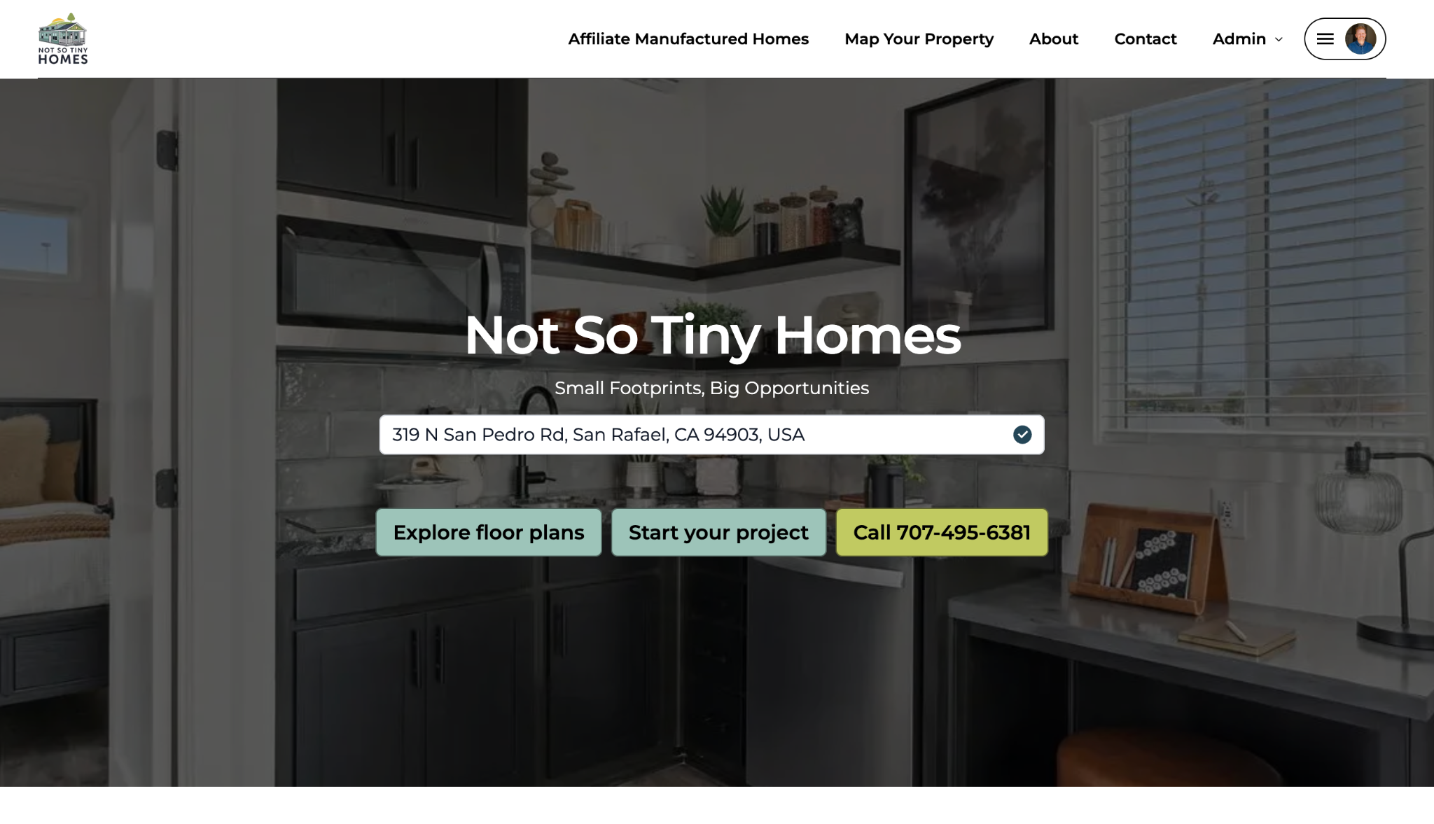
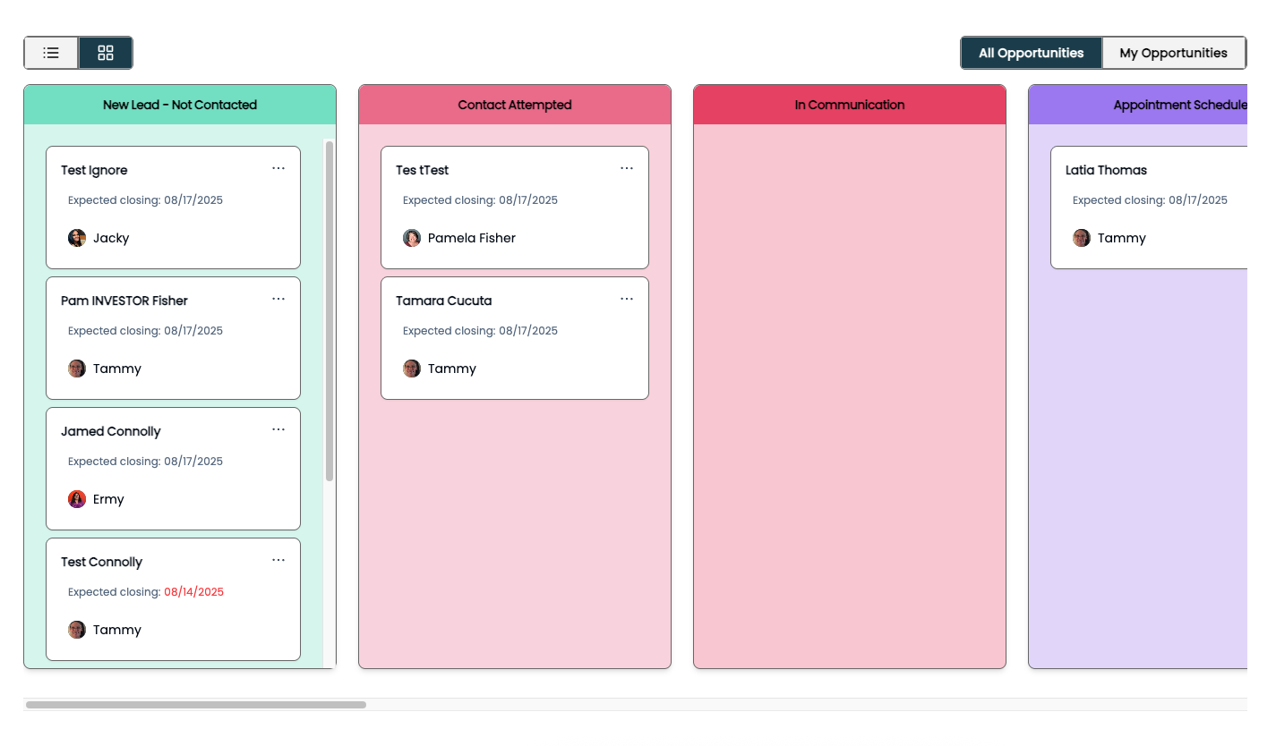
How do I change these variables?
Traffic x
Conversion Rate =
Leads & Sales
You Need to Have a Strong Online Presence (Website):
Prominent phone number
Online forms throughout
Photos of real homes
Pricing of homes
Engaging tools (design, mapping, comparison)
Helpful blogs
Team member photos
Leads are worthless, but sales are valuable! A CRM can help:
A CRM is a place for you and your sales reps to see all your deals
You should send automated emails for every lead
You should call customers as soon as you can
Pro Tip: You can feed data back into the advertising machines to help drive better targeting

Slide 27
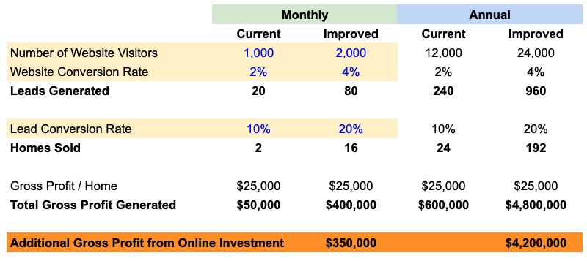
Imagine if you could just double each variable

Slide 28
If it's so great, why doesn’t everyone just dump $1M into this today?

Slide 29

If it's so great, why don’t I just dump $1M into this?
Answer: The Law of Diminishing Returns!
Imagine you invested in a billboard on a busy highway for $50k, and you sold 10 homes at $5k / home.. That would be great!

Slide 30

If it's so great, why don’t I just dump $1M into this?
Answer: The Law of Diminishing Returns!
Imagine you invested in a billboard on a busy highway for $50k, and you sold 10 homes at $5k / home.. That would be great!
So you invest another billboard on that same highway, but only a few more people notice it. You sell just 5 homes at $10k / home. Not great, but hey! More sales is nice.

Slide 31
If it's so great, why don’t I just dump $1M into this?
Answer: The Law of Diminishing Returns!
Imagine you invested in a billboard on a busy highway for $50k, and you sold 10 homes at $5k / home.. That would be great!
So you invest another billboard on that same highway, but only a few more people notice it. You sell just 5 homes at $10k / home. Not great, but hey! More sales is nice.
So you add another, but now you only added 1 more sale at $50k / home. Now you lost money on that deal!

Slide 32

How do I know how much I can spend?
There is no way to guess how deep the “well” is for each of your channels for your business, it depends on:
Demand for your product & services
How big of a reach your geographic coverage is
How good your advertising is
How much you are willing to pay per customer
How good you are at converting leads into sales
The only way to know is to test! You really don’t know until you go for it. Our advice is to:
Figure out what the most is you would pay in marketing to acquire a customer
Budget that amount for 3-months, and analyze how many homes you sell from the leads generated
For example, invest $5k / month for 3-months = a $15k investment in digital marketing

Slide 33
Thank you!

Slide 34
Ready to Build Your Future with Trove?
Visit buildtrove.com
Give us a call at 415-412-385
Stop by our booth!

