Slide 1
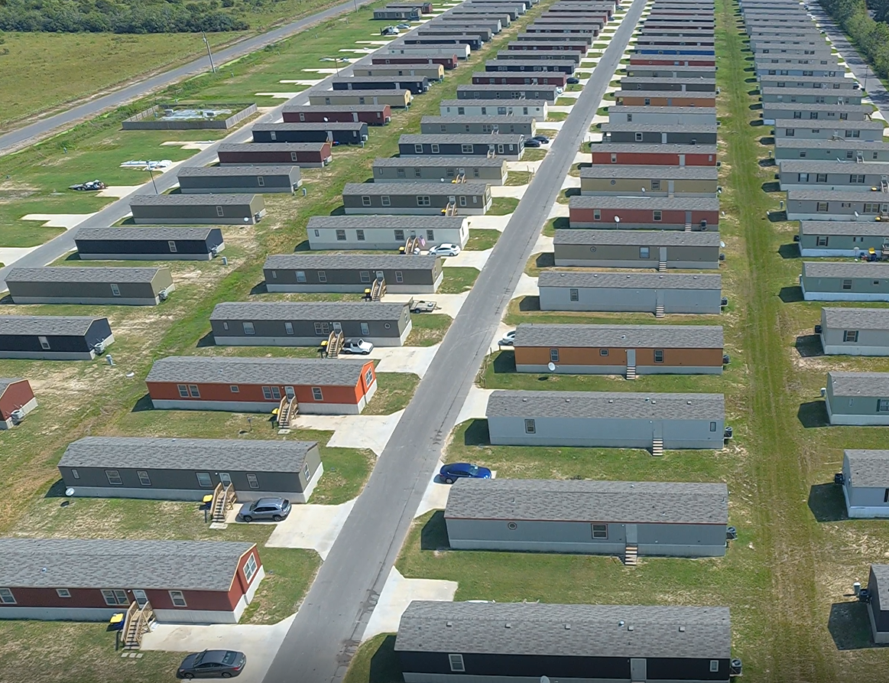
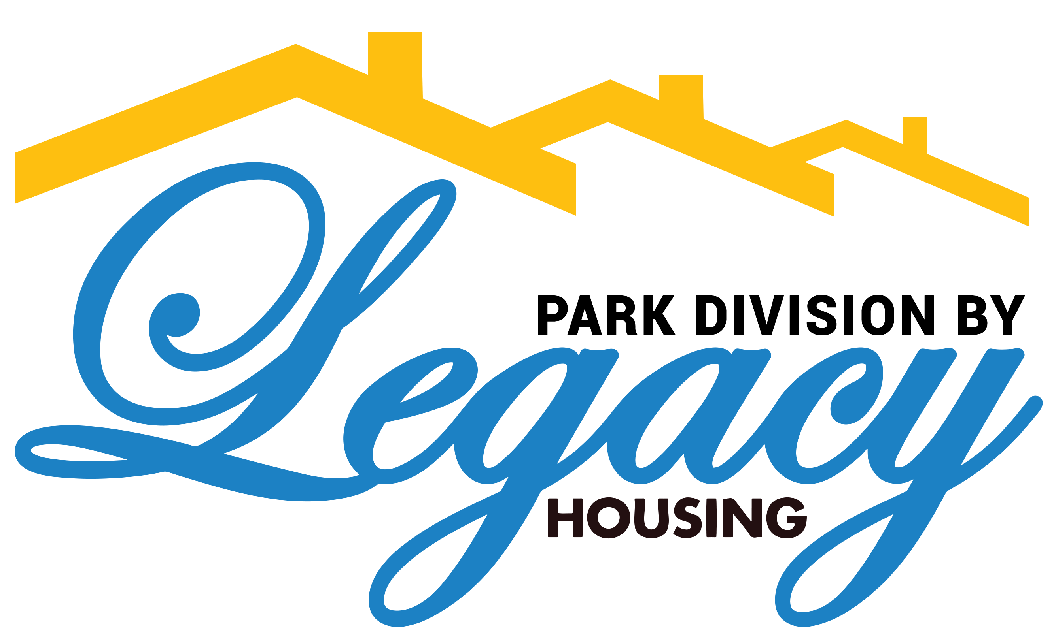
Legacy Park Financing 101
Presented By:
Keaton Shepard
Finance Manager
Notes:
Good morning, and welcome to the Legacy Housing Corp Fall Show 2024, we are very excited to have you all here to showcase the new options and features for Legacy Homes. I wanted to take a second and thank everyone for taking time out of their busy schedules to attend the Legacy Housing Fall Show 2024. A little bit about me, I have been with Legacy for about 3.5 years in our corporate office in Bedford. During that time, I have been working with and managing the Mobile Home Park financing program, which is what I will be talking about today. This program was designed to fit any shape Whether you are already well established in the mobile home park industry or are working on your very first park, this financing program can be a huge benefit to kick-start your business! So, without further ado, let’s get right into it!

Slide 2
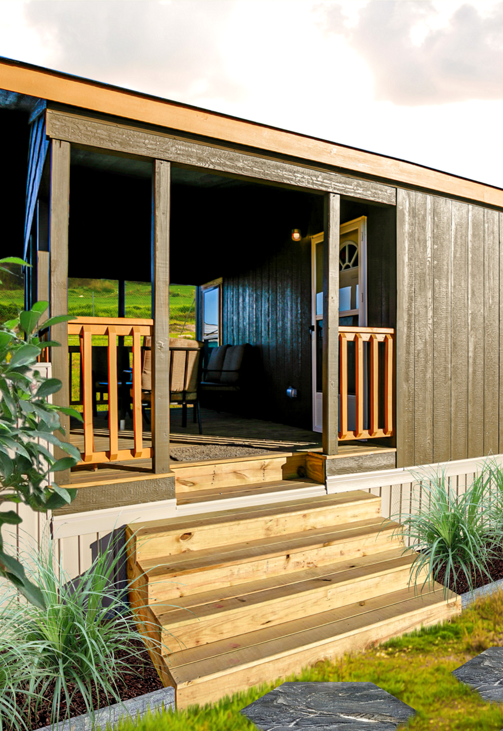

Standard Purchase Options
What is your priority as a community owner?
Priority - Cash Flow
  10% Down
Priority - Total Cost
  20% Down
Notes:
When Curt and Kenny built this financing program back in 2018, they put themselves in the shoes of community owners but kept running into the same problem - How do we tailor this program to meet the needs of all different kinds of community owners? No two mobile home parks are the same, and do not all operate in the same way. Some parks have 10 pads and others have hundreds. This posed a serious question that Curt and Kenny boiled down to this – what do you prioritize as a park owner, cash flow or total cost? To answer this question, Curt and Kenny designed a MHP financing program that has 4 creative options to meet the needs of all community owners. We will go through those 4 different options during this presentation. Historically, newer, less-established parks & community owners prioritize cash flow. They prefer to put up the smallest down payment required to start receiving homes be rented out, allowing them to start generating cash flow with minimum capital commitment up front. The leasing option or the 10% down payment financing option are tailored for this priority. On the other hand, historically speaking, the more established, large operation community owners sometimes have more capital readily available and are willing to pay the higher down payment, so they prioritize the total cost over cash flow. (Less principal amount financed, more competitive interest rate) Let’s jump into the different financing options that Legacy offers so you can determine which one fits into your business model!

Slide 3
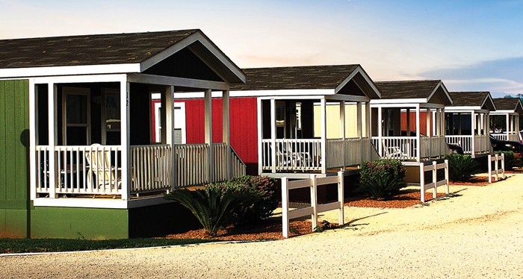
Priority: Cash Flow
10% Down Payment
7.9% interest rate for 2 years, then 10-year variable interest @ prime +3.8%
$2,000 deposit per unit to start production
Less capital required up front
Finance straight from Legacy, no third-party complications
Notes:
This program is extremely competitive on the terms offered for park owners looking to expand their community or replace older homes with new units. If your main priority is more in line with cash flow, these are the terms offered. List terms Locking in a sub-prime interest rate is unheard of, especially for 24 months. This will allow you to receive all of the homes while putting up the lowest down payment and have the benefit of low monthly payments on the units for the first 2 years. After the first two years, monthly payments switch to a fixed principal amount per month, plus accrued interest @ prime + 3.8%. The good news as of late is that the

Slide 4
Priority: Total Cost
20% Down Payment
6.9% interest rate for 2 years, then 10-year variable interest @ prime +3.8%
$2,000 deposit per unit to start production
Extremely competitive interest rate
Finance straight from Legacy, no third-party complications
Notes:
If your main priority is reducing the total cost over the term of the note, and you have additional capital that can be used towards the down payment on these homes, the terms offered under this option are for you! *list terms. The down payment is larger than the “cash flow priority”, but you are given a fixed interest rate of 6.9% for the first two years. You couldn’t get a rate this competitive from great grammy, but Legacy is still offering this for our customers. If your priority is total cost, locking in the lower interest rate and financing a smaller amount will help you achieve this.

Slide 5
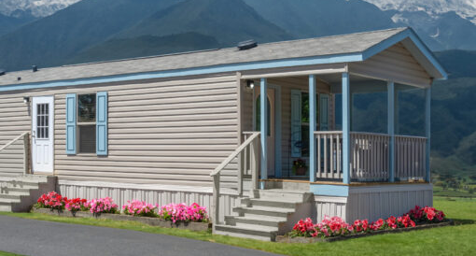
Tiny Home Terms
15% Down Payment
7.9% interest rate for 5 years. 10-year amortization, 5-year balloon.
$2,000 deposit per unit to start production
Flexibility - Can be built to HUD code or no code
Notes:
We have recently seen rapid growth in the tiny house market for our community owners. With 10+ tiny home floorplans, we are certain that Legacy has a home that is the perfect fit for your tiny housing needs. Lake/Campground areas, RV parks, etc. have been a hot spot for these tiny homes. *Go through terms

Slide 6
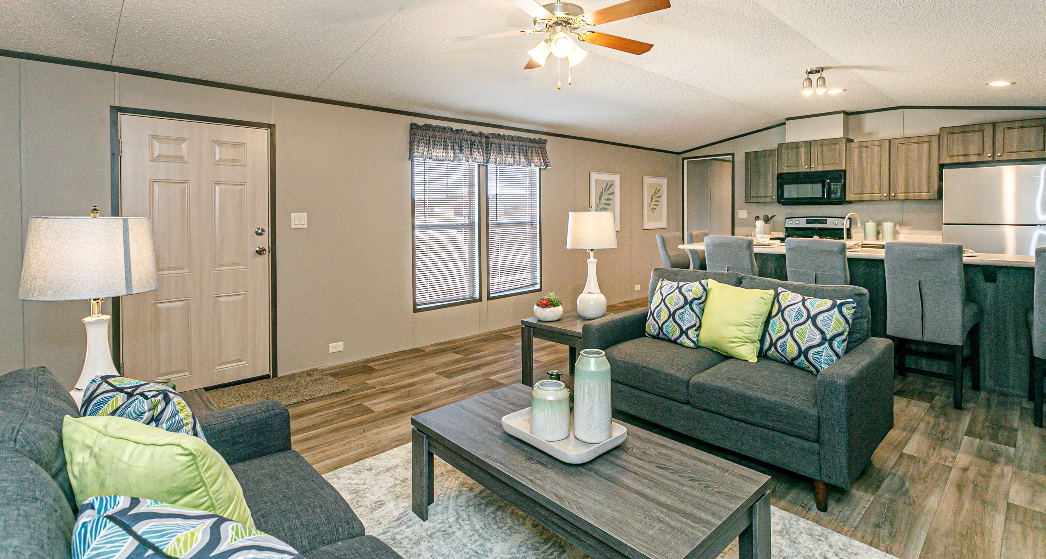
LEASING
96-month term with fixed monthly payments
Up to $2,000 of freight per unit included in your lease arrangement.
Purchase options or extensions are available at the end of the lease.
Notes:
Legacy also offers a lease program for commercial consumers that is different than entering a loan. These are 96-month leases, and the units leased are intended to be rented out to the consumer. The down payment requirement on leases is only $2,000 per unit is required as a down payment. Also, up to $2,000 in freight will be included in the lease arrangement, if freight is more than $2,000, then any extra must be paid up front with the down payment. One common misconception on the lease program is that these homes can not be individually paid off or sold. This has caused issues in the past, when a park owner has a tenant who wants to purchase the property, but the home is leased from Legacy to the park owner. That home can not be offered for sale, it is still owned by Legacy. We have had instances where customers with a lease convert the entire lease into a buyout, which can be done on a case-by-case basis. If you intend to purchase the units outright, we strongly encourage you to use on of the purchase options mentioned previously.

Slide 7
HOW & WHERE DO I START
Your sales representative is your primary point of contact!
Complete MHPP application and submit to your sales rep.
Entity on MHPP application needs to be the entity buying the homes and taking on the loan.
Basic Park Information
Other documentation may be required*
Notes:
Since Legacy originates these loans in house, we pride ourselves in having a quick and easy application process compared to other commercial lenders. Typical turnaround time from when an application is submitted to an approval/denial is 1-2 business days.

Slide 8
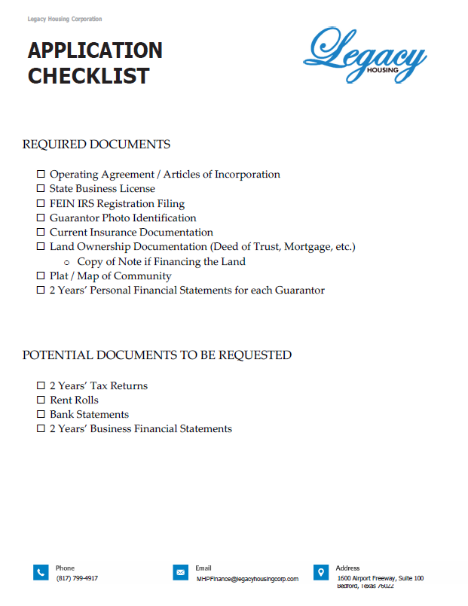
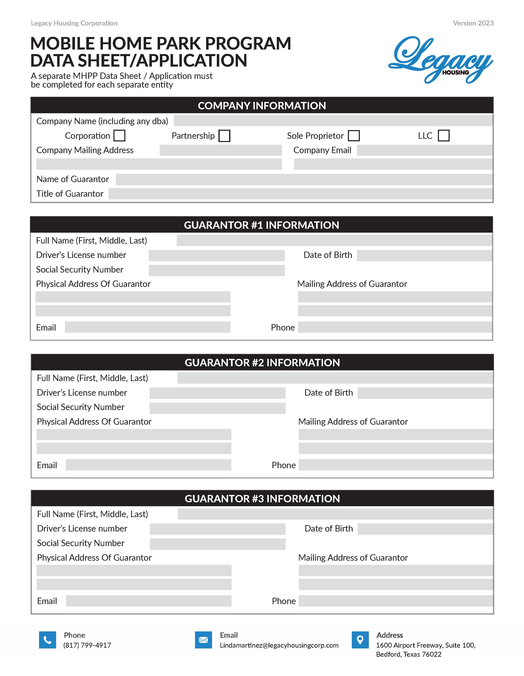
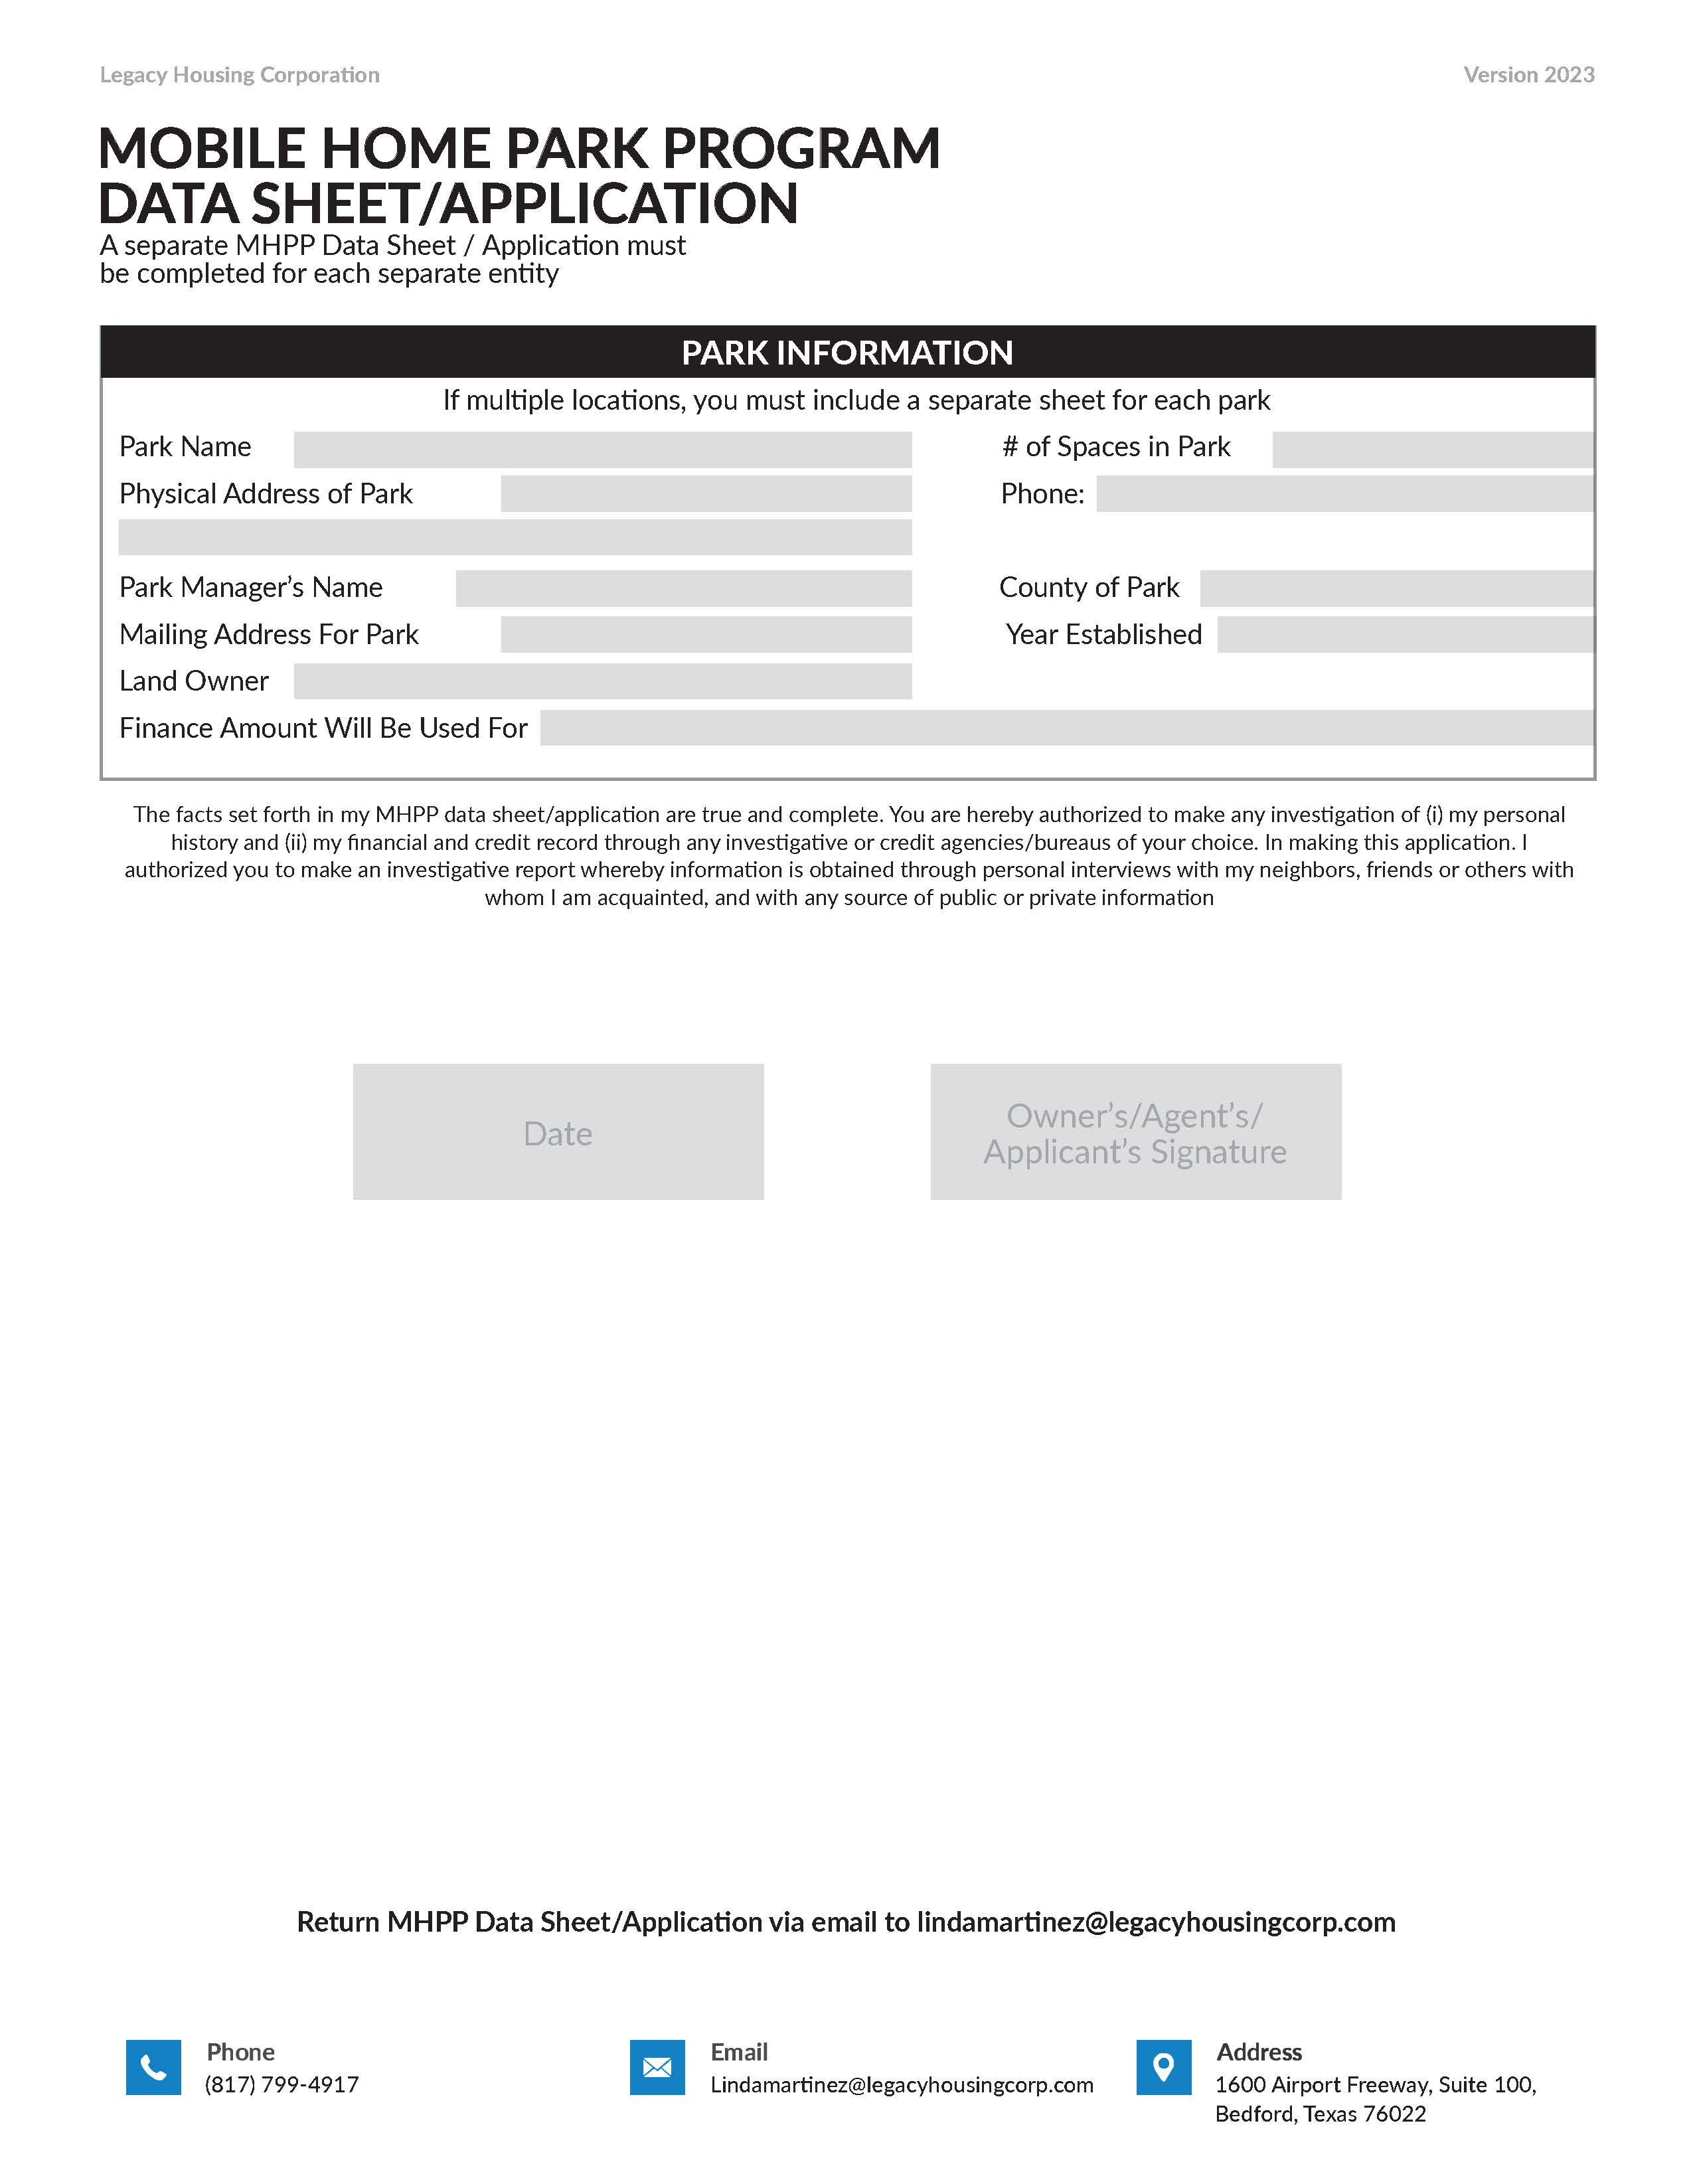
MHP APPLICATION
Notes:
Our financing application is relatively short compared to other lending institutions. Basic entity information is required (name, address, operating agreement) so we can establish which individuals have the authority to sign on behalf of that company. A credit pull is also done on each guarantor of the note to establish the level of risk.

Slide 9
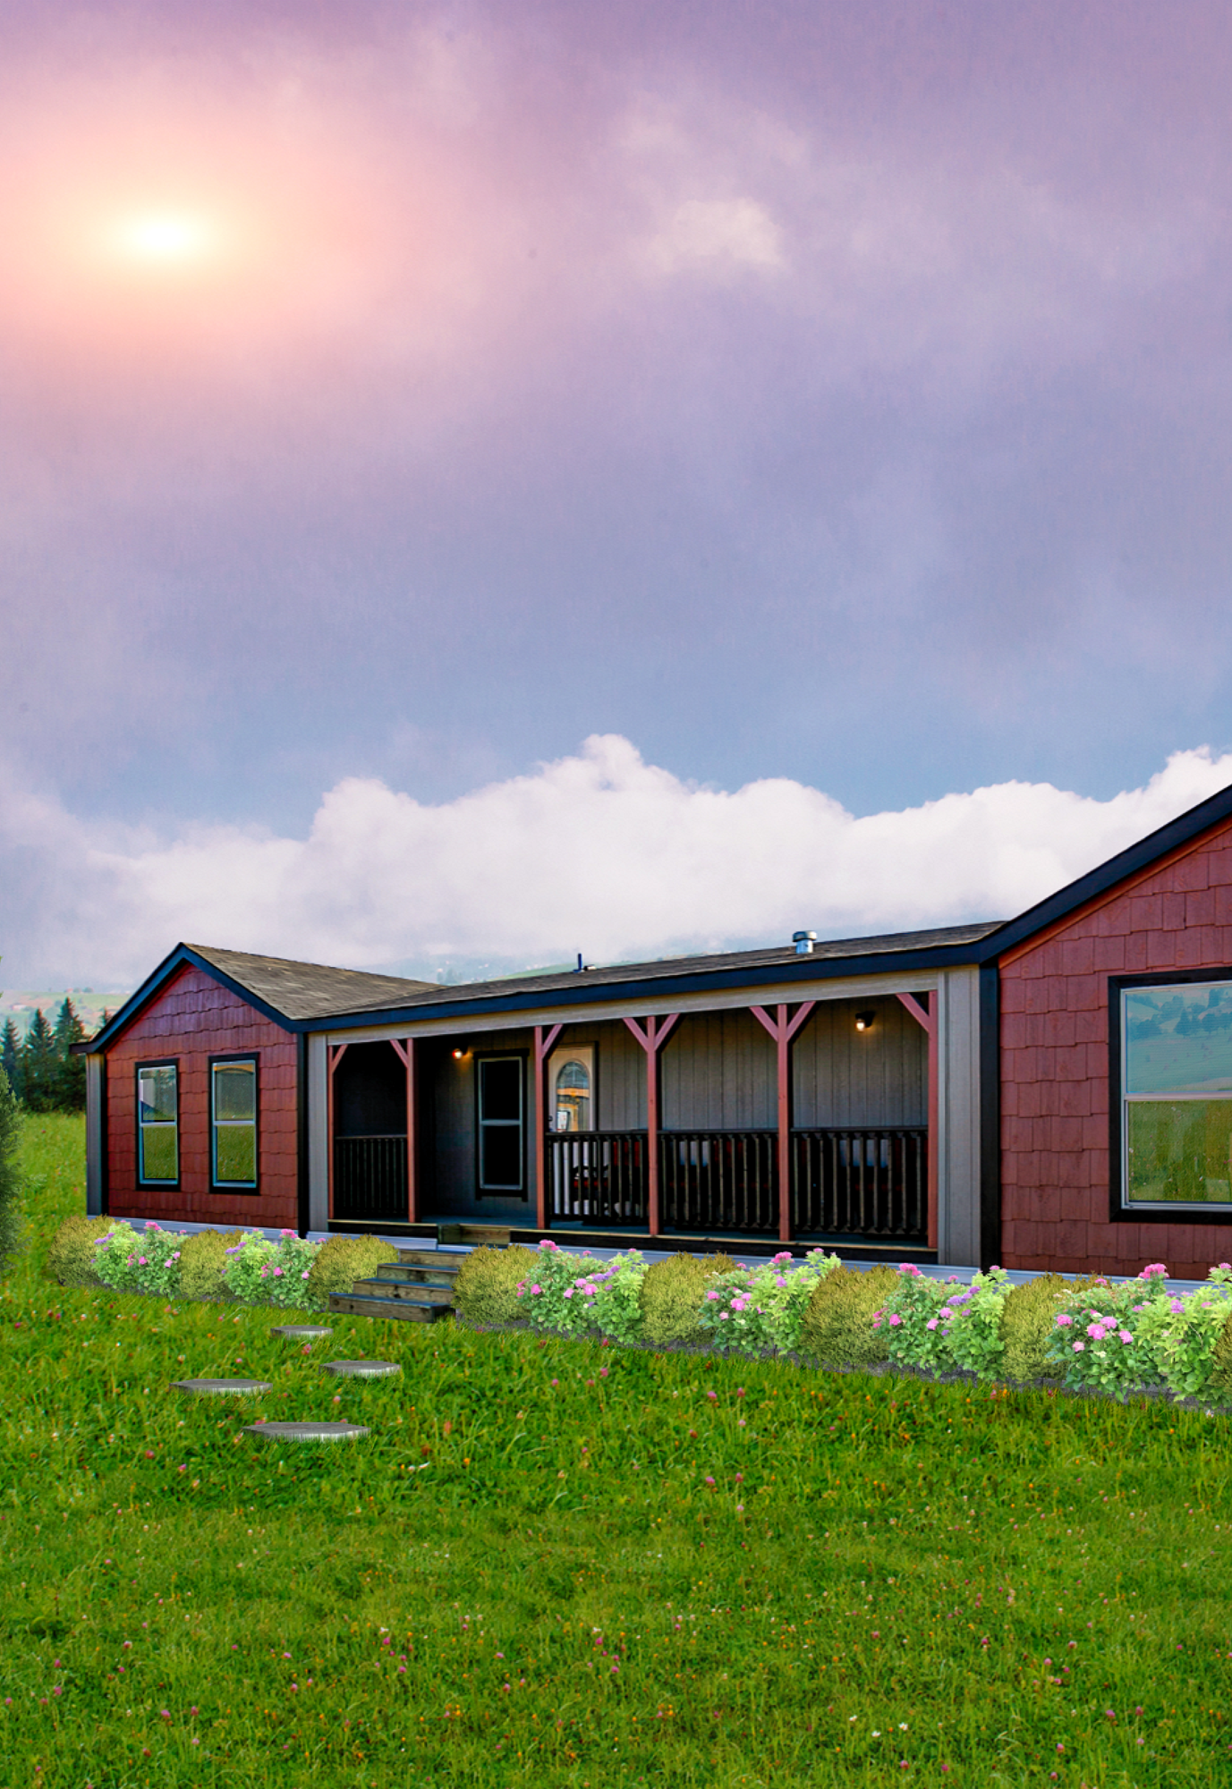

OTHER DOCUMENTATION
Operating agreement that provides ownership and control up to the individual level.
Insurance Documentation
Current and valid ID
Park plat/map
Accurate sales tax/entity information – for titling

Slide 10
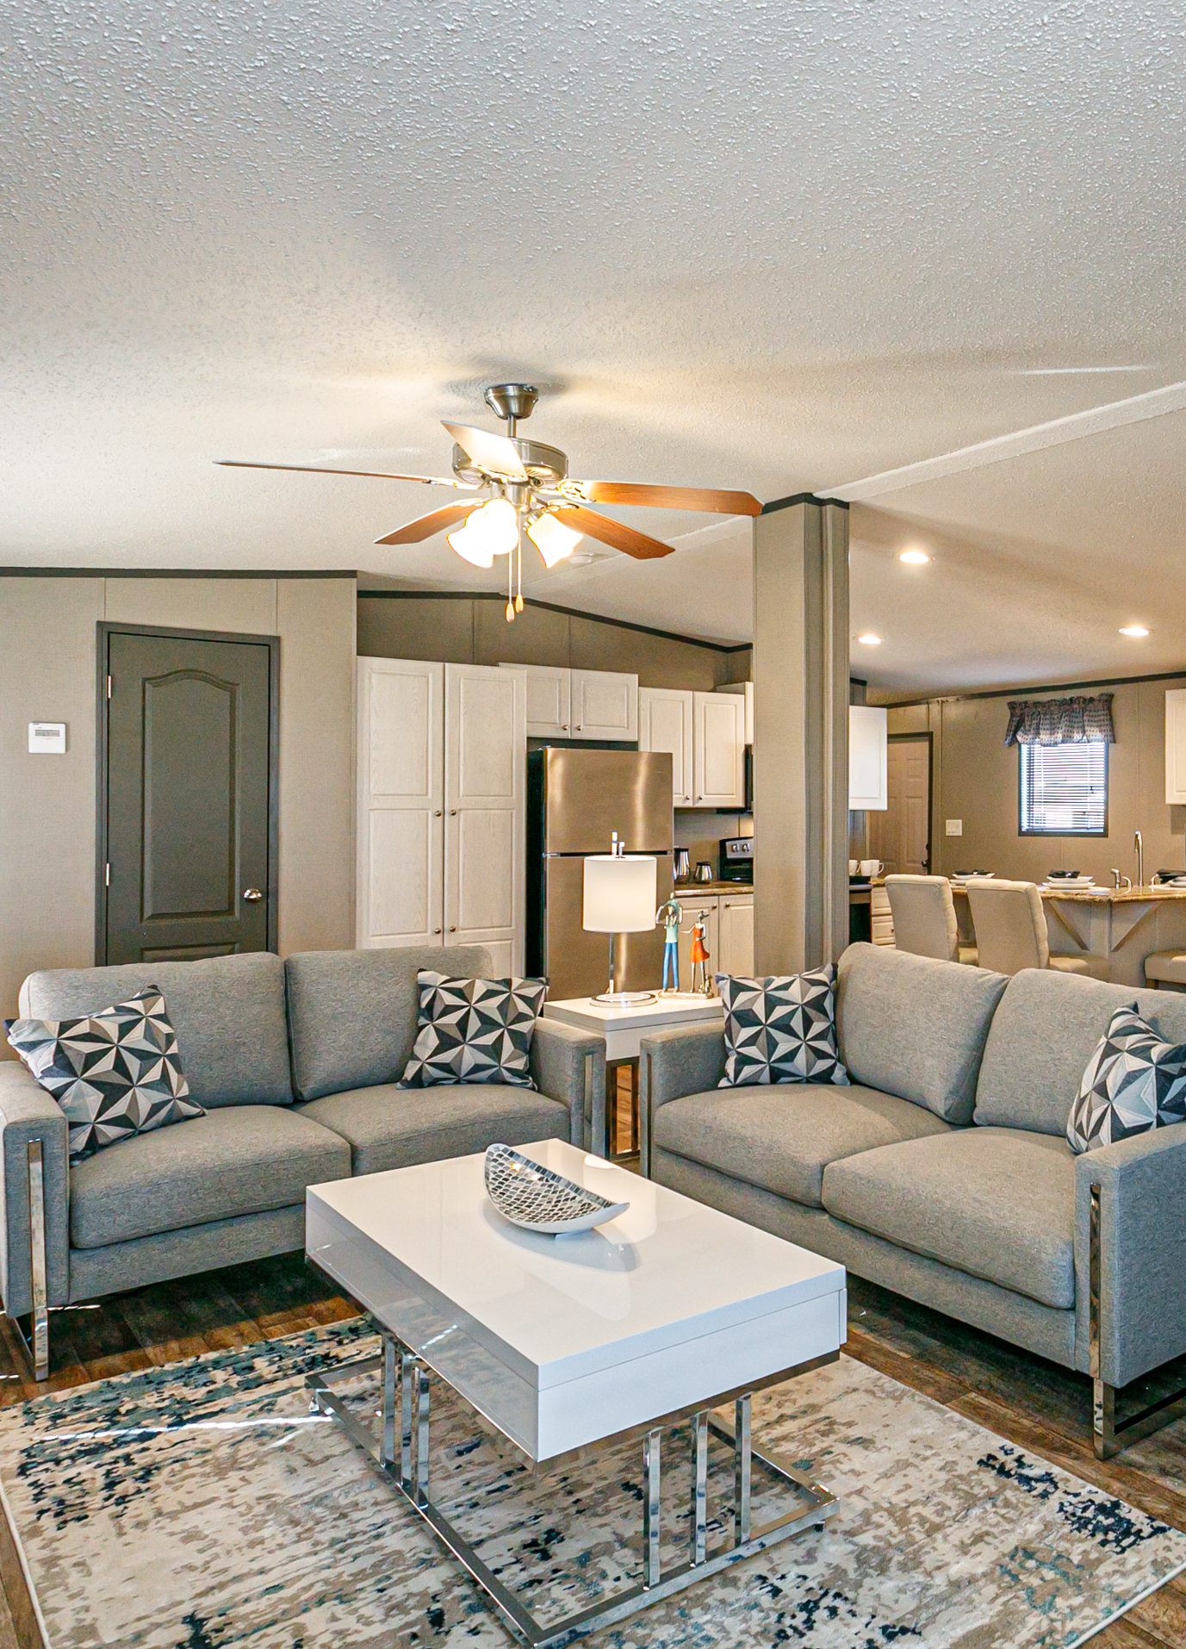
ORDERING (GUIDELINES)
Complete a Sale & Finance Agreement with your sales representative
6 home minimum per contract
All homes on the loan must go to one location, no scattered sites
Homes are titled to the purchasing entity listed on the contract

Slide 11
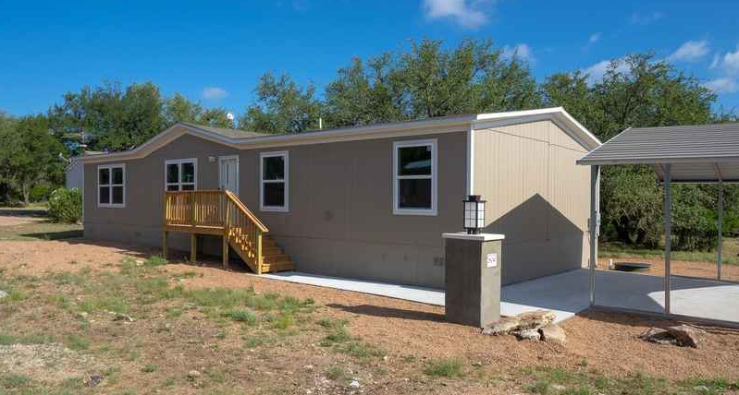
MISCONCEPTIONS
Partial Payoffs
Rent to Own
Order when ready to take delivery
Assumptions
ACH Payments
Notes:
Some common misconceptions we see in the MHP finance program is that community owners list the homes for sale that are on their Legacy loan. The homes financed on the loan are intended to be rented out, and ownership of the homes are with you the community owner, with Legacy’s lien on it. Once the loan is paid off, the lien will be released and original titles in your business’ name will be mailed to you. The homes are not intended to be listed for resale upon delivery of the home. Legacy does have a program for retail sales lots under our inventory finance program, and that program is intended for the resale of homes. Rent-to-own agreement with the tenants are also prohibited.

Slide 12
SUMMARY
Legacy Housing Corp. is the one stop shop for your Mobile Home Community needs –
Manufacturing, Financing, Servicing
Your sales representative is your primary point of contact
Select your initial investment: 20%, 15%, 10%, or Lease (< 10%)
Maximize your margin – Find the program that works for you!
Take advantage and place your order today!

Slide 13
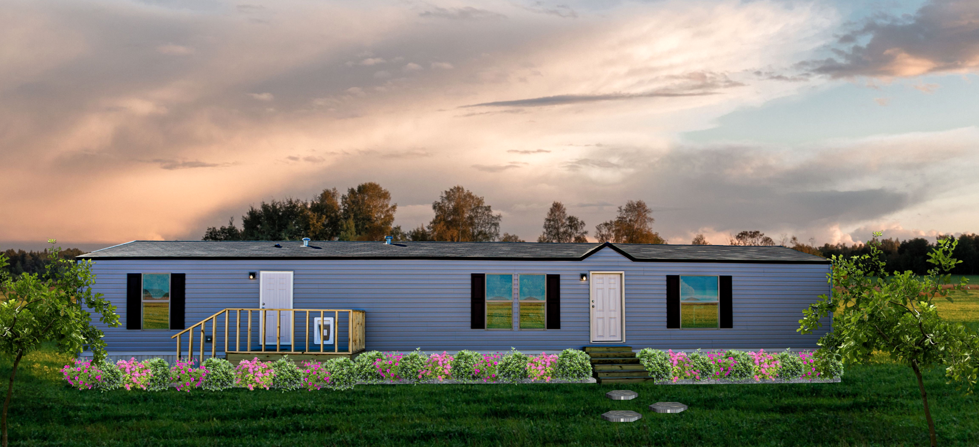

THANK YOU!
Keaton Shepard
Email: keatonshepard@legacyhousingcorp.com
Phone: 817-799-4917

