Slide 1
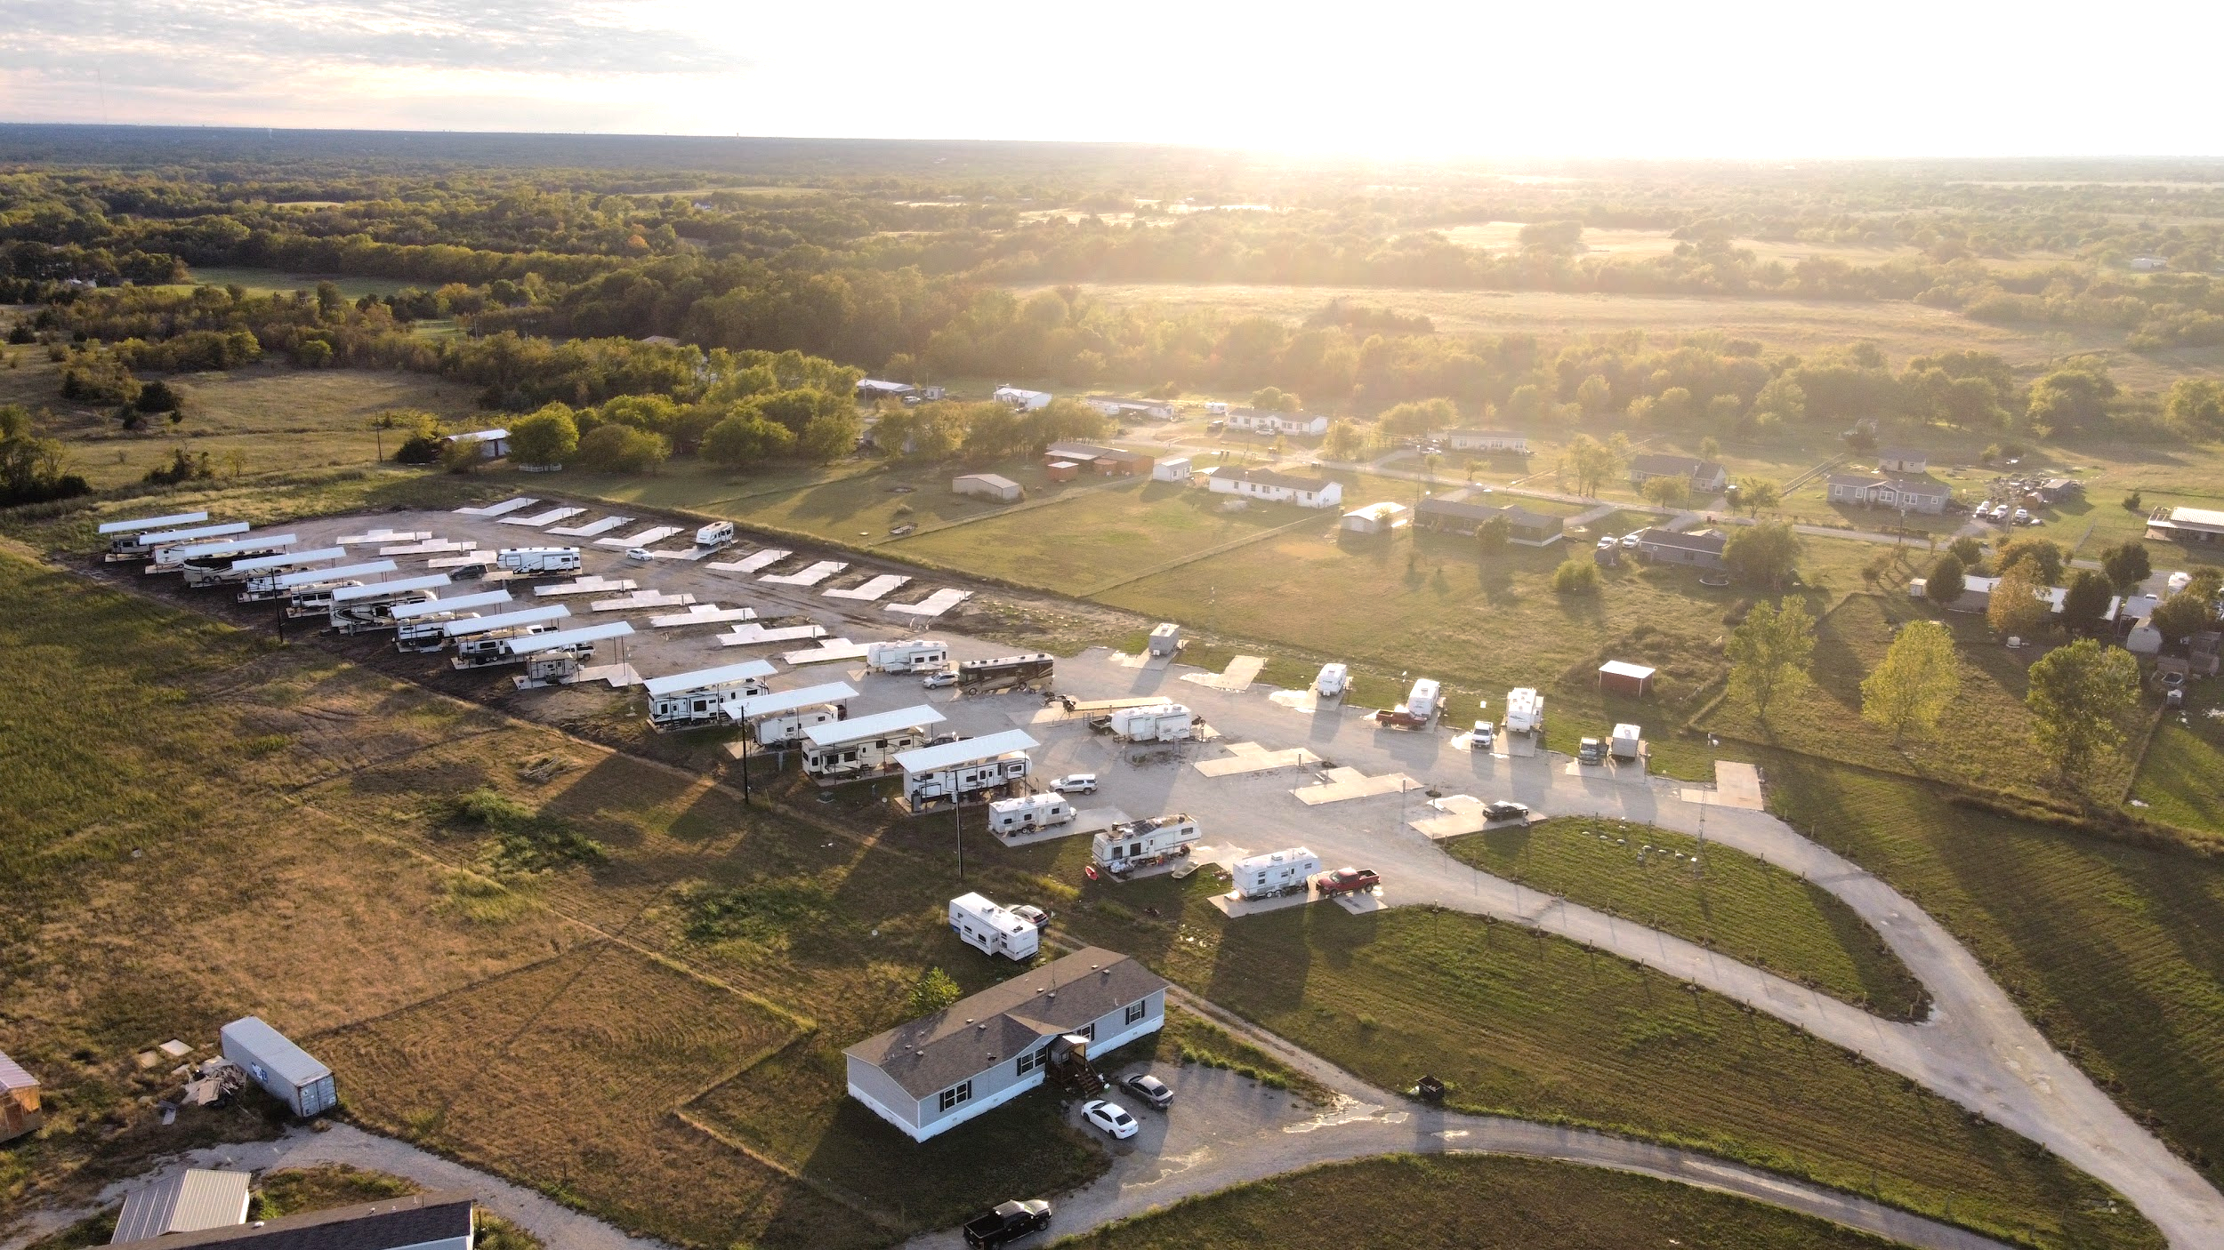

FROM RVS TO TINY HOMES:
MARKET TRENDS & HOW TO CAPITALIZE
Dive into this lucrative journey and discover the strategies that promise solid returns amidst a flourishing market.
PRESENTED BY TANG WYNN
JAN 2024 EDITION
Notes:
Entered text
The Secrets to RV Park Investing

Slide 2

MEET TANG WYNN
  Happily married for 12 years. 2 awesome kids: 8 and 10
  Started Real Estate Investing in 2016
  Partnered up with Eric Kane in 2018 and the Odd Brothers were born.
  - 400+ property transactions
  - Fix and flipped 100+ homes
  - Rentals, Airbnb’s, Owner Financing, WRAP’s, Sub-To’s, CREATIVE FINANCING
  Diversified into mobile home sales in 2020, recognizing opportunities in RV and affordable housing markets post-COVID-19. Shifted focus to RV park investments in 2023, quickly acquiring 4 premier locations with a goal to expand to 15 parks within the next three years.
  Leads operations and acquisitions across his portfolio, utilizing marketing expertise for continuous expansion.

Slide 3
  Why RV Parks?
    Why I made the shift in 2023
    Who inspired me
    The big shift
  Case Studies
    North Texas RV Park
    Firetower RV Park
  Market Trends
    Demand for Affordable Housing
    Marketing Strategies
    How to Capitalize
AGENDA

Slide 4
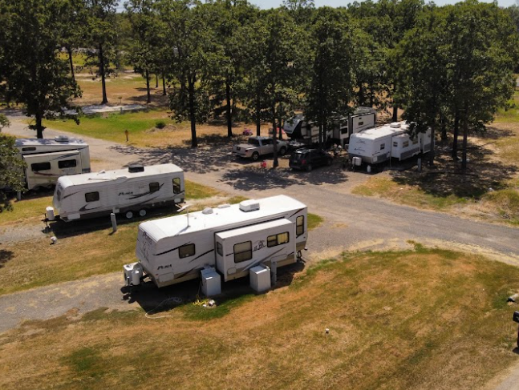
WHY RV PARKS?

Slide 5
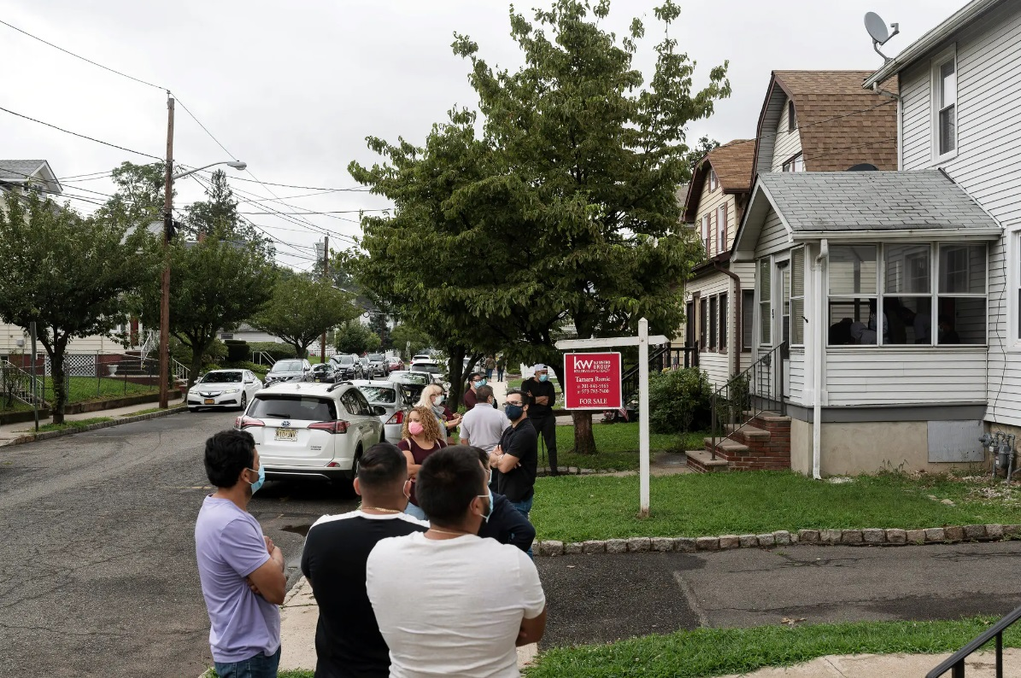
  What was happening in the
  Real Estate market in 2021-2022?
  The market was going NUTS!
  What was the cause?
  Low Interest Rates
  Pandemic-Driven Demand
  Limited Housing Supply
  Government Stimulus
  Favorable Demographics
  Investor Activity

Slide 6

  What did we see?
  Rapid Price Appreciation
  Speculative Buying
  High Levels of Debt
  Supply Chain Disruptions
  Rising Interest Rates
  Shift in Economic Conditions
  Government Intervention

Slide 7
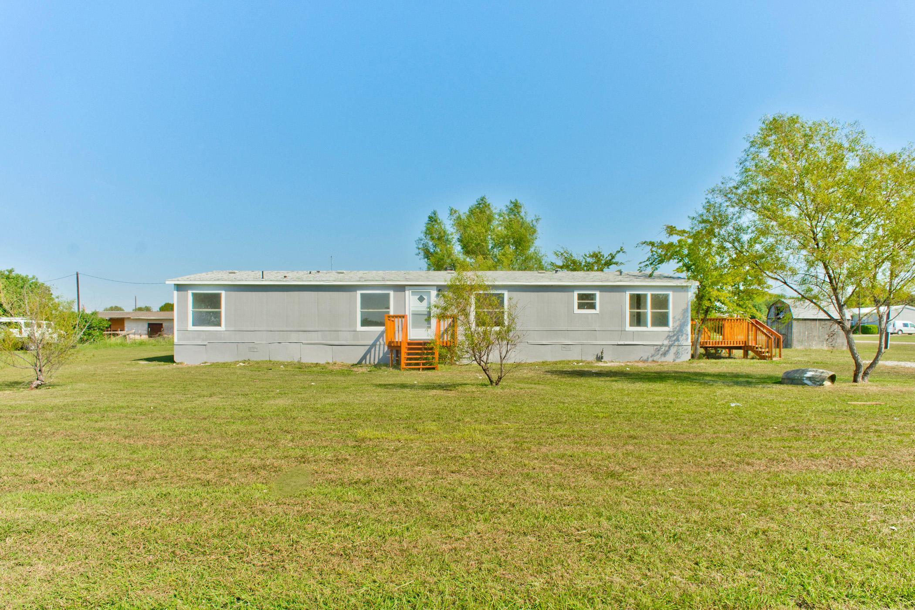
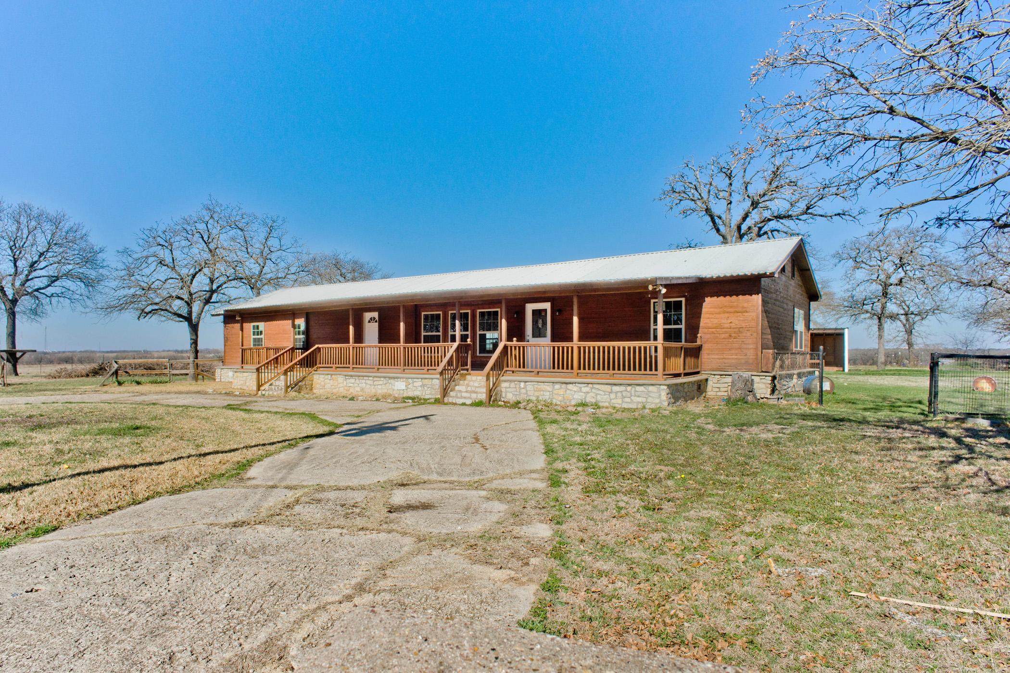
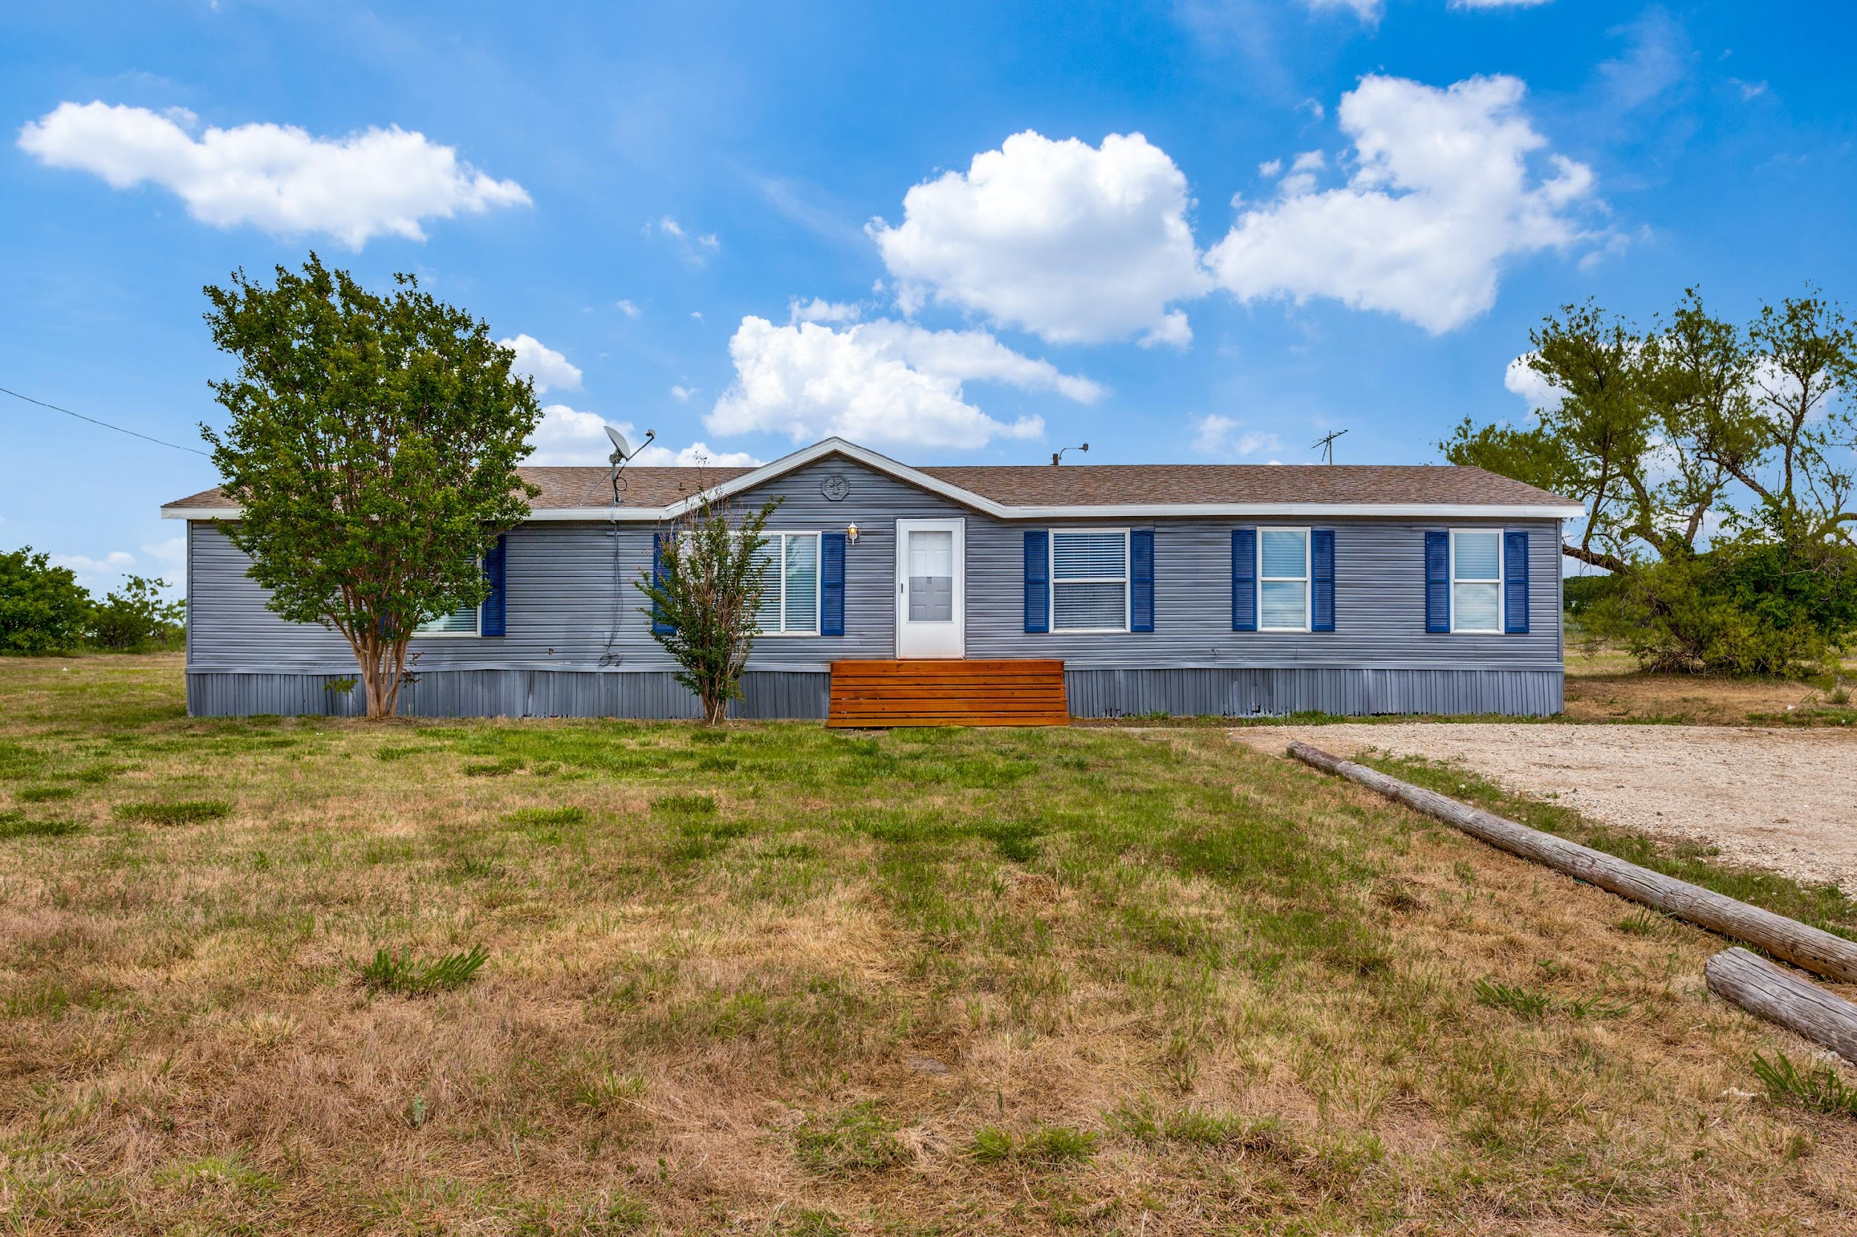
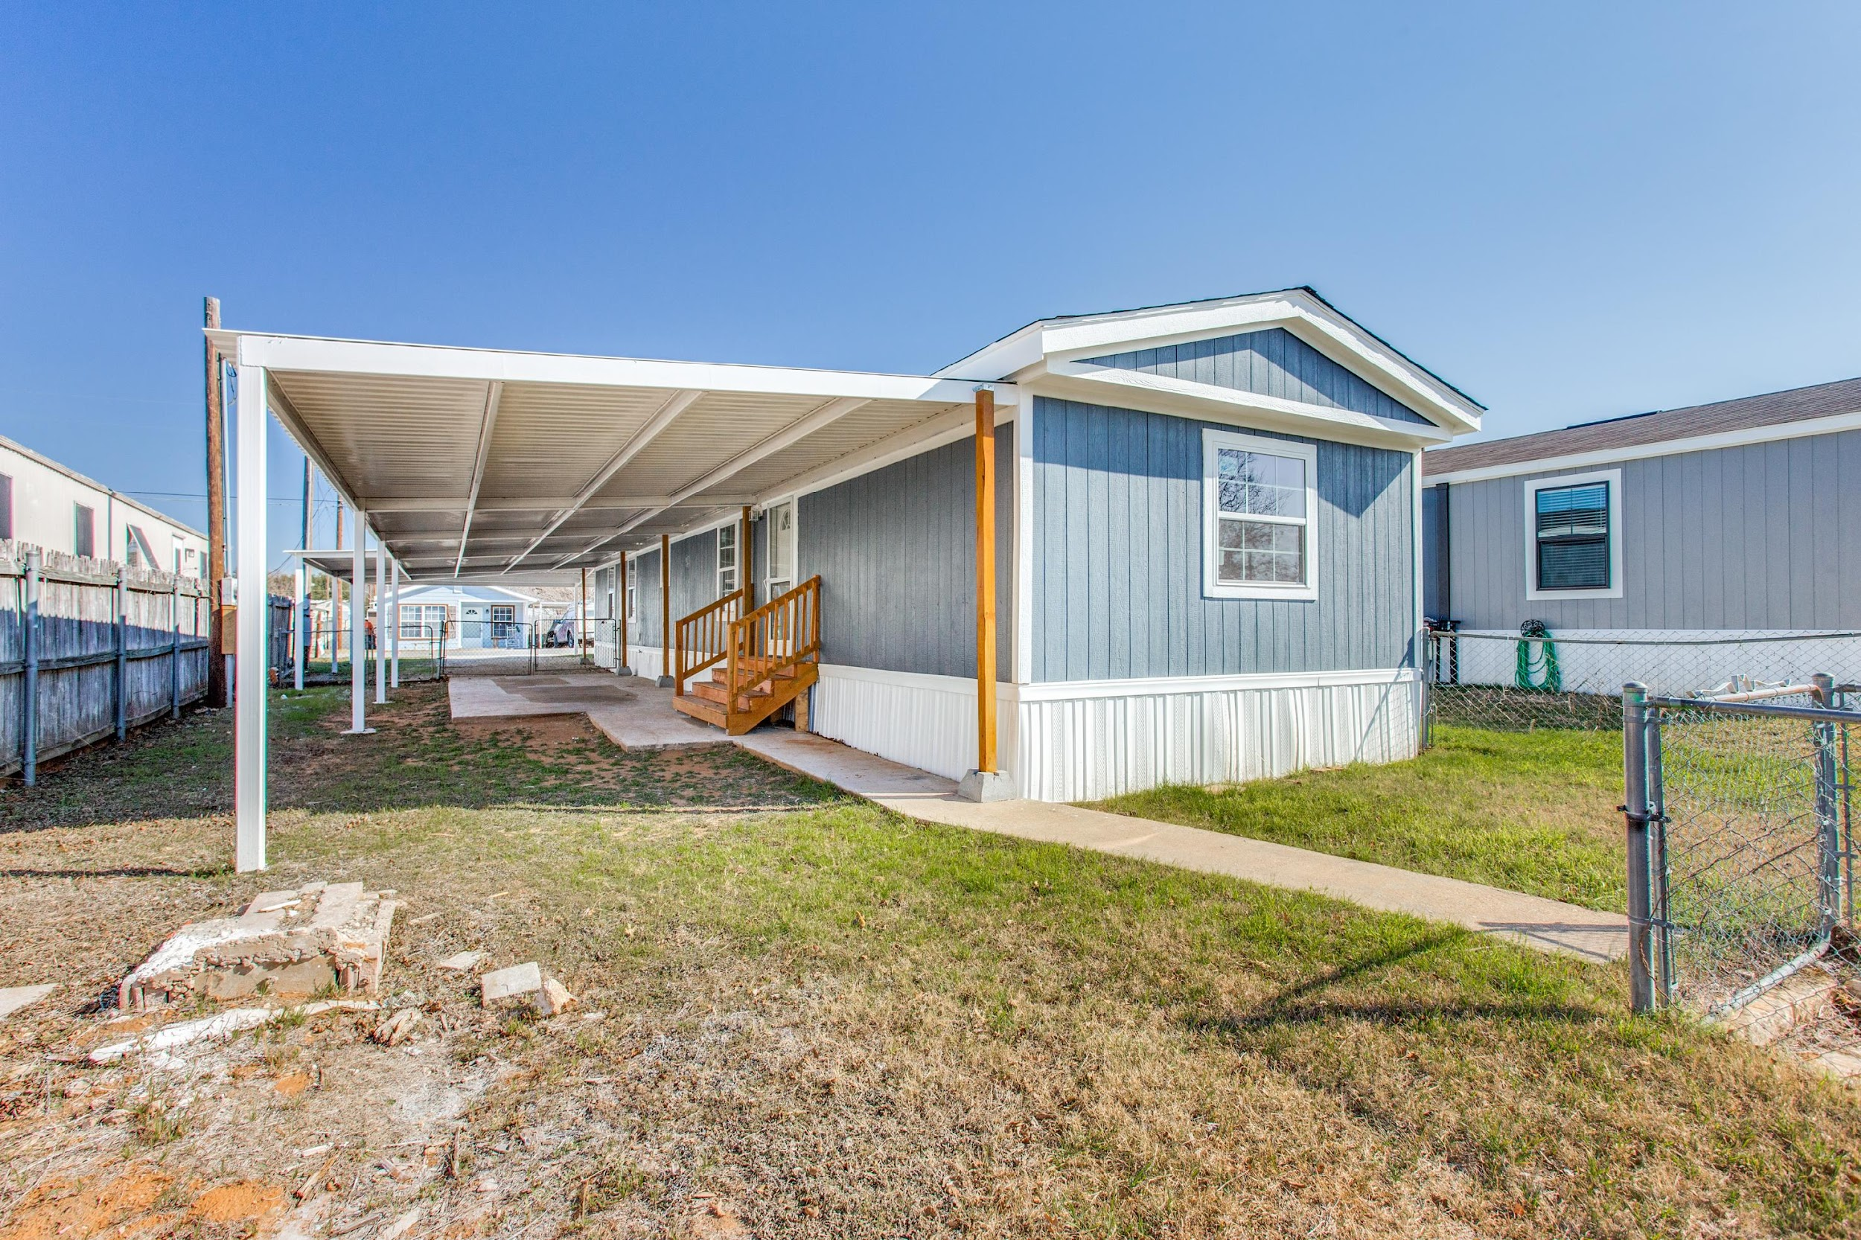
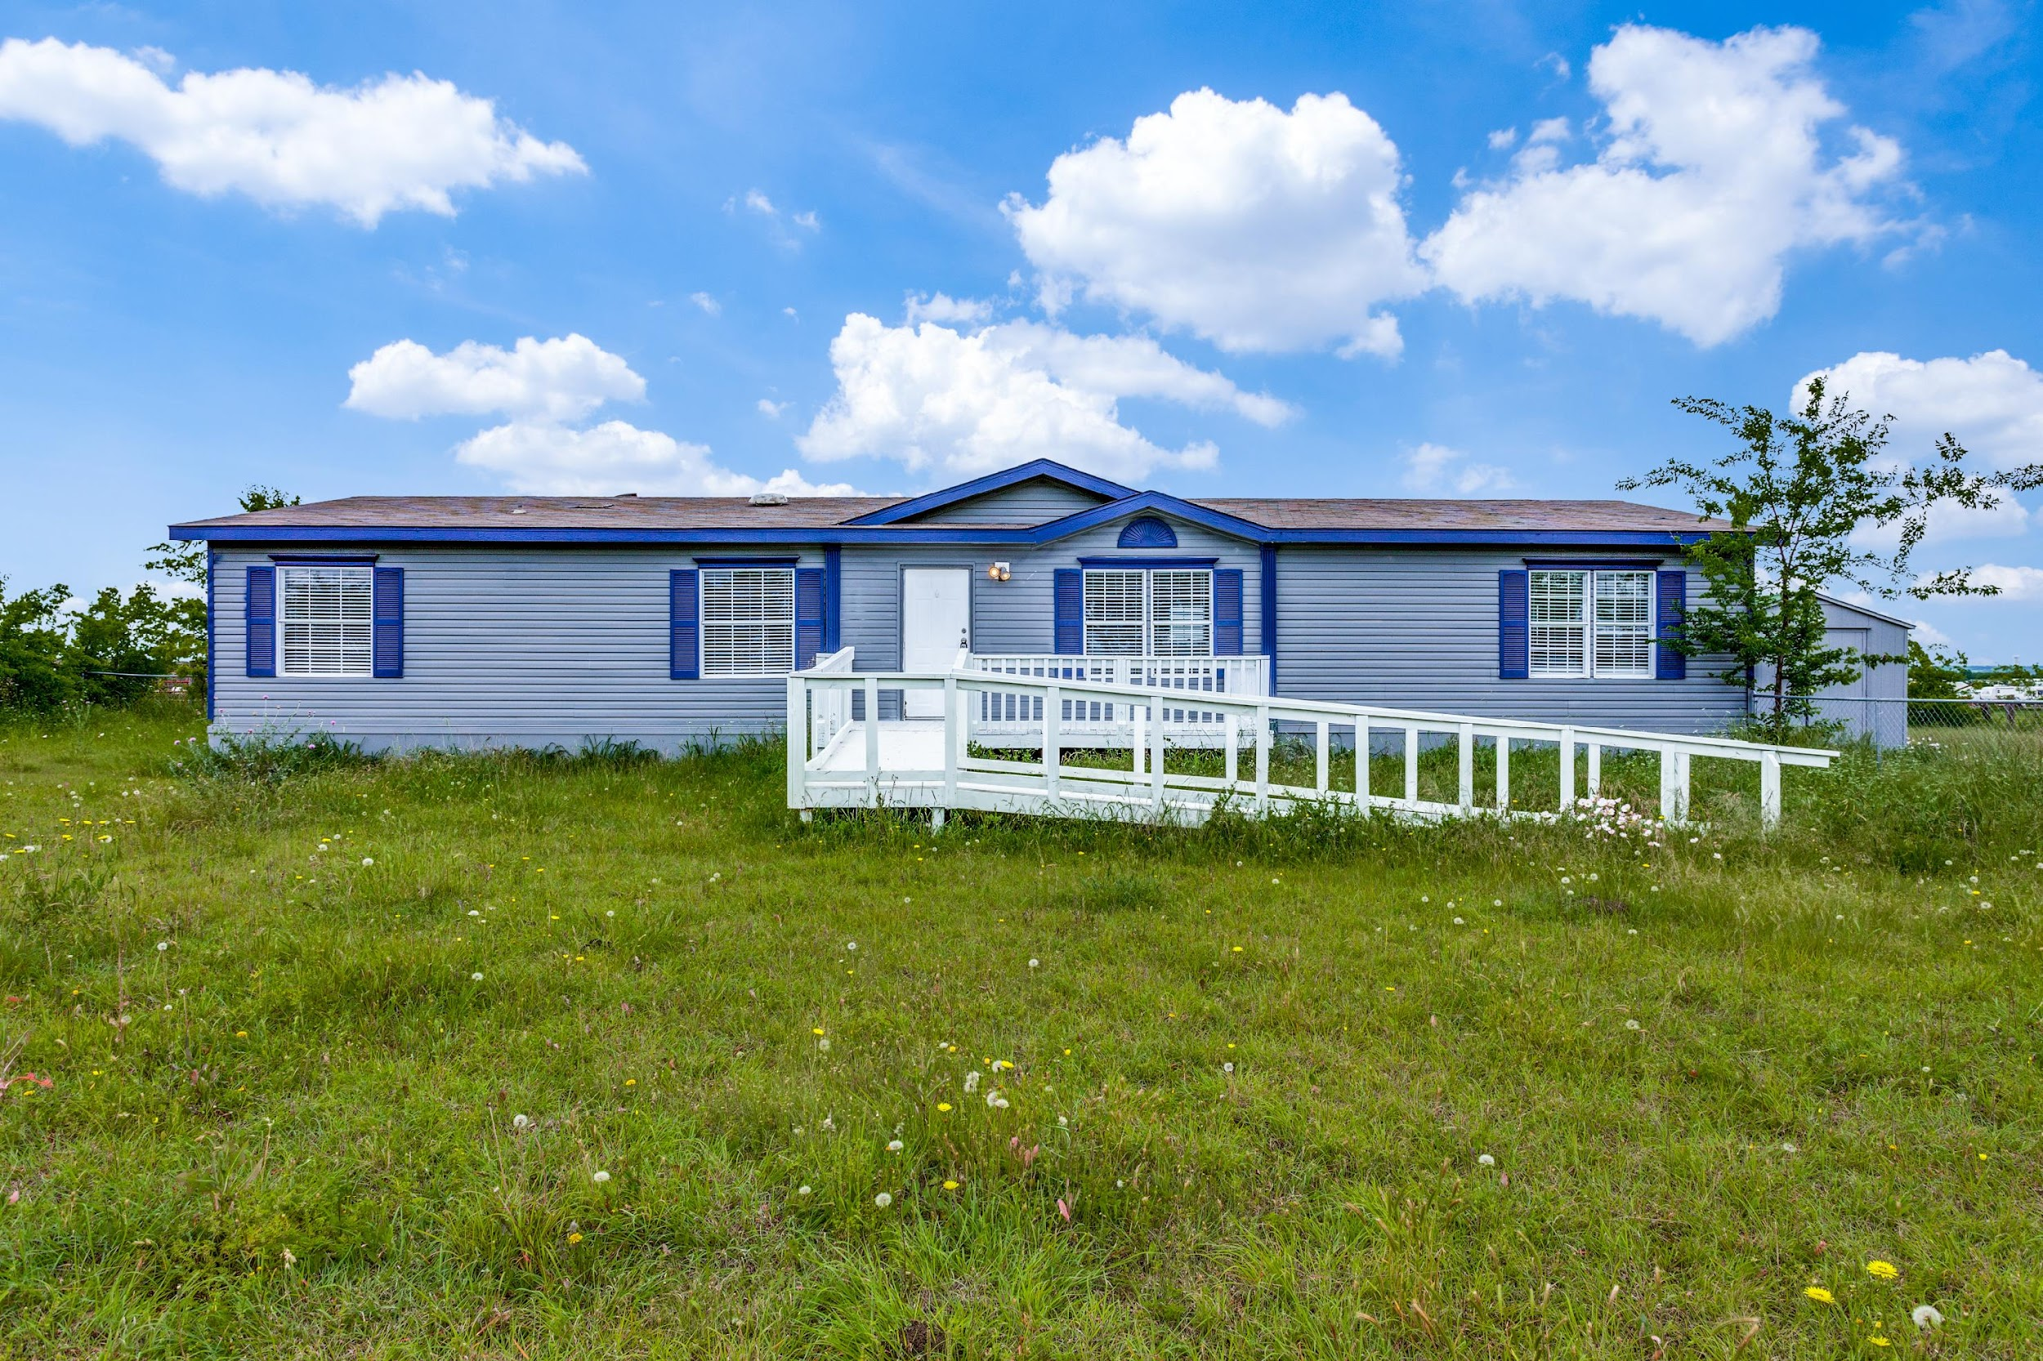
  #1 Focus: AFFORDABLE HOUSING
  Mobile Homes
  Price point under $200k
  Distance was not a factor anymore
  Consumers wanted space (During/Post Covid)
  Installing brand new mobile homes to sell/rent

Slide 8



July 31, 2022
I attended SARECON in California
(Subtle Asian Real Estate Conference)
I met Hersh Rai, a 24-year old who owned a 16-unit apartment building, a boutique hotel and 2 mobile home parks, all while living in
Hawaii!
How is this possible?
He was the inspiration that I needed to jump into mobile home parks.

Slide 9
  I HAD TO MAKE DRASTIC MOVES
  Let go of my entire acquisitions/disposition team Q4 of 2022
  Spent 3 months learning everything about Mobile Home/RV Park Industry
  Lastly, one of the hardest things for me to do was…

Slide 10
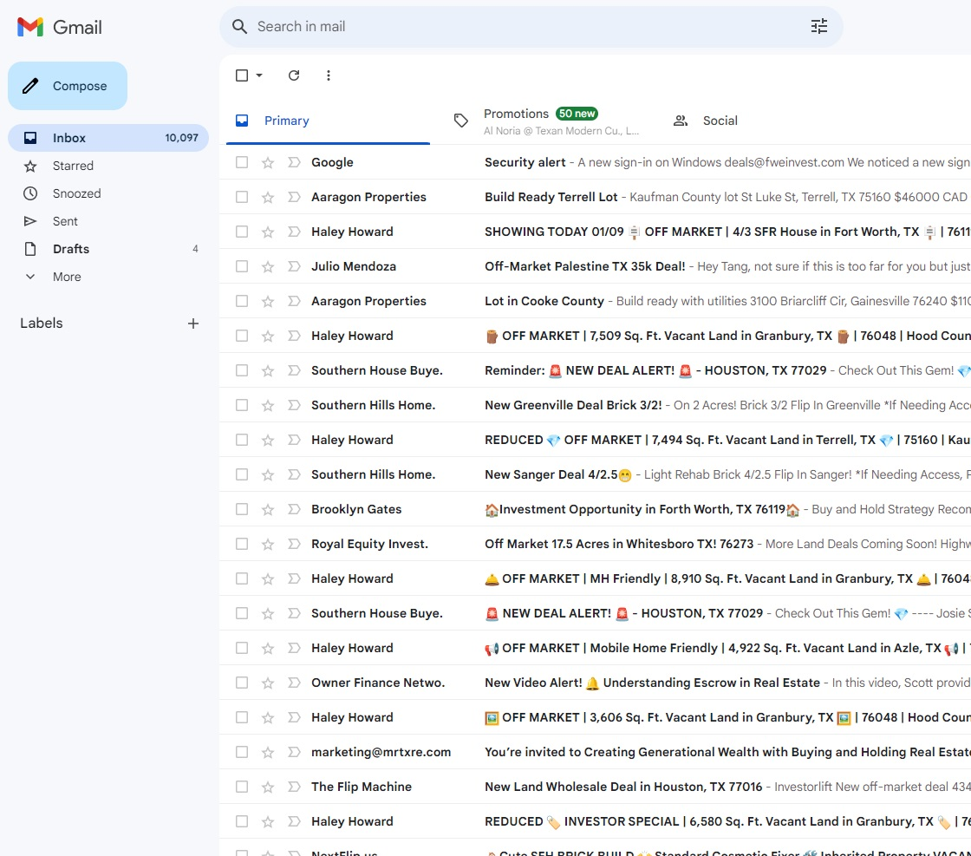

  FROM EVERY EMAIL PERTAINING TO SINGLE FAMILY RESIDENTIAL

Slide 11
PIVOTING TO RV PARKS IN 2O23
During my 3-month research on Mobile Home/RV Park industry in Q4 of 2022,
I realized quickly that RV Parks was the way to go…
Lower infrastructure costs
Higher Daily/Weekly Rates
Inventory
Eviciton Process is much faster
Turnover is much faster and cost efficient
We have dirt, water, utilities, and sewer

Slide 12
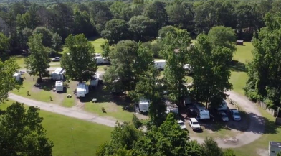
CASE STUDIES

Slide 13
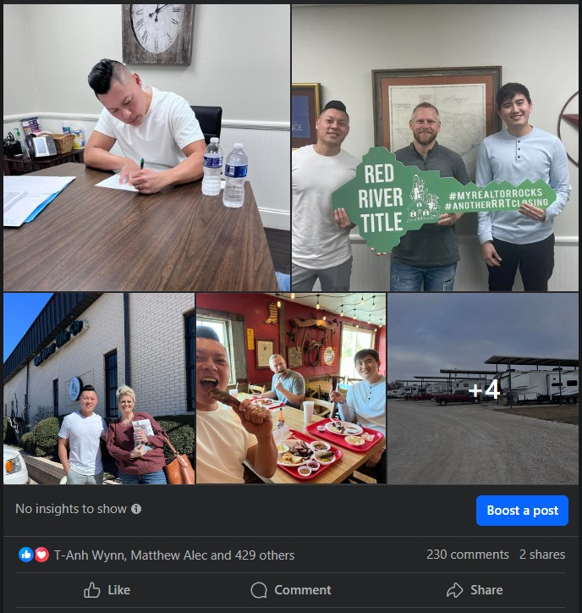
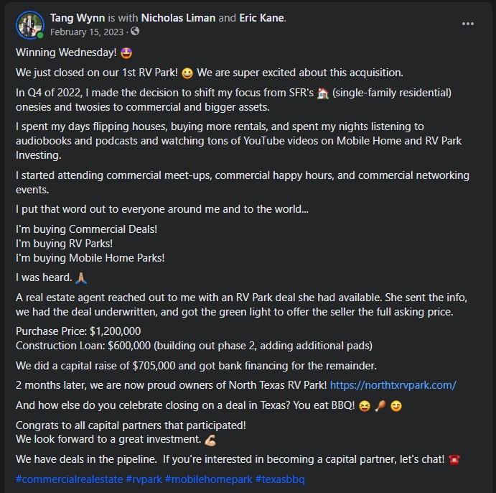
NORTH TEXAS RV PARK

Slide 14
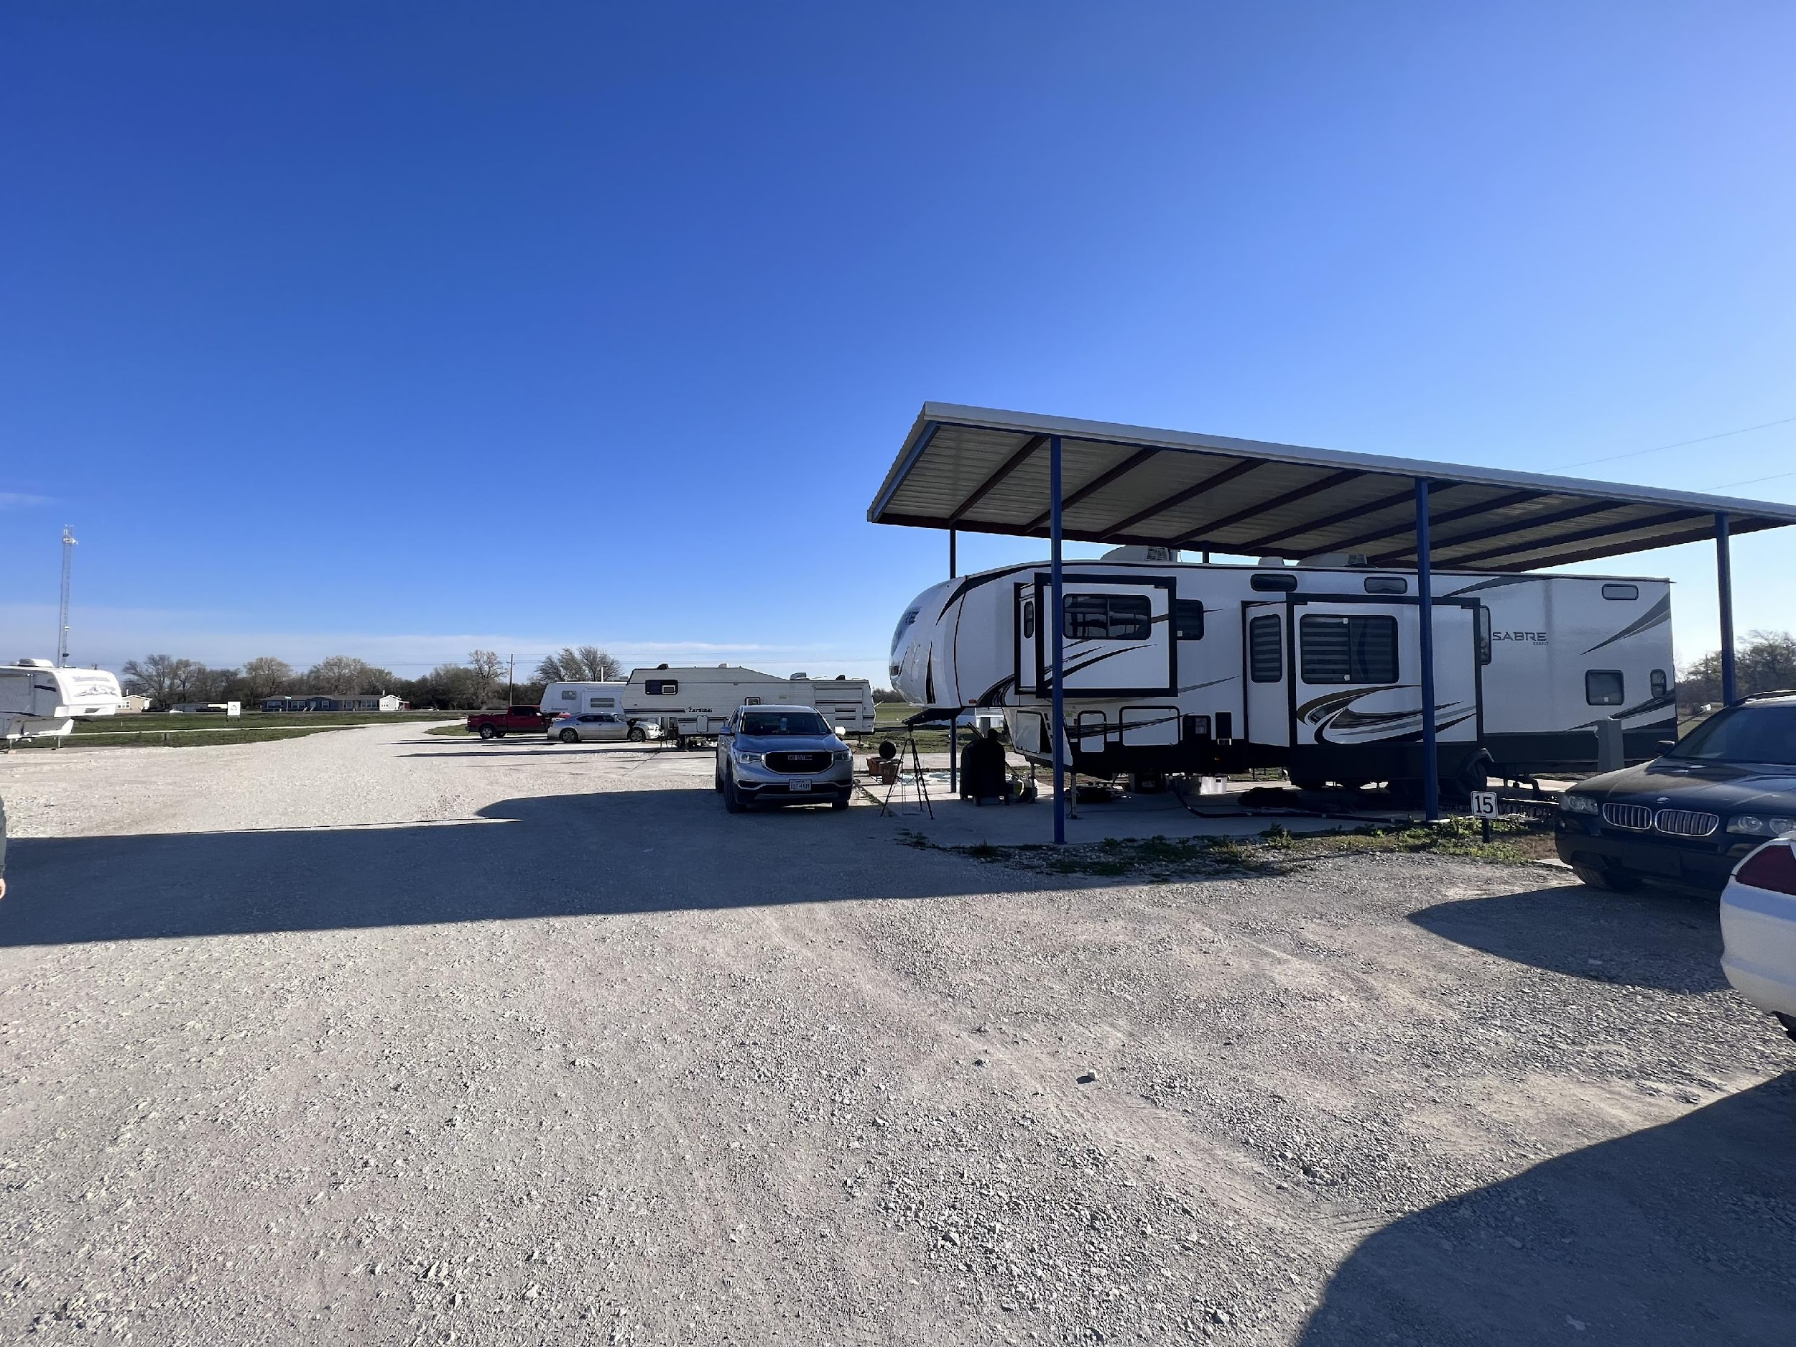
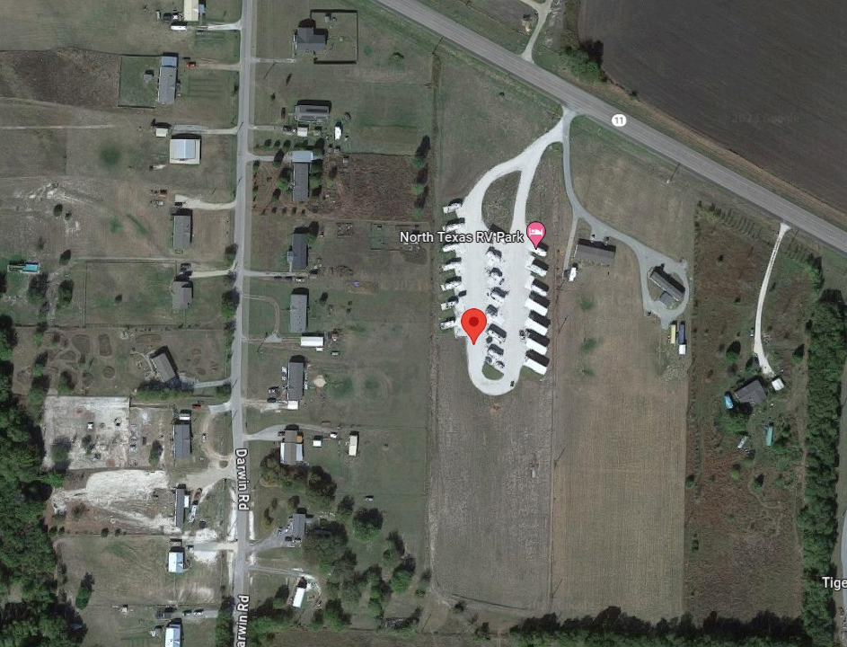
NORTH TEXAS RV PARK
North Texas RV Park was a 21-unit RV Park in Whitewright, TX, located 16 mins from Sherman, TX, one of the hottest developing areas in DFW.
  There were 4 acres of undeveloped land ready to be outfitted with 34 additional units, according to the seller’s original plans.
  This was a strong value-add along with an upside in rent and cost-saving measures.
  There is strong demand for RV parks in the area due to the development and need for long-term housing for employees
Purchase Price: $1,200,000
Equity Raise: $705,000
Price Per Unit: $57,000
Current Avg Rent: $492
Proforma Avg Rent: $516

Slide 15
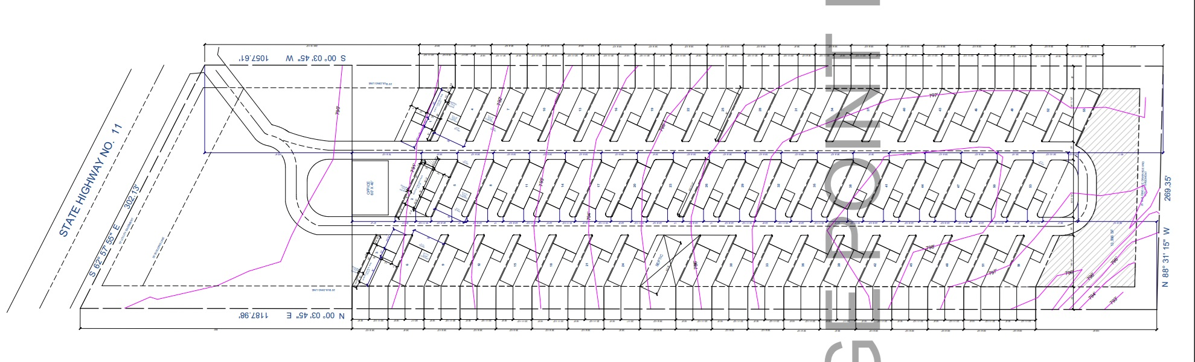
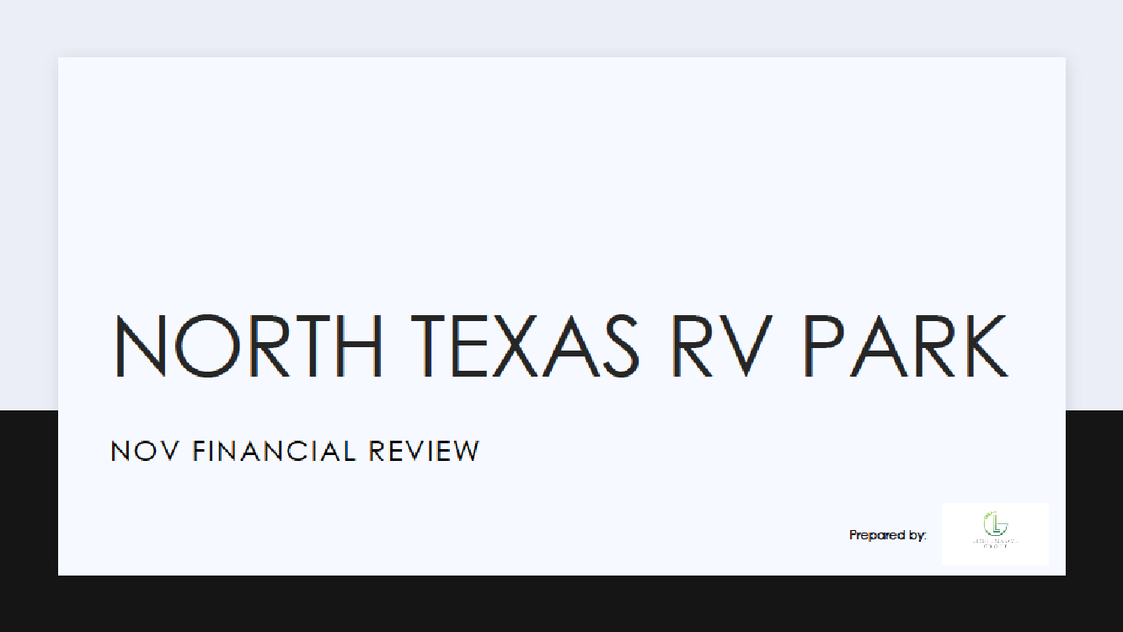
NORTH TEXAS RV PARK
  The Seller’s original plans had 55-pads. However, by the time we closed on this property and Eric started doing research, Grayson County made some changes to how many pad sites are allowed on an acre according to the new septic regulations and requirements.
  We went from 10 pad sites per acre down to 8.6 pad sites per acre. 😫Losing 7 spots would lower our valuation by $400,000! We needed to figure how make up for it.
  And that’s when we looked in to Tiny Homes. 😀😀😀

Slide 16
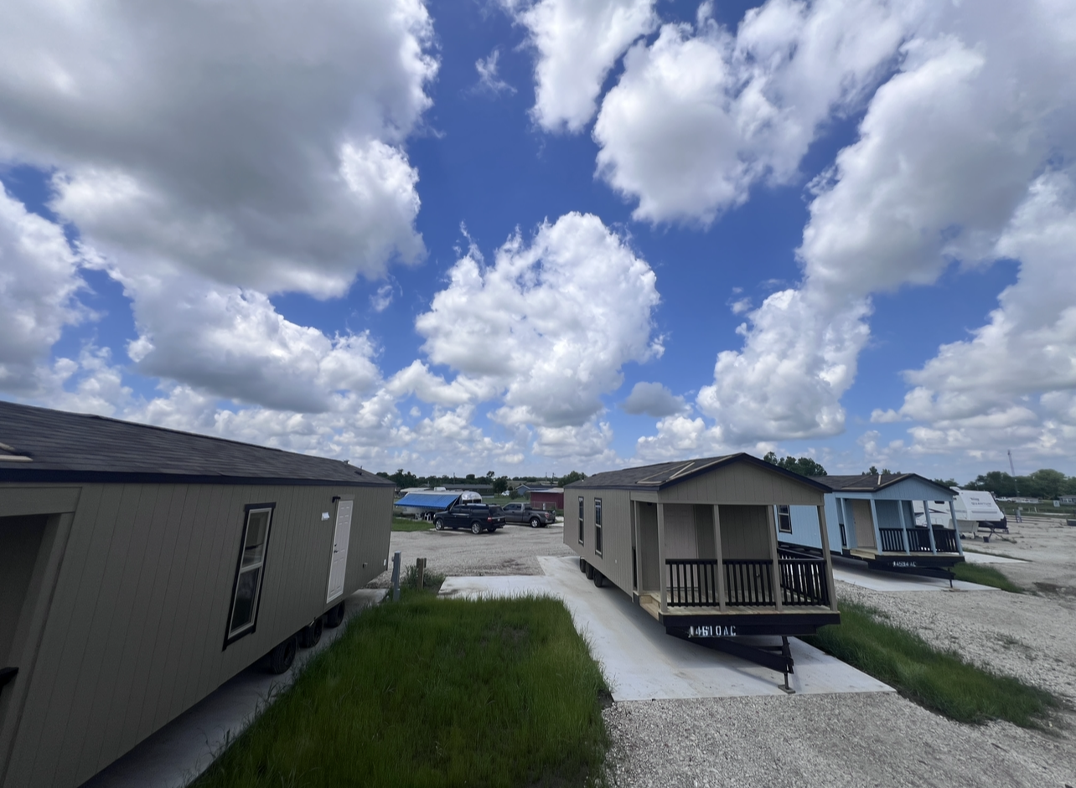
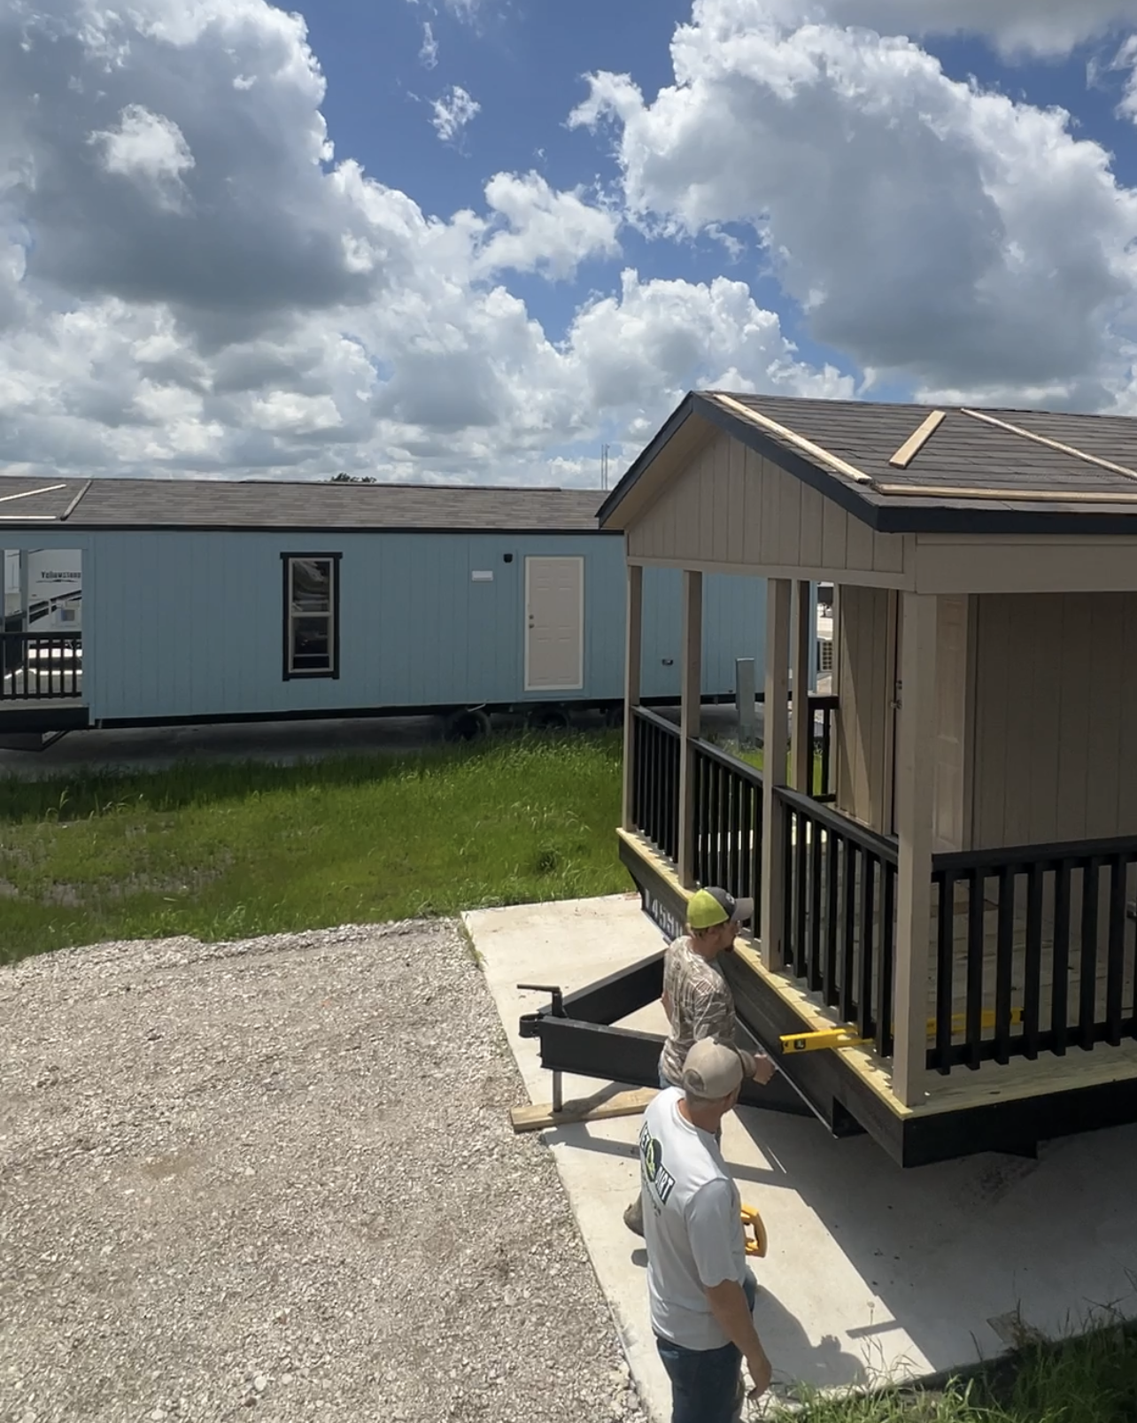
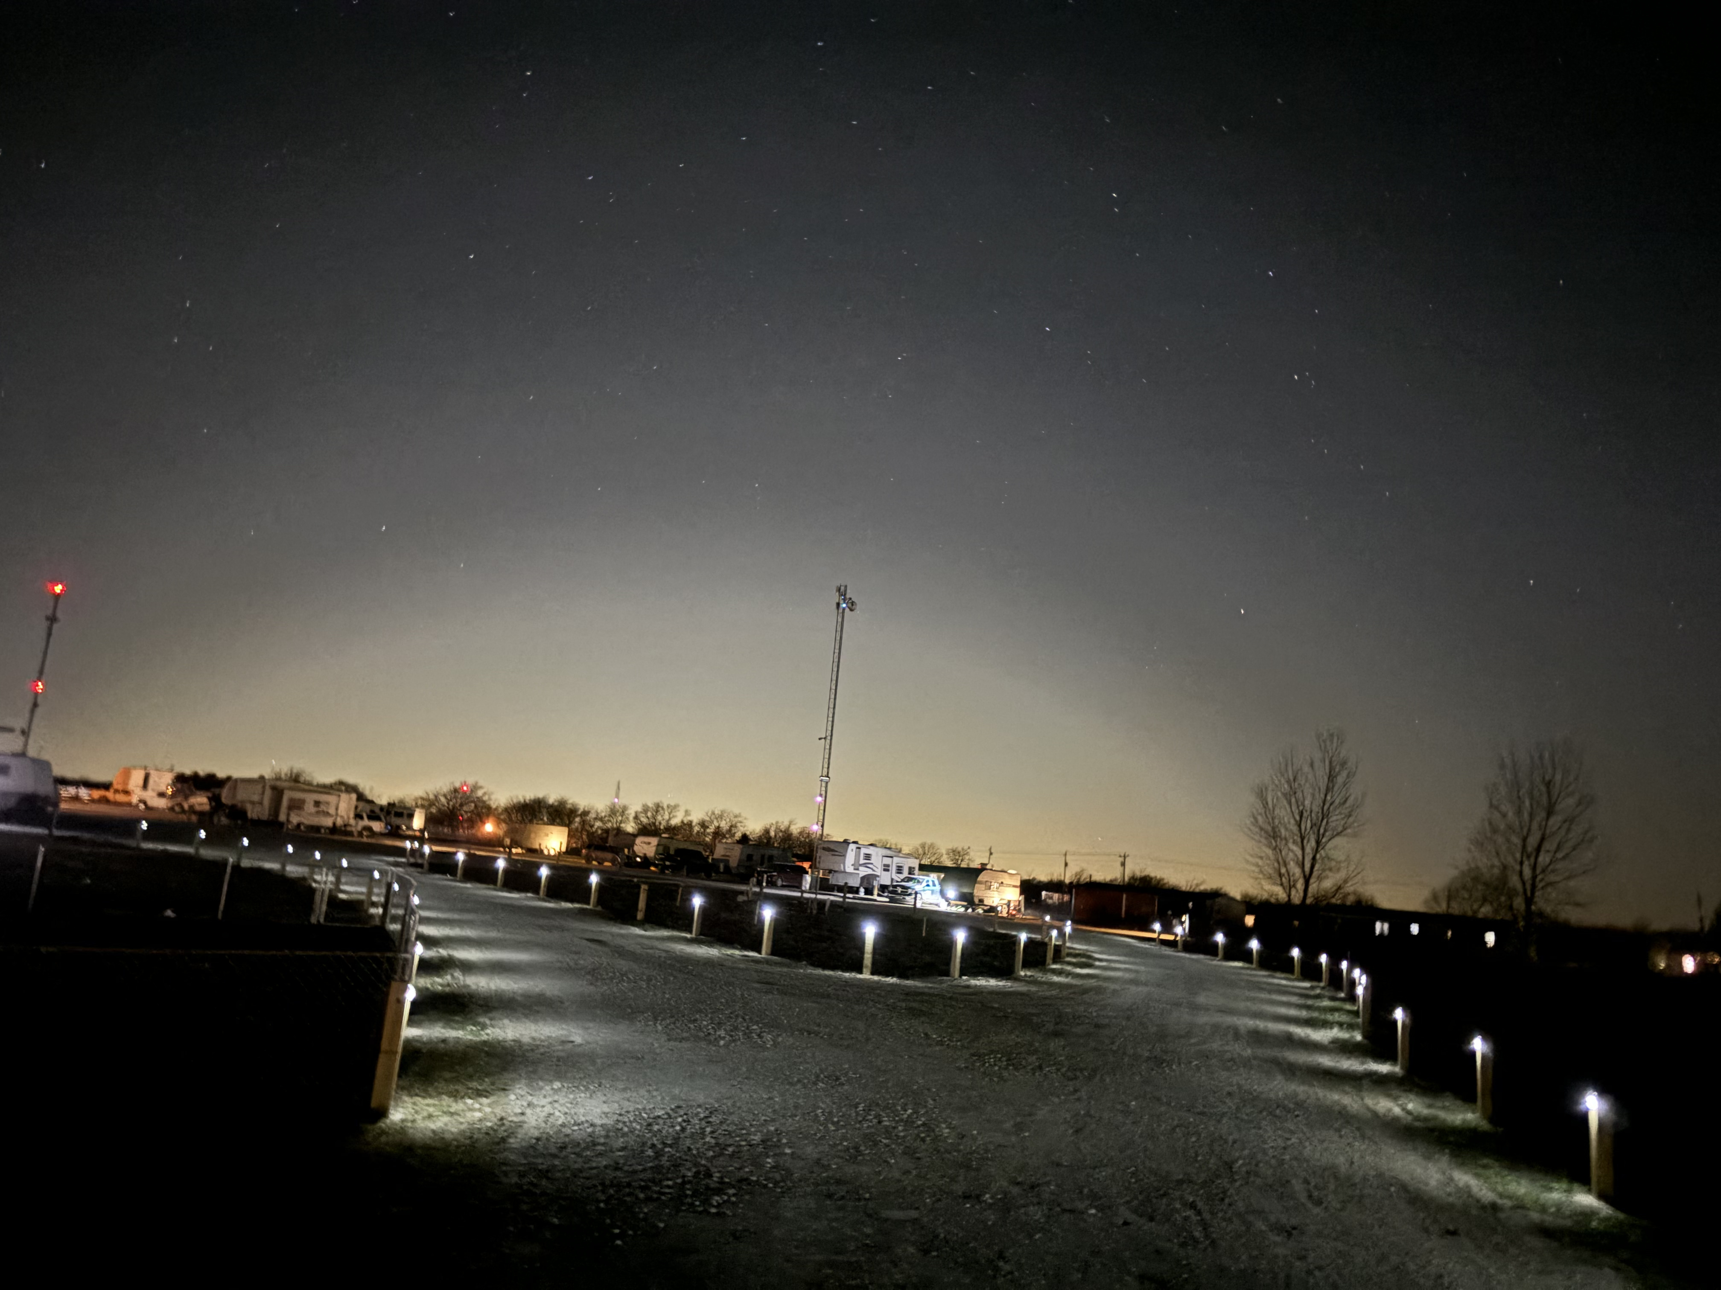
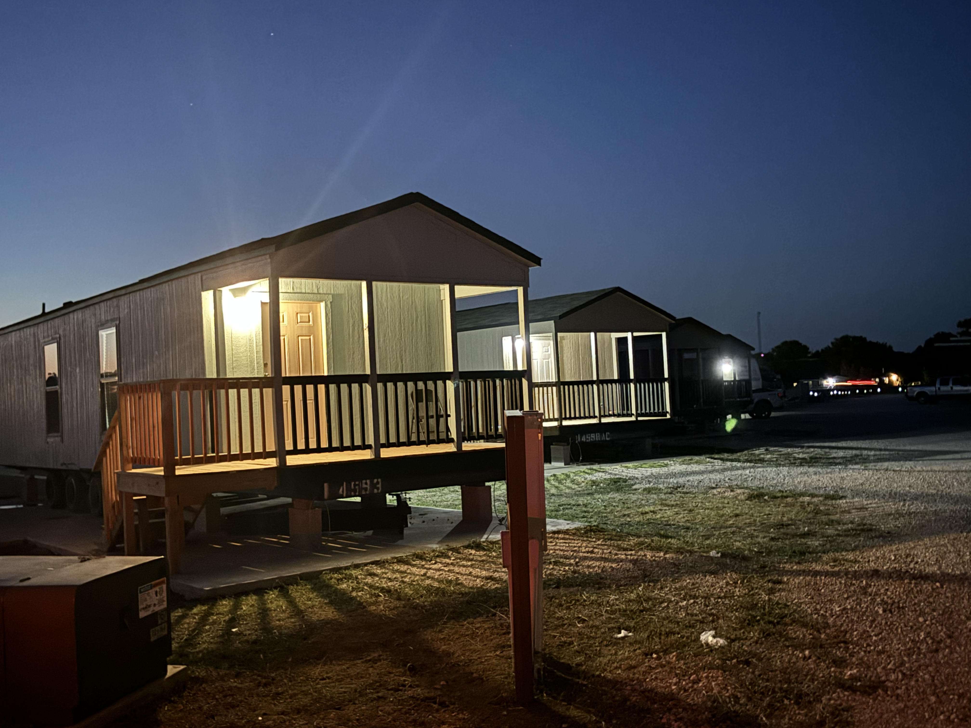
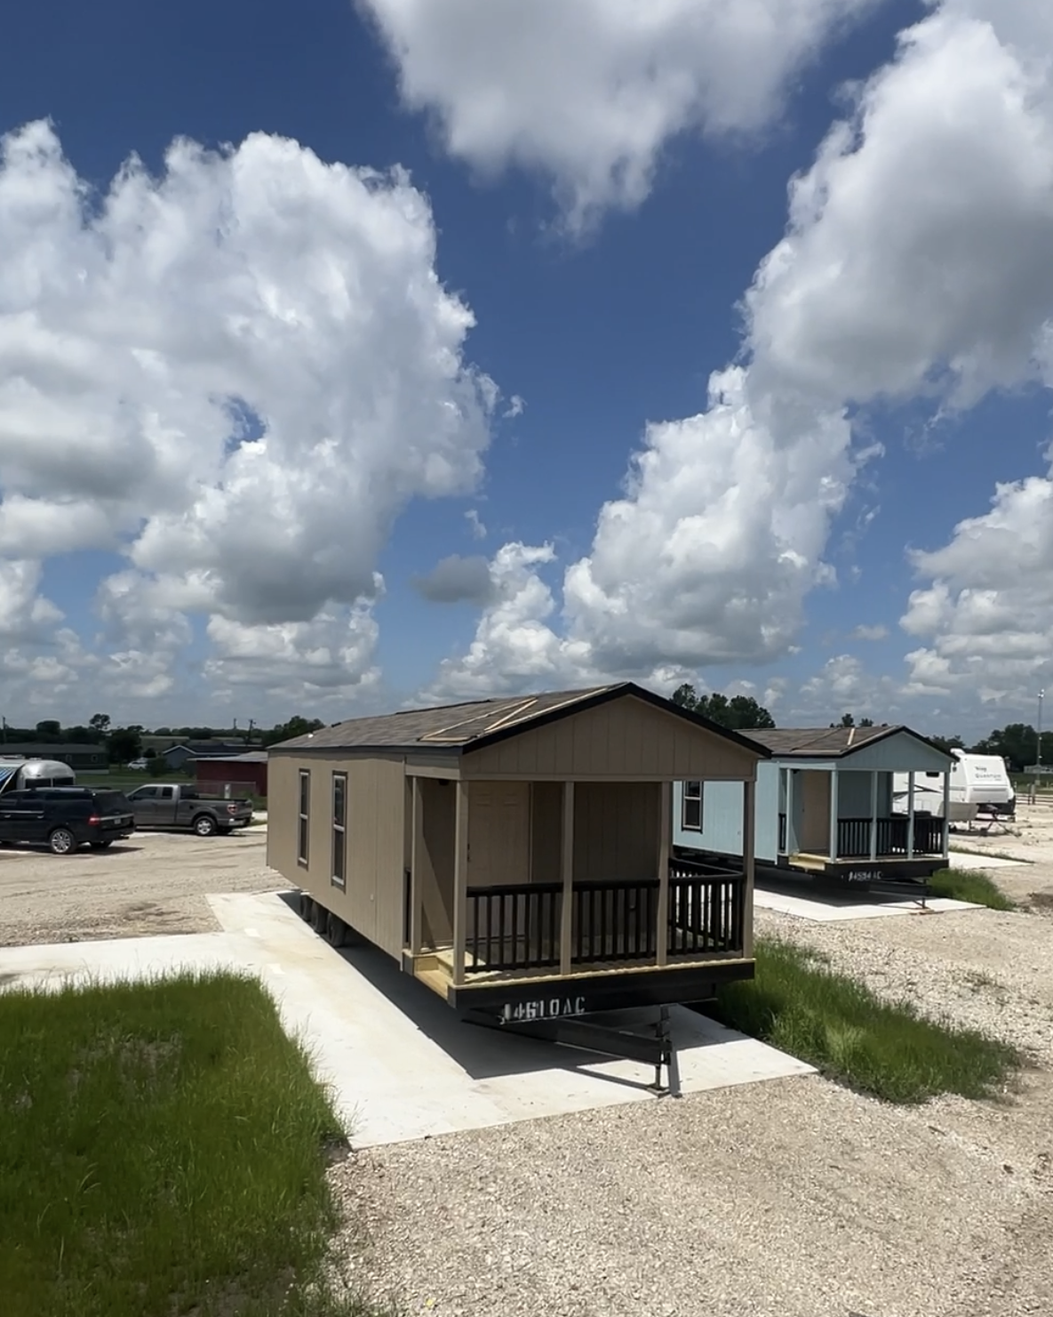
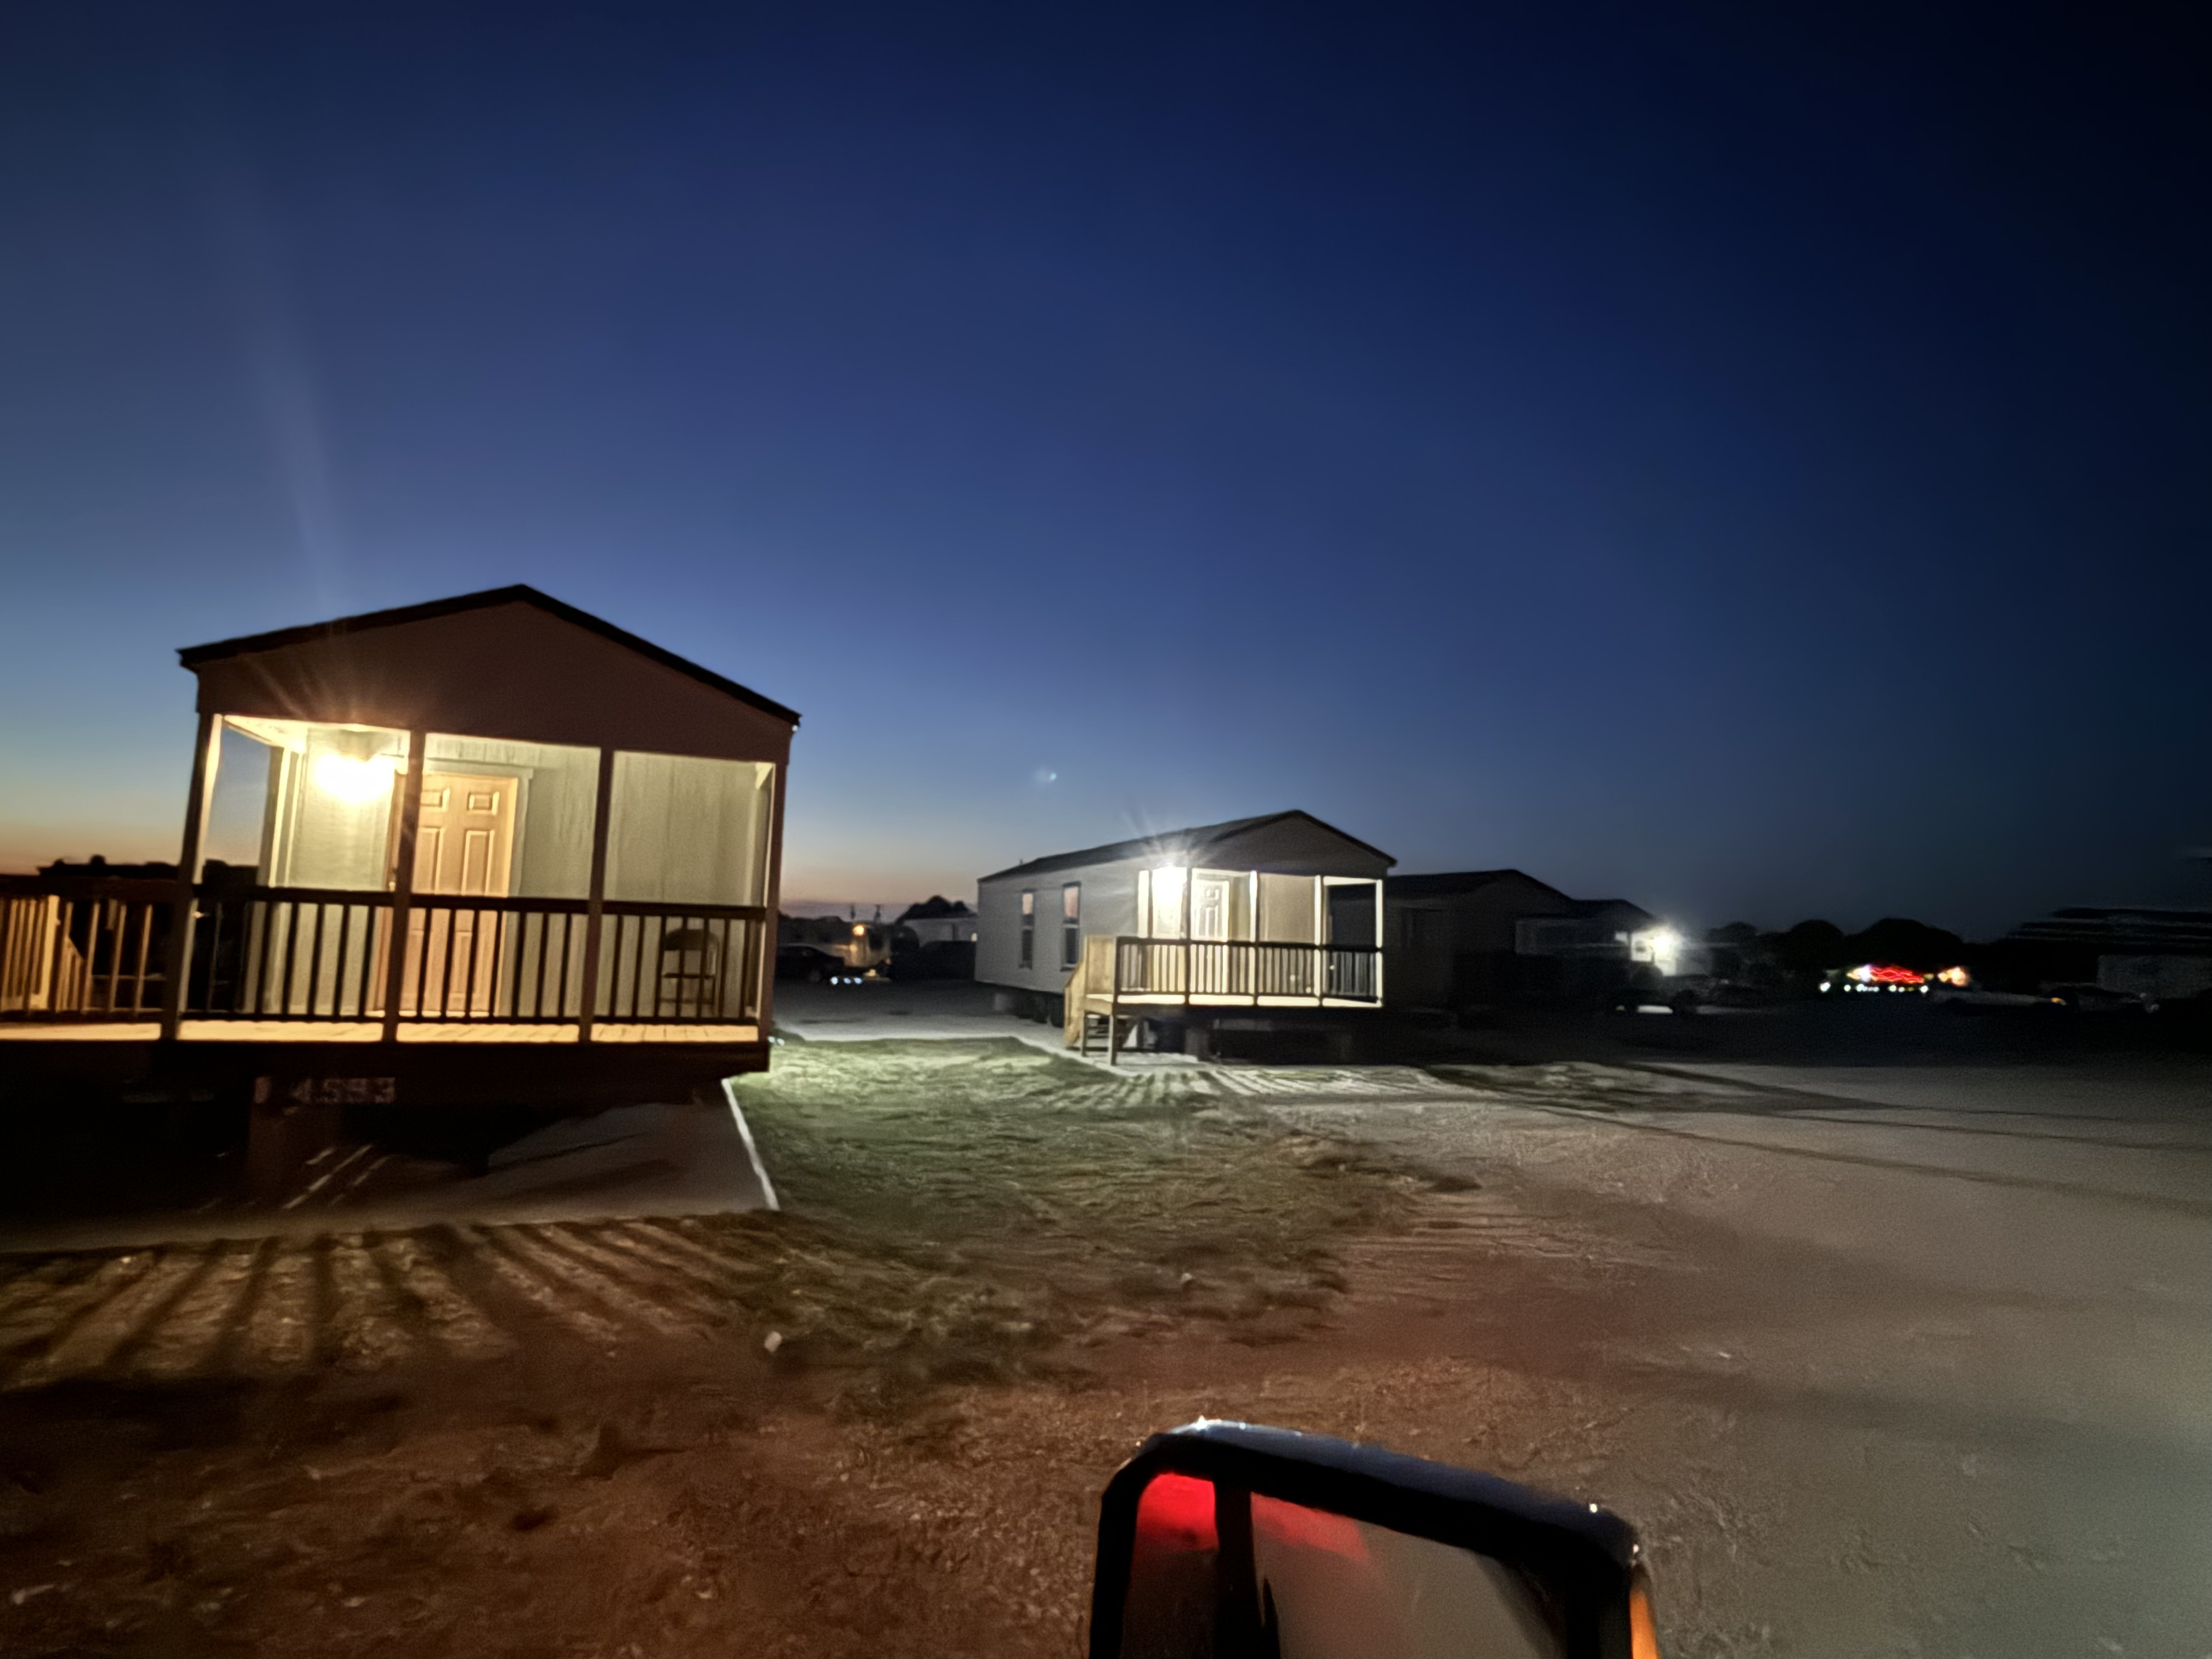
NORTH TEXAS RV PARK

Slide 17
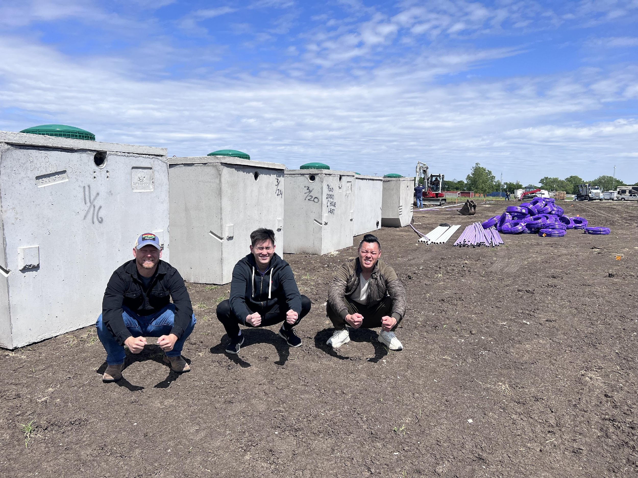
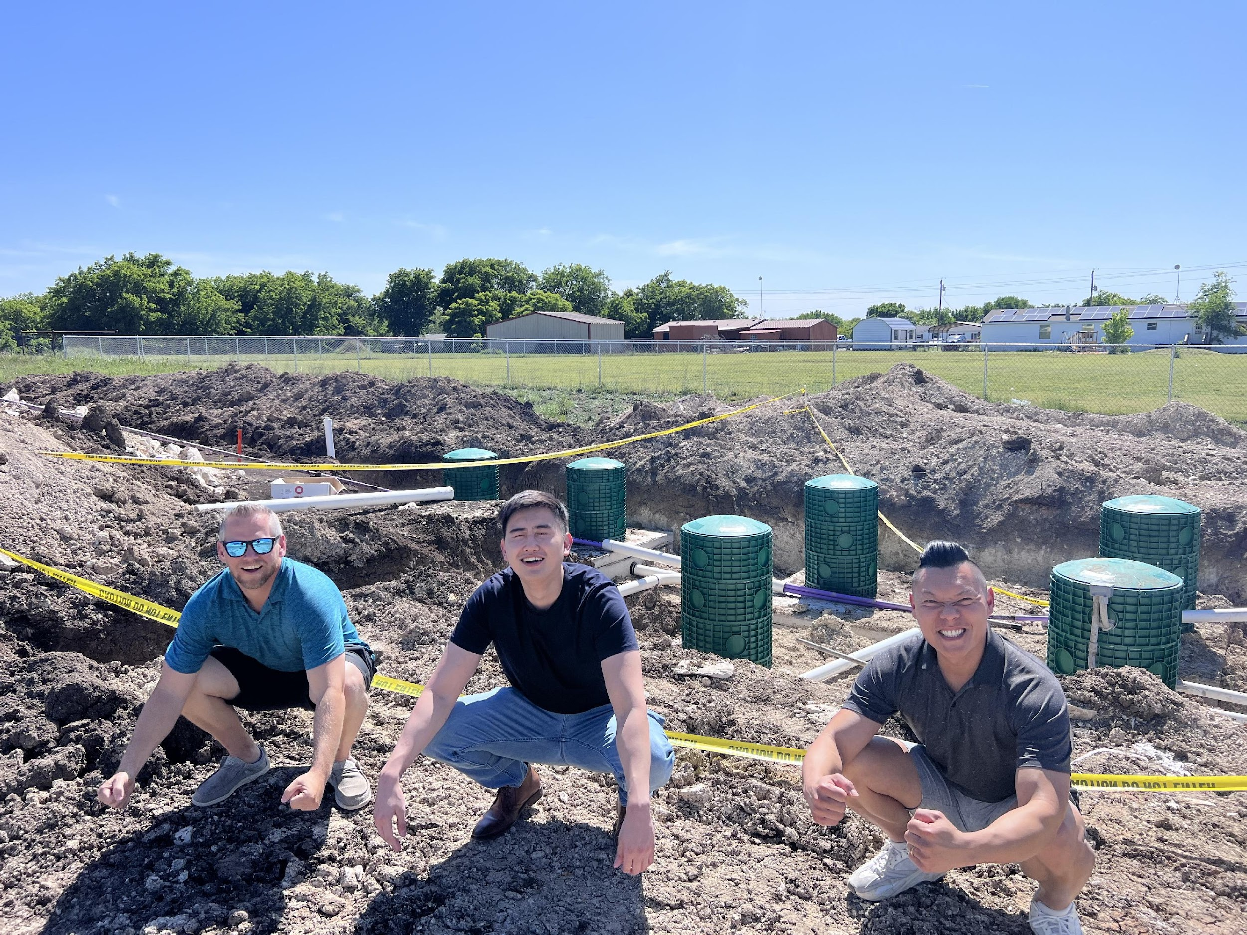
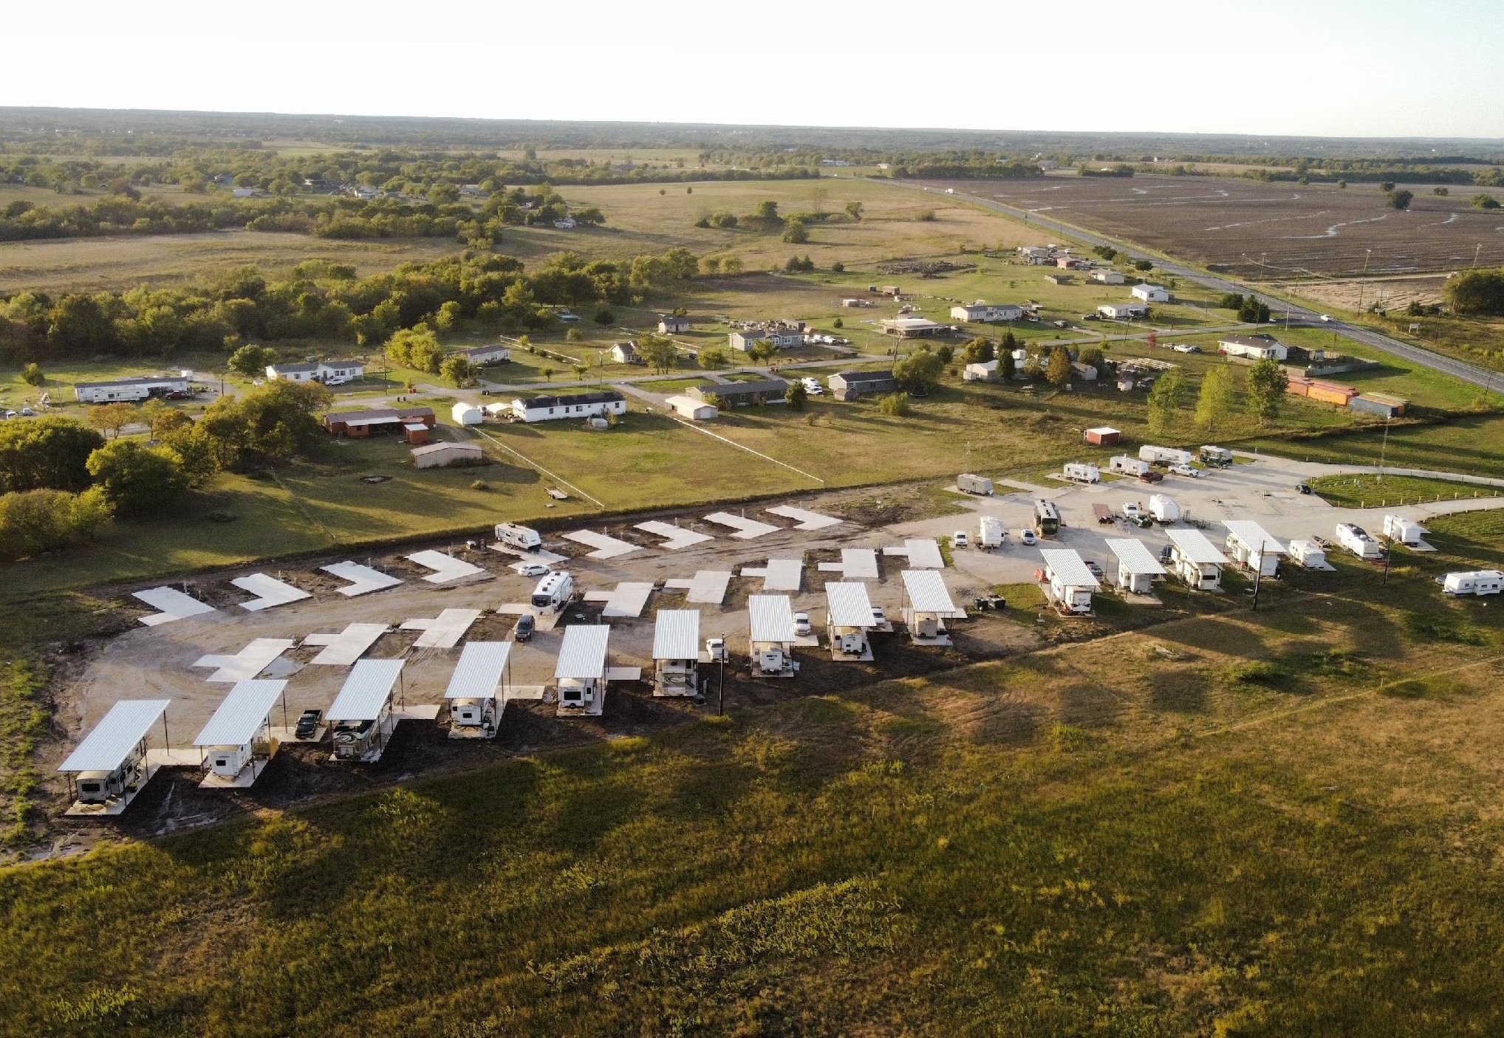
NORTH TEXAS RV PARK
Our goal in 3 years:
Get all 44 pad sites leased out at an average $600 per site = $316,800 per annum
Get 4 tiny homes leased out at $1,200 per tiny home =
$57,600 per annum
- Income from laundry facility =
$6,000 per annum
NOI for 2025: $274,368
EXIT at 9 CAP = $2,900,000

Slide 18
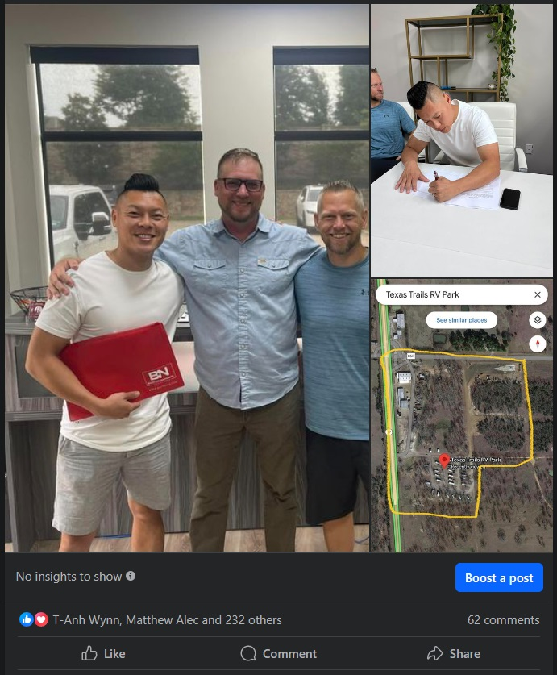
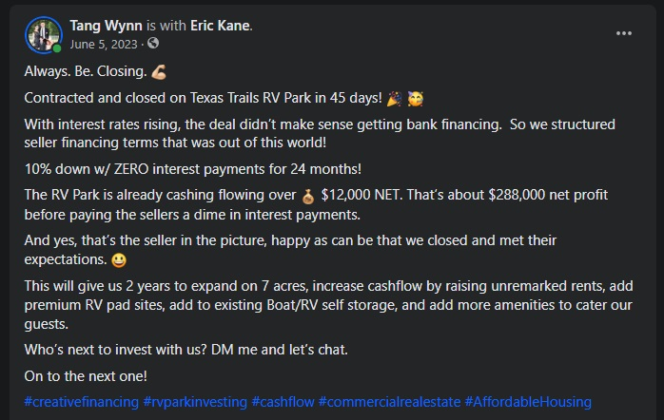
TEXAS TRAILS
RV PARK & STORAGE

Slide 19
TEXAS TRAILS
RV PARK & STORAGE
Salford & Co.
A total of 24 acres fit with:
  29 RV Pads
  17 Self-Storage Units
  1 Shop & 1 Office
Arranged the following seller finance terms:
  20% down = $490,000
  $0 interest payments for 24 months**
  6% interest
  30-Year Amortization
    7-Year Balloon
Equity Raise Requirement:
$700,000
Purchase Price: $2,450,000
Down Payment: $490,000
Est. Closing Costs: $49,000
Acquisition Fee: $73,500
Construction: $87,500
Additional Details:
  Expect Cash Flow on Day One
  Currently netting $10,000 per month.
    We look to increase that to $13,000 without any capital expense.

Slide 20
Our goal in 2 years:
  Get all 29 pad sites leased out at $500 = $174,000 per annum
  Find a tenant to lease out commercial shop at $10,000 per month = $120,000 per annum
  Find a tenant to lease out office at $2,500 per month = $30,000 per annum
  Renew lease with the current trucking company for ground lease $5,000 per month = $60,000 per annum
  Increase rents on 17 self-storage spaces to $1700 per month = $20,400 per annum
  Add 8 premium RV Sites at $700 per month = $67,200 per annum
Gross Operating Income: $471,600
30% Expenses: $141,480
NET Income for 2025: $330,120
EXIT at 9 CAP = $3,668,000
TEXAS TRAILS
RV PARK & STORAGE

Slide 21
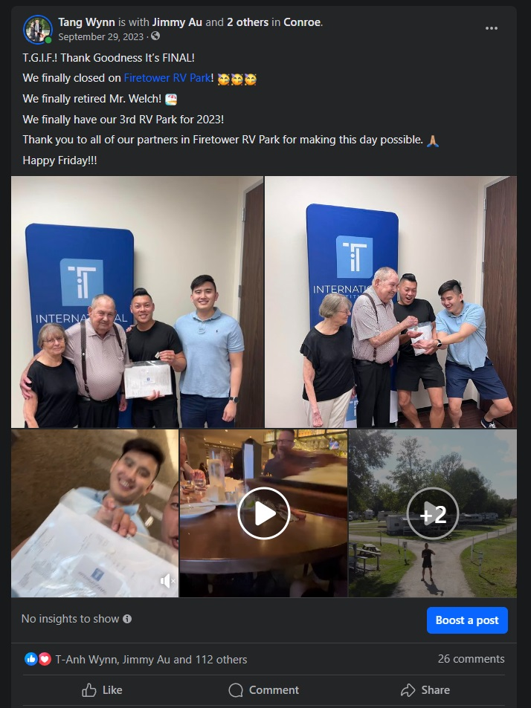
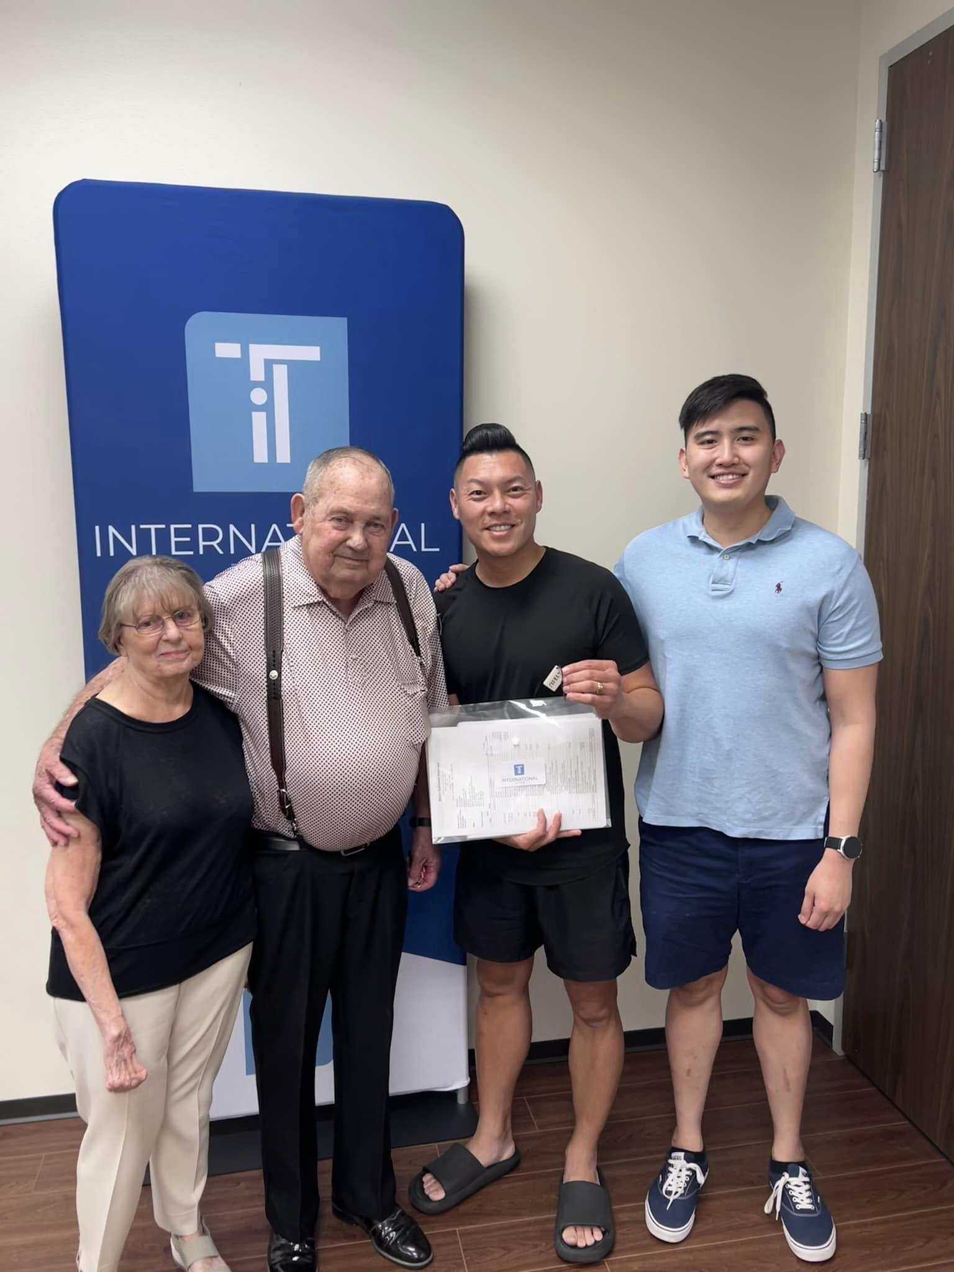
FIRETOWER RV PARK

Slide 22
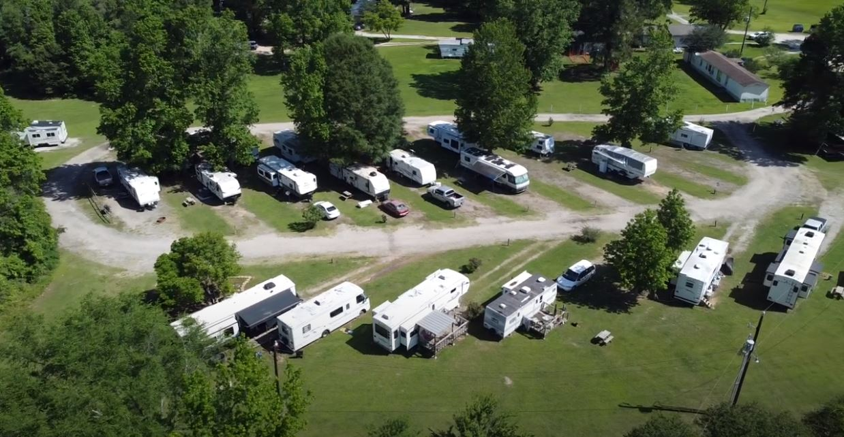
Salford & Co.
FIRETOWER RV PARK
A total of 24 acres fit with:
  29 RV Pads
  8 Mobile Homes
  1 Triplex
  Additional 4.5 acres of expansion
Arranged the following seller finance terms:
  20% down = $490,000
  $0 interest payments for 12 months
  5% interest
  50-Year Amortization
  30-Year Balloon
Purchase Price: $3,360,000
Equity Raised: $705,000
Current Avg Rent: $387
Proforma Avg Rent: $480
Current Ave Mobile Home Rent: $1,000

Slide 23
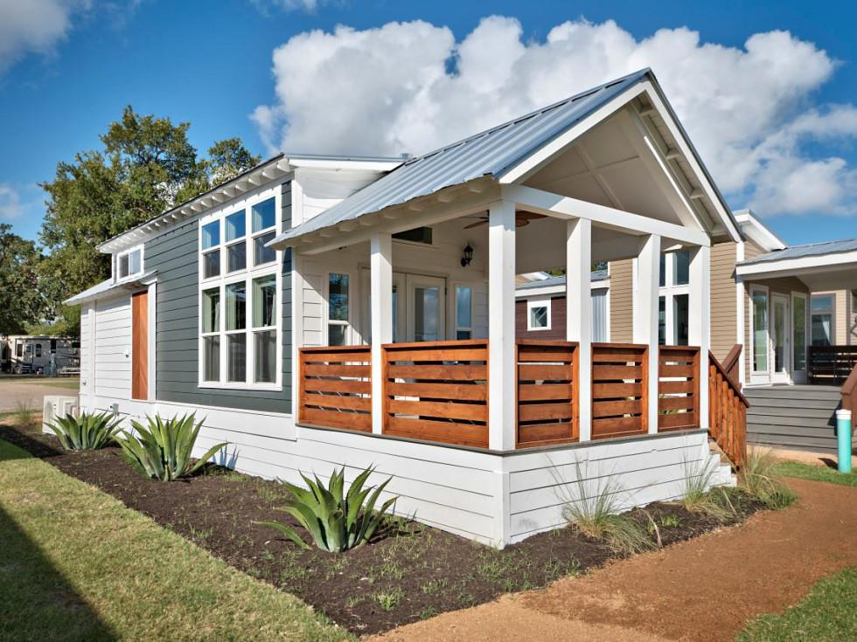
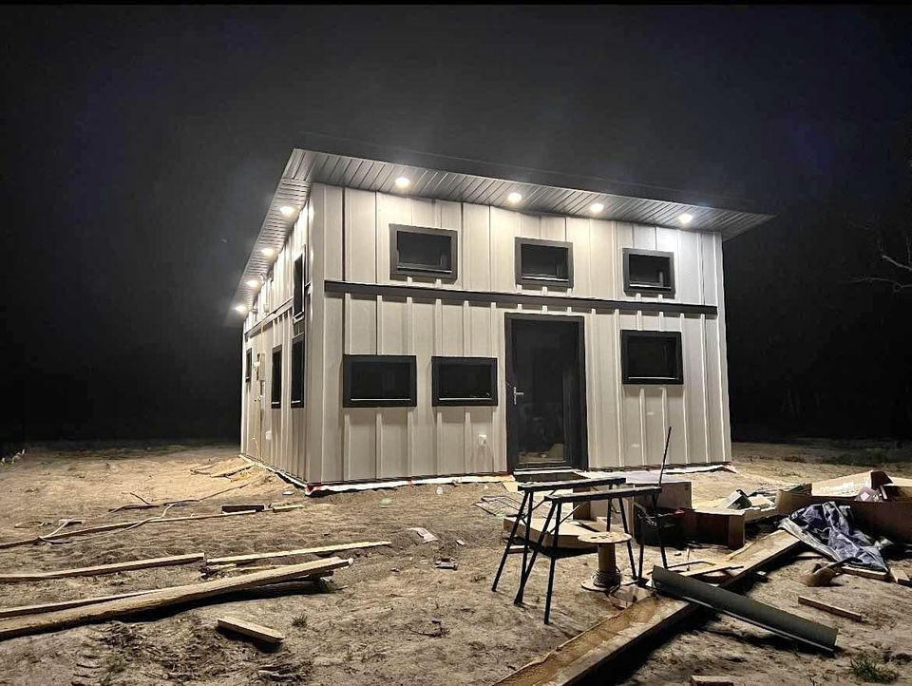
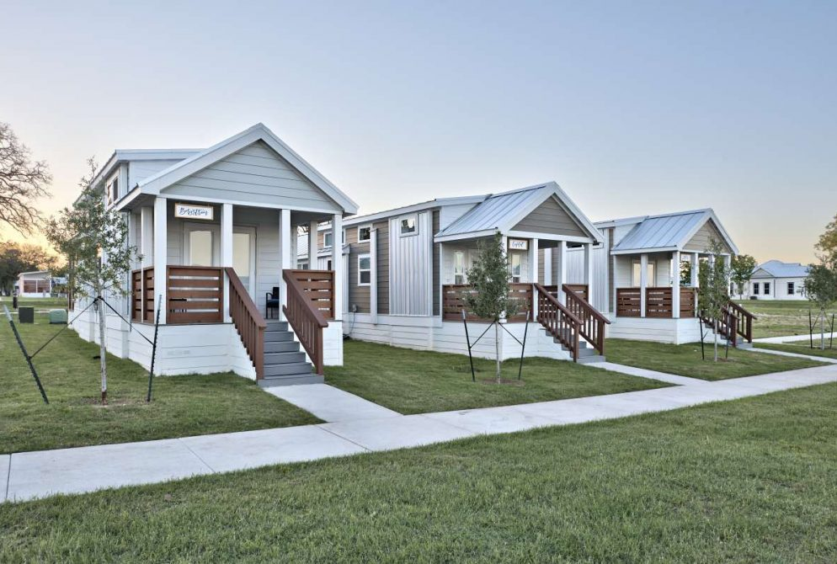
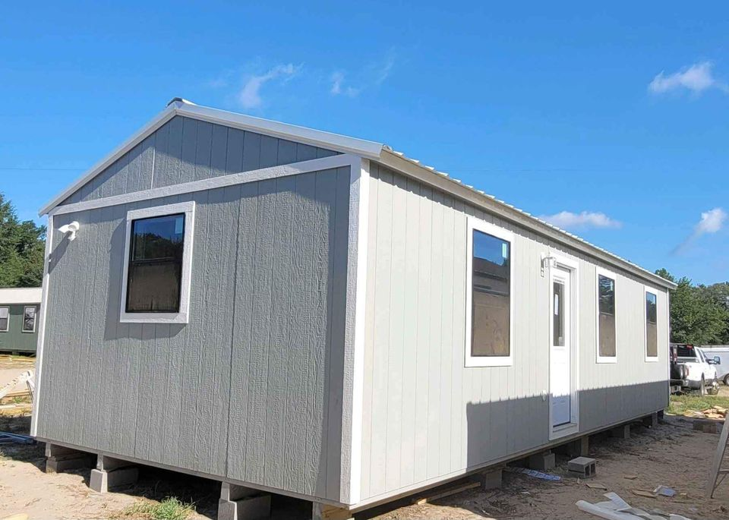
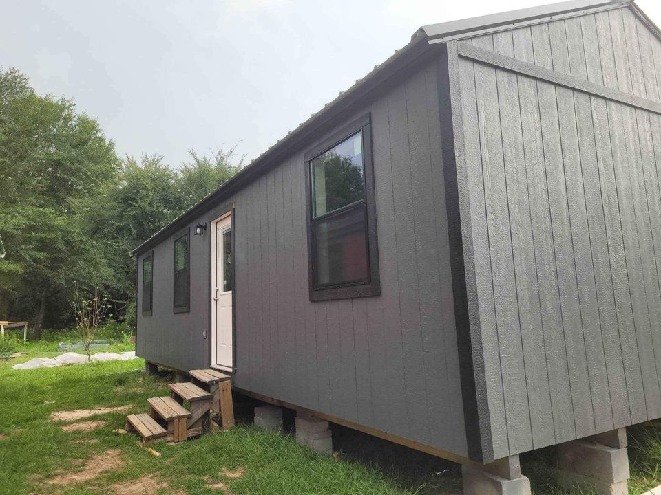
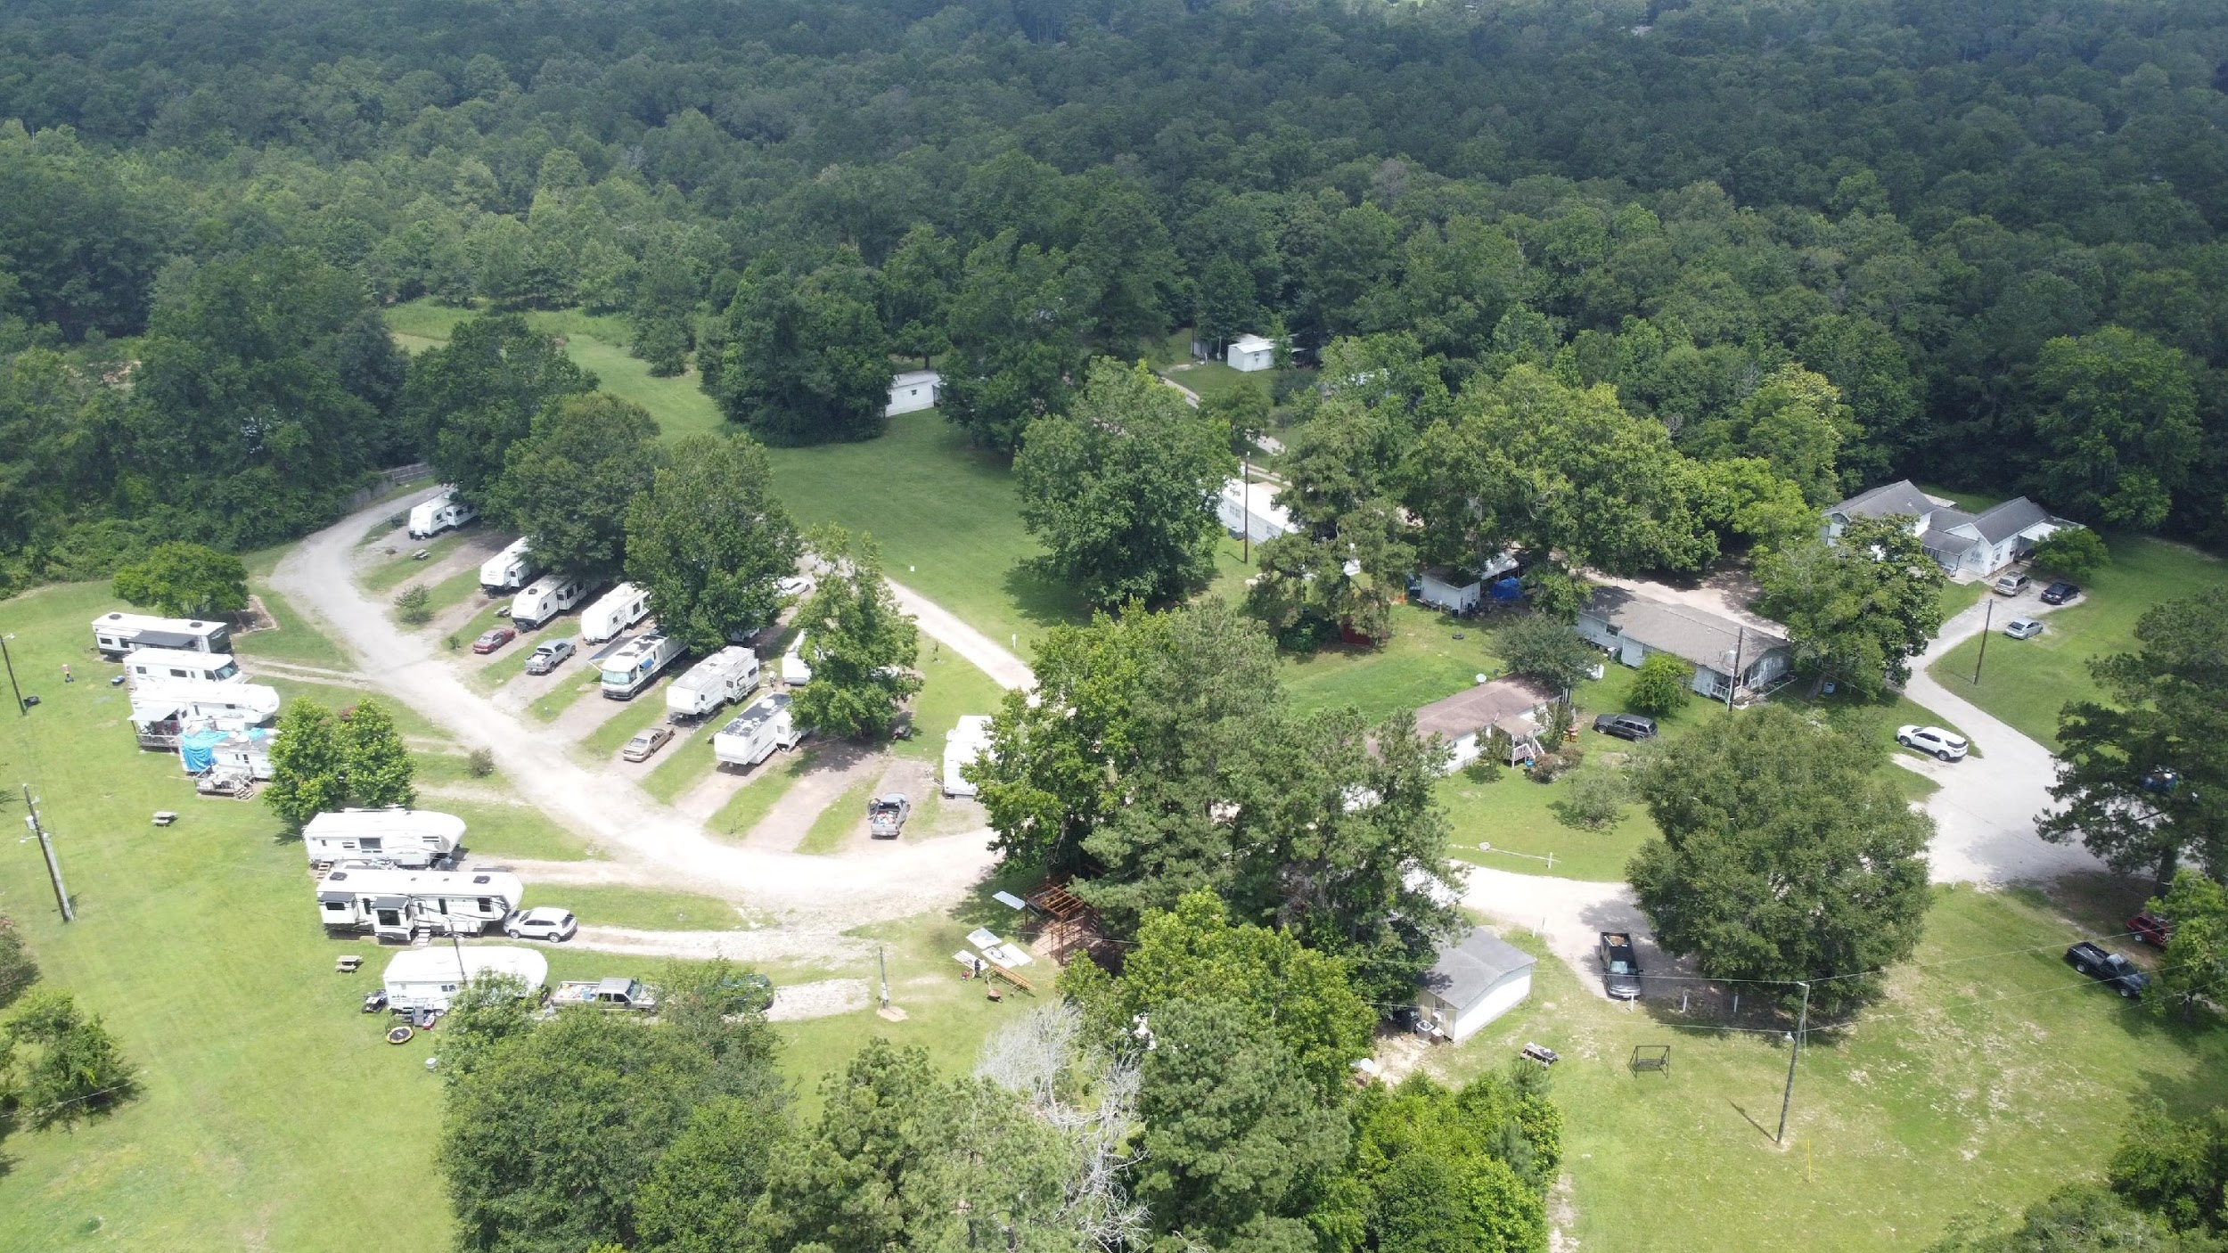
Our goal in 5 years:
  Turning Firetower RV Park in to a tiny home community.
  Adding a septic plant to handle the expansion.
  Adding 30 tiny homes on to the 4.5 acres of undeveloped land.
  Sell our 8 mobile homes on the property and we can swap it out for 4 tiny homes per mobile home. = 32 more tiny homes! =0
NOI for 2029: $646,591
EXIT at 8.5% CAP = $7,606,952

Slide 24
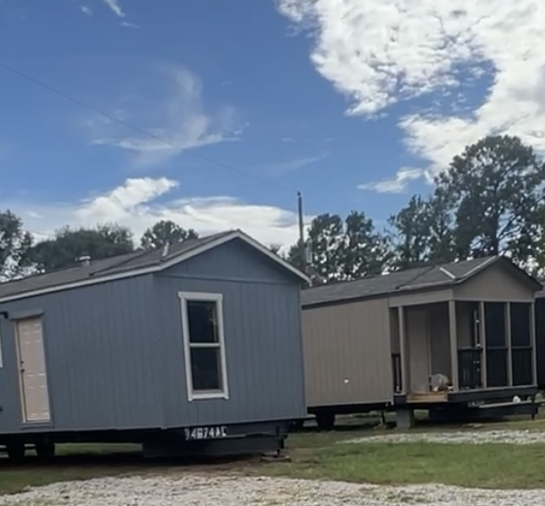
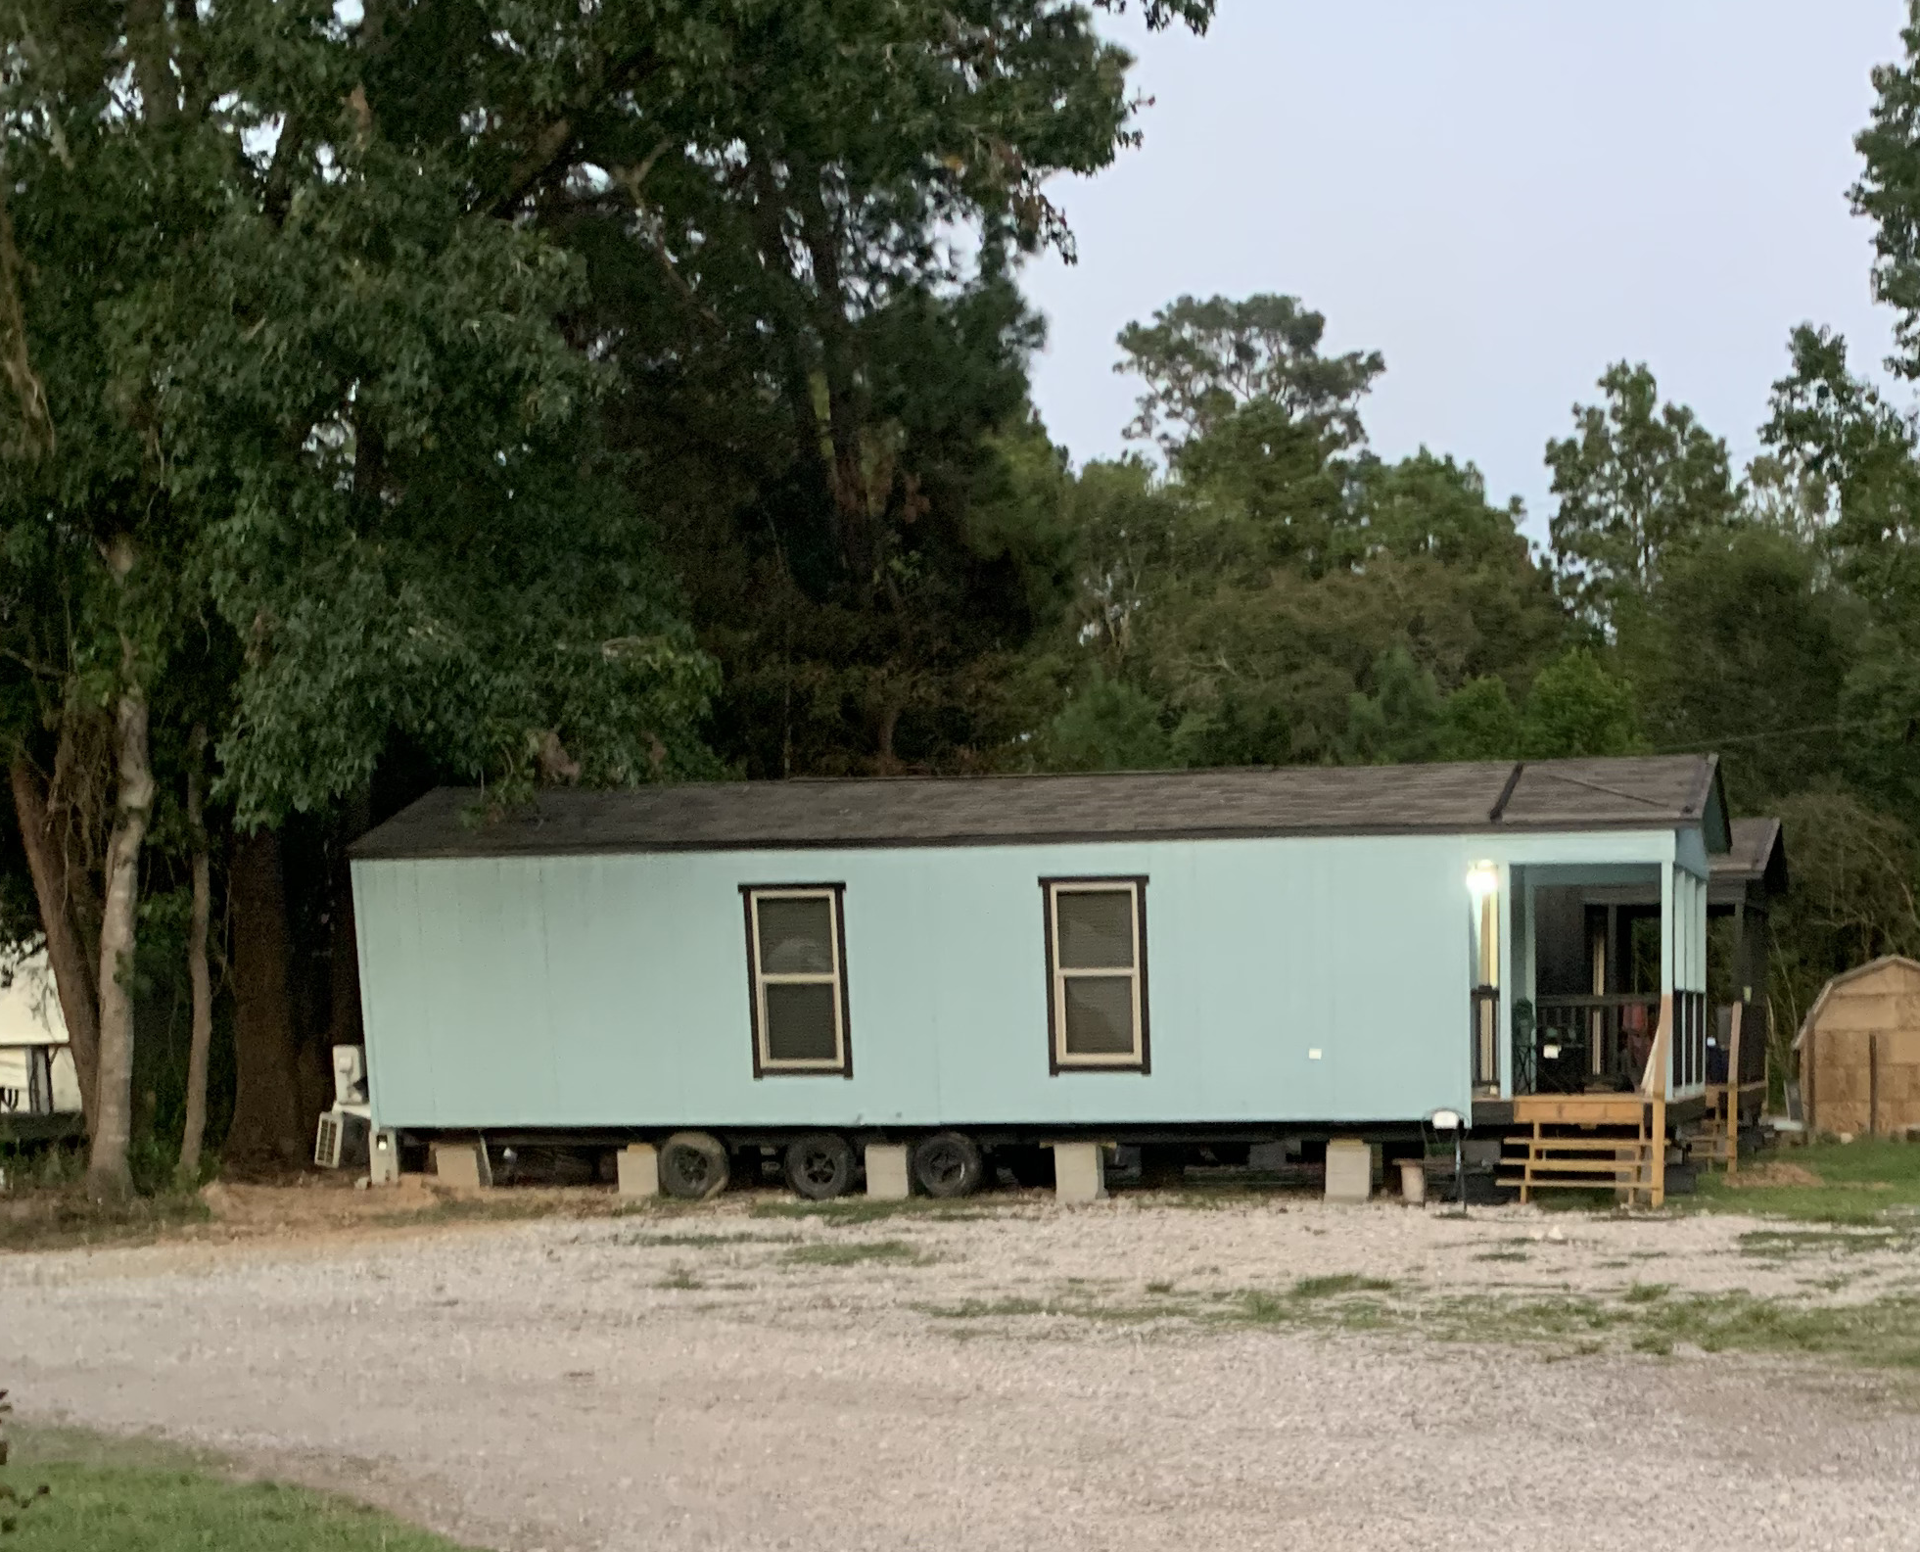
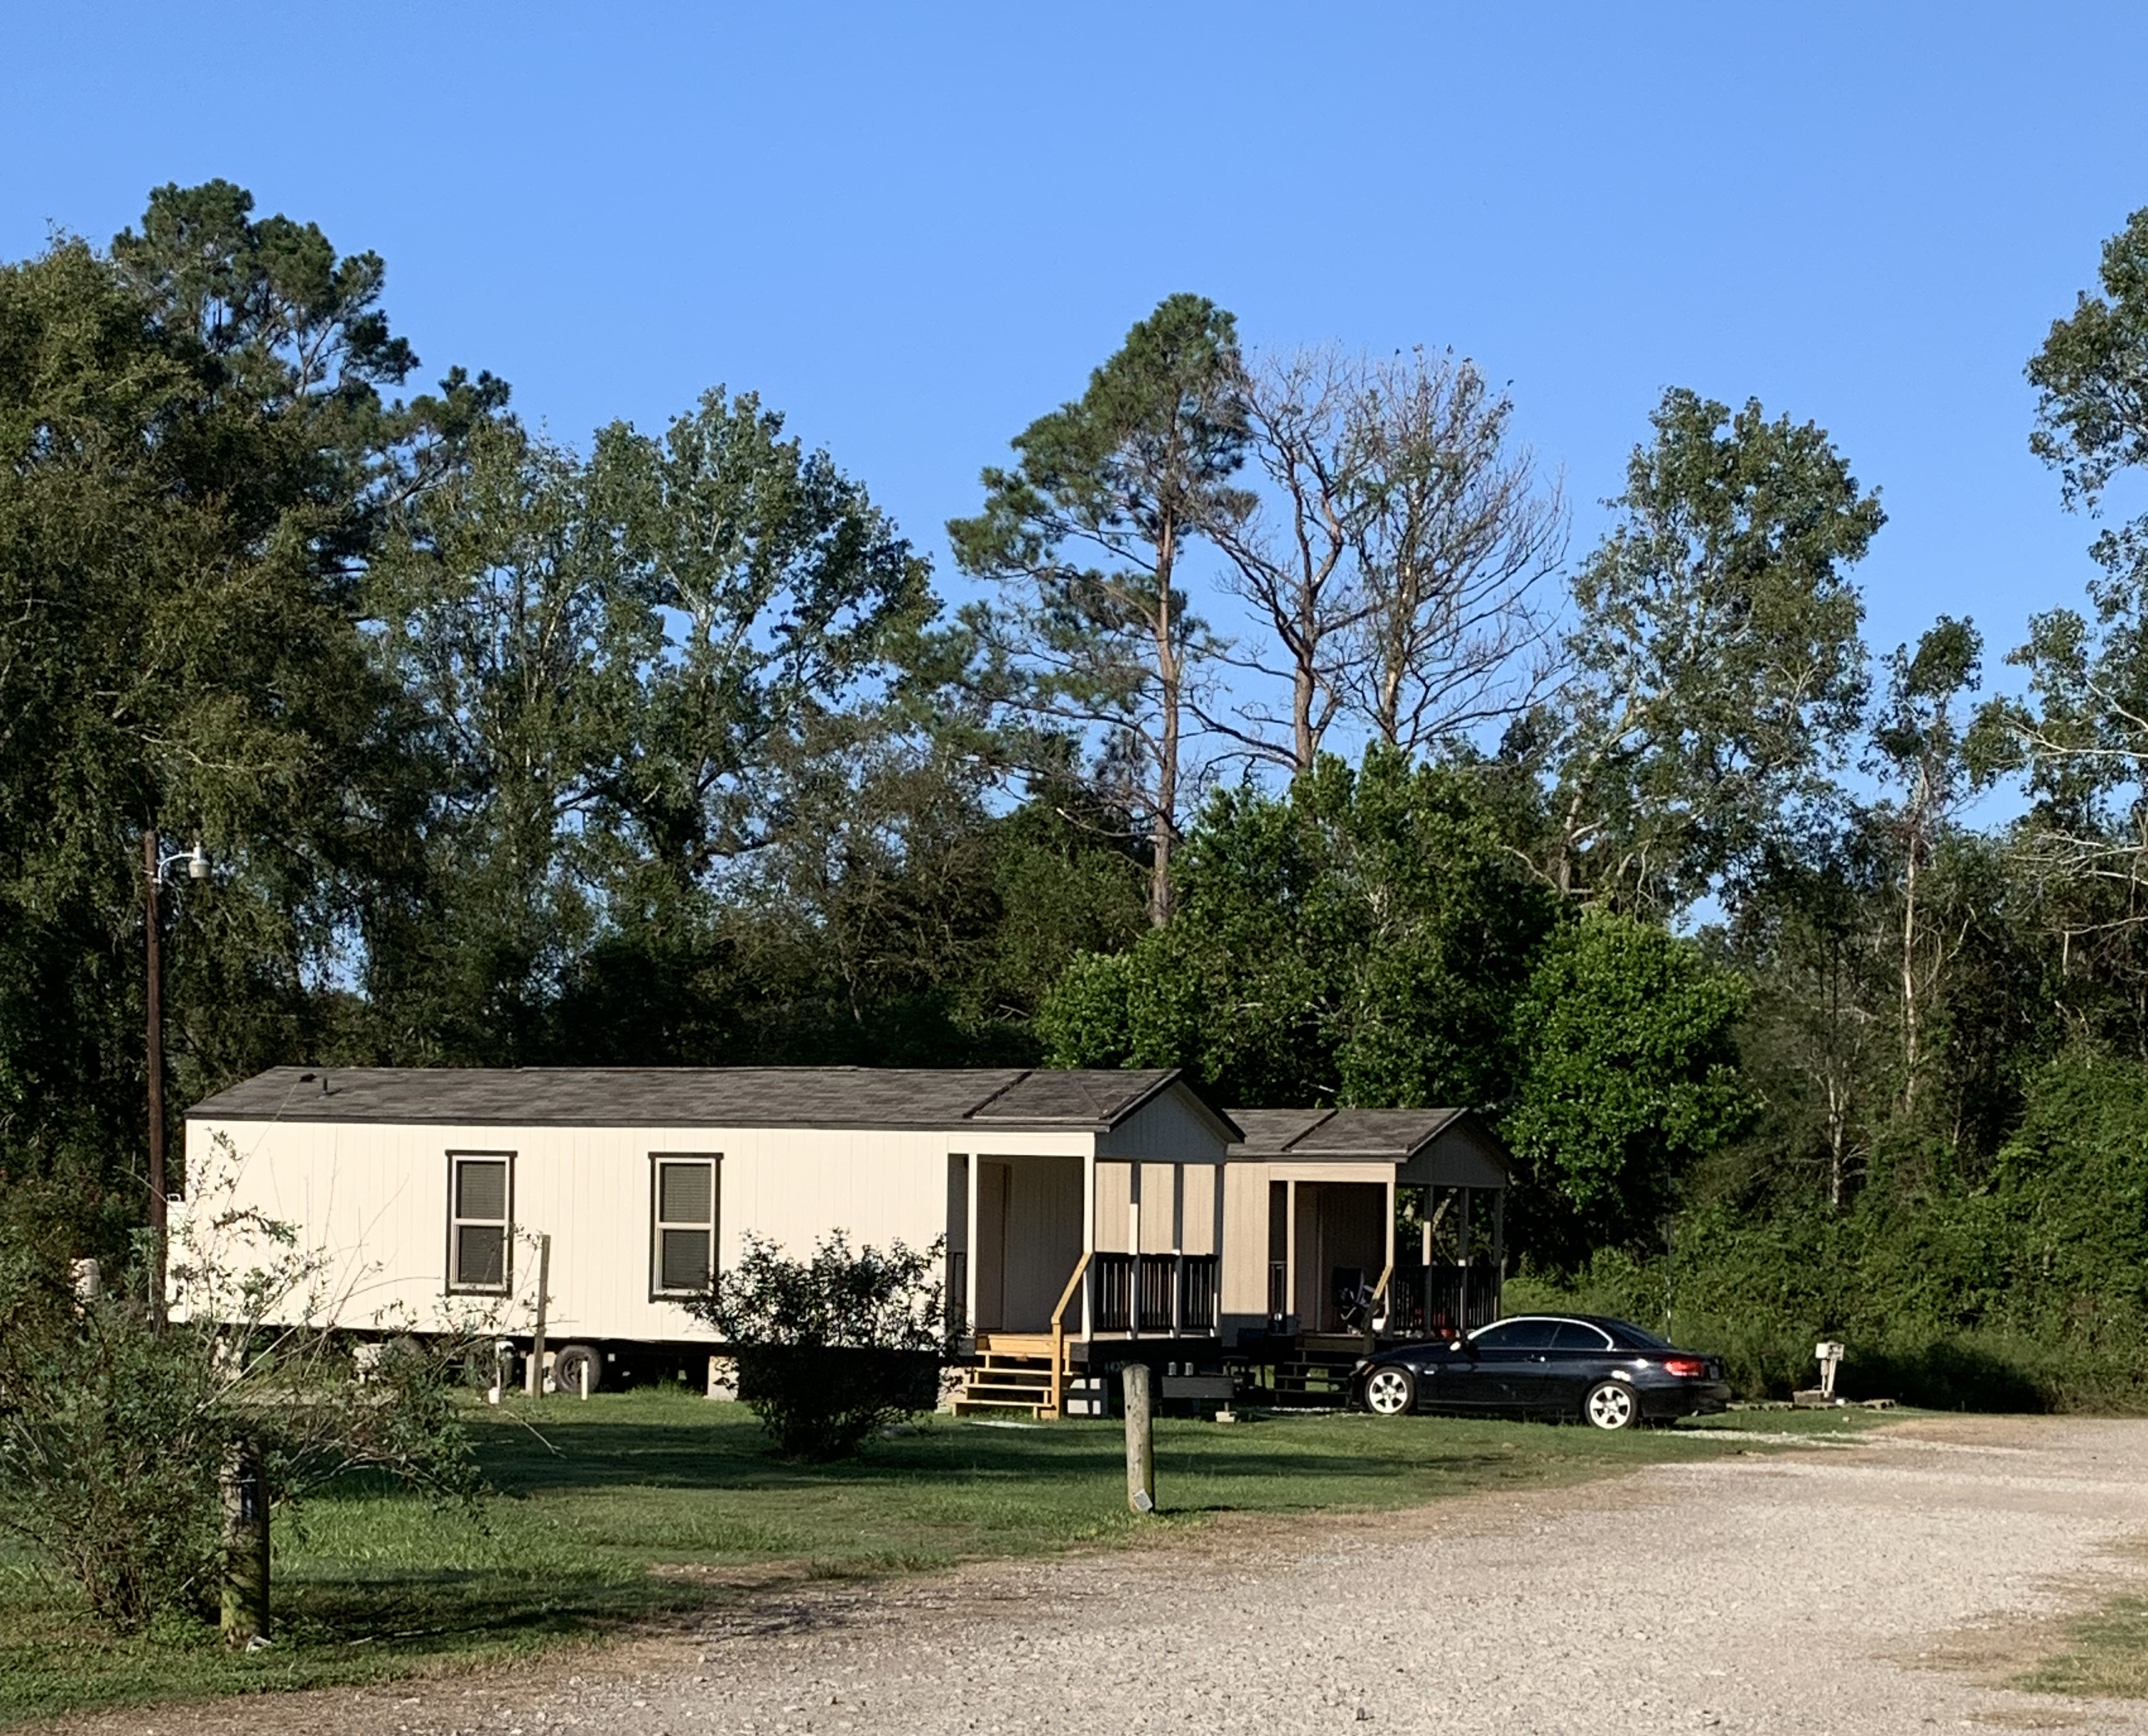
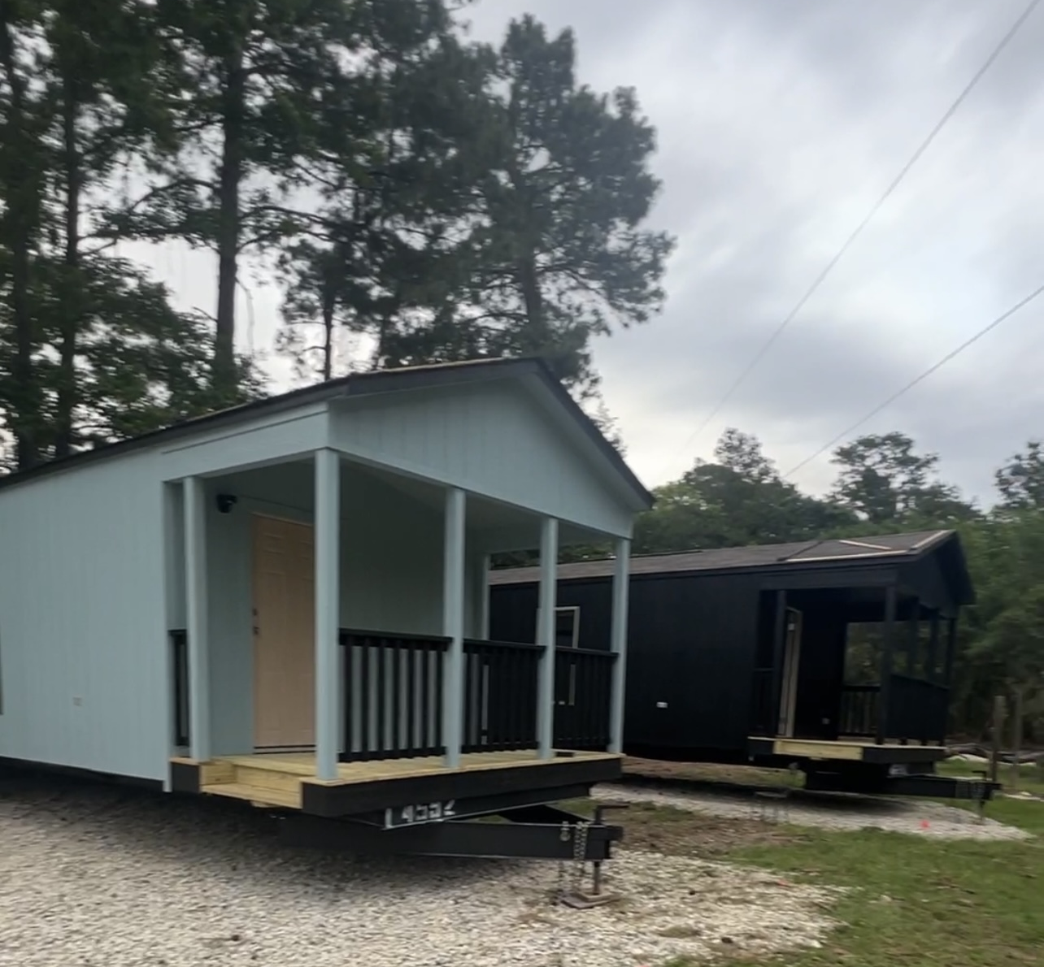
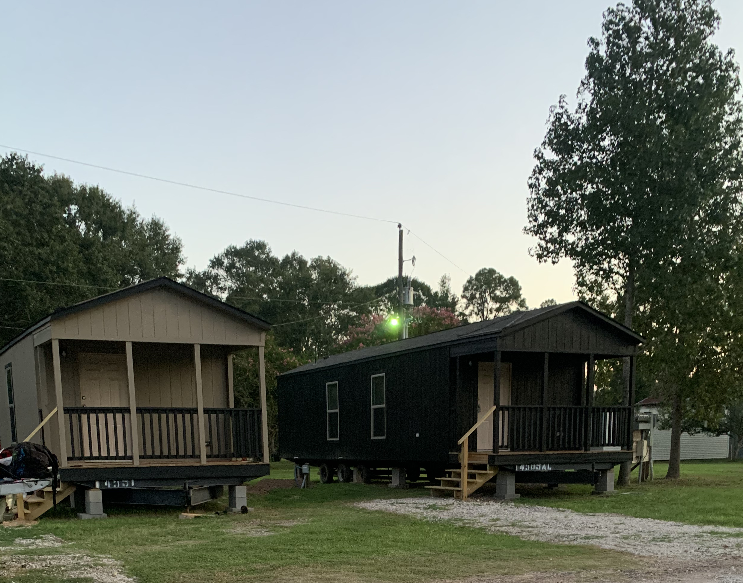
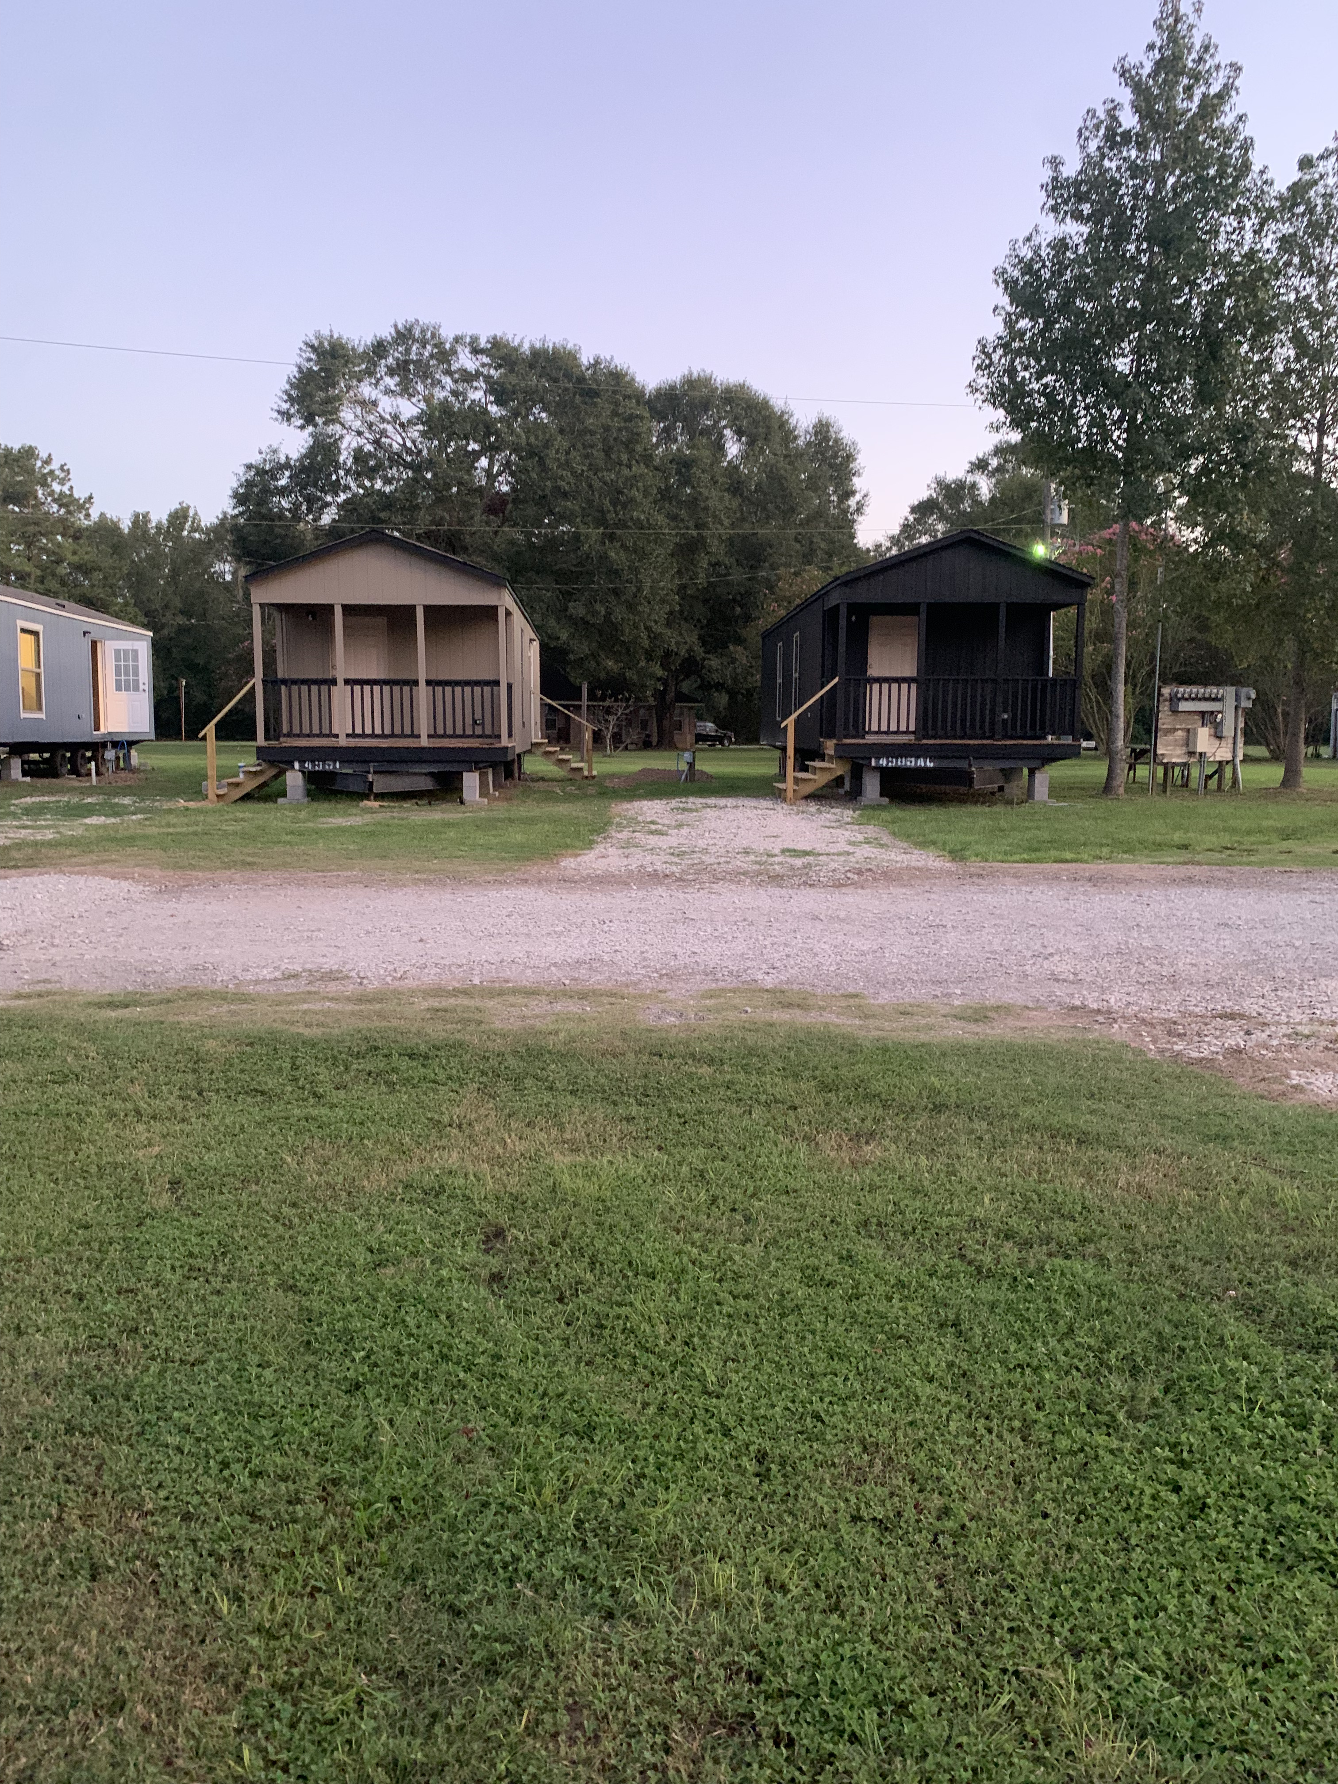
FIRETOWER RV PARK

Slide 25
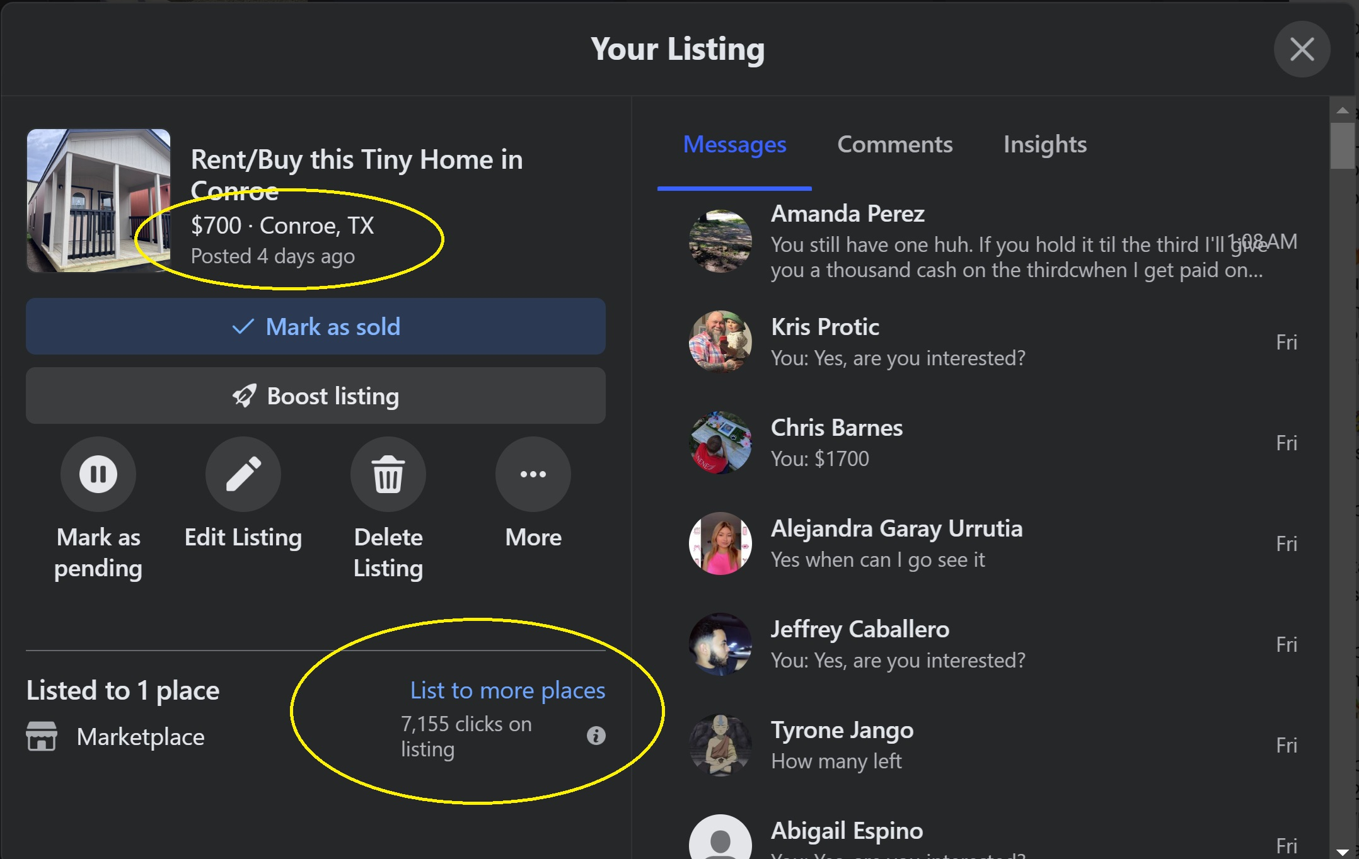
I posted an ad on Facebook Marketplace on 9/17, and leased out 4 tiny homes last week.

Slide 26
Top 10 Market Trends for Tiny Homes in 2024
1. Eco-Friendly Designs: Tiny homes continue to embrace sustainable building materials and eco-conscious features like solar panels, composting toilets, and rainwater harvesting systems. Buyers are prioritizing green energy solutions and low-carbon footprints.
2. Off-Grid Living: As self-sufficient lifestyles grow in popularity, many tiny homes are being equipped with off-grid capabilities, allowing owners to live without relying on municipal utilities, appealing to eco-conscious consumers and adventurers alike.
3. Smart Home Integration: Tiny homes are getting smarter, with integrated technology like automated lighting, temperature control, and security systems becoming standard. This trend offers added convenience without compromising the minimalist lifestyle.
4. Multi-Functional Spaces: With limited space, tiny home designs are increasingly focusing on maximizing efficiency. Multi-purpose furniture and convertible spaces (e.g., fold-away beds and tables) are being integrated to make the most out of every square foot.
5. Affordable Housing Solutions: Rising housing costs are pushing more people to consider tiny homes as a practical and affordable alternative. Many cities and regions are beginning to relax zoning laws to accommodate tiny homes, making them a viable solution for affordable living.

Slide 27
6. Luxury Tiny Homes: While tiny homes are traditionally thought of as budget-friendly, there's growing demand for high-end tiny homes. These homes often feature premium materials, luxury finishes, and cutting-edge appliances for a more upscale living experience.
7. Co-Housing and Tiny Home Communities: As the concept of tiny home communities grows, more people are embracing co-housing setups, where shared resources and community spaces (like gardens or workspaces) enhance the lifestyle. These communities foster a sense of belonging while maintaining individual living spaces.
8. Customizable Modular Units: The trend toward modular and prefabricated tiny homes allows for greater customization. Buyers can select layouts and features that suit their needs, often at a lower cost and faster build time compared to traditional construction.
9. Tiny Homes as Vacation Rentals: The popularity of short-term rentals like Airbnbs has led to an increased interest in tiny homes as unique vacation experiences. Many homeowners are investing in tiny homes to generate rental income, offering guests a minimalist, nature-focused escape.
10. Urban Infills and Backyard ADUs (Accessory Dwelling Units): With limited space in cities, tiny homes are being used as urban infills and backyard ADUs. These small homes add value to existing properties by providing extra living space for rental income, guest accommodation, or home offices.

Slide 28
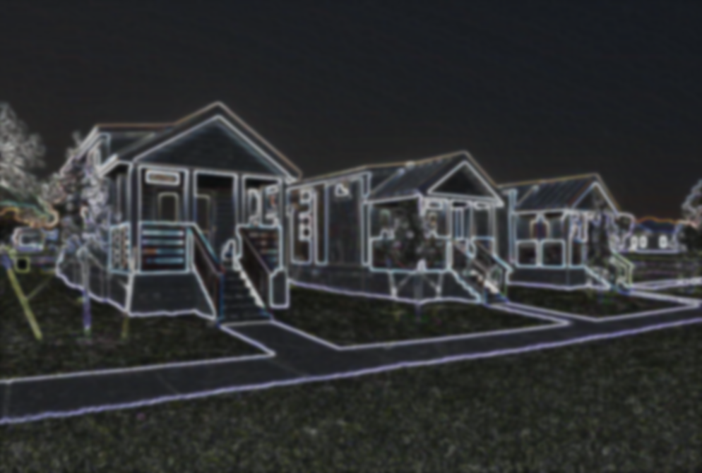
How to Capitalize…
Stick with Affordable Housing!
Whether it’s an up market or down market, there will always be a need for affordable housing!

Slide 29
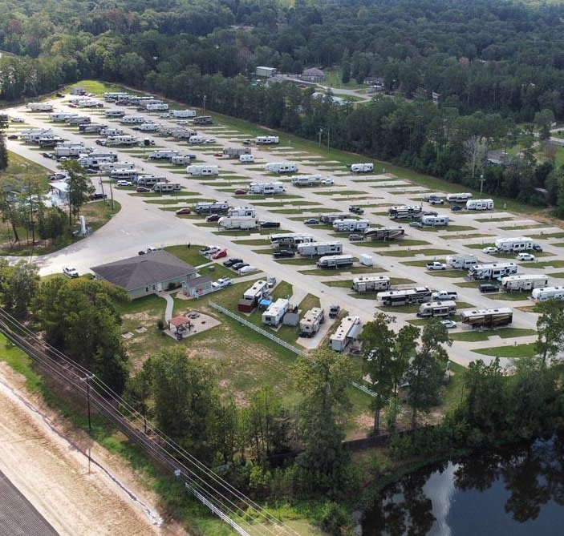
FINDING DEALS
Who wants to make $50,000 on their next assignment fee or referral fee?

Slide 30
FINDING DEALS
Step 1: Google search: “RV Park Sherman”
Step 2: Pick up the phone and call the park.
Step 3: Ask questions!
“I’m checking to see if you have any spots avilable?“
“My name is John, and I represent a cash buyer that’s needing to make another RV Park purchase in the next 60 days. He likes this park in particular and ask me to set up a phone call with him this week.”
“Hi, I was wondering if you can help me out. I have a buddy that’s looking to buy an RV park in the next 60 days in (whatever city/state you’re calling) He’s looking to expand and has funds ready. Would you entertain an offer?”
Step 4: Check their websites. Most mom and pop shops will list their name and direct phone numbers.

Slide 31
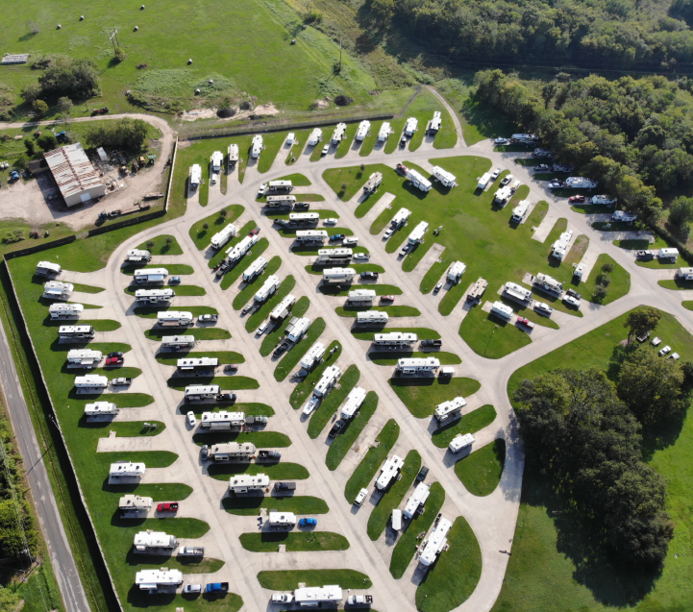
FINDING DEALS
  Our Criteria:
  - 20+ acres
  - 100+ pads
  - Value-Add
  - Room for Expansion
  - TX, OK, AR, AL, FL, SC,
  NC, GA, MO, and UT

Slide 32

Slford & Co.
SCAN TO GET SLIDES AND PITCH DECKS

Slide 33
Send Deals To:
IG
@tang.wynn

