Slide 1

Combing Digital and Real World Marketing
Legacy Home Show 2024
PRESENTED BY :
David Finney
Owner and Founder of Bild Media

Slide 2

Nice work, everyone.

Slide 3
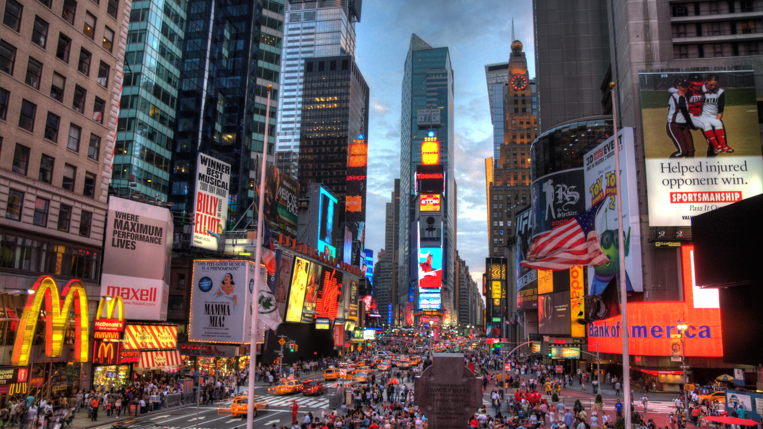
“
Doing business without advertising is like winking at a girl in the dark. You know what you are doing, but nobody else does.”
Steuart Henderson Britt

Slide 4
“We sell mobile homes. There’s nothing interesting or exciting about affordable housing”
- Some guy I used to work with

Slide 5


Slide 6

Be bold.

Slide 7




Slide 8
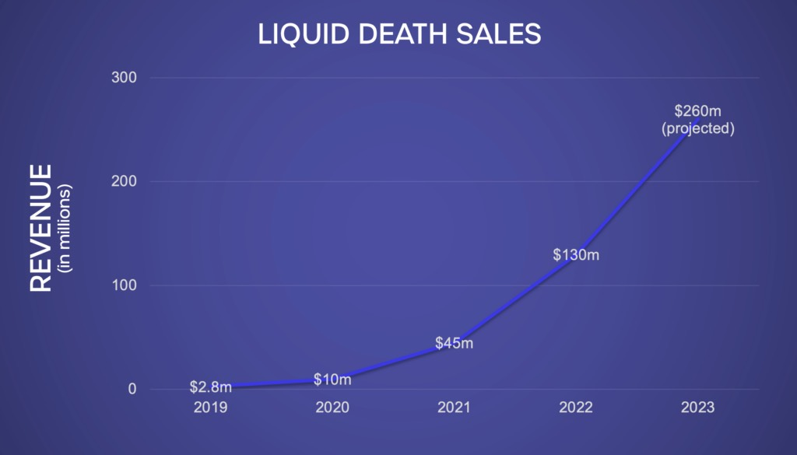
How’s that for growth?

Slide 9
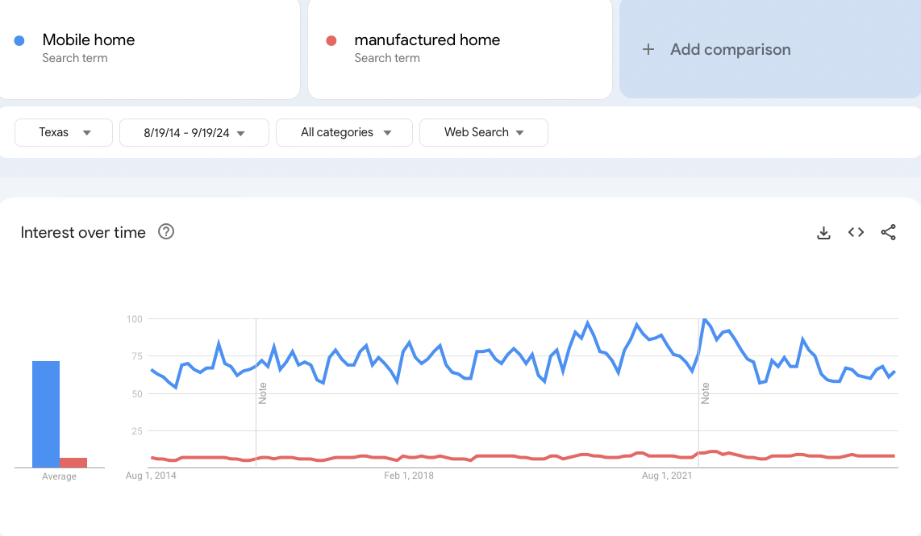
How are we looking?

Slide 10
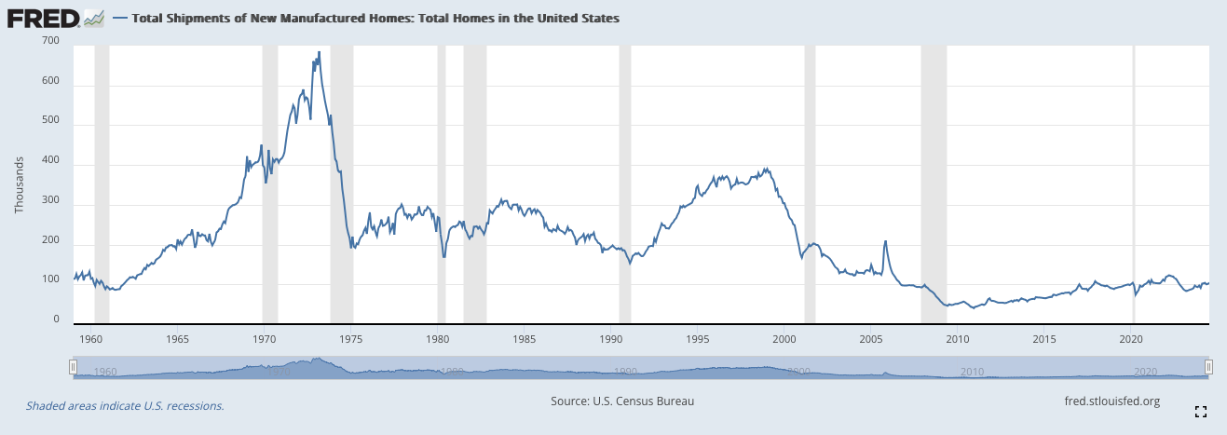
Shipments - How do we get that back?

Slide 11
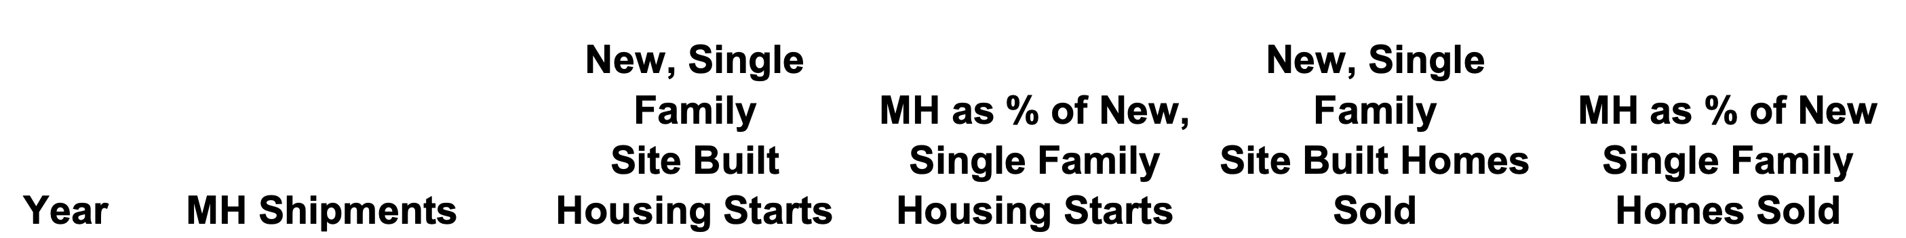
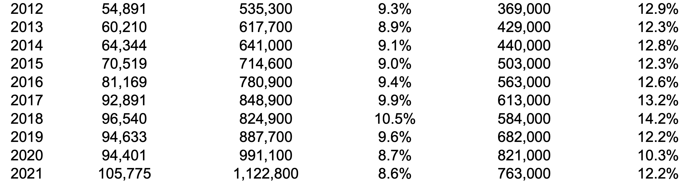
How do we grow our share?

Slide 12
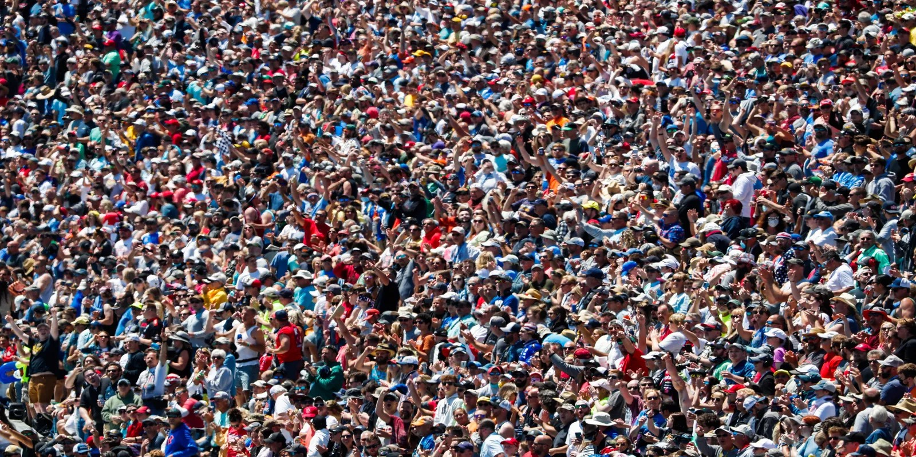
BE EVERYWHERE
Don’t let them forget you.

Slide 13
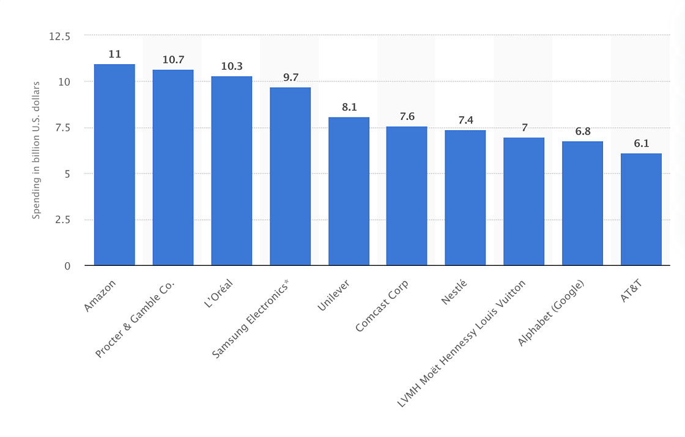
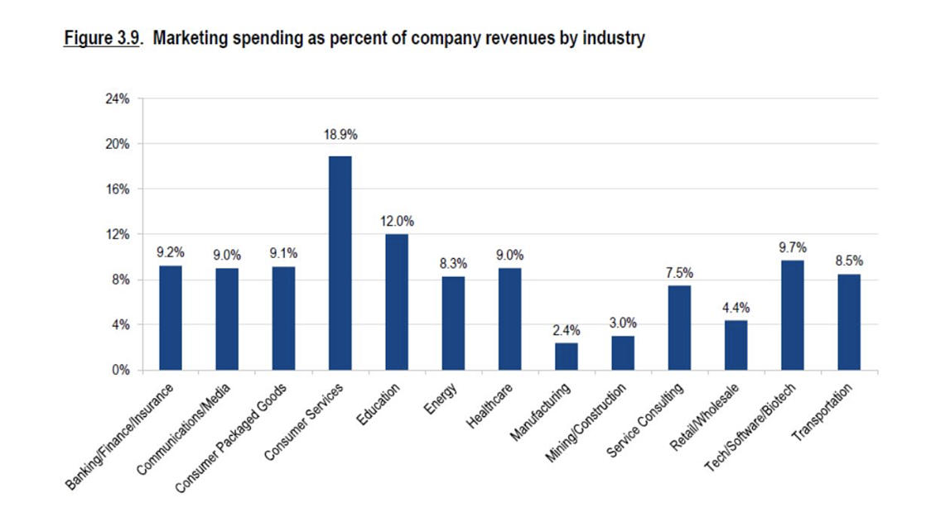
How much should you spend on marketing?
“As a general rule, small businesses with revenues less than $10 million should allocate 7-8 percent of their revenues to marketing.” -SBA

Slide 14









What is Digital Marketing?
“Digital marketing, also called online marketing, refers to all marketing efforts that occur on the internet. Businesses leverage digital channels such as search engines, social media, email, and other websites to connect with current and prospective customers. This also includes communication through text or multimedia messages.”
In short? Marketing that you see on a screen.

Slide 15
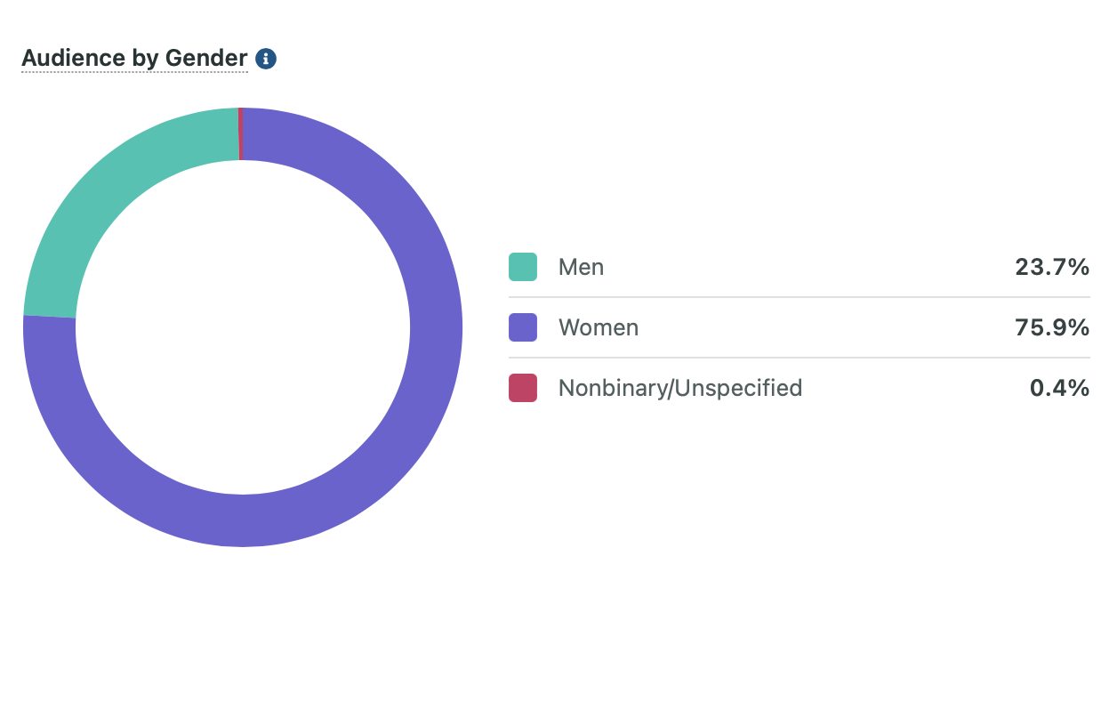
Today’s Digital MH Customer
They’re young, mostly women, and they want to see the whole picture of a nice home.
A
The largest buying group is ages 25-34
I
The median buyer income is $60,000
L
They’re in every county in Texas

Slide 16

Your online first impression
Website Marketing Tips

Slide 17
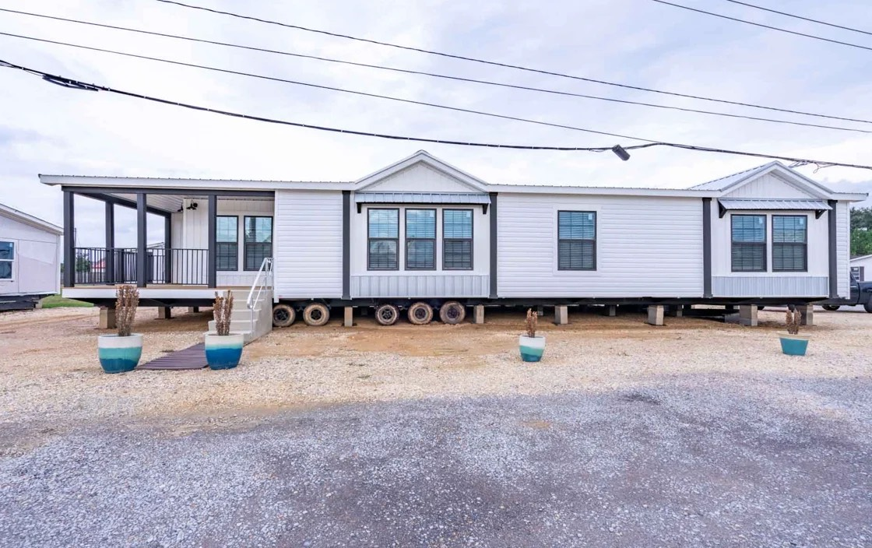
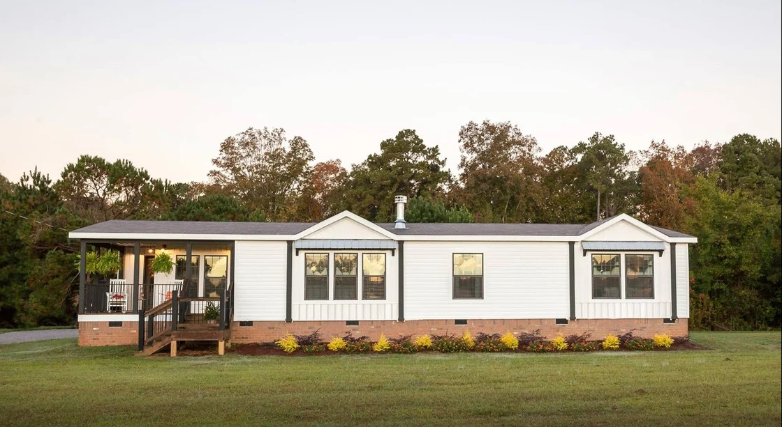
This?
Or this?

Slide 18
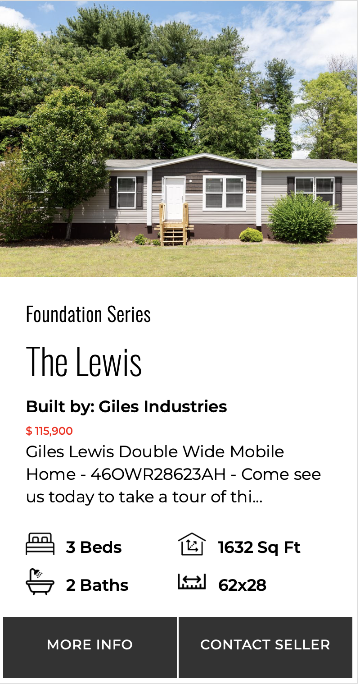
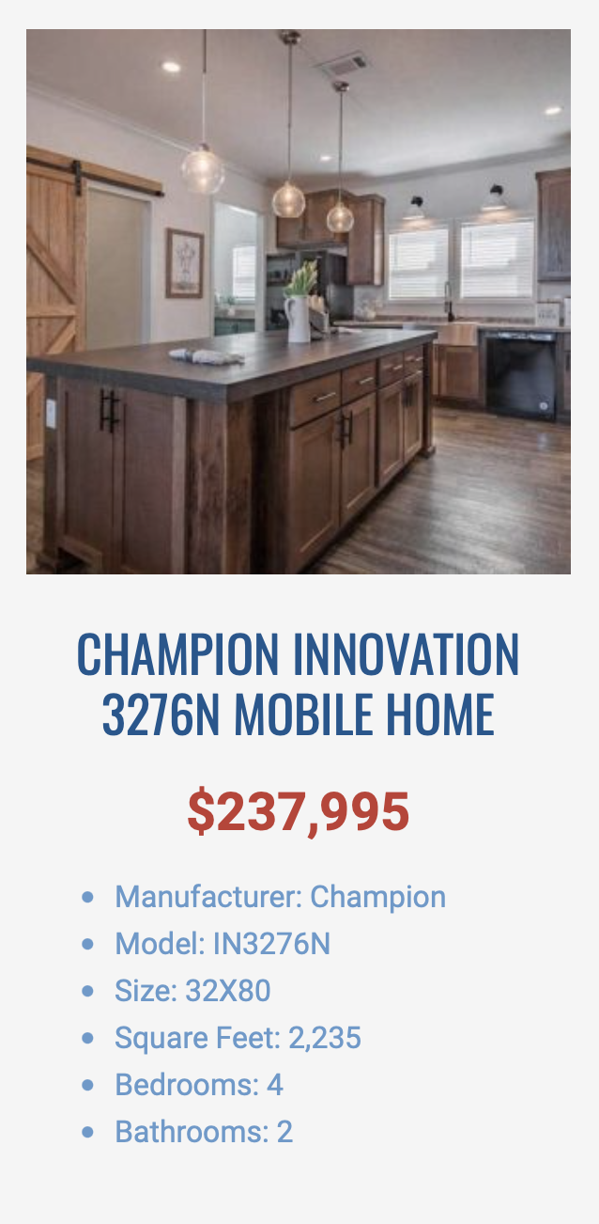
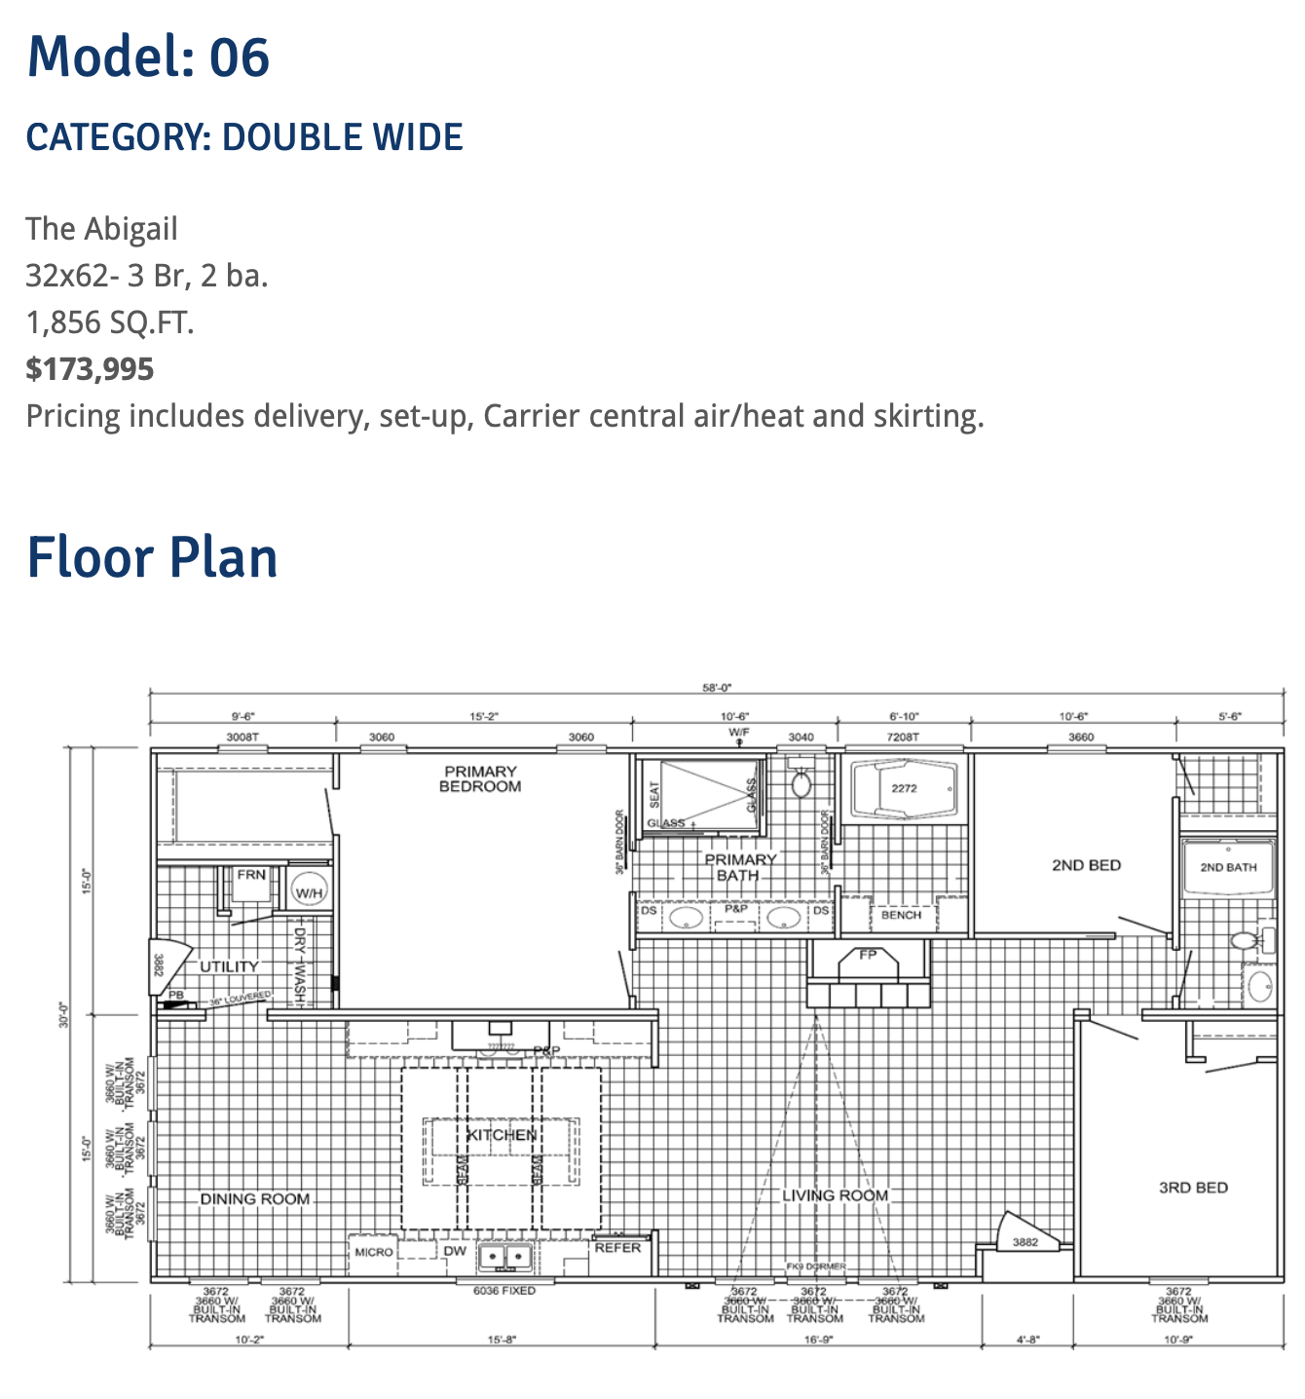
Transparent Pricing
1. “If you have to ask, it’s affordable.”
2. Modern buyers expect it
3. 2-3x improvement in web lead
conversion rate
4. Better experience - more
referrals

Slide 19
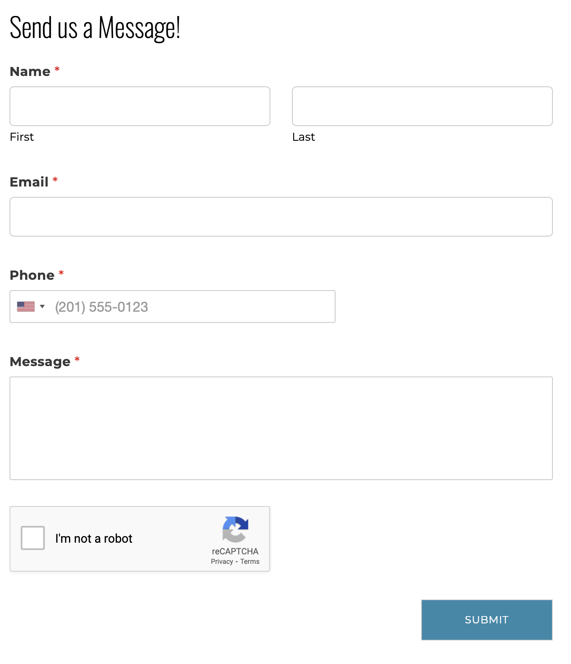
Simple Contact Forms
Contact forms exist to collect lead contact info. Not qualify leads - that is done by the sales staff.
Effective MH websites should have a 2-3% web lead conversion rate.

Slide 20

Just be social… : )
Social Media Marketing Tips

Slide 21
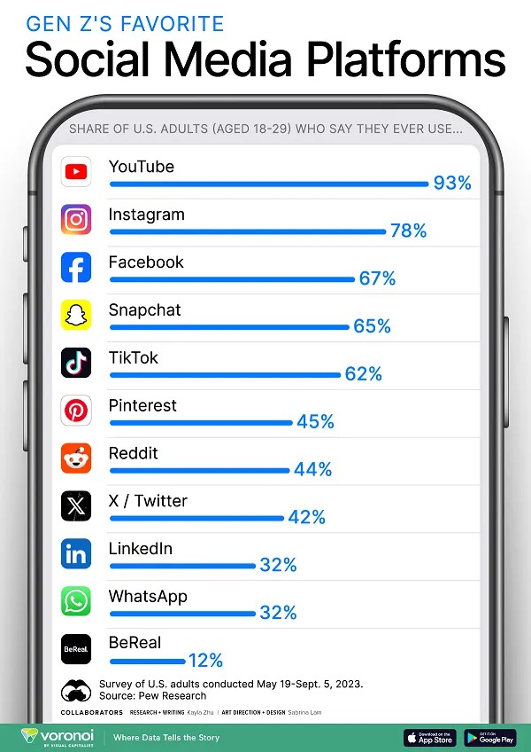
Where are your buyers hanging out?

Slide 22
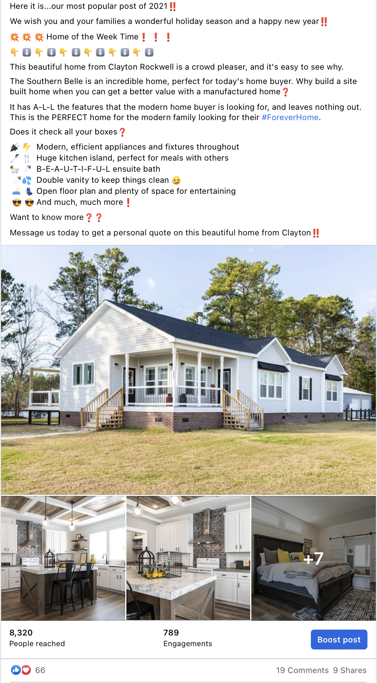
Be Social, Be Professional
Respond to every comment - no matter the comment. It’s social media, so be social. : )
1.
Use professional pictures and start with the exterior first.
2.
Use emojis to disrupt their newsfeed.
3.
Clear CTA - Tell them what to do next. Act like they have no idea how to contact you or buy from you.
4.

Slide 23
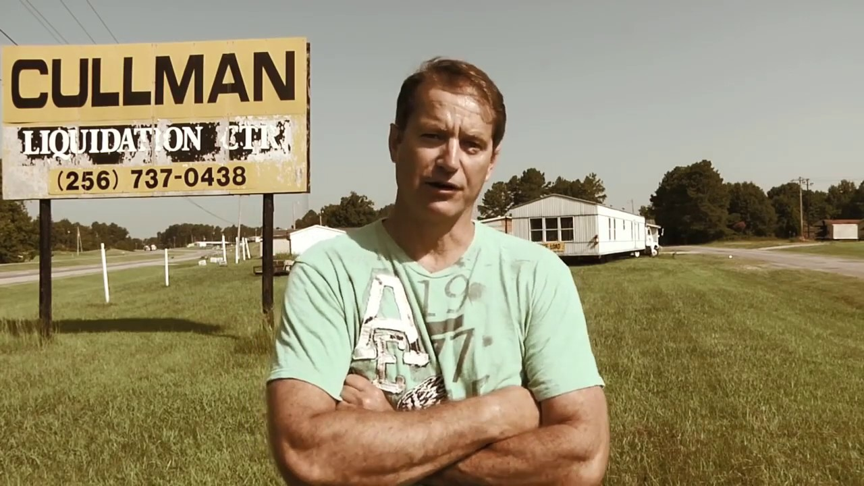
Why you?

Slide 24
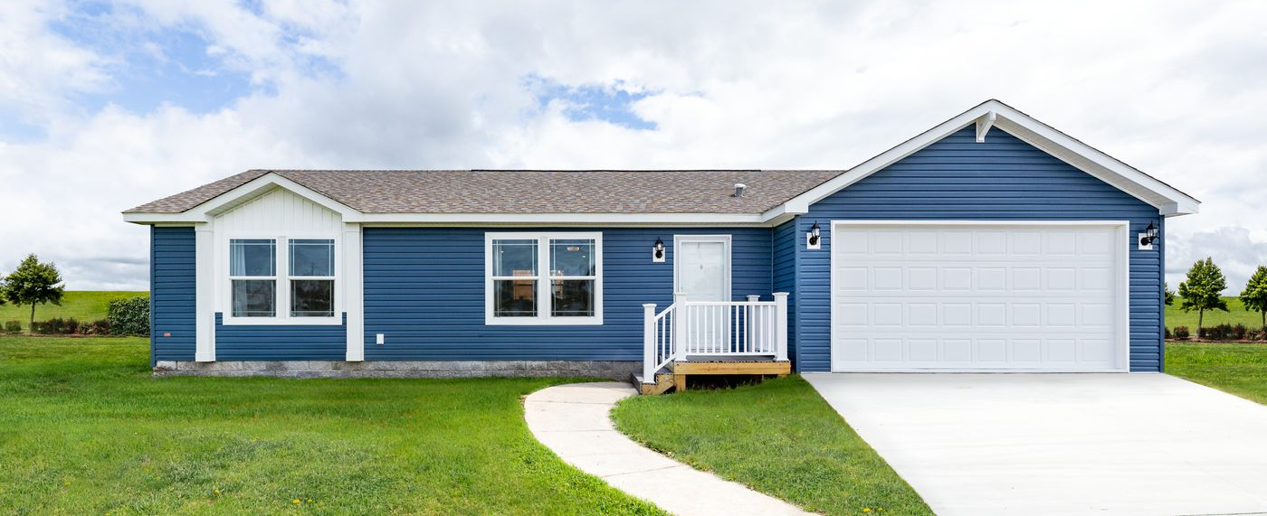
No “Affordable Housing”

Slide 25

Everyone sees it
Google Business Profile Tips

Slide 26
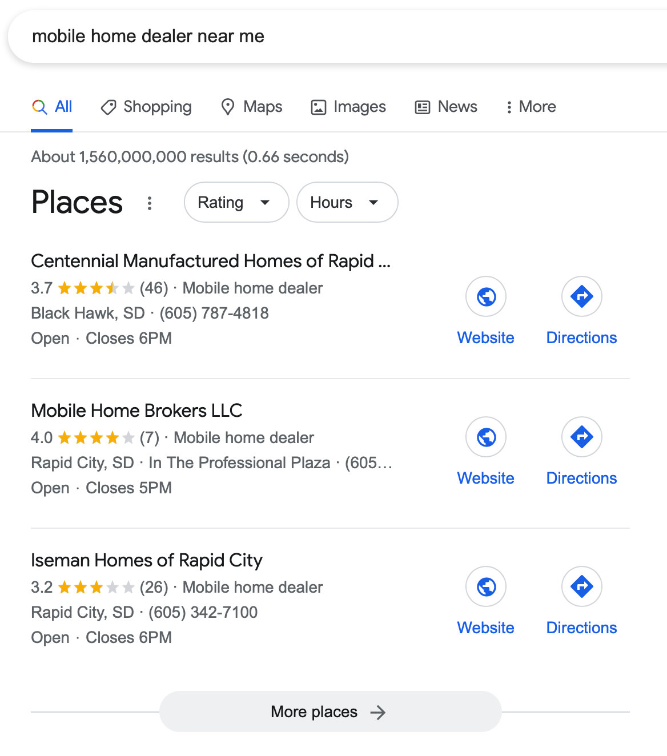
Reputation Management
What are buyers
thinking here?

Slide 27
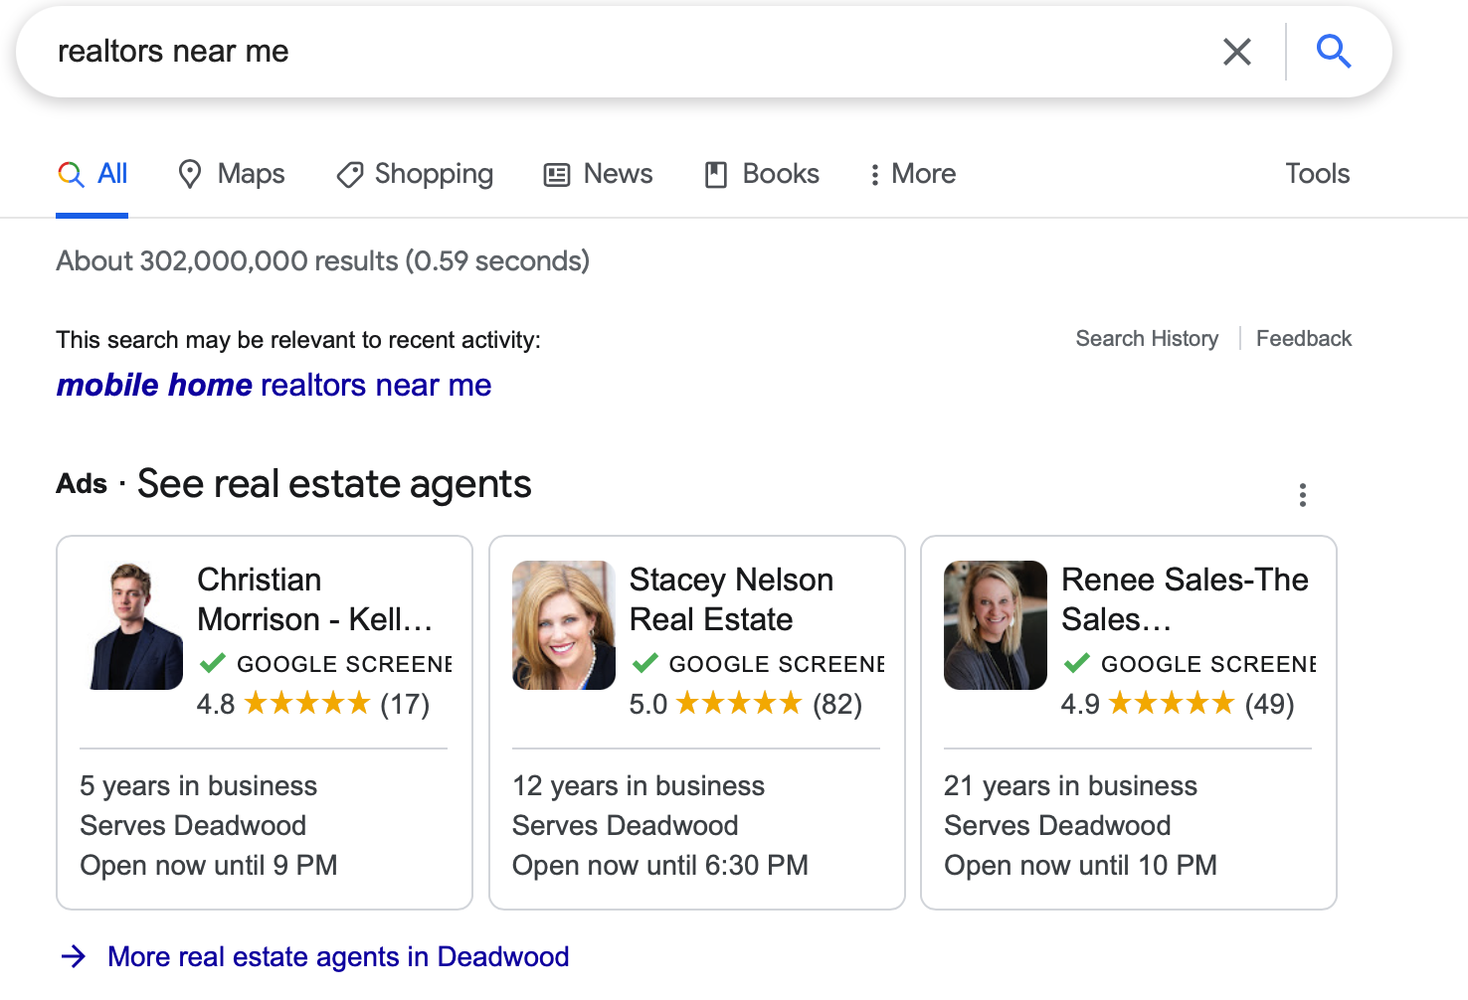
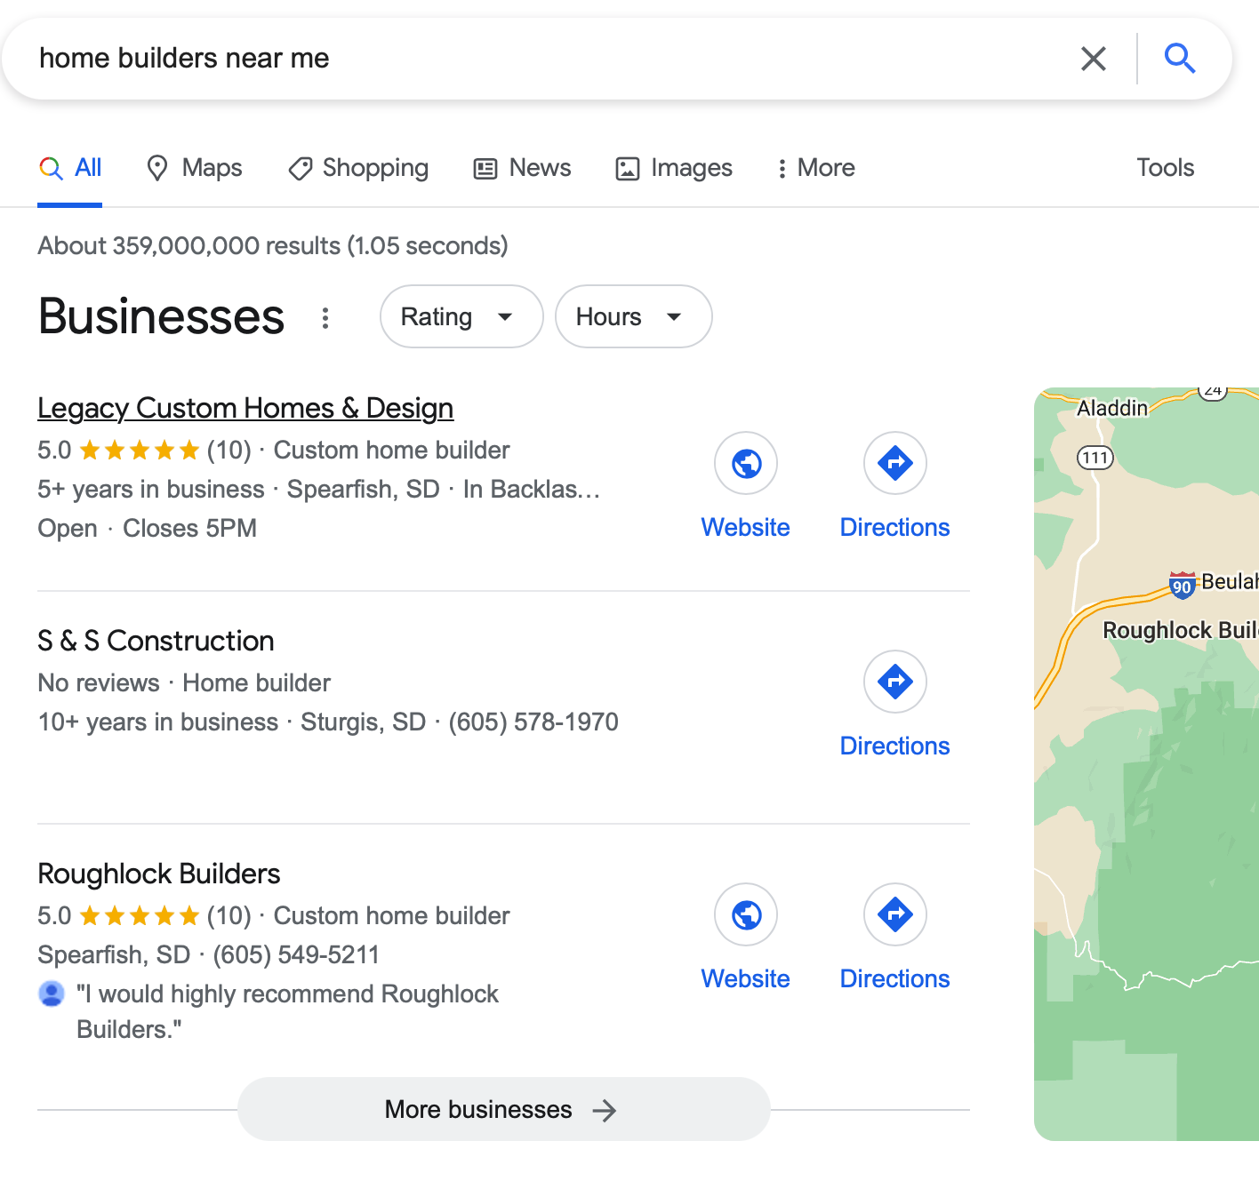
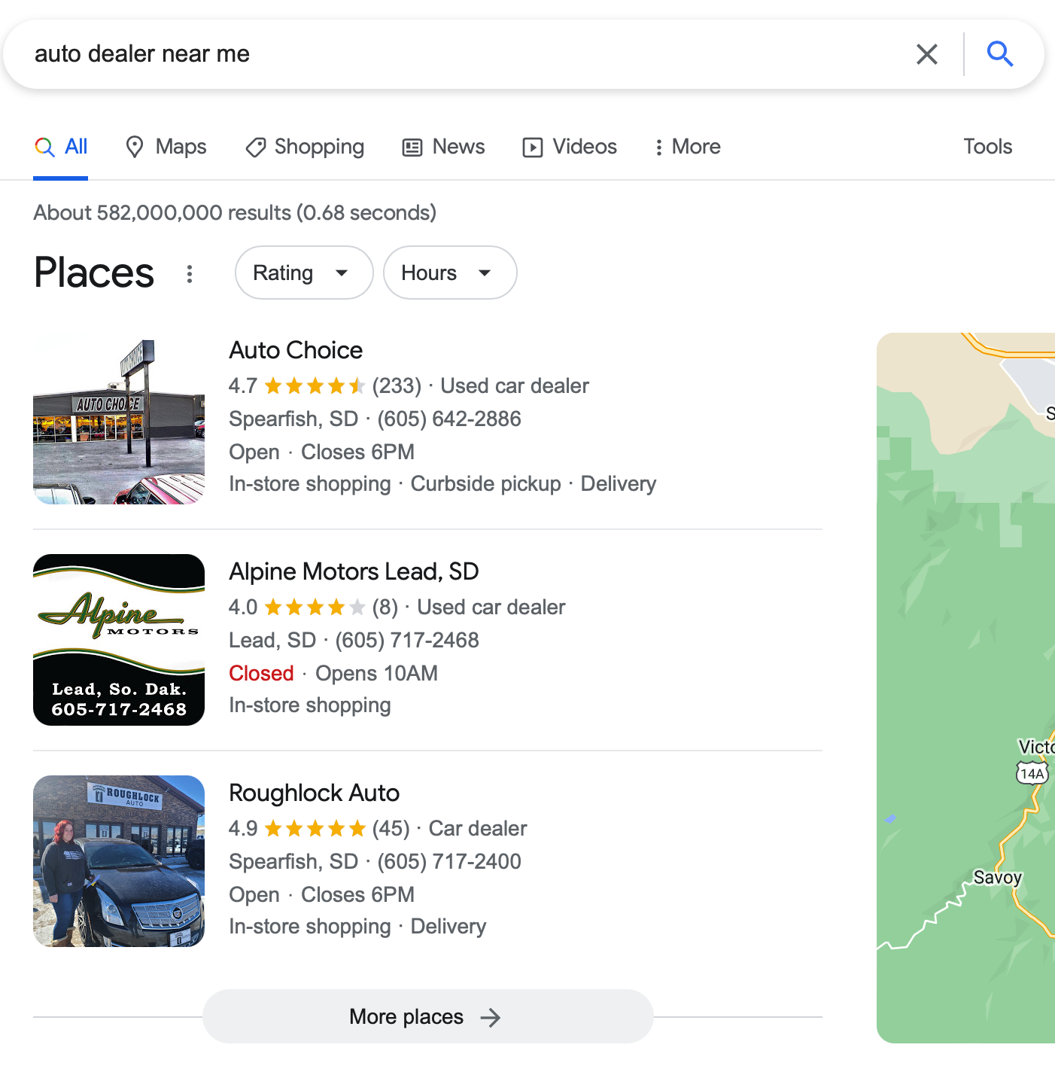
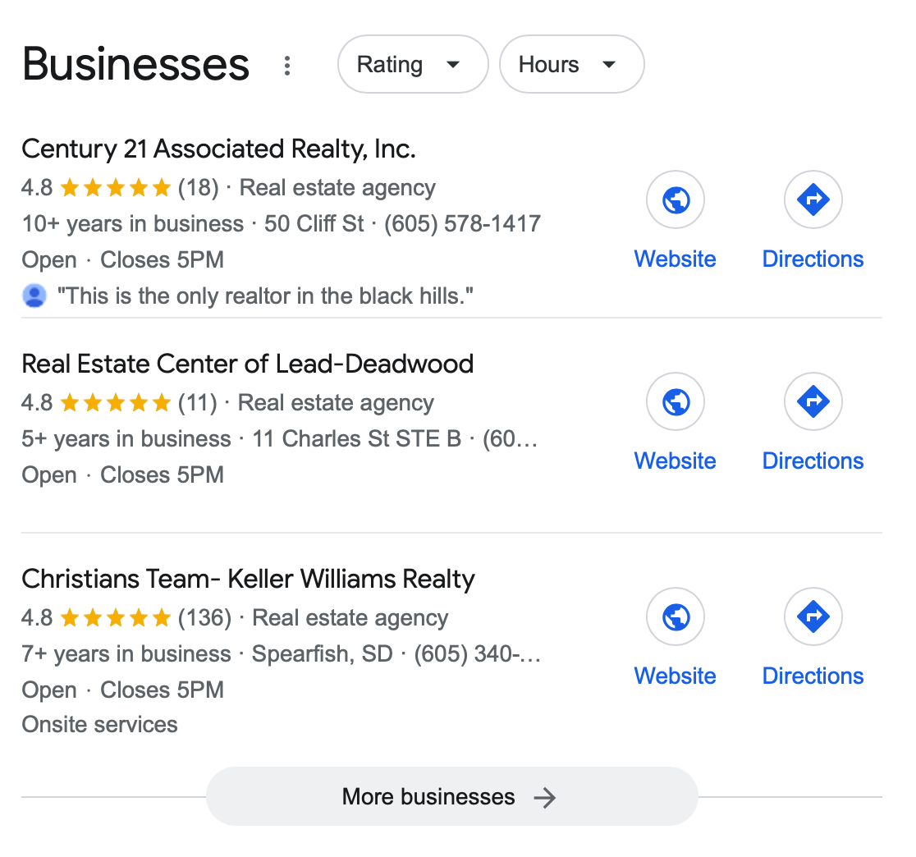
How’s the competition looking?

Slide 28
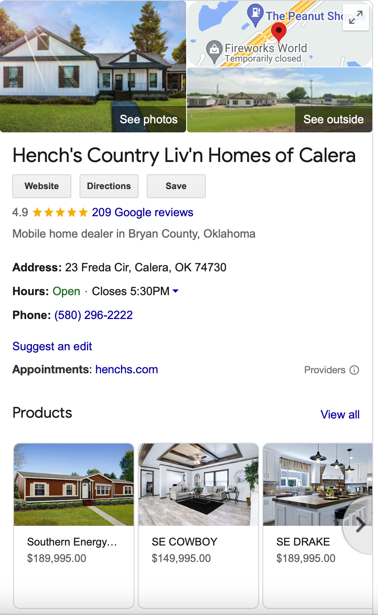
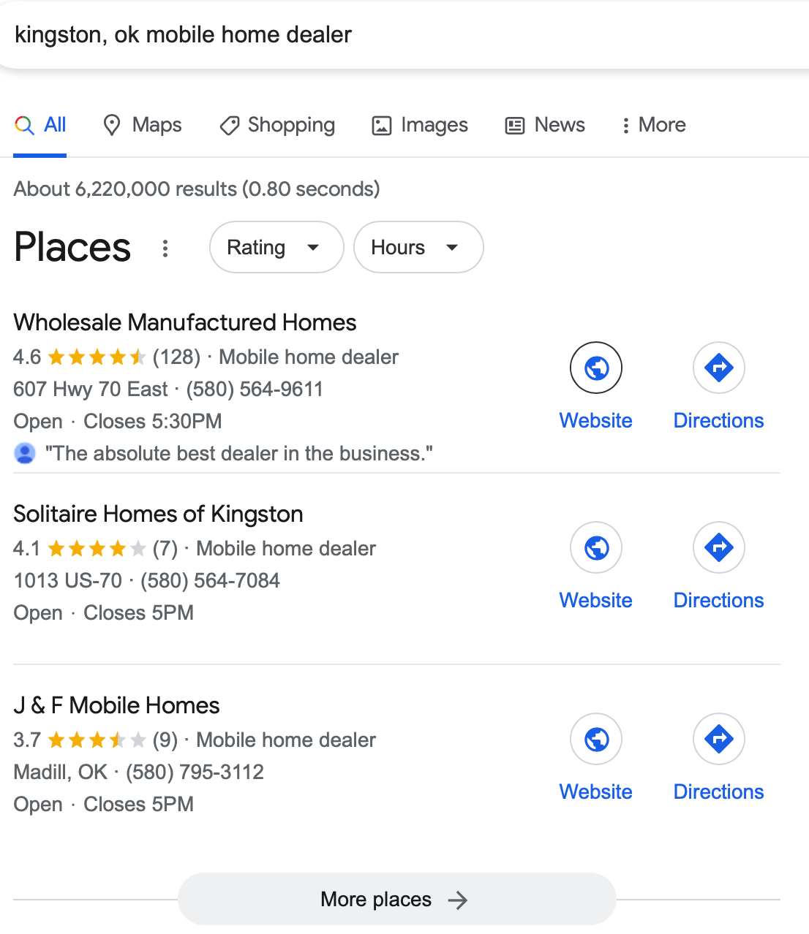
Can MH retailers get good reviews too?
Yes, yes you can.
“
Hi Mr. Customer. This is David, from Finney’s Home Center. I hope you’re enjoying your new home! I’d like to ask a favor. Would you please leave us a 5 star review on our Google business page? We’re a locally owned business, and 5 star reviews help us compete with the large, corporate stores. If you didn’t have a 5 star experience, please give me a call at this number. I want to make things right.
Here’s the link for that 5 star review. Thanks for the help!

Slide 29
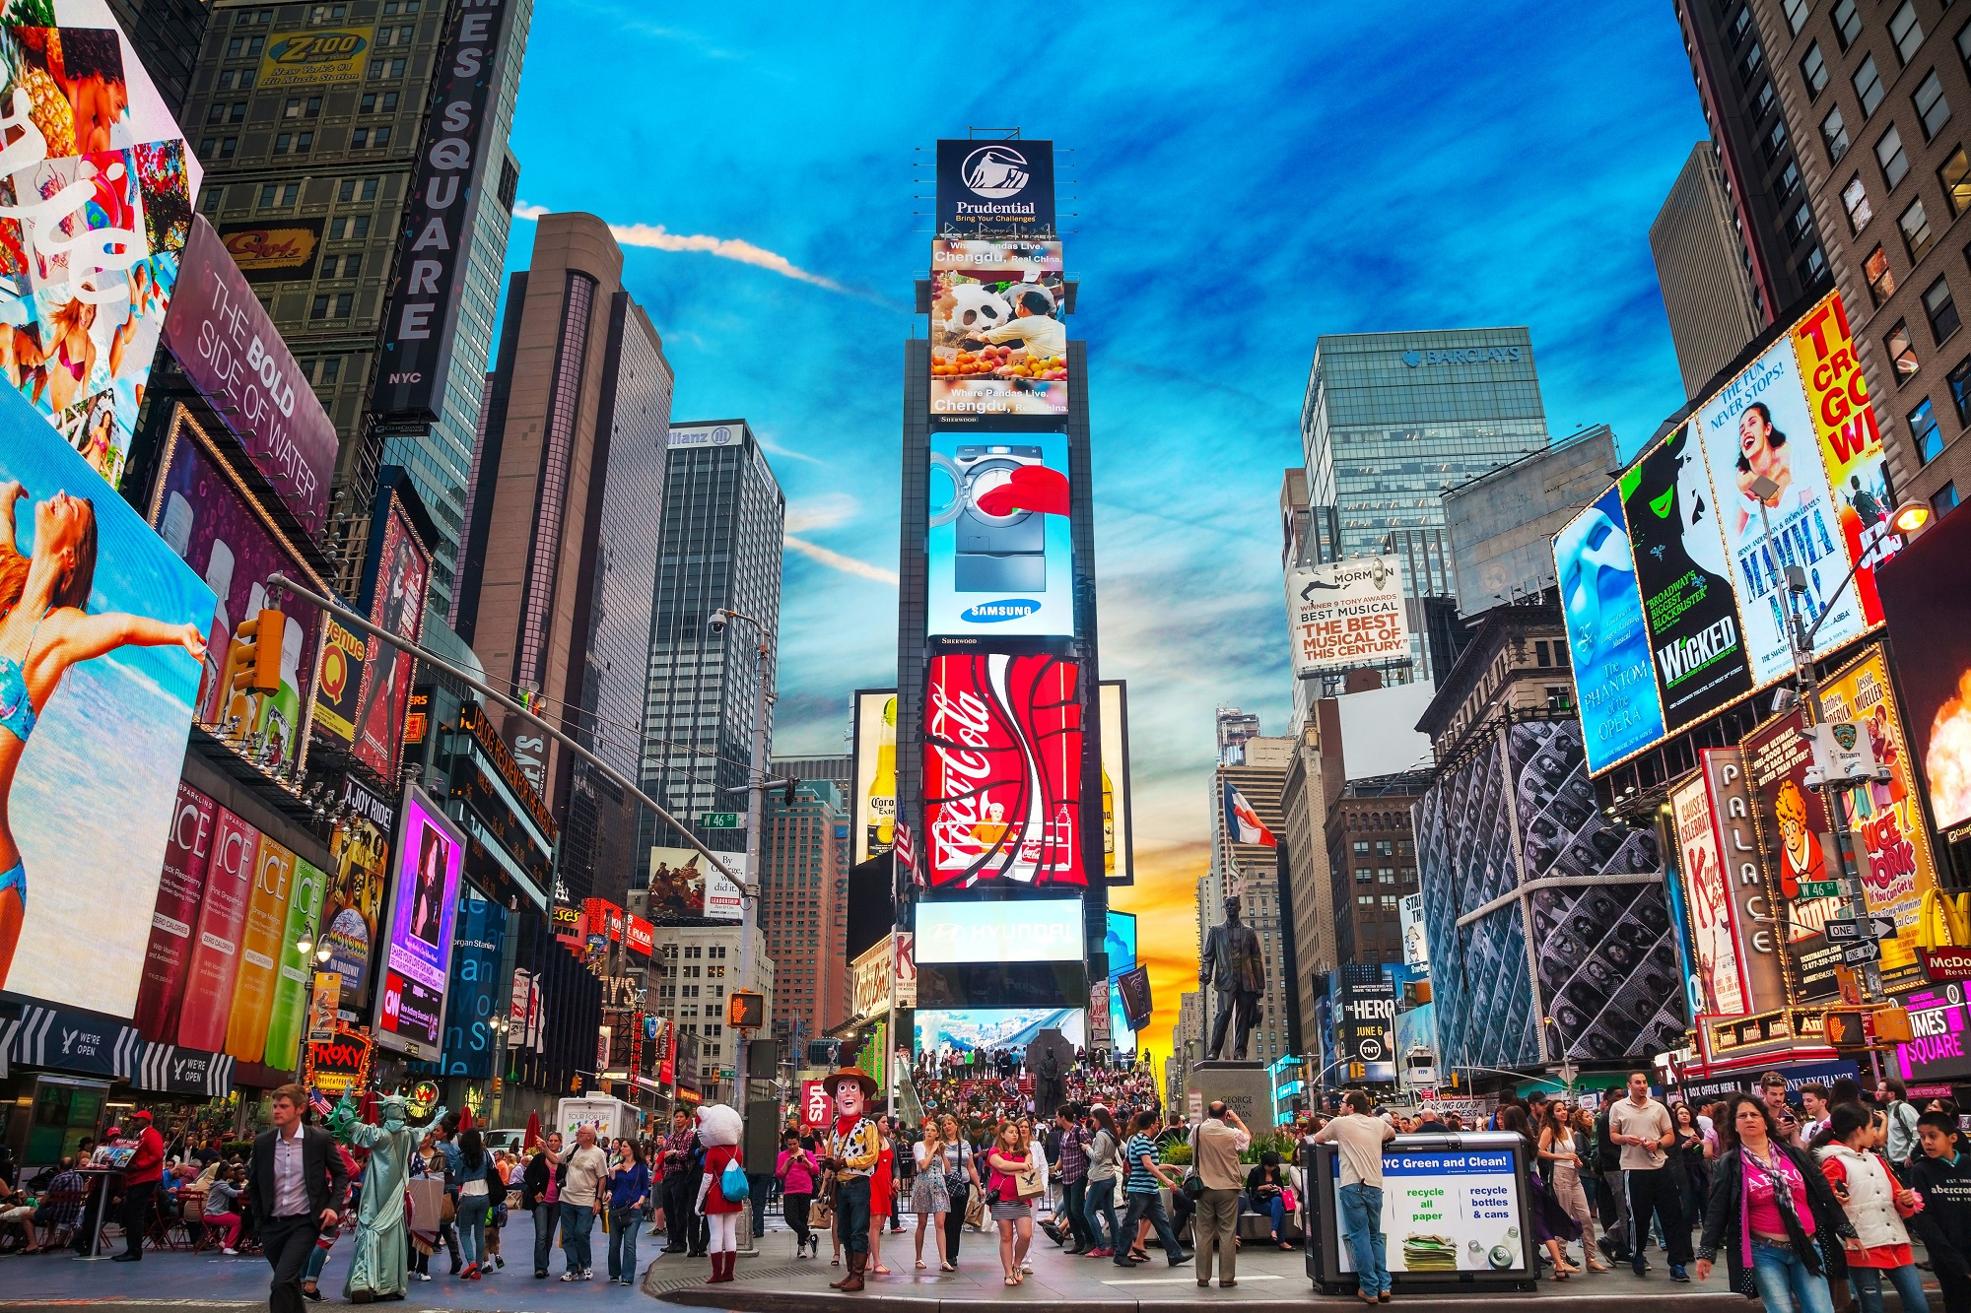
What is ‘Real World’ Marketing?
“Real World, or Traditional, marketing refers to all of the marketing techniques that predate what we now call digital marketing. Traditional marketing is any form of marketing that uses offline media to reach an audience. Basic examples of traditional marketing include things like newspaper ads and other print ads, but there are also billboards, mail advertisements, and TV and radio advertisements.”
In short? Marketing that you see in the real world.

Slide 30
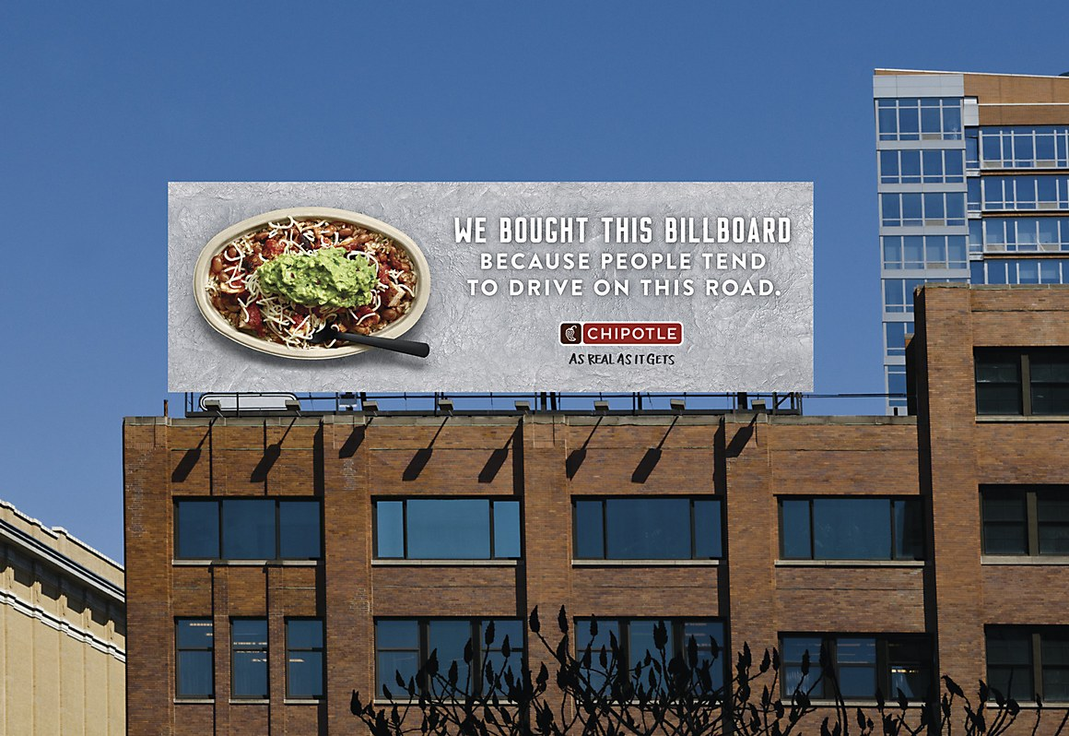
Do your buyers drive on the road?

Slide 31
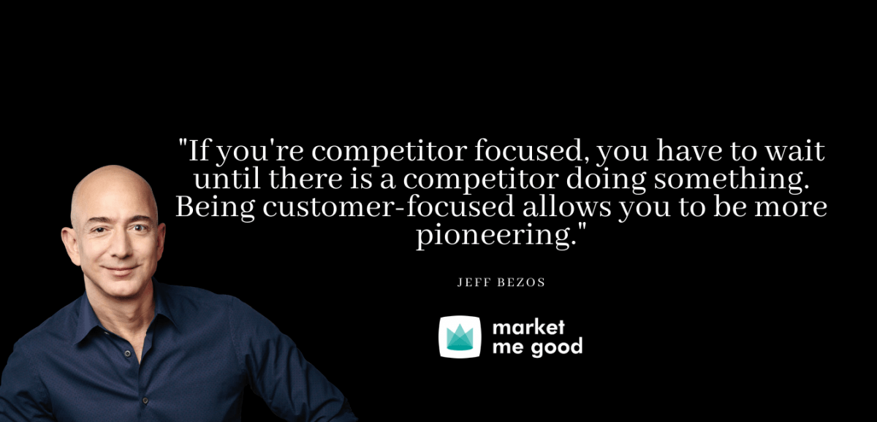
Should experience be a priority?

Slide 32
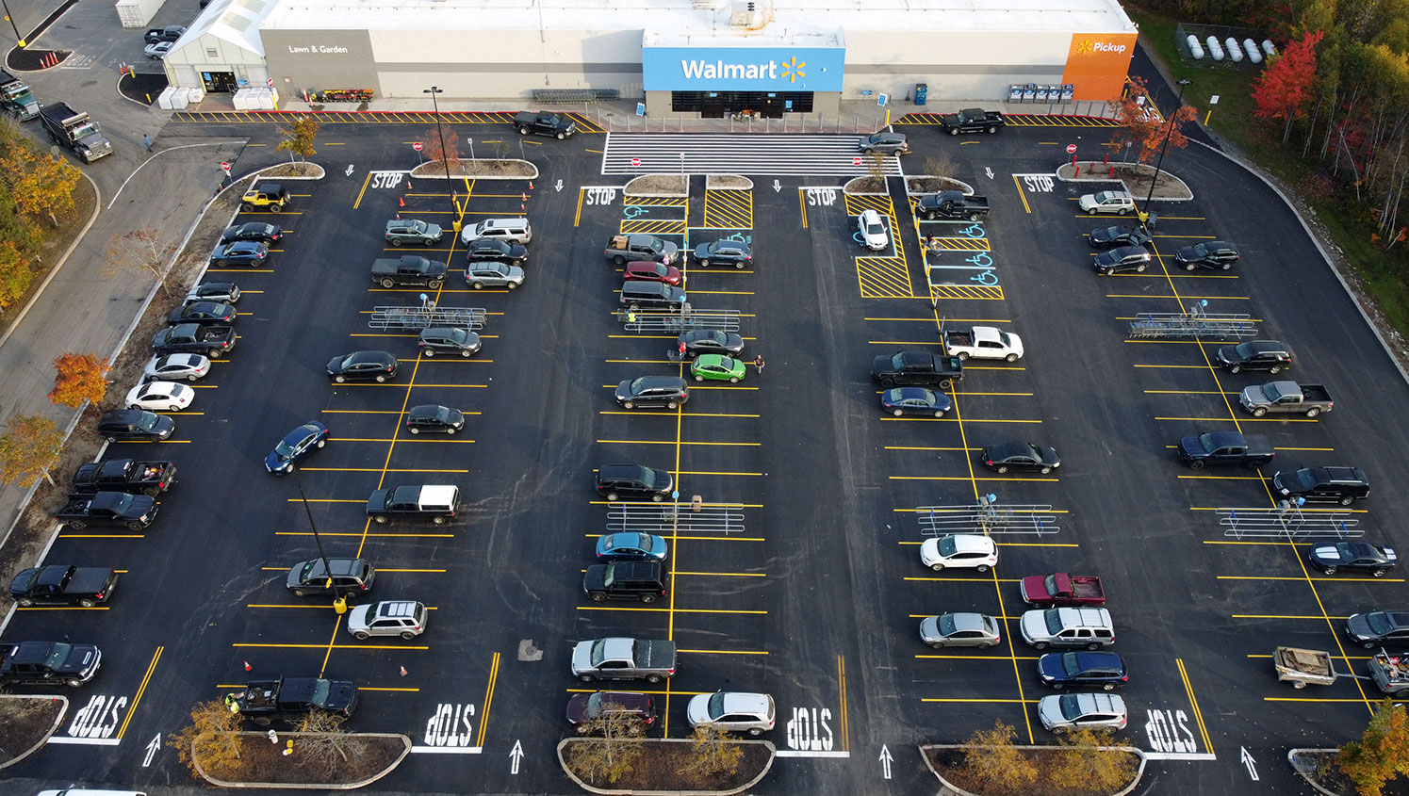
How’s the parking?

Slide 33
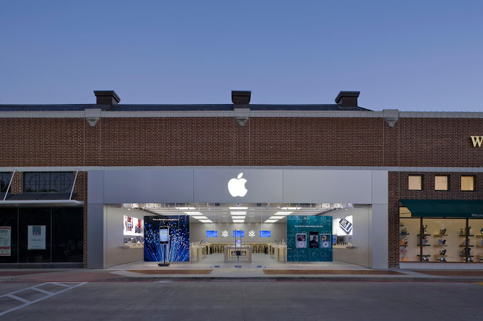
Does you store feel modern?

Slide 34
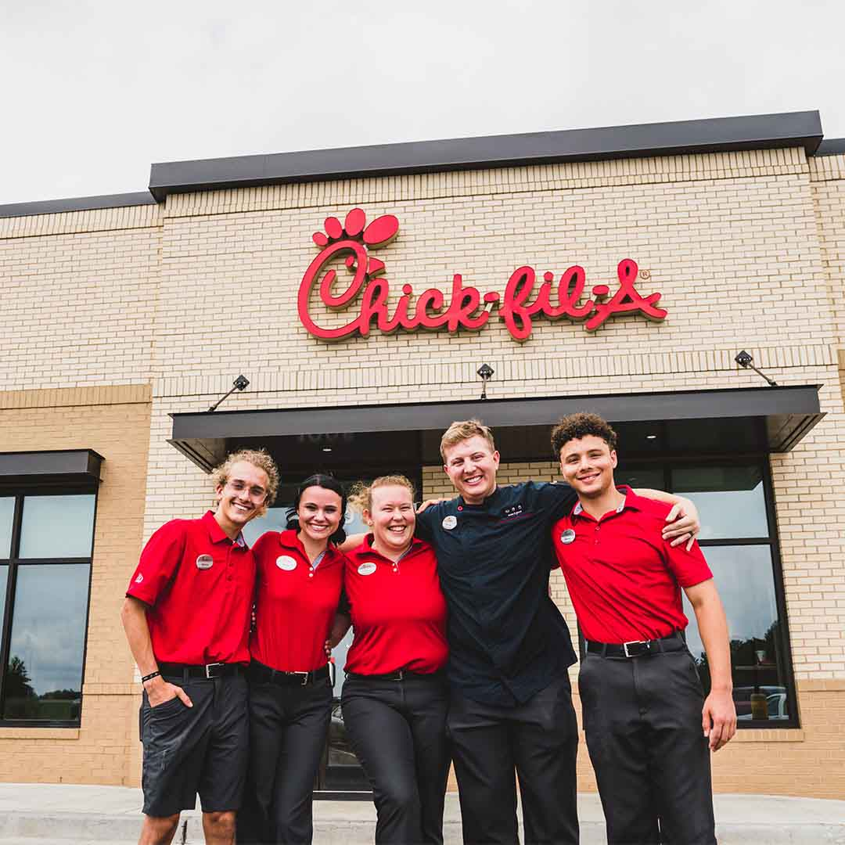
Do your employees look the part?

Slide 35
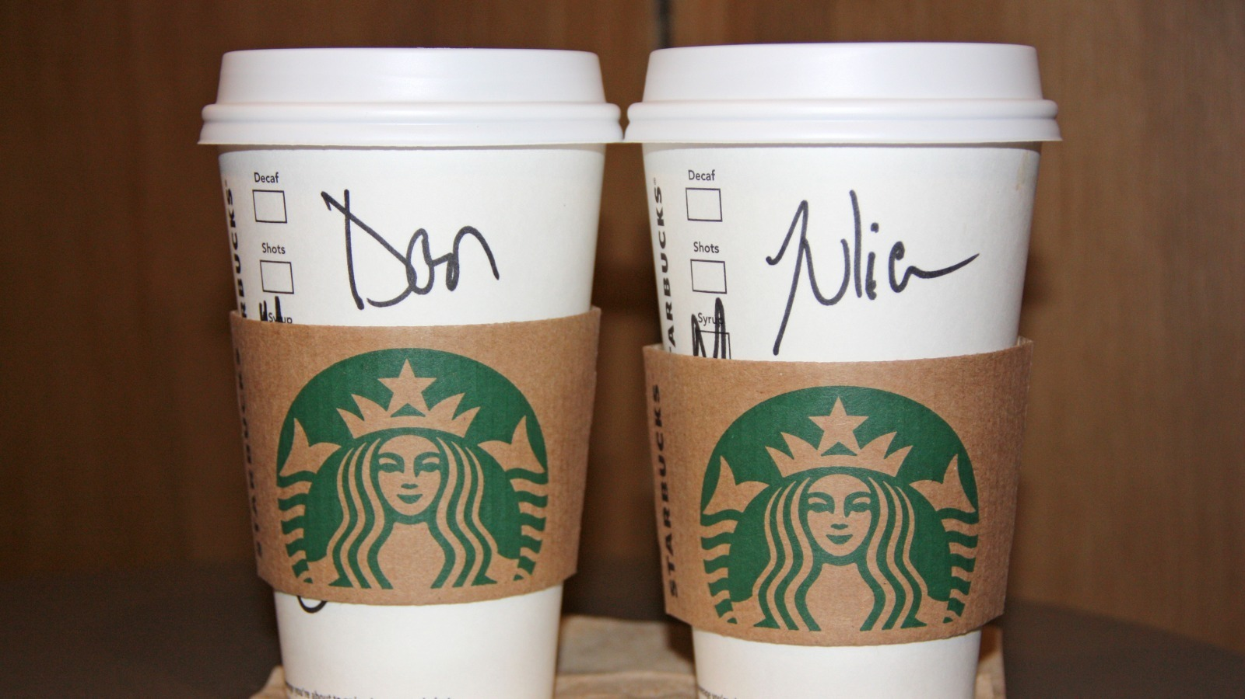
Do your buyers feel like a person, not a number?

Slide 36

Thank you for coming!
Please contact me if you ever need marketing help with your business.

