Slide 1


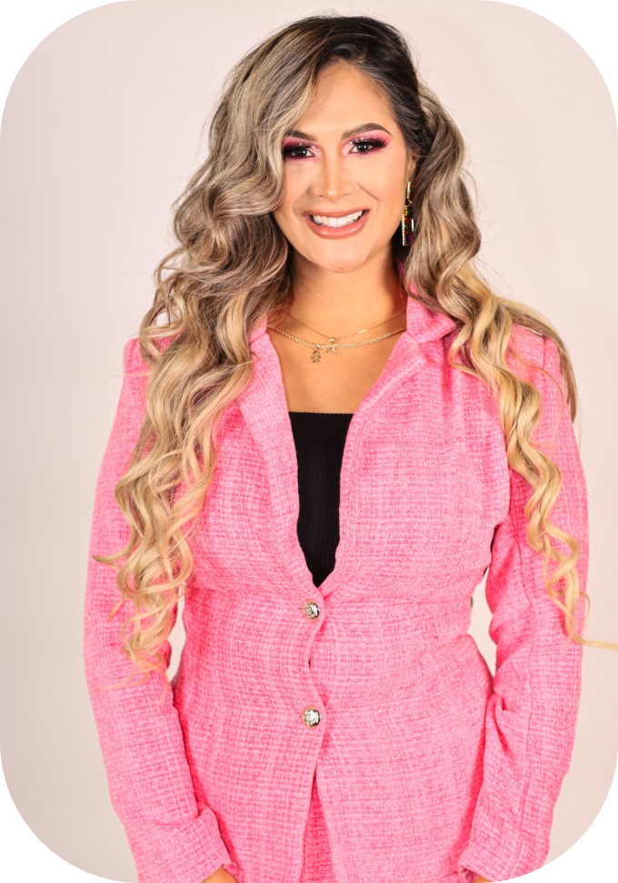

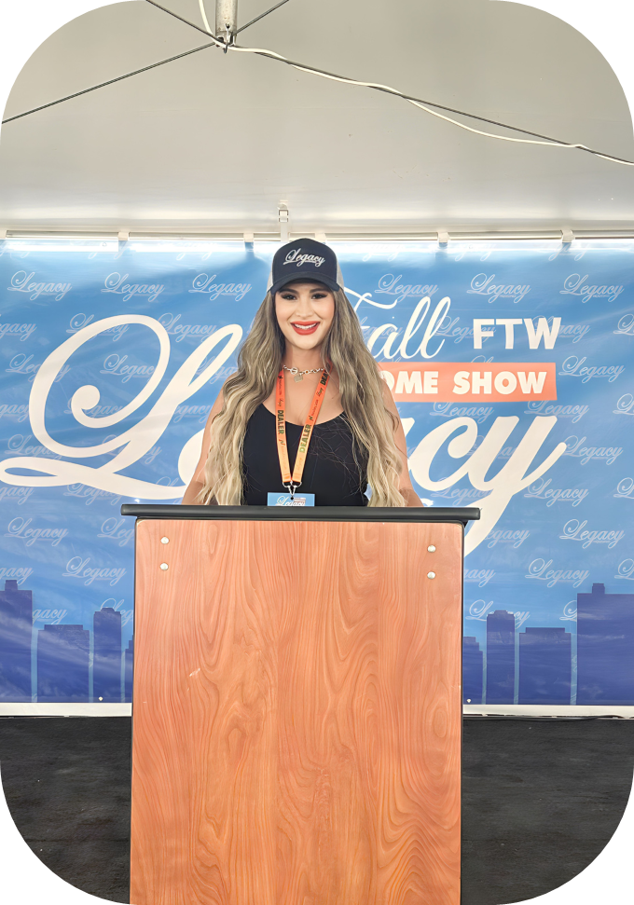

Introduction
Arilene Carrasco is the Co-Founder and CEO of Diamond Homes. An enthusiastic young woman, her focus and determination are key to her success in day-to-day operations. As a mother of a beautiful young boy and the wife of a supportive husband, she draws inspiration from her family to reach new heights. At the age of 26, she entered the manufactured home business, driven by her mission to help more families achieve homeownership. Although she acknowledges that establishing her own business was challenging, her hard work has paid off.
Arilene has built a strong reputation in the manufactured homes industry and takes pride in her dedicated team, whose collaboration continues to fuel their success. Delivering the keys of a new home to families who once believed homeownership was out of reach is what motivates her to work harder each day. Her goal is to continue pursuing her dream of helping people become proud homeowners, while fostering the growth of her company for decades to come.
For Arilene, ‘’The sky is the limit.’’

Slide 2











HOW TO MASTER SELLING & INFLUENCE ON SOCIAL MEDIA
By: Arilene Carrasco

Slide 3


Slide 4


4 YEARS AGO

Slide 5



Arilene Carrasco is the Co-Founder and CEO of Diamond Homes.
An enthusiastic young woman, her focus and determination are
key to her success in day-to-day operations. As a mother
of a beautiful young boy and the wife of a supportive
husband, she draws inspiration from her family to reach
new heights. At the age of 26, she entered the
manufactured home business, driven by her mission to
help more families achieve homeownership. Although she
acknowledges that establishing her own business was
challenging, her hard work has paid off. Arilene has built
a strong reputation in the manufactured homes industry
and takes pride in her dedicated team, whose collaboration
continues to fuel their success. Delivering the keys of a new
home to families who once believed homeownership was out
of reach is what motivates her to work harder each day.
Her goal is to continue pursuing her dream of helping people
become proud homeowners, while fostering the growth of
her company for decades to come.
For Arilene, ‘’The sky is the limit.’’

Slide 6








Slide 7



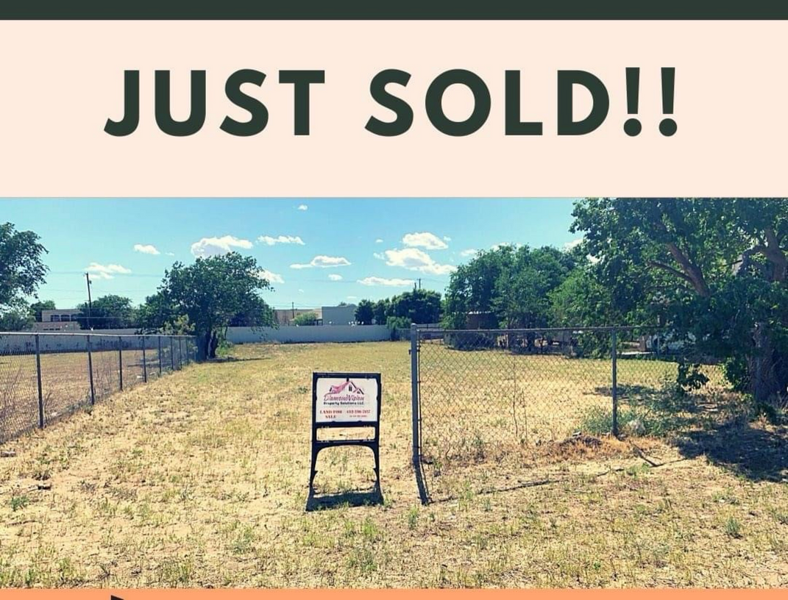

In my beginnings
2019

Slide 8
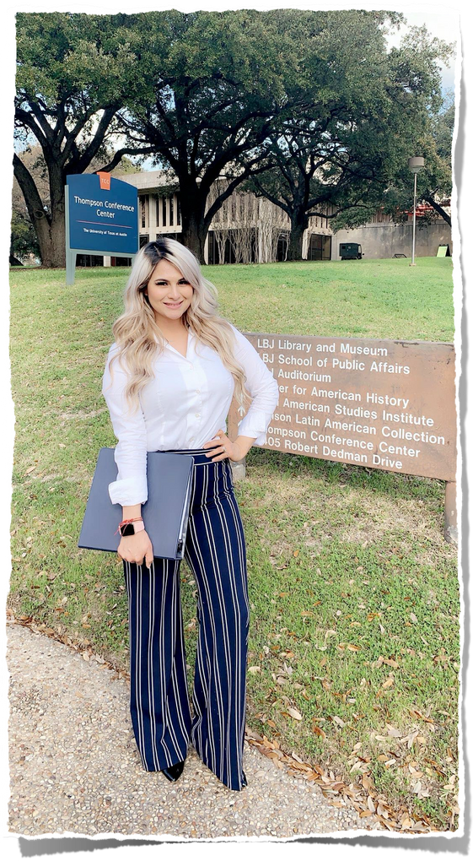
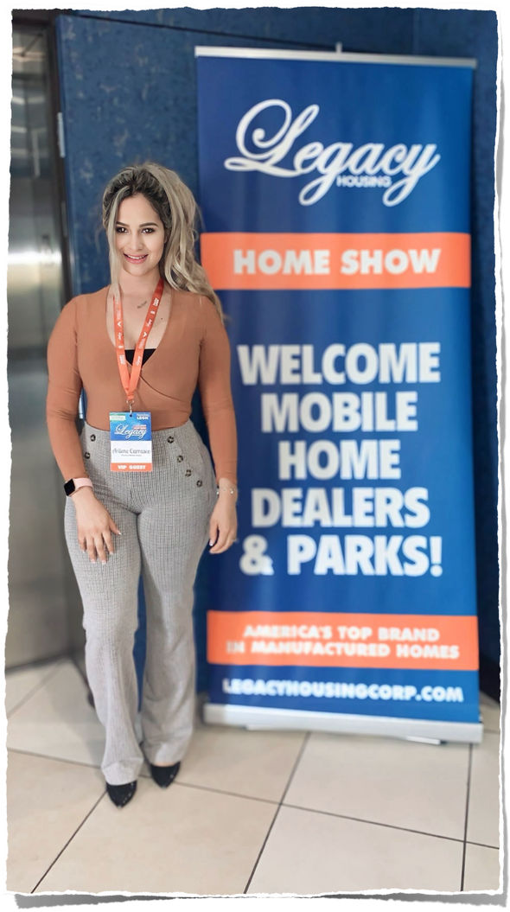
03/2020 10/2020
RBI LICENSE
1ST LEGACY HOME SHOW

Slide 9


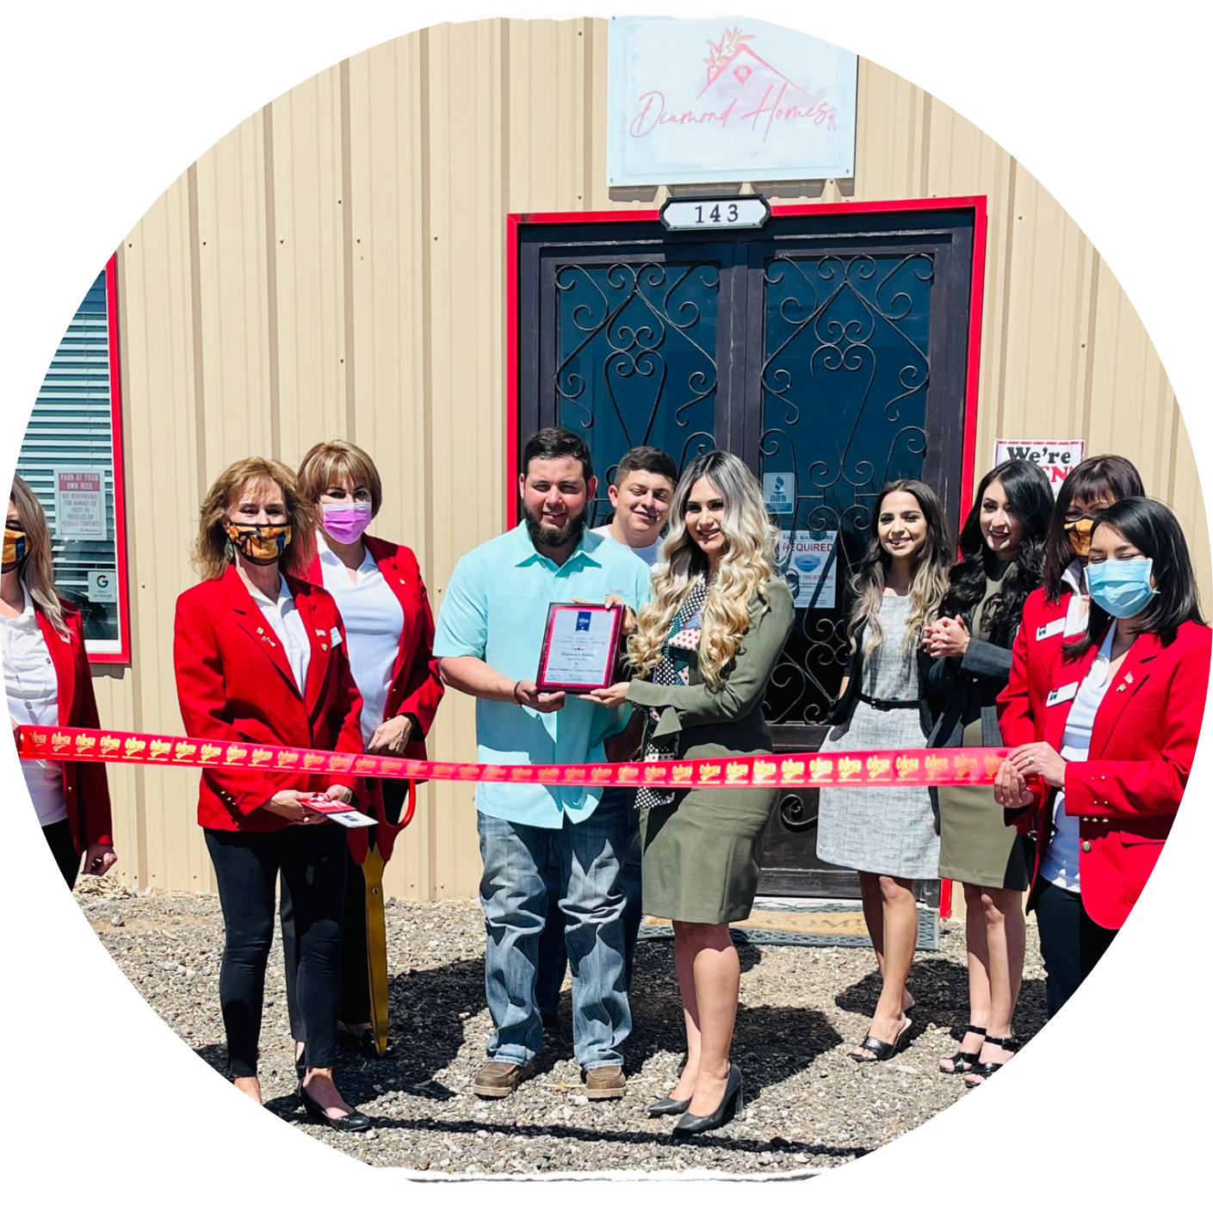




03/2021
05

Slide 10



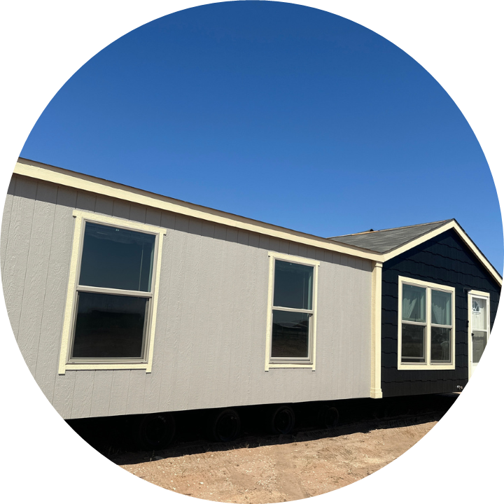




We Opened Our Business With 2 Homes
2021
2 Homes

Slide 11


‘’They bought my brand, my company, and my commitment’’

Slide 12


Slide 13



As time passes
2024
+ 30 Homes

Slide 14




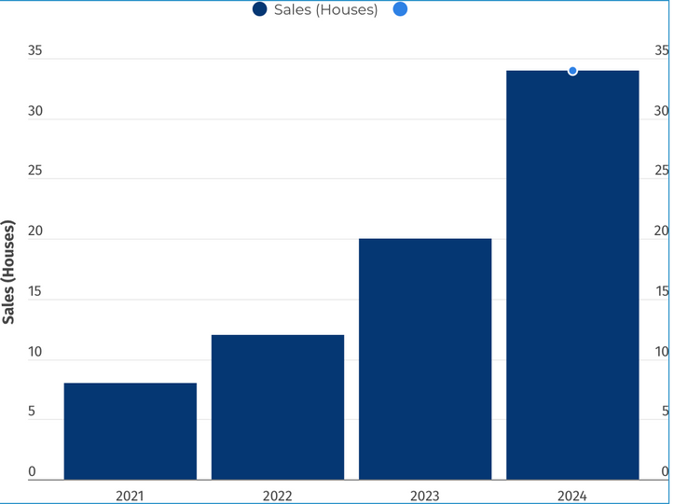
How did we do it?
Our main secret?
Being a master of social media!

Slide 15





Do You Have A Marketing Person On Your Team?

Slide 16

In today’s world, social media is not just a platform; it’s a powerful tool that can help you grow your business tremendously and help you connect with future customers.

Slide 17





Key Strategies To Become a Master of Social Media
1.- Build your Personal Brand
2.-Creating Engaging Content
3.-Developing Deep Connections
4.-Leveraging analytics

Slide 18



1-Build Your Personal Brand
Know Your Purpose:
Start by defining your goals. Many of you may already have a Vision and Mission defined. Ensure your brand’s mission and your vision align with your brand’s promise or positioning.
If your customers don’t understand the core values that drive your company, they won’t have a clear reason to choose your business.
Mission: Why you exist.
Vision: What you aim to achieve.

Slide 19
MISION:
Our mission is to provide the Permian Basin with comfy, affordable homes and exceptional service. We offer quality mobile homes tailored to our customers' needs, making the buying process easier and keeping prices fair. With transparency and integrity, we aim to exceed expectations, build lasting relationships, and become the go-to place for manufactured home.
VISION:
Diamond Mobile Homes’ vision is to simplify the home search process while maintaining the highest standards. We aim to enhance our clients' lifestyles and cater to their unique interests and preferences. Our dedication is focused on becoming a trusted and respected company, fulfilling our customers' dreams.

Slide 20




Build Your Personal Brand
Tell Your Brand’s Story
Share your brand’s story in a way that connects emotionally with your audience.

Slide 21
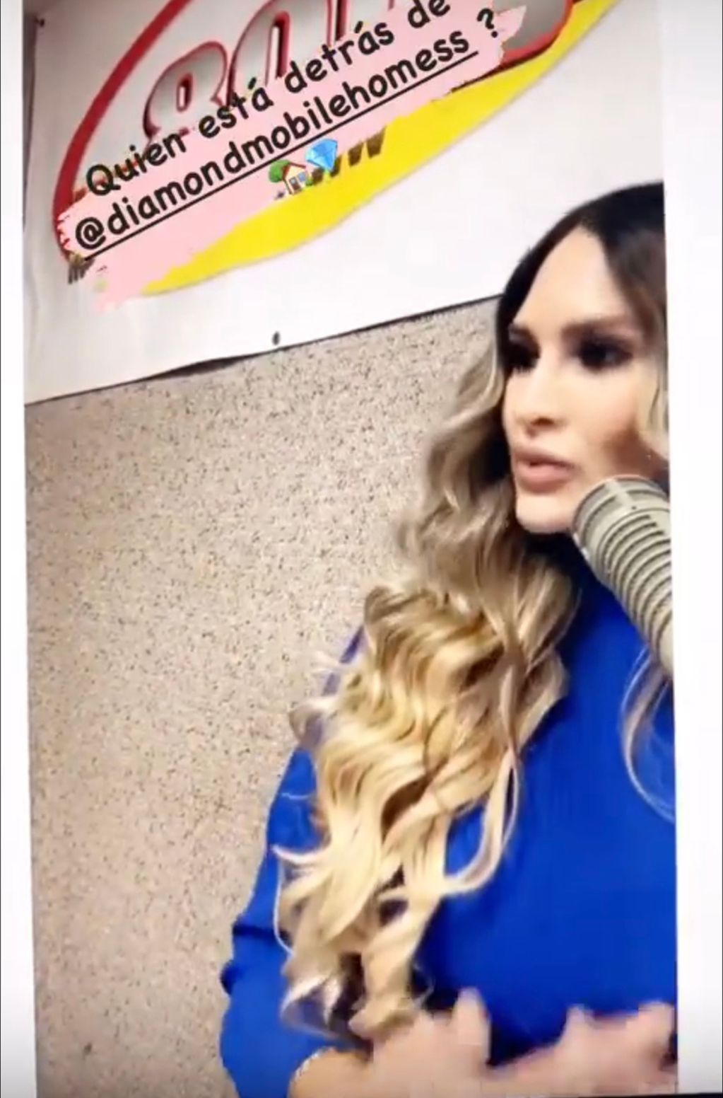


Tell Your Brand’s Story

Slide 22

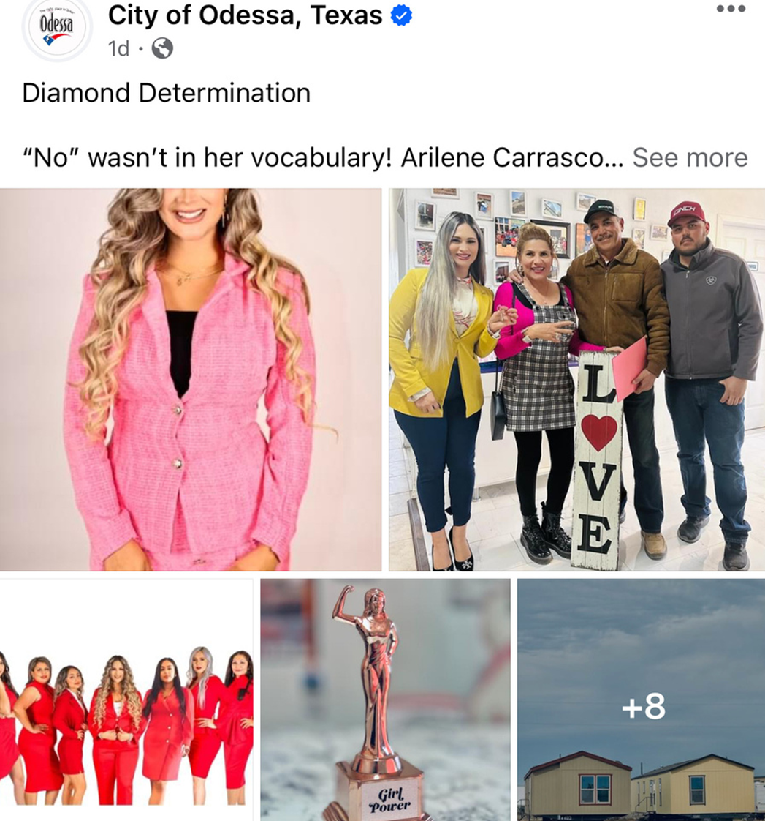









Build Your Personal Brand
Authenticity & Transparency
Always be authentic. People connect with real stories and genuine emotions. Your authenticity will set you apart and help build trust and loyalty. Show real-life experiences, behind-the-scenes moments, and be transparent about your intentions.
My sales team can attest to this: I have never sent them out to shop around and see what other dealerships are doing. I believe in authenticity, and our mission is clear: it is simply to solve the problem for a customer who walks into our office looking to buy a home. We don’t need to copy what our competition is doing in order to succeed. Instead, we are always seeking to innovate and try different approaches so we can stand out and differentiate ourselves from the rest of our competition.
Consistency is Key
Establishing a consistent posting schedule on all social media platforms is crucial for your business. This consistency helps your audience recognize and relate to your brand.
REPEAT

Slide 23





Live Streams
Live streams are crucial for helping our Facebook audience get to know us better, see how we interact, and experience our environment. This builds trust and engages potential future clients.

Slide 24






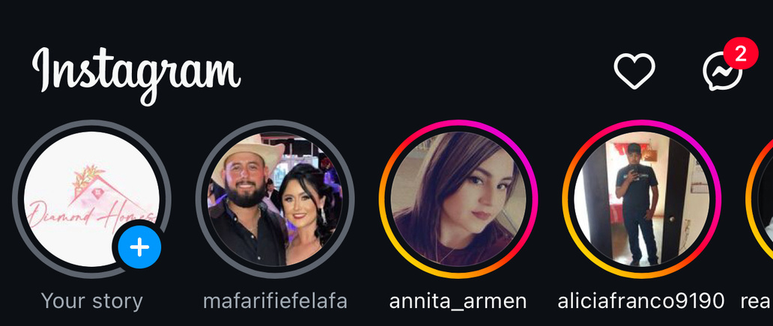




Tips:
We share story posts every day, typically posting about 3-10 stories daily on our Facebook and Instagram platforms.

Slide 25
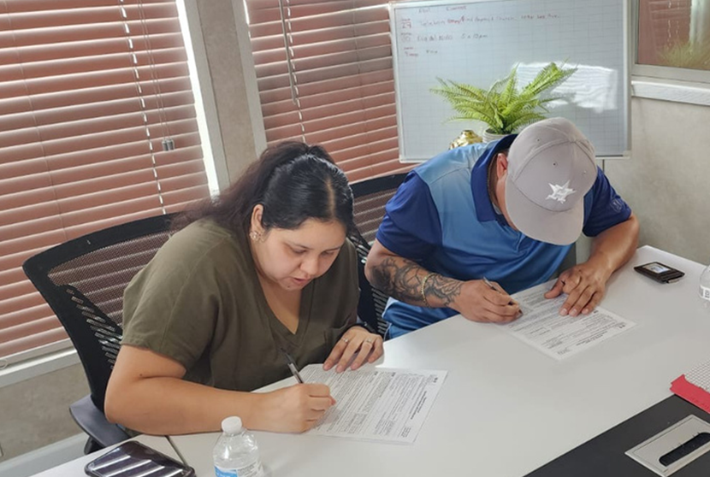
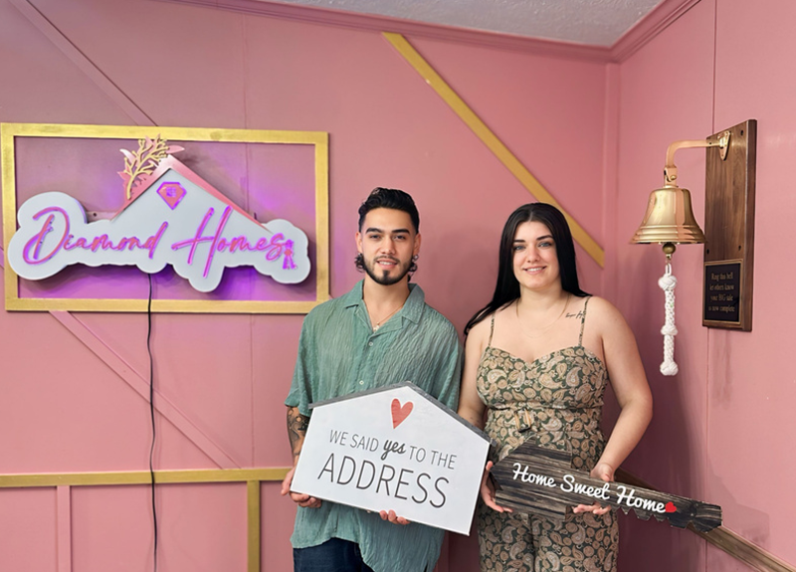
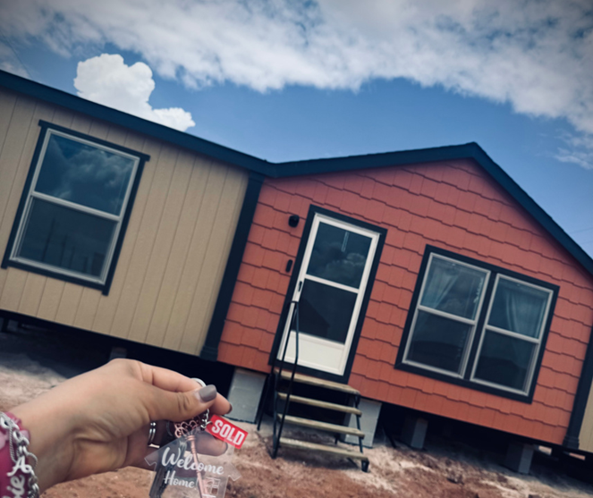

People are interested in seeing how we work and understanding the real process behind it.

Slide 26
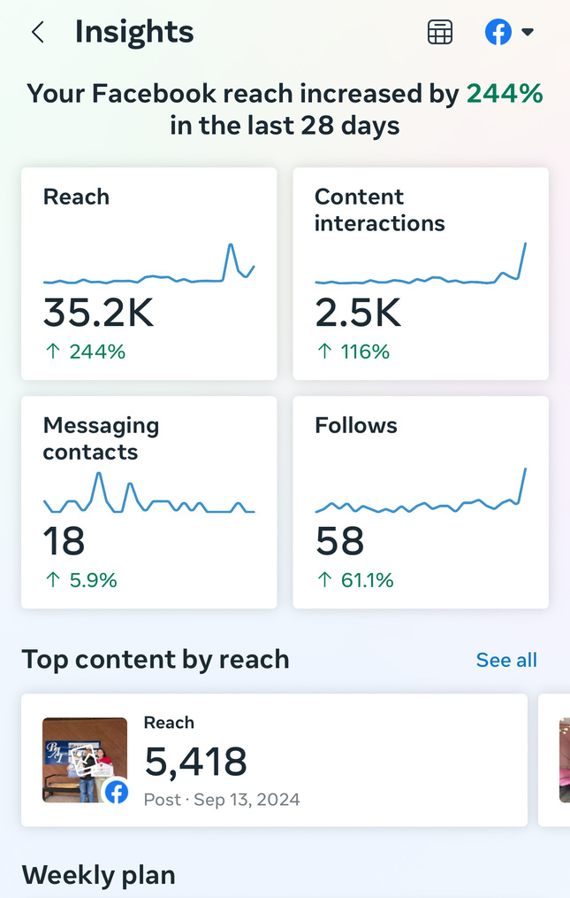

2-Creating Engaging Content
Know Your Audience:
Research your target audience's interests, preferences, and needs. That way you can get a clear picture of your audience’s needs and tailor your content to engage them effectively.

Slide 27
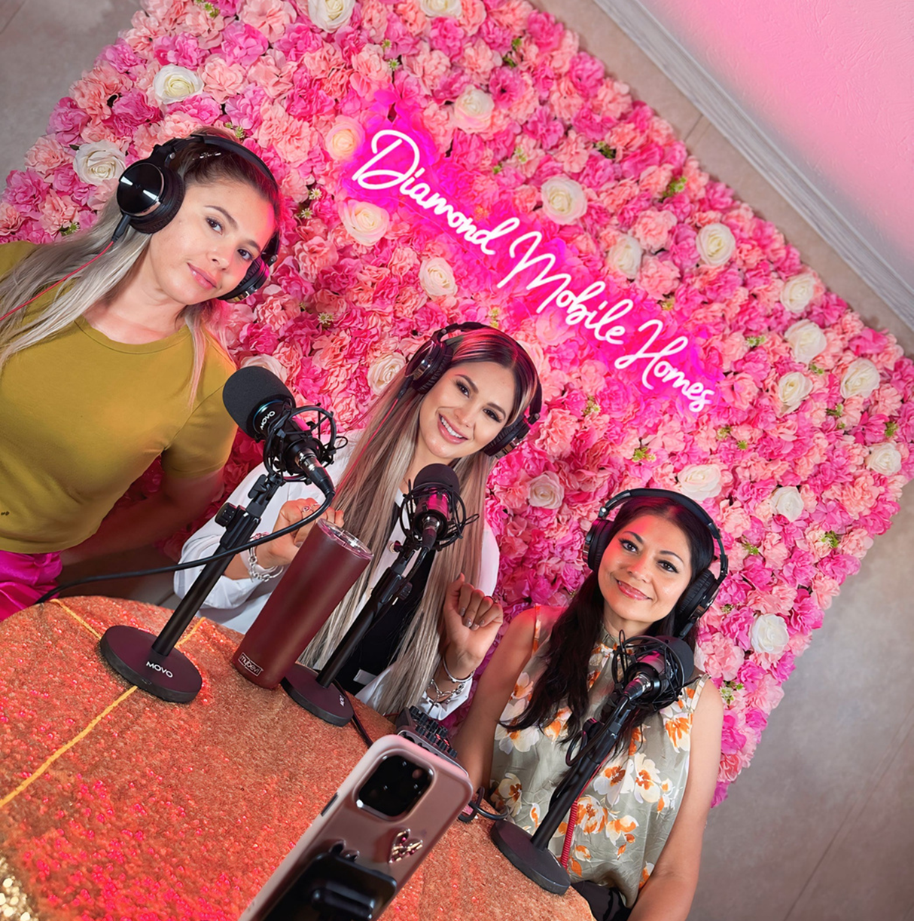

Value-Driven Content:
Focus on creating content that provides value, whether through education, inspiration, or entertainment.

Slide 28


Be Creative:
Stay updated on trends, but always add your unique point of view.
If something or someone is popular at the moment, take advantage of that trend and create content that attracts your audience, but make sure it aligns with your business.

Slide 29

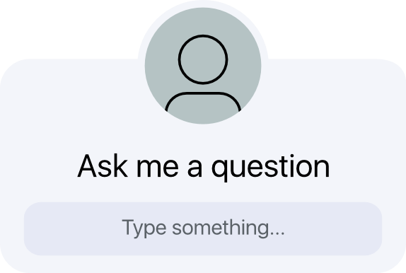


3. Developing Deep Connections
Engage Actively:
Don’t just post content—engage with your audience by responding to comments, asking questions, and participating in discussions.

Slide 30
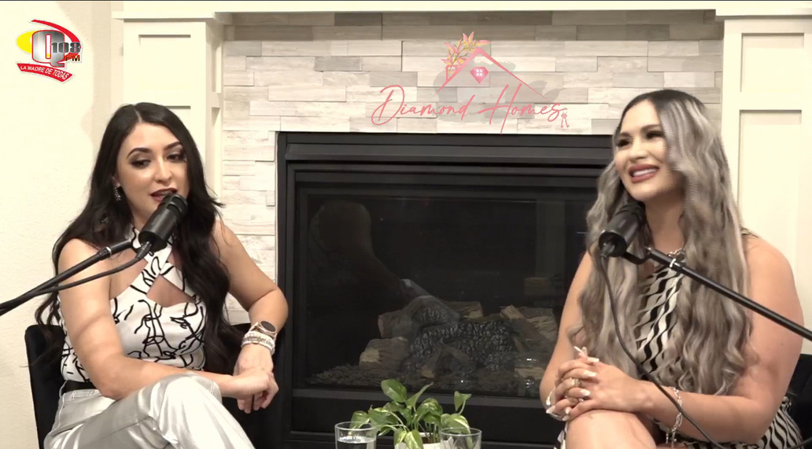



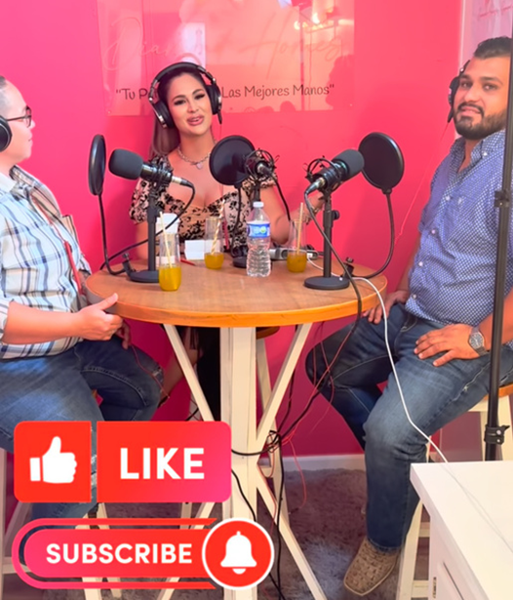
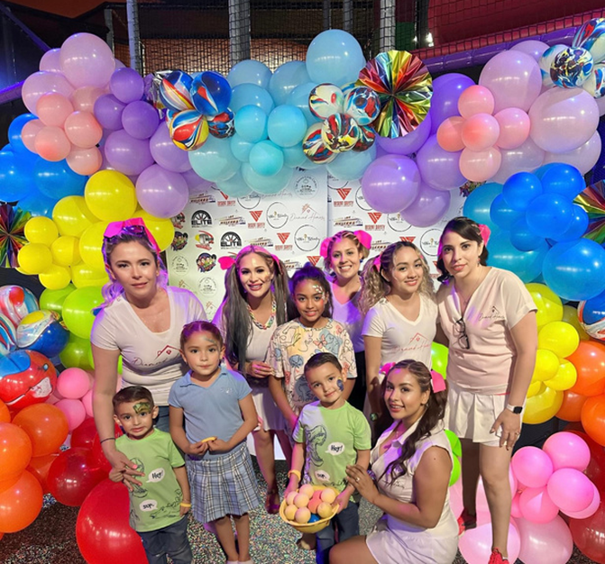
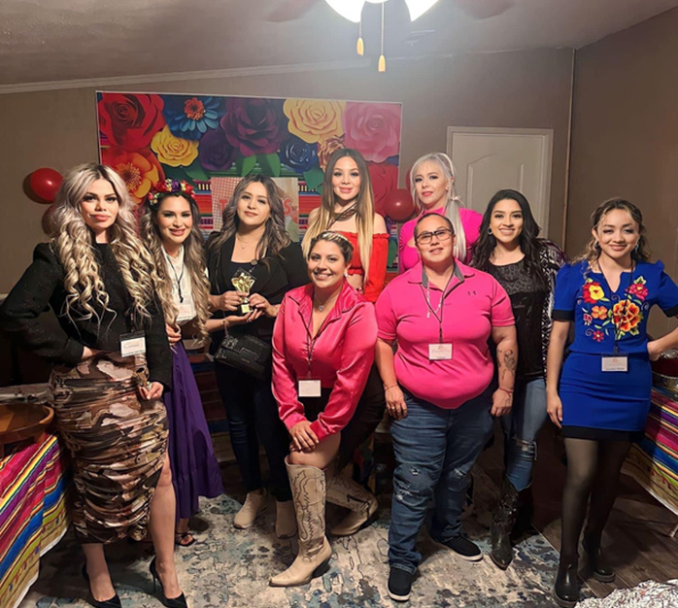
Be Social:
Remember, social media is about interaction. Collaborate with others to expand your reach.

Slide 31
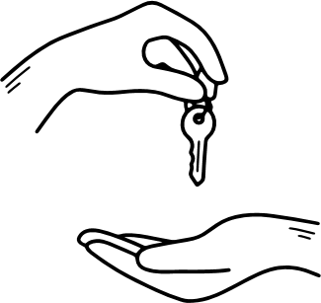
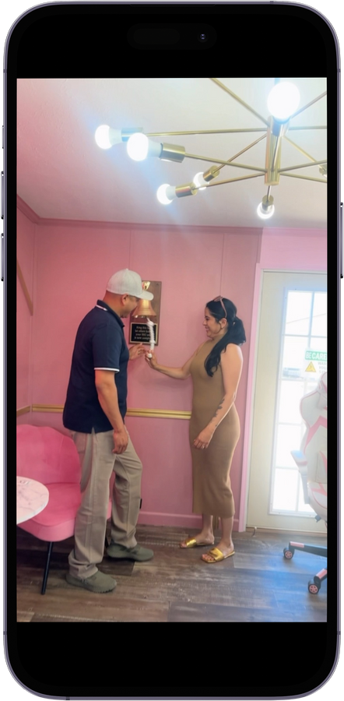
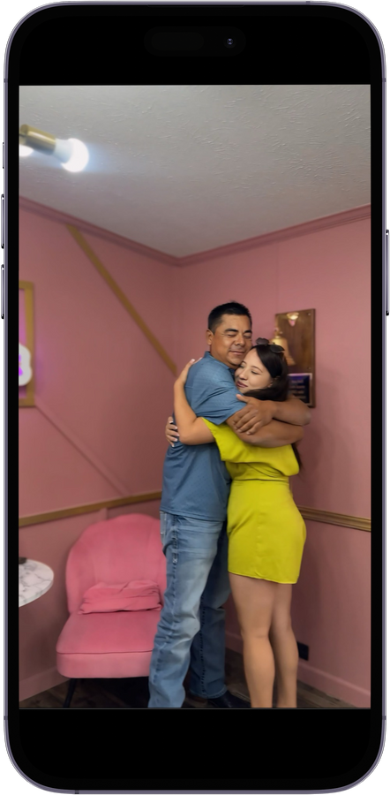
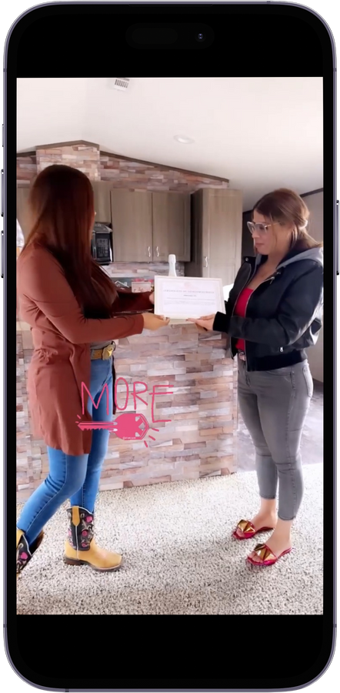

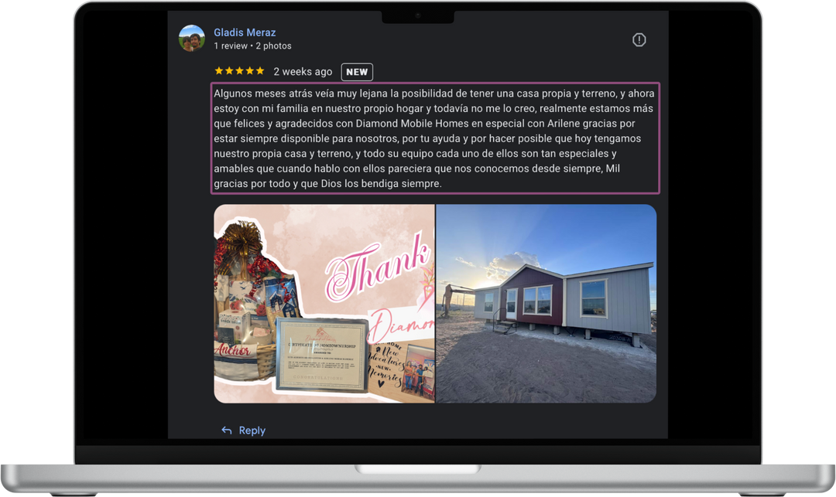

Be Social:
Notes:
poner fotos relacionadas con el tema

Slide 32
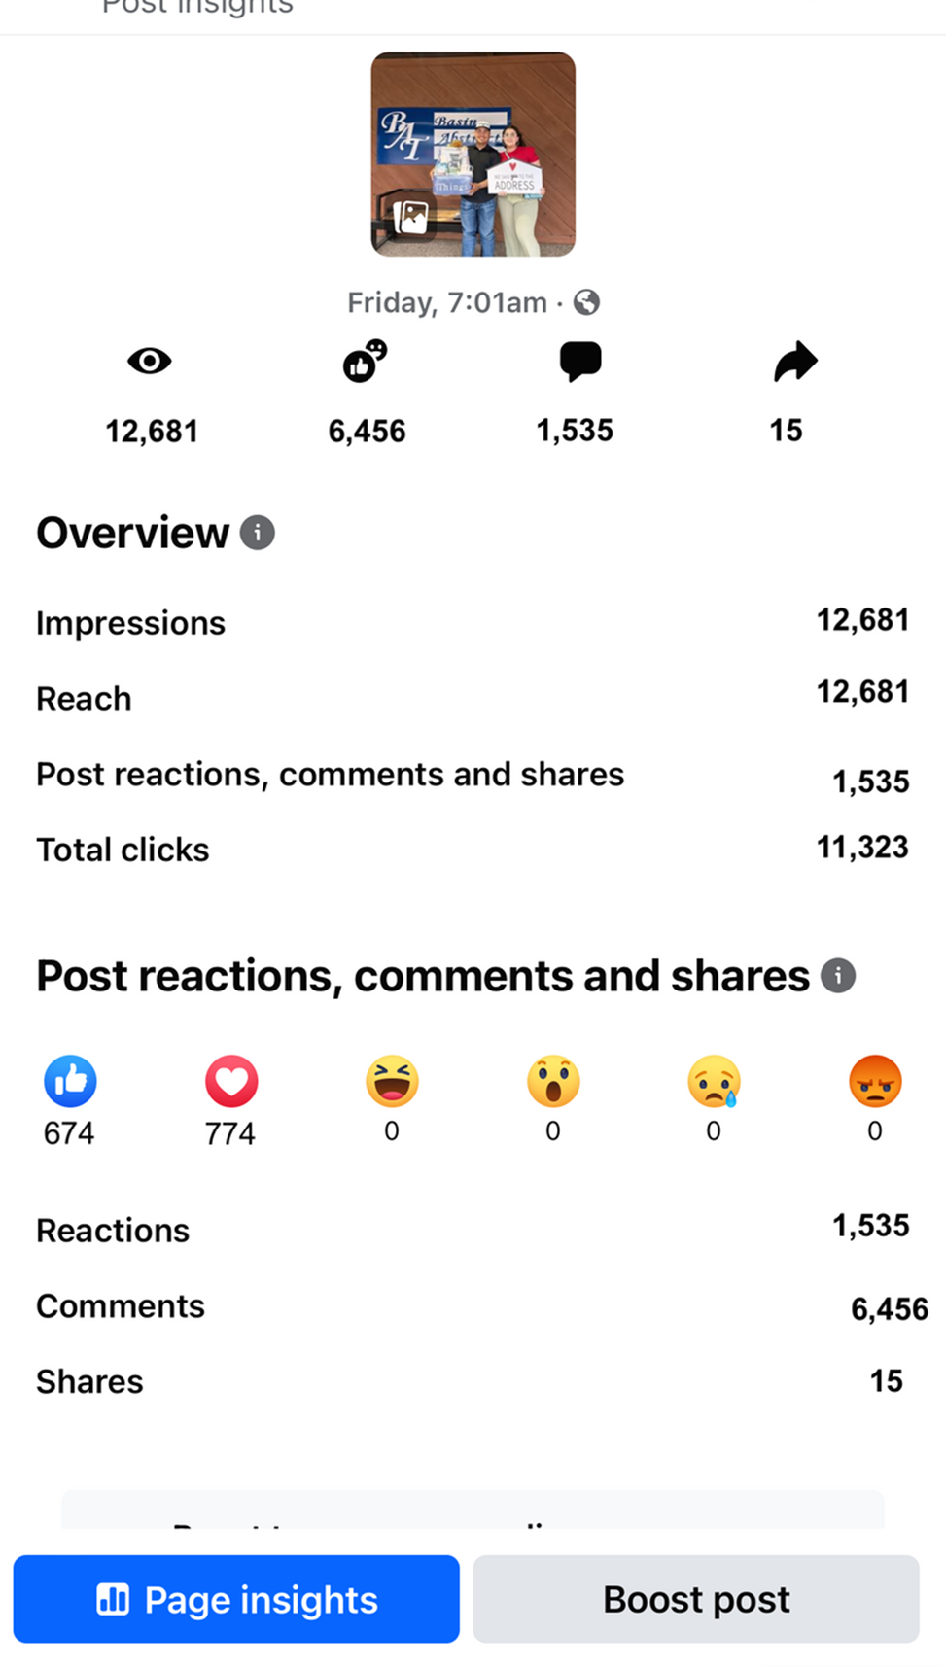

Be Social:
Notes:
poner fotos relacionadas con el tema

Slide 33


4.- Leveraging Analytics
Monitor Performance:
Track how your posts are performing and adjust your strategies accordingly.
Adapt:
Be flexible and evolve your approach based on data.

Slide 34

We know that managing social media pages can be challenging, even for experts. It requires a lot of effort and time, which is why we use tools to help manage our social media platforms. I’m going to share two essential tools that we use to excel in social media.

Slide 35







Tools
Scheduling posts
1.-
Hootsuite is a comprehensive social media marketing and management tool that helps with scheduling posts, managing multiple accounts, and tracking engagement all in one place.
*On this platform you can schedule up to 350 future posts at once.
Hootsuite has a 30 day free trial.
https://www.hootsuite.com/select-plan

Slide 36




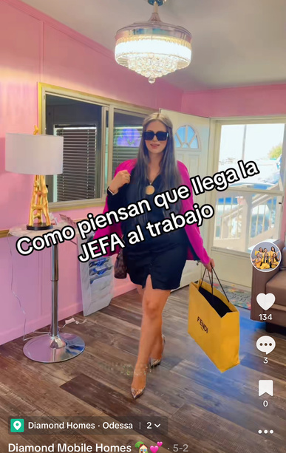
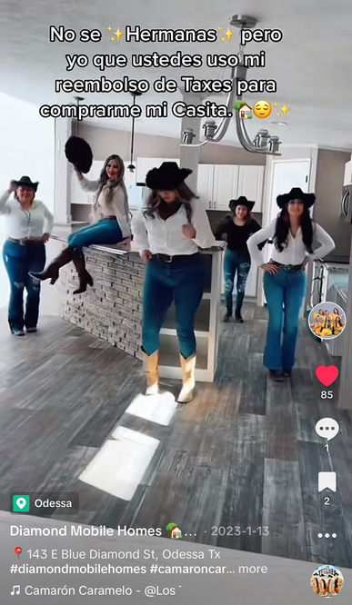
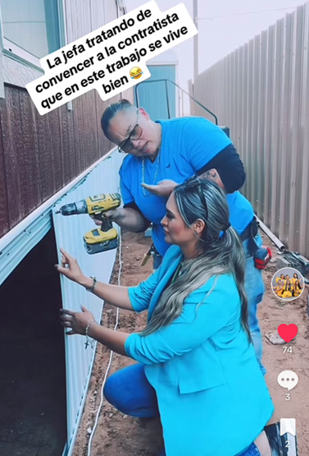

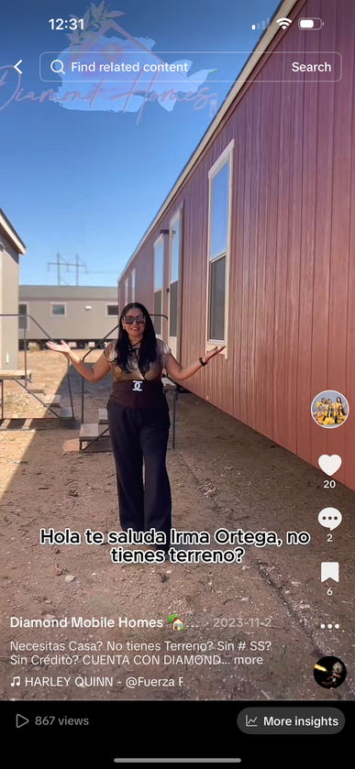
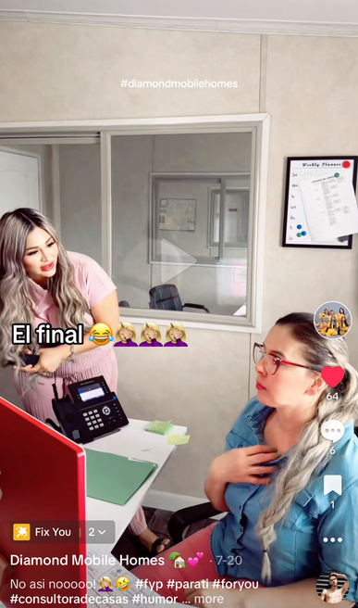
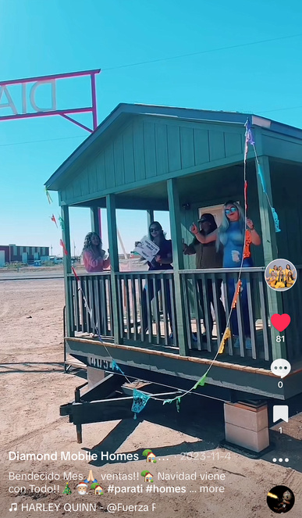

Notes:
poner fotos chistosas

Slide 37


Tools
2.-
Canva helps us create social media posts, presentations, posters, videos, and more. It’s important for us to design posts that attract attention, so we use eye-catching templates to achieve that.

Slide 38


FLYERS

Slide 39

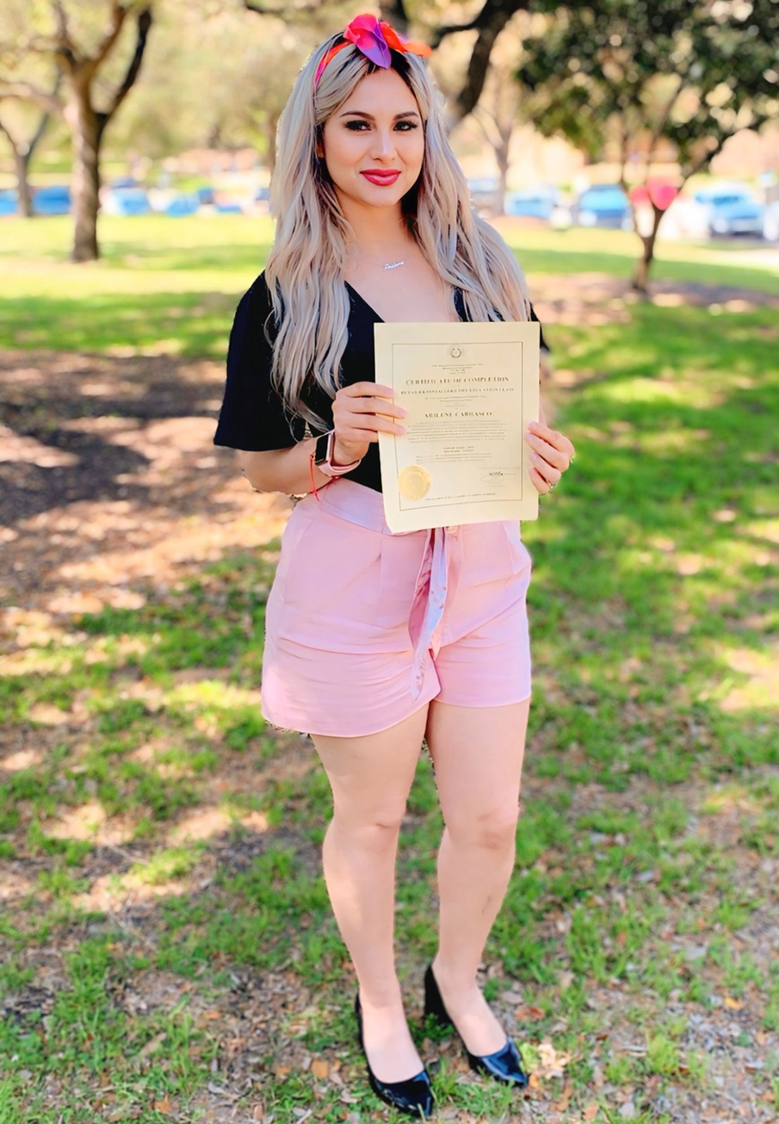


VS
ME AT 26
JUST PASSED MY RBI EXAM

Slide 40






Diamond Mobile Homes has been voted as
‘’The Best Manufactured Home Dealership’’
in the Permian Basin since established!!

Slide 41


Start today by applying these strategies to your social media presence, and watch how you transition from a user to a true master of the platforms.

Slide 42


Slide 43


Always be selling!
PROMOTE, PROMOTE, PROMOTE.

Slide 44




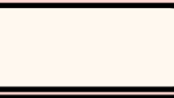




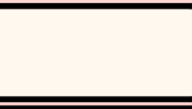




Arilene Carrasco
Thank You
432-236-7127
info@diamondhomess.com
https://www.diamondhomess.com
7561 S Hwy 385, Odessa, TX 79766

Slide 45


