Slide 1
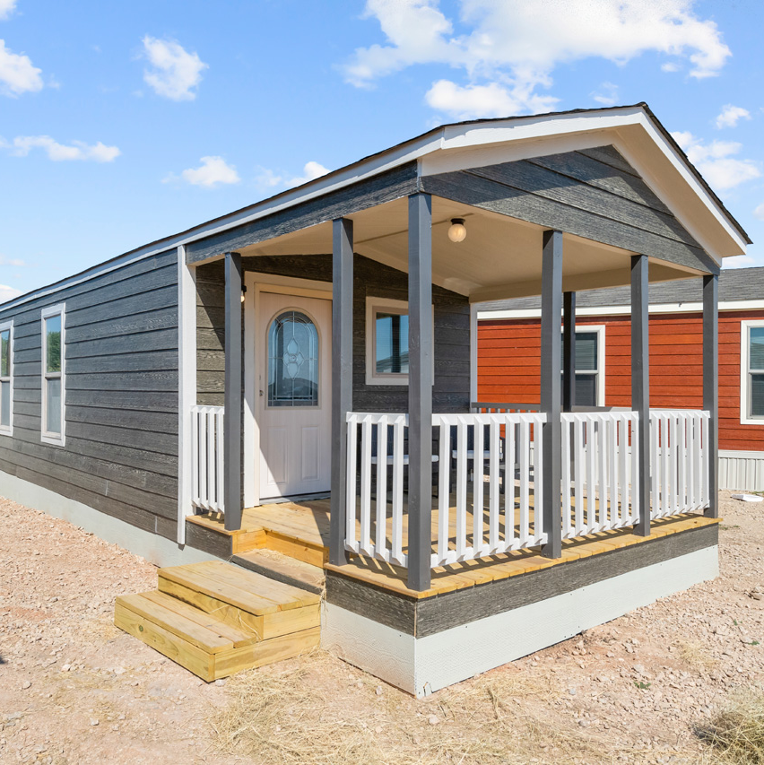
9 Steps to the Sale
Processes Solve Problems.
Craig Austin

Slide 2
The Agenda
The Greeting
The Gameplan
1.
2.
3.
4.
5.
6.
7.
8.
9.
Building Rapport
The Show
The 4-Step Process
The Close
The Interview
The TO
The Review

Slide 3

Are you a Friendly Professional or a Professional Friend?
Are you a Salesperson or a Sales Consultant?
Salesperson vs Sales Consultant
I want to know more.
I want to sell more.
Let's look at the difference...
What is a Professional Friend?
A professional friend is an association between 2 or more people that is based on the service provided to the customer in a safe and appropriate manner. A professional relationship is a formal relationship whereas a friend is informal, open and free. It is not set in a structured way.
What is a Friendly Professional?
A friendly professional is an association between 2 or more people that is based on a combination of affection, loyalty, love, respect and trust. The general traits of a friendship include similar interests, mutual respect, an attachment to each other and is never one-sided. This often results in the other person knowing you better than you know yourself. A friendly professional is an informal relationship whereas a professional friend is formal and has an ethical business relationship with the customer.

Slide 4
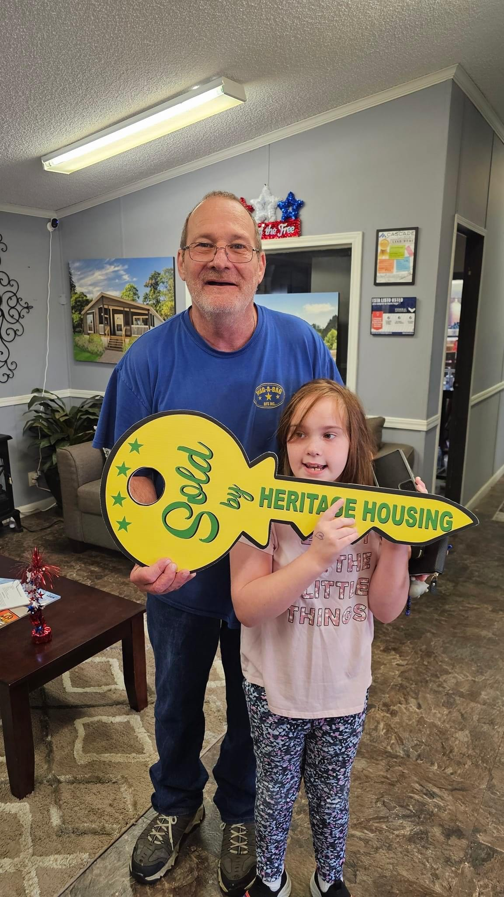

The Training Objective
The 9-step process builds trust and effectively matches customers with homes, boosting sales and satisfaction.

Slide 5
The Greeting
Hello!
Welcome the customer and ask if they've visited or spoken to any other consultants before.
E.g., "Hi! Welcome to Heritage Housing and you are? Have you been in before or spoken to any consultants on the phone?"

Slide 6

Building Rapport
Establish common ground to ease high stress levels and build a connection with the customer.
This is one of the most important things to do after you sit them down in your office. Stress levels are high at this point, and we must find some common ground before we can ever move forward with our presentation.

Slide 7

The 4-Step Process
01 Company Overview: Briefly introduce Heritage Housing.
02 Customer Needs: Understand what the customer is looking for.
03 Home Tour: Show homes based on their preferences.
04 Pricing Discussion: Provide pricing details for the chosen home.

Slide 8
We do things a little differently than everyone else. We've come up with a system designed to save you time.
The
4-Step Process
First, let me tell you about our company.
Second, I want to get an idea of what you're looking for.
Third, based on your ideals (wants and needs) I'll take you out and show you some homes.
Fourth, when you find the one you want, and I know you will,
Fifth, I'll bring you back in for some pricing information. Does that seem fair?

Slide 9
The Interview
Finding out the 5 W's: WHO, WHY, WHAT, WHEN and WHERE. Have a conversation and slow down. Bankers call this conversational interviewing.
Use open-minded questions.
Be engaged; Learn their pain points. This should not feel like a sleazy sales pitch.
Build trust; Show them you care.

Slide 10
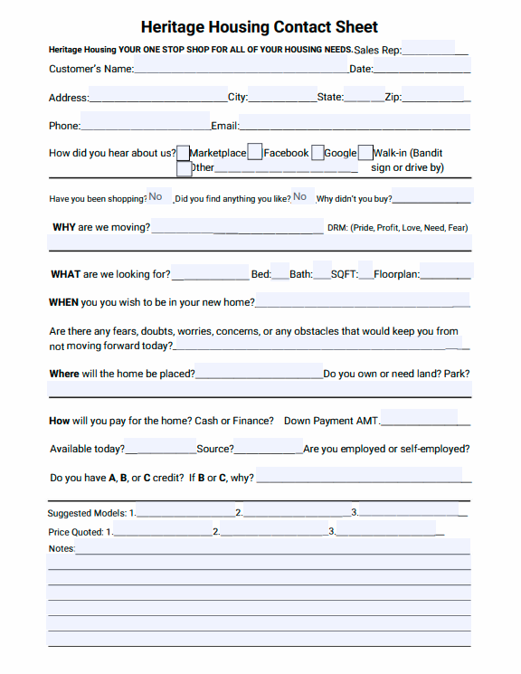
The Matchmaker

Slide 11
The Review
This step is mandatory and is essential to leading the prospect in providing additional information.
Review interview information with the customer to ensure accuracy and build further trust. Allow customers to confirm or adjust their needs.
This is a POWERFUL step. The customers will either agree that this is what they're looking for, or they tell you why it isn't.

Slide 12
Selling is problem solving. You can't solve a problem you have never identified. This is exactly what you do when you try to sell any home without the harnessing the information gained from a completed interview.
01 Collaborate with the General Manager and produce a solution of what homes to show.
02 Select 3 homes, allowing the General Manager a chance to aid you in the process and to stay updated with who you're working with and the status.
03 Use this time to prepare for The Show begins.
The Gameplan
Between you and the General Manager.

Slide 13
The Show
Only show 3 homes to avoid confusion.
Your competition will do that for you.
Emphasize value over cost.
1st Home: Focus on featuring the exterior; ground to roof. After, take them in the home for a look around. Once they've seen it all, ask for a ranking of 1-10. Expect a low score and listen to what they say would make it a 10. | 2nd Home: Focus on featuring the exterior and interior of this home. Point out as many benefits/features as possible. When finished, ask them to rank it 1-10. If it's a 10, close the sale. If not, move to the 3rd home. | 3rd Home: Present the WOW factor home. Focus on featuring and benefiting the home to build value. If your interview and gameplan were excellent, the house will get a perfect 10!

Slide 14
The Close
1. Stop talking and actively listen.
2. Have the prospect repeat their objection and explain why they feel it's important.
3. Next, you repeat the objection, showcase defeat and get them to agree it is the only thing standing in the way.
4. Sum up all the features and benefits.
5. Address the objection with a solution and encourage the prospect to agree.
6. Once agreed, go for the close and present the sales agreement to finalize the deal.
There are several types of closes you can use, but no close can fix poor presentation. Closing is about understanding and overcoming objections.

Slide 15
Always involve the General Manager. Saying no to 1 person is much easier than saying no to 2.
This step is mandatory. No matter the outcome. If all else fails, the General Manager will rescue you.
No one walks until the manager talks.
The TO
(Turn Over)

Slide 16
In Drawing Things to a Close...
Continue to grow.
No sales consultant ever learned anything new by reviewing techniques they are already using. The best way to continue to learn throughout your entire career is to review each presentation and identify where you made a mistake. Few people have the courage to do this, but the most successful do it all the time.
"When you're green, you grow, and when you're ripe, you rot."

Slide 17
Thank you & Happy Selling
Don't be upset by the results you didn't get for the work you did not do.

