Slide 1
GROWING YOUR BUSINESS!
Ken Corbin ken@callkencorbin.com

Slide 2
Flexibility
“If You Always Do What You Always Did … You’ll Always Get What You Always Got!”
Albert Einstein

Slide 3
4 Stages of Growth
2
4
3
1

Slide 4
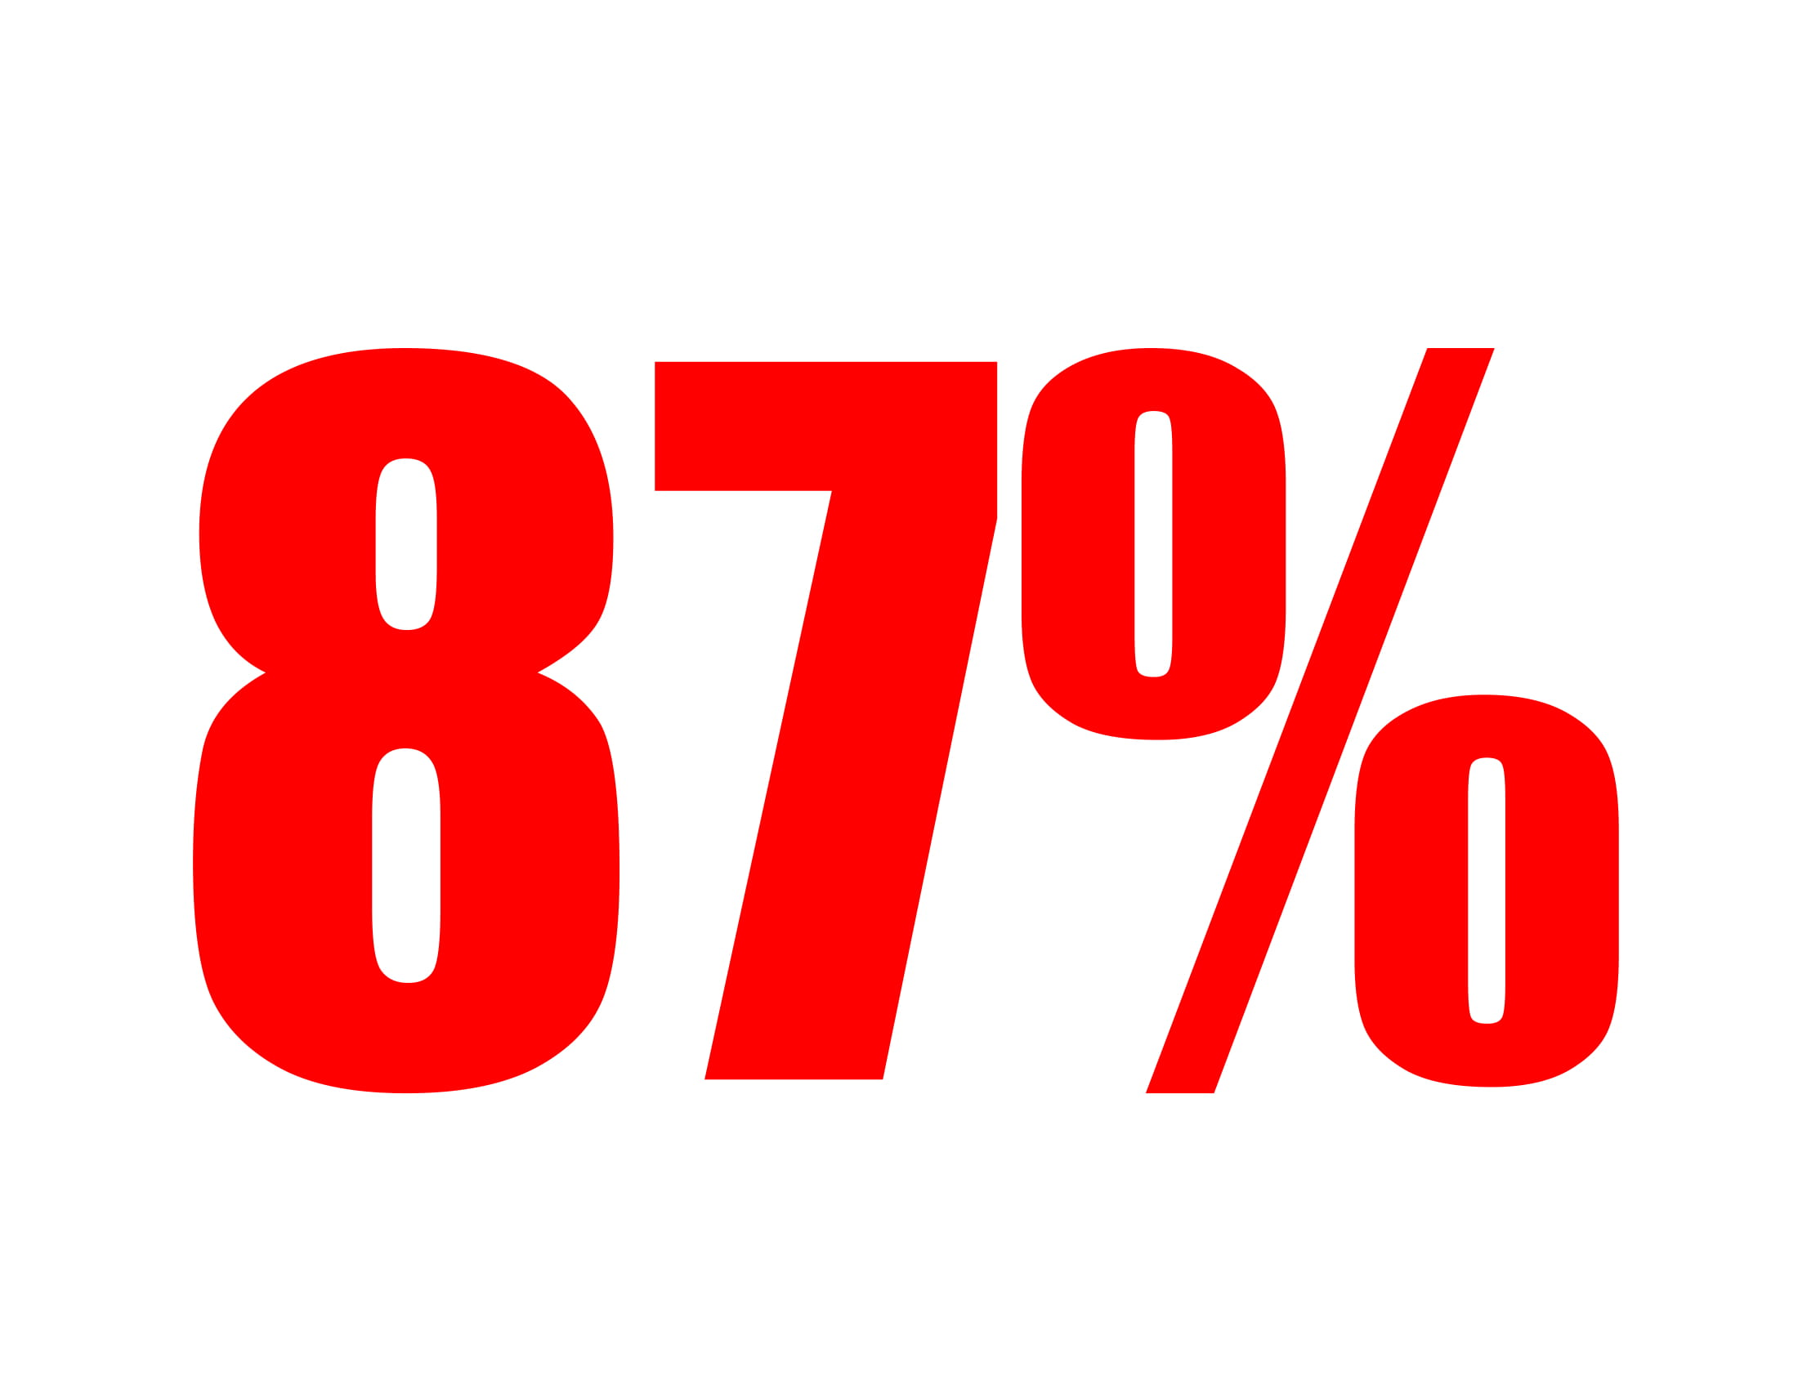
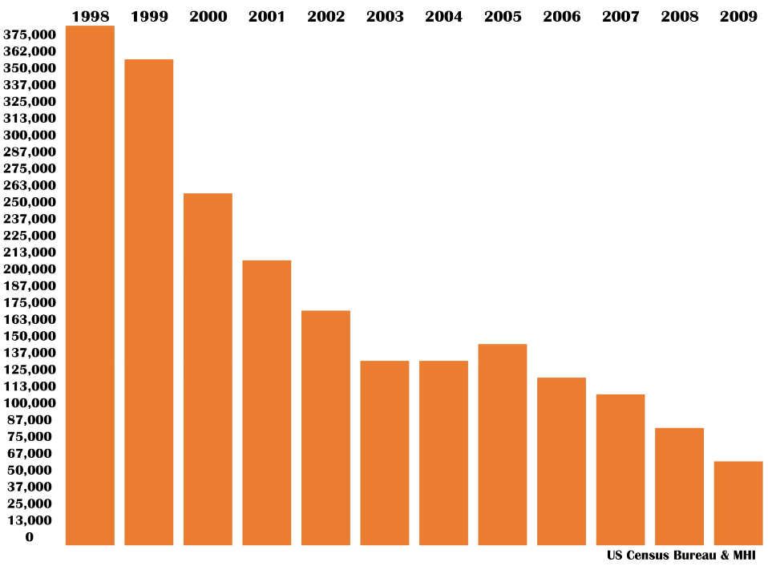
the slow death of mfd housing

Slide 5
The “10,000” drop

Slide 6
THE 3 WAYS

Slide 7
Sell More

Slide 8
Spend Less

Slide 9
Increase Margins

Slide 10
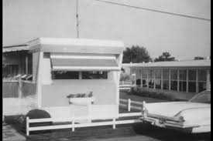
DON’T GROW OLD!

Slide 12
FORTUNE 500 LONGEVITY
1955 74 Years
1965 43 Years
1990 20 Years
2016 14 Years
2020 10 Years

Slide 13
Gone since 2016

Slide 14
NEXT
YEARS

Slide 15
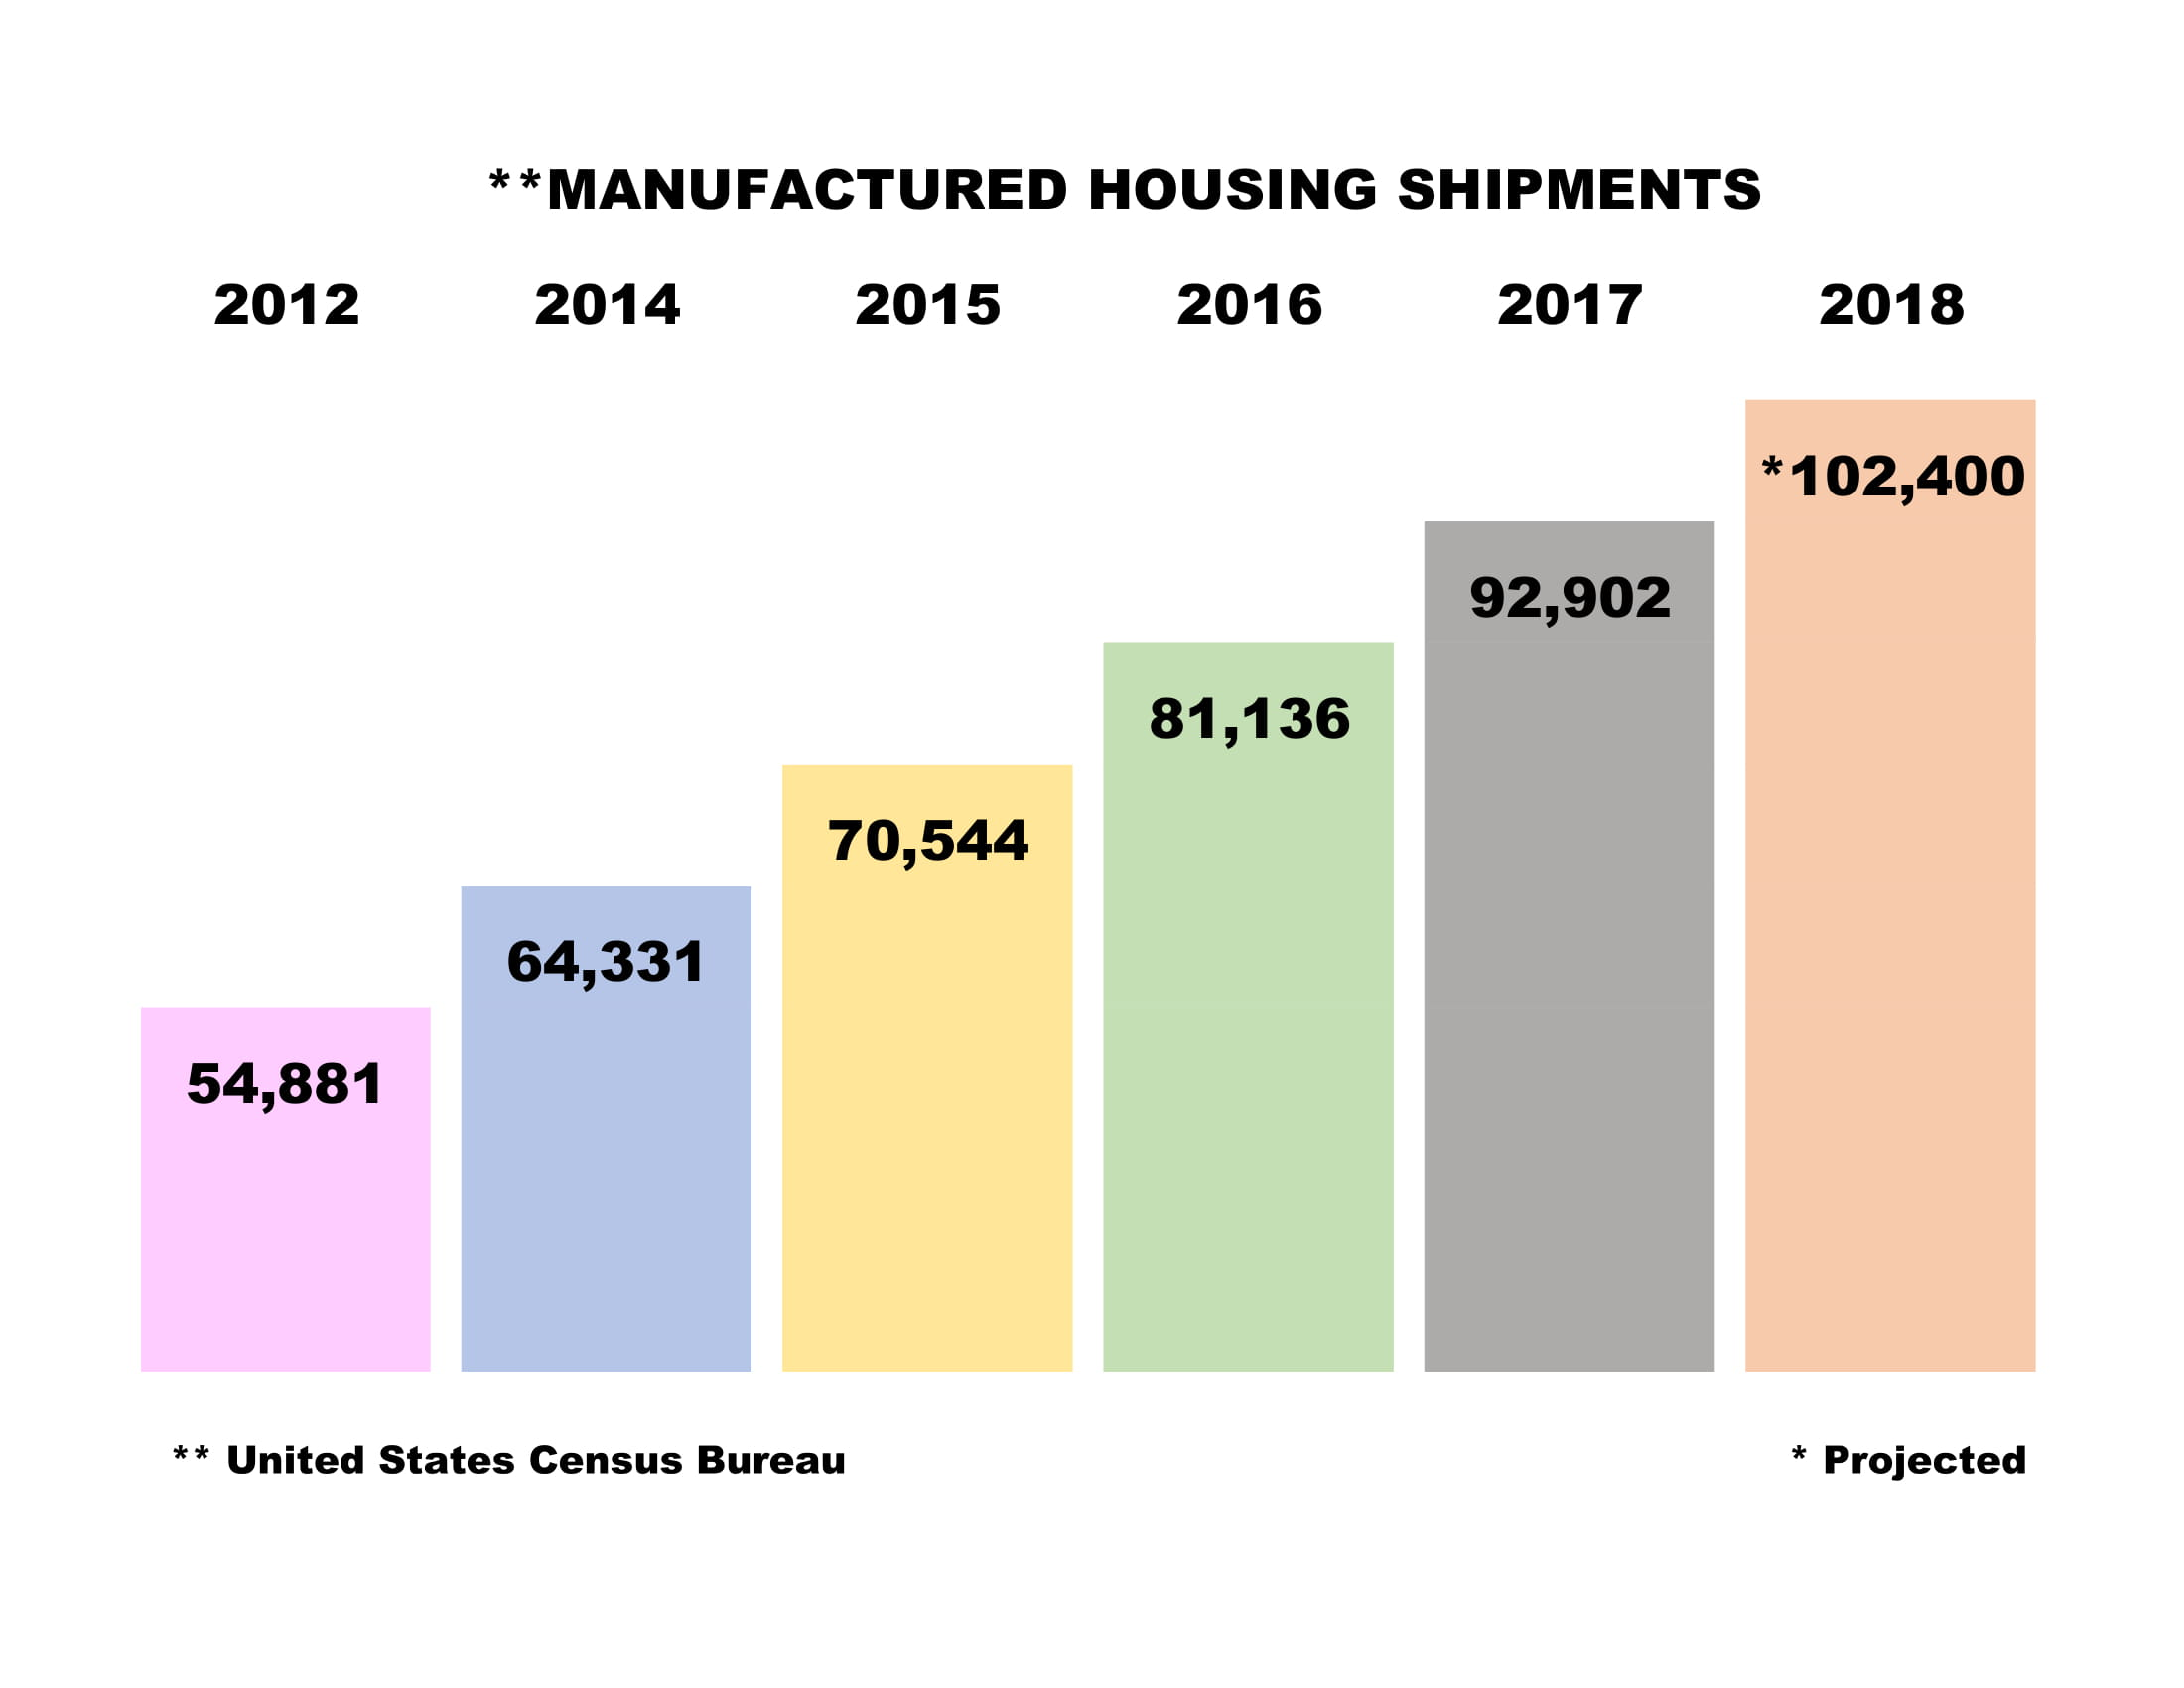

Slide 16
323 MILLION

Slide 17
8 Seconds 11 Seconds

Slide 18
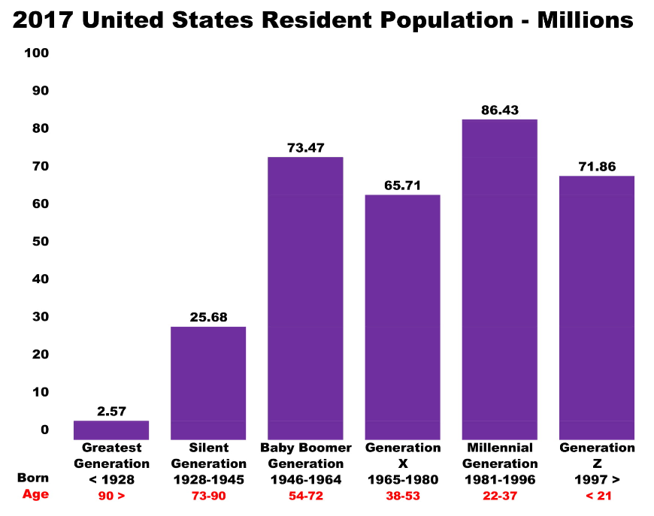
2017 US Population - Generation

Slide 19
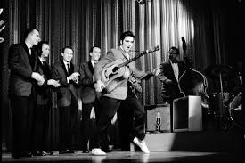
Silent Majority
Born 1945 & Prior
12.3% Population
Conformists
Strong Work Ethic
$aves Money
Technology Desktop
Social Media Facebook
Communication Landline

Slide 20
baby boomers
Born 1946 - 1964
22.3% Population
ME Generation
Good Work Ethic
Self Assured
Technology Desktop
Social Media Facebook
Communication Cell Phone

Slide 21
generation x
Born 1965 - 1976
19% Population
Independent
Geeks
Flexible Work Hours
Technology Laptop
Social Media Facebook
Communication Cell Phone

Slide 22
millennials
Born 1977 - 1995
24.3% Population
Social Minded
Job Jumpers
51.7% of 2016 Election
Technology Tablet
Social Media Instagram
Communication Texting

Slide 23
generation z
After 1996
22.1% Population
Cord Cutters
Eco Friendly
#1 Generation in 2028
Technology Smart Phone
Social Media Snapchat
Communication Texting

Slide 24
Today’s generation
“Most young people believe in Socialism
…until it’s their OWN money! ”

Slide 25
First Time Homebuyers
“Over the next 10 years, older……. Millennials (aged 28 to 38) will make up 13.6% of the population … BUT, 30% of the home buyers in the US.” .

Slide 26
First Time Homebuyers
86% of all Millennials want to buy a home
38% of Millennials want to buy a home in the next 12 months
42% of the new home buying market are Millennials

Slide 27
First Time Homebuyers
“Today, 46% of ALL new home buyers are millennials; up from 42% in 2017”

Slide 28
Millennial Communication

Slide 29
The millennial homebuyer
Will DISRUPT the market over the next 5 years
2-4 x’s more likely homebuyer than ANY age group
DEDICATED to their COMMUNICATION devices
97% search ON-LINE for information on homes
2x’s as likely to use DEVICES vs Baby Boomers
BOTTOM LINE
Technology plays a CENTRAL role in THEIR home buying

Slide 30
Why texting is the key
EASY way to express an INTEREST
EASY way to schedule an APPOINTMENT
EASY way to ASK questions
PHONE CALLS ARE USED
URGENT or PRESSING matters

Slide 31
Forbes 10 year trend
30’s million
Growth %

Slide 32
Forbes 10 year trend
60’s million
Growth %

Slide 33
SOCIAL MEDIA MAGIC

Slide 34
98%

Slide 35
274 MILLION

Slide 36
Largest us newspapers
2.3 Million
2.1 Million

Slide 37
2.2 BILLION

Slide 38
1.9 BILLION

Slide 39
Growing fast!
1 Billion 532 Million 293 Million

Slide 40
The 5 Year Change

Slide 41
The gold standard

Slide 42
More on-line sites

Slide 43
the real estate market

Slide 44
Facebook for business

Slide 45
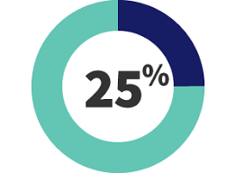
The 25% rule

Slide 46
The 25% rule

Slide 47
FACEBOOK MARKETPLACE

Slide 48
FACEBOOK live

Slide 49
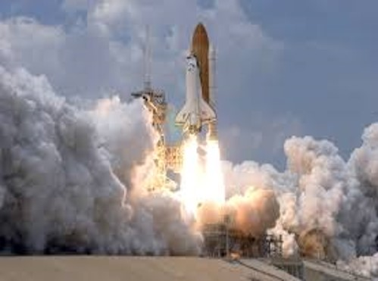
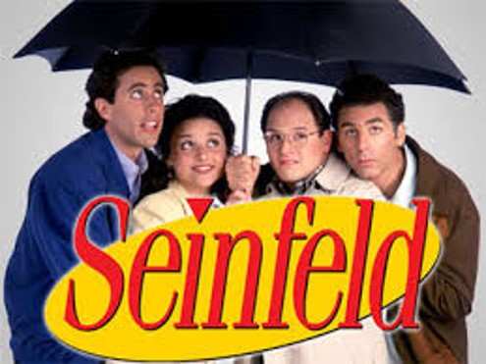
20 years of planning
3 Years
55 Hours
10,000 GALAXIES

Slide 50
Listen To Your Customer!
“Get closer than ever to your customers. So close, that you can tell them what they really want before they realize it themselves!”
Steve Jobs, Apple

Slide 51
Sense-able selling

Slide 52
I’m Scared!

Slide 53
emotional BUYING TRIGGERS

Slide 54
Selling with emotion
Fear
Comfort
$ Price
Value
Feature
Benefit
Safety
Warranty
Quality
Feel

Slide 55
Make sure they remember you
It’s NOT your customers job to remember you.
It’s YOUR obligation & YOUR responsibility to make sure they NEVER have the chance to forget YOU!

Slide 56
Make sure they remember you
1 Wear a NAME TAG
2 ALWAYS use their names
3 Send a PERSONAL E-Mail
4 Send a PERSONAL USPO note
5 Do a FOLLOW-UP text

Slide 57
2018 what Customer’s “Want”

Slide 58
86,400
86,400

Slide 59
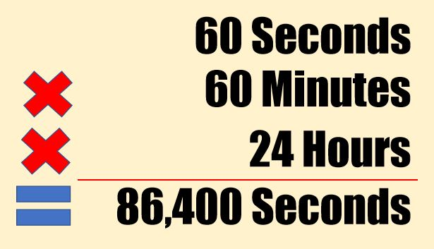
The 86,400 question

Slide 60
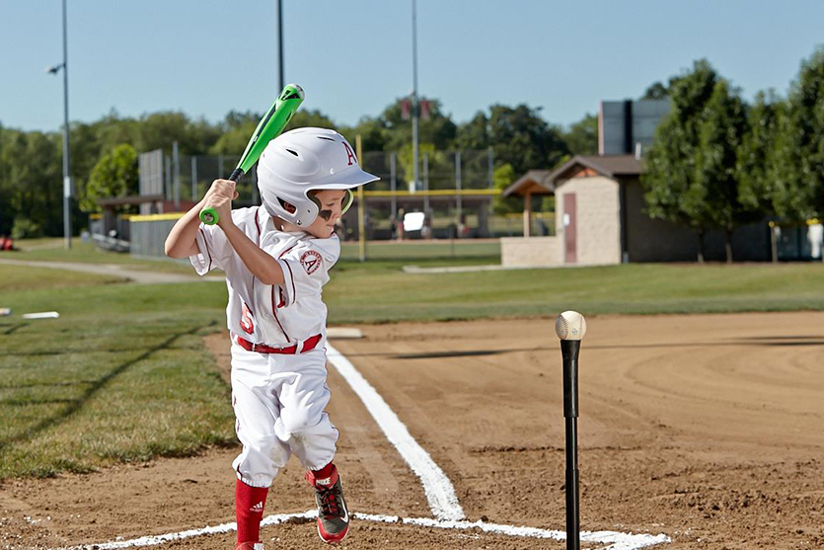
Keep swinging the bat!

Slide 61
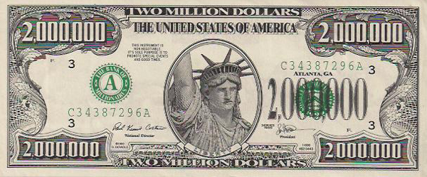
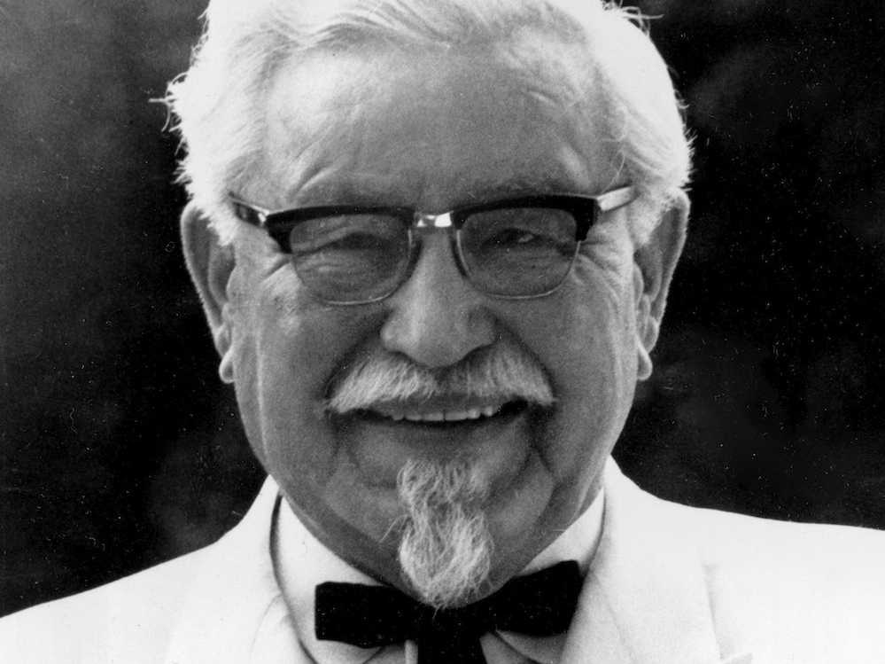
Perseverance pays

Slide 62
Never Give Up
Harrow School for Boys
October 14, 1941

Slide 63
“Never, Never, Never, Never, Never, Never Give Up!”

Slide 65
Increase Productivity!
$149

Slide 66
NyMHA CONFERENCE
$99

Slide 67
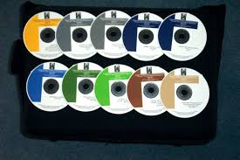
Selling The American Dream of home ownership
$349

Slide 68
nyMHA CONFERENCE
$149

